Slide 1
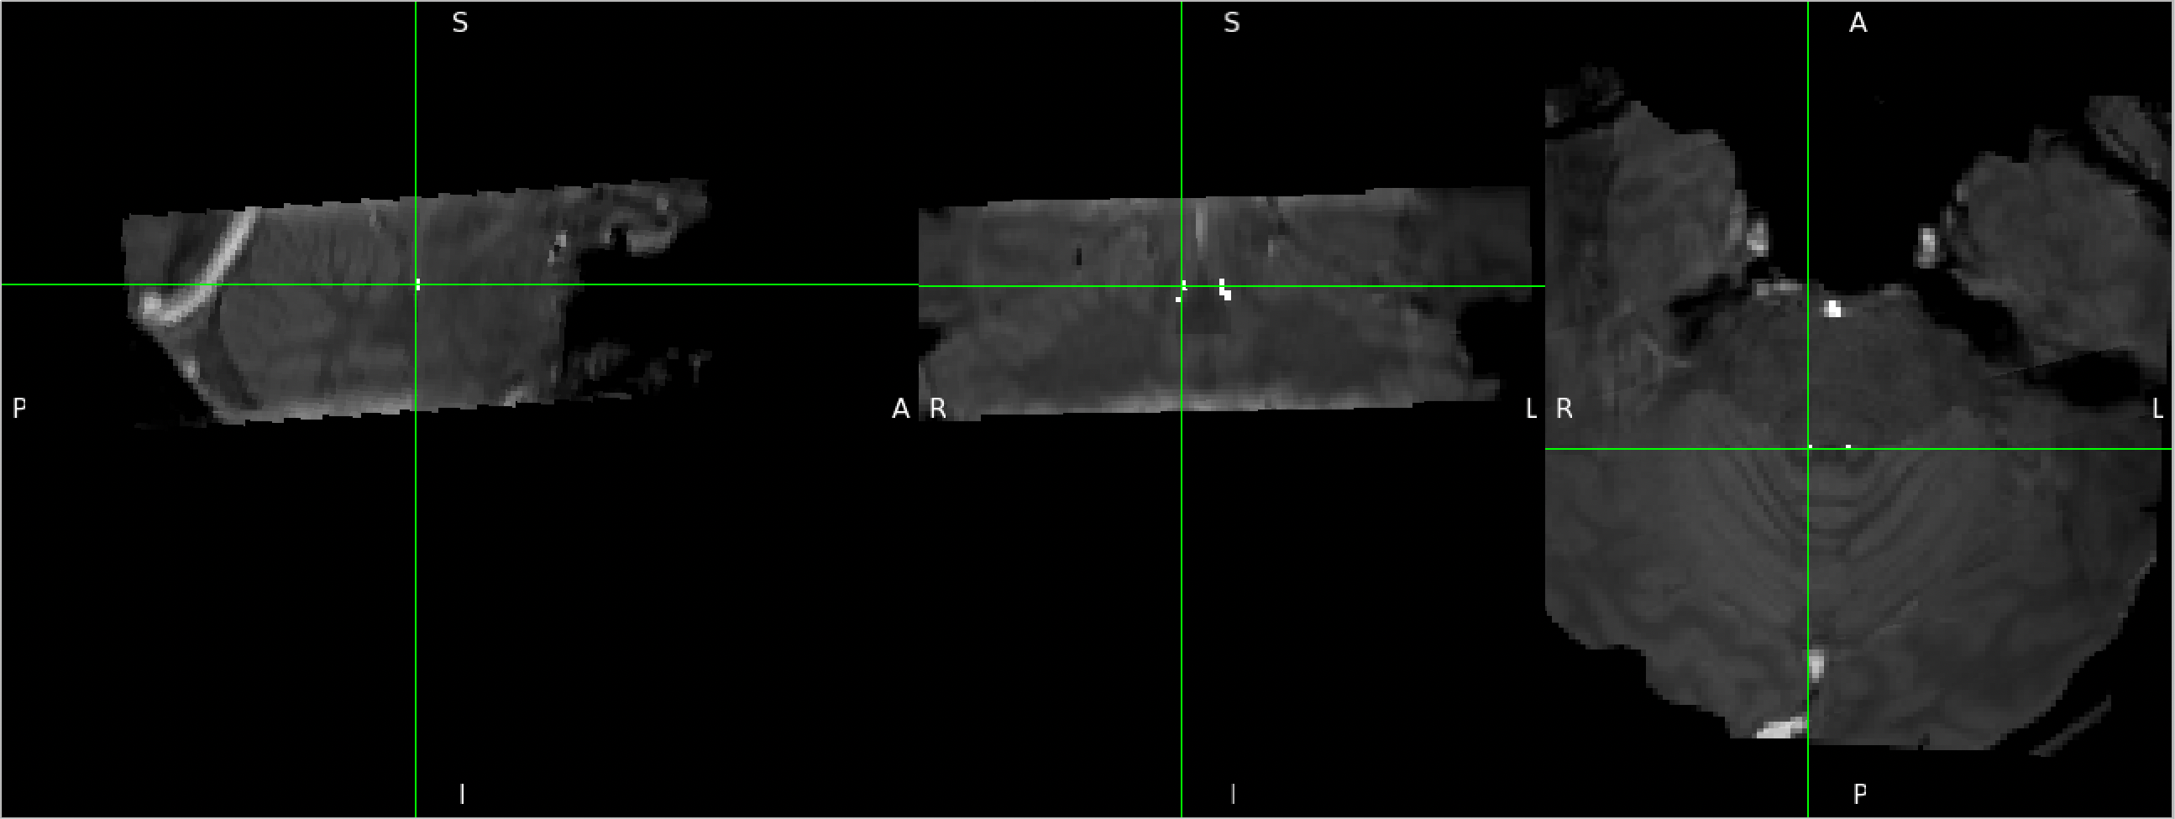
Thr: 0.2
Code in terminal: flirt -in LC.nii.gz -ref MTC_07162021_WIP_MPRage_2_1_reoriented_brain.nii.gz -out LC_reg6dof.nii -init MTC_09152021_WIP_MTC_p6a850d2k_9_1_brain_reg_p1.mat -applyxfm
fslmaths LC_reg6dof.nii -thr 0.2 -bin LC_reg6dof_thr.2_bin.nii
Code in terminal:

Slide 2
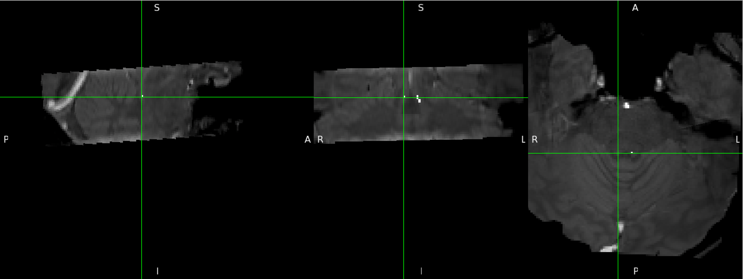
Thr: 0.3
Code in terminal: flirt -in LC.nii.gz -ref MTC_07162021_WIP_MPRage_2_1_reoriented_brain.nii.gz -out LC_reg6dof.nii -init MTC_09152021_WIP_MTC_p6a850d2k_9_1_brain_reg_p1.mat -applyxfm
fslmaths LC_reg6dof.nii -thr 0.3 -bin LC_reg6dof_thr.3_bin.nii
Code in terminal:

