Slide 1
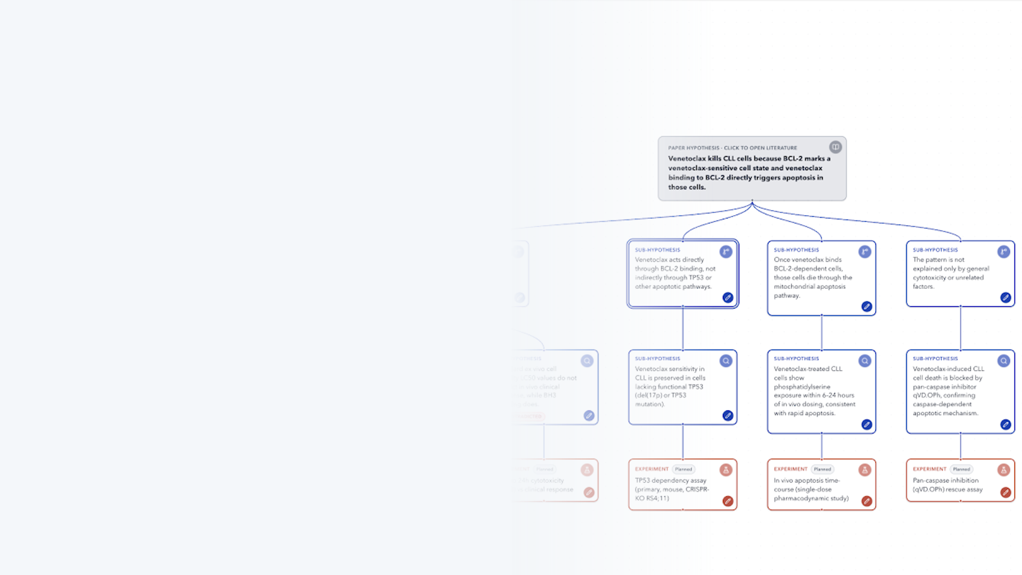
Human-Computer Interaction Lab
Scientists and AI Working Together to
Test a Hypothesis
HypoTree | Internship Project S26
September 2026
Wonjin Kim
Notes:
Title slide. Edit name, lab, and date here. Background image is a faded screenshot of the HypoTree tree view.

Slide 2





Project Roadmap
Human-Computer Interaction Lab
How the project went: learn the problem, build a tool, test it with scientists
1
2
3
4
5
Research the Problem
Interview Scientists
Build the Tool
Plan the Test
Test with Users
Weeks 1–4
Weeks 5–7
Weeks 7–11
June–July
August
Read past work on how scientists test ideas and on robot labs; wrote two research questions
Talked with 10 researchers about where their process breaks down; set three design goals
Built HypoTree and improved it with feedback from 6 researchers
Built a chat tool to compare against, wrote scoring guides, ran trial sessions
Study 1: planning (16 people). Study 2: reading results (10 people)
Outcome: a working tool, two user studies where scientists clearly preferred it over a regular AI chat, and a research paper draft
1
Notes:
Five phases of the internship project. Weeks refer to the weekly lab meeting cadence in the source deck.

Slide 3



Background: Testing an Idea Takes Many Rounds
Human-Computer Interaction Lab
Scientists rarely prove an idea with one experiment. They run a chain of experiments and adjust as they go
Idea (hypothesis)
Plan experiment
Run experiment
Read the results
Adjust the plan
what you learn early changes what you test next
One idea, many experiments
People and robot labs
Help the scientist, don't replace them
A big idea has several parts, and each part needs its own experiment. Each result decides what to test next.
People can make mistakes or bring bias. Robot labs ("self-driving labs") run routine steps the same way every time.
Past research says scientists should stay in charge of the goals and the big decisions.
The gap: few tools help scientists and AI work together while an idea is being tested: talking through results, handling unclear outcomes, and deciding the next experiment.
2
Notes:
Framing from the Week 1 proposal: validation = planning, execution, interpretation, replanning. SDL = self-driving lab.

Slide 4
What Other AI Tools Do
Human-Computer Interaction Lab
Most AI science tools try to work on their own. Few help the scientist decide what to do next
Co-Scientist
Coscientist
CRISPR-GPT
The AI Scientist
Robin
Several AIs debate to come up with new ideas
AI plans chemistry experiments and runs lab machines
AI plans gene-editing experiments step by step
AI writes code experiments and papers on its own
AI suggests drug ideas and analyzes lab data
Limitation
Only a chat; does not break ideas into parts or help discuss results
Limitation
Works alone; little back-and-forth with the scientist about results
Limitation
Follows a set plan; rarely changes it based on new results
Limitation
Computer-only; no real lab experiments
Limitation
Scientist only gives the starting goal, then is left out
Tests show AI alone is not enough: AI spots useful links but struggles with long, multi-step research. In one test, AI agents got single steps right 20–35% of the time but finished a full experiment only 0.5% of the time.
Our approach: instead of AI working alone, HypoTree keeps the scientist in charge of breaking down the idea, reading results, and choosing the next step.
3
Notes:
Systems reviewed in Weeks 1 and 8. Benchmarks reviewed in Week 2.

Slide 5


Research Questions
Human-Computer Interaction Lab
First, find out what goes wrong today. Then, build a tool and test whether it helps
RQ1
RQ2
Understand the problem
Build and test a tool
Where do scientists get stuck when they test an idea over many experiments and have to keep deciding what to do next?
Does a tree-shaped AI workspace help scientists organize their experiments, understand results, and plan the next step?
Interviewed 10 researchers
Each walked us through a real project of their own
Result: a list of problems and three design goals
Built HypoTree with feedback from 6 researchers
Each person tried both HypoTree and a regular AI chat
Study 1: planning (16 people). Study 2: results (10)
Find problems (RQ1)
Set 3 design goals
Build HypoTree
Test with users (RQ2)
How the project fits together
4
Notes:
RQ1 and RQ2 as phrased in the paper draft (Week 5 slides).

Slide 6




Interviews: Where Scientists Get Stuck (RQ1)
Human-Computer Interaction Lab
We talked with 10 researchers in biology and materials science about a real project of theirs
How we did it
What we found
Who
10 researchers (PhD students, postdocs, and staff scientists) in biology, bioengineering, biochemistry, and materials science
Steps are not connected
The idea, its parts, the experiments, the results, and the next step were rarely tracked in one place
The "why" gets lost
Reasons for choosing an experiment are rarely written down and are forgotten later
How
45–60 minute interviews. Each person showed us one real project using their own lab notes, protocols, and planning documents
Notes are scattered
Plans and results are spread across Word files, slides, spreadsheets, and memory
What we asked
How they organize ideas and experiments, what tools they use, how they read results, and how they pick the next step
AI chat only helps one step at a time
ChatGPT answers single questions but can't keep track of a long project, so trust stays low
What they wanted: one place that shows how ideas, experiments, results, and decisions connect, and that remembers why each choice was made.
5
Notes:
Participants: PhD students, postdocs, research scientists (cell biology, bioengineering, biochemistry, materials science). 45–60 minute sessions.

Slide 7
From Problems to Design Goals
Human-Computer Interaction Lab
Each problem we found led to one goal for the tool
Problem
Why it hurts
Design goal (DG)
Thinking in branches, writing in lists
Scientists think in branches (parts, causes, alternatives) but write in top-to-bottom notes
Hard to keep track
They have to hold the whole picture in their head
DG1
Show the whole testing process as a tree that grows over time
1
Reasons are not written down
Why an idea was split a certain way, or why an experiment was chosen, lives in papers and memory
Hard to explain later
Reasons are lost, so work is hard to share or reuse
DG2
Attach the reason, backed by papers, to every link in the tree
2
Results don't lead to next steps
Surprising results are seen as "it failed" instead of a hint about what to change
Hard to decide
People stick to one path and miss good alternatives
DG3
Help read each result and suggest next steps that fit the project
3
Core idea: put the plan, the reasons, and the options on screen so scientists don't have to keep them all in their head
6
Notes:
DG1–DG3 as defined in the Week 9 slides; theoretical grounding from the design-goals slide (external cognition, provenance, bounded rationality).

Slide 8
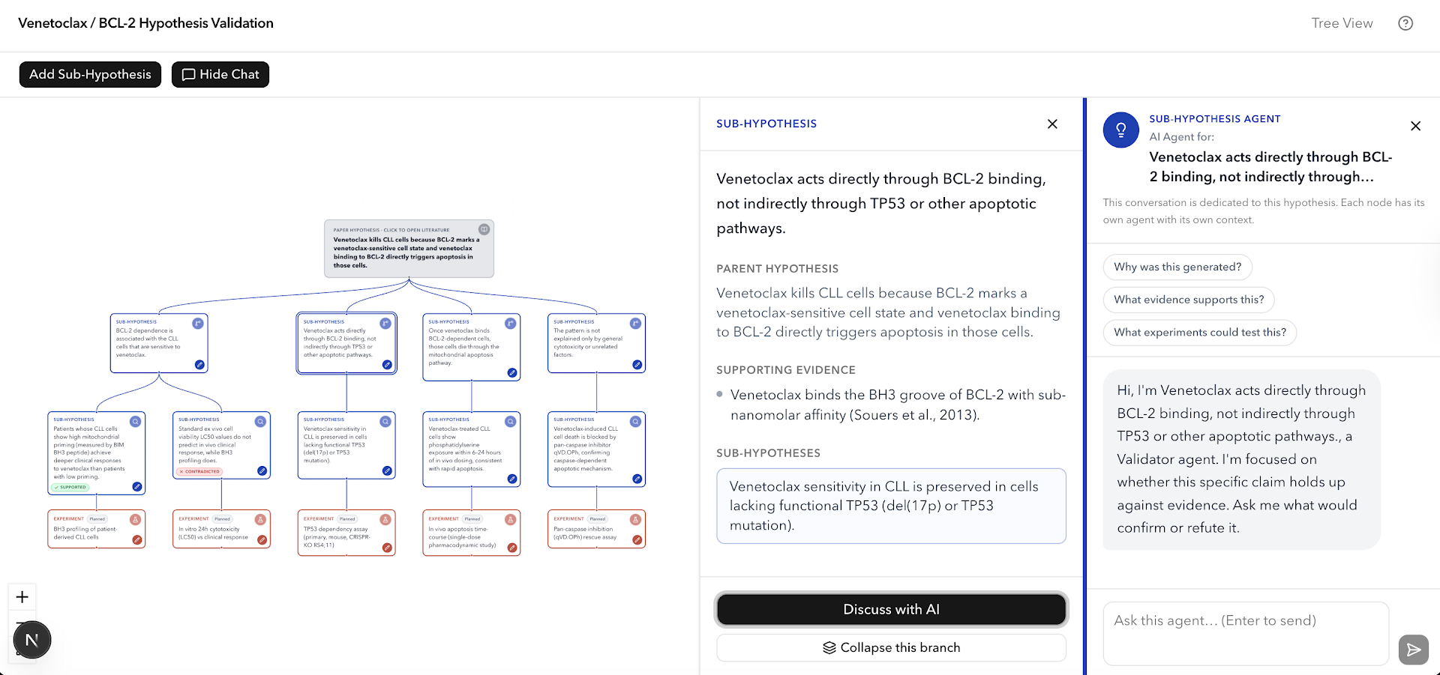
HypoTree: What the Tool Looks Like
Human-Computer Interaction Lab
A tree-shaped workspace where the scientist and AI assistants test an idea together
1
Tree view (DG1)
2
3
The main idea at the top, its smaller parts below, and experiments at the bottom. Each box shows if it is planned, supported, or disproved.
1
2
Detail panel (DG2)
Click any box to see where it came from, the research papers that support it, and what sits below it.
3
AI assistant per box (DG3)
Each box has its own AI assistant that remembers its topic. Quick buttons: "Why was this suggested?", "What supports this?", "How could we test this?"
Add or edit any idea
Fold away ideas that failed
Upload results (data, graphs, notes)
Approve the next step
The scientist stays in control: nothing changes in the tree without their approval
Behind the scenes: AI language models + a research paper search
7
Notes:
Screenshot from the deployed system (Week 7+). Numbered circles on the screenshot match the callouts on the right.

Slide 9



How HypoTree Works
Human-Computer Interaction Lab
Four steps. At each one, the scientist and AI talk it through instead of the AI giving one answer
1 Break down
2 Plan experiments
3 Read results
4 Choose next step
The scientist types in their main idea. The AI splits it into smaller ideas that can each be tested, by asking: what must be true, what could cause it, what else could explain it, and when might it not hold?
Each smaller idea gets one or more experiments with a goal, steps, and the result we expect. The reason for each experiment, backed by papers, is saved on the link.
The scientist uploads results (data, graphs, short notes). The AI explains what the result means for that idea, marks it supported or disproved, and points out what is still unclear.
The AI suggests what to do next: repeat the test, add a comparison, change the idea, try another explanation, or drop it. It also suggests new ideas. The scientist picks one.
Result: a tree of smaller ideas
Result: experiments with reasons attached
Result: each idea marked with its status
Result: a new branch; the old one is folded away
The scientist decides at every step: they can edit anything, choose between AI suggestions, and approve each change.
8
Notes:
Agent prompts for decomposition are grounded in the Hierarchy-of-Hypotheses (HoH) literature (Week 10 slides).

Slide 10

Example: When a Result Is Unexpected
Human-Computer Interaction Lab
The AI suggests new explanations, and the scientist picks which one to test next
Idea
Experiment
AI suggestion
Before: the result goes against the idea
After: AI offers three new ideas, the scientist picks one
Idea: cells with more Protein P die more often when given Drug D
Protein P is a sign of which cell types respond, not the cause of cell death
Protein P is linked to the type of cancer, not to the drug itself
Splitting one group of cells was too short-term to show a difference
Experiment: split one group of cancer cells into high-P and low-P, give both Drug D for 3 days, count how many survive
The scientist picks idea 1 and asks the AI: why this idea, what supports it, and how to test it
AI suggests new ideas
New experiment: compare several high-P and low-P cell types from the same kind of cancer, give all Drug D, count survivors
Old idea is folded away, not deleted
You can still see what was tried and why. The AI also checks if the new idea affects other parts of the tree.
Result: both groups survived equally
Why it matters: a surprising result becomes a clue about what to fix, instead of just "the idea failed".
9
Notes:
Example from the project's own figures (Drug D / Protein P). Blue = sub-hypothesis, orange = experiment, dashed = AI candidate.

Slide 11
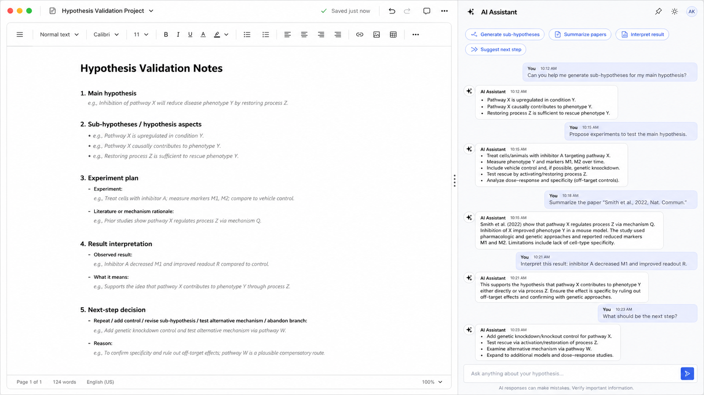
What We Compared Against
Human-Computer Interaction Lab
A regular AI chat next to a document, using the same AI and the same research papers
Comparison tool: document + AI chat
HypoTree: tree workspace
A document with fill-in sections: main idea, smaller ideas, experiment plan, results, and next step
The AI chat can suggest ideas, experiments, paper summaries, and next steps as text
The scientist has to copy and organize the answers into the document by hand
The same AI suggestions appear as boxes in a tree that grows (DG1)
Each link shows its reason and papers; each box has its own AI that remembers (DG2)
New results update the tree and bring up suggested next steps (DG3)
10
Notes:
Baseline described in Week 9 slides. Screenshots: baseline (left) and HypoTree (right).

Slide 12
Improving the Tool With Researchers
Human-Computer Interaction Lab
We built a first version, showed it to scientists, and improved it based on what they said
Week 7
Weeks 10–11
June
July
August
1
2
3
4
5
First version
Screen mock-ups and a first AI setup
Feedback sessions
6 researchers tried it on their own ideas
Online version
Tool put online; comparison chat built
Trial runs
Shortened tasks to 25 min; made a scoring guide
Main studies
Study 1 (16 people) and Study 2 (10 people)
What researchers asked for, and what we changed
"Show how sure the AI is"
Links drawn thicker when the AI is more confident
"Tell me what result to expect"
Every experiment now lists its expected result
"Experiment steps are too long and vague"
Shorter steps inside each box, fitted to the idea being tested
"Let me add and change ideas myself"
Any box can be added, edited, or folded away
"Remember what we discussed"
Each box has its own AI that keeps its chat history
"After a result, suggest new ideas and new tests"
The AI now offers both; the scientist chooses
11
Notes:
Co-design (intermediate) sessions in Weeks 10–11 with 6 researchers; feedback themes summarized from those slides.

Slide 13
How We Tested HypoTree
Human-Computer Interaction Lab
Two studies. Each person used both HypoTree and the regular AI chat on their own research
Study 1: Planning experiments (16 people)
Study 2: Understanding results (10 people)
Setup
Each person brought two similar ideas from their own research: one for HypoTree, one for the chat. Half started with each tool
Setup
We gave each person sample experiment results for their own idea, in both tools
Task
Break the idea into smaller parts, choose experiments, and write a short plan: the main idea, its parts, the reasons, the experiments, and expected results
Task
Add the results, figure out what they mean for the idea, decide the next step, and update the plan
What we measured
1–7 ratings of organization, reasons, control, and confidence; how much effort it took; 3 experts scored each plan without knowing which tool made it
What we measured
1–7 ratings of help with reading results and choosing next steps, confidence, fit with their work, and control; follow-up interview
Same-person comparison
each person's two scores compared directly
Two statistical tests
checked results two ways to be sure
Stricter threshold
adjusted for testing many things at once
Expert scoring guide
clear, organized, traceable, testable, sound, doable
12
Notes:
Phase I = planning (DG1, DG2); Phase II = result interpretation and replanning (DG3). Order counterbalanced.

Slide 14
Study 1 Results: Planning
Human-Computer Interaction Lab
16 people rated HypoTree clearly higher on every measure, and found it less tiring to use
+1.9
Very large
−1.3
5.8 vs 4.2
points higher overall rating (4.3 → 6.2 out of 7)
difference, far beyond chance
points lower workload (3.6 → 2.3)
how successful people felt, HypoTree vs chat
13
Notes:
Means from the Week 08/26 table. Overall effect size Cohen's dz = 1.84. Paired t-tests: DG1 t = 6.63, DG2 t = 6.40, steerability t = 5.24, confidence t = 6.20, overall t = 7.37, workload t = −7.79; all p < .001.

Slide 15
Expert Scores and Study 2 Results
Human-Computer Interaction Lab
Experts scored HypoTree plans higher, and HypoTree helped most with understanding results
Biggest gain: clear reasons. Experts could trace why each experiment was chosen (4.7 → 7.0) and found plans easier to test. "Doable" stayed the same, which the tool was not designed to change.
Study 2: ratings rose by about 4 points out of 7 on every measure, and every single person preferred HypoTree.
14
Notes:
Left: Table 4 medians (16 paired artifacts, 3 judges, Holm-adjusted; traceability and testability p < .001, feasibility n.s. p = .052). Right: Phase II means from the Week 08/26 table; Wilcoxon p = .010 Holm-adjusted, rank-biserial r = 1.00 on all constructs.

Slide 16

Key Takeaways
Human-Computer Interaction Lab
What we learned, and what comes next
A tree works across fields
AI answers you can check
The scientist stays in charge
Researchers from biology to materials science put their own ideas into the tree and found it far clearer than regular notes.
Saved reasons, one AI per box, and suggested ideas turn AI text into steps a scientist can follow and verify.
The AI breaks down, explains, and suggests. The scientist approves every step, and it felt like less work, not more.
Next steps
Paper
Finish the research paper for CHI, a top conference on people and computers
Robot lab
Connect HypoTree to a robot lab so experiments can be split between the scientist and the robot
Real-world use
Let scientists use it for months on real projects and see how their trees grow
15
Notes:
Discussion themes from the Week 08/26 slides. Next steps reflect the proposal (SDL integration) and paper plan.

