Slide 1
vARIAN apiS in V11 & v13
Information for Collaborators
1/17/2014

Slide 2
Goals of this session:
Broad overview of what’s available in Varian’s APIs & Scripting.
Scripting Demos
Notes:
A little Dave Barry style humor…

Slide 3
What is an API?
API – “Application Programming Interface”
Provides access to functions within an application, which Enables Scripting.
API Enables Scripting
Notes:
Before we get started, what is an API?

Slide 4
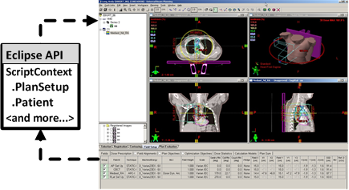
API
Script API Eclipse .
Eclipse Scripting API : ESAPI
Notes:
The API gives access to the Eclipse data and functions.
In this example, the script accesses the active PlanSetup and Patient through methods on the API.

Slide 5
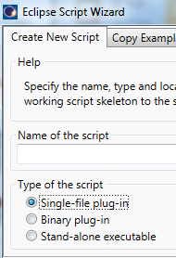



Eclipse Script Types
Single File Plug-in
Binary Plug-in
Standalone Executable
Notes:
These are the script types referred to in the Eclipse Scripting API reference guide, and those you see on the Eclipse Script Wizard when you run that.

Slide 6
Standalone Executable
Geekspeak for “An Application”.
An application installed on your computer that you run by double clicking on its icon.
Examples: Microsoft Word, Excel, Powerpoint.

Slide 7
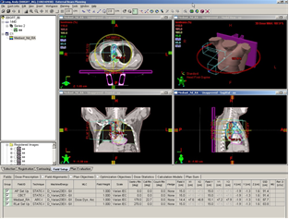
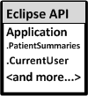
ESAPI Standalone Executable
Script API Eclipse .
Standalone Executable Memory Space
Eclipse UI is hidden
Notes:
Q: how to run it?
double click
CMD prompt / console application
Example of standalone executable.
Mention the data mining example (Example_Patients).

Slide 8
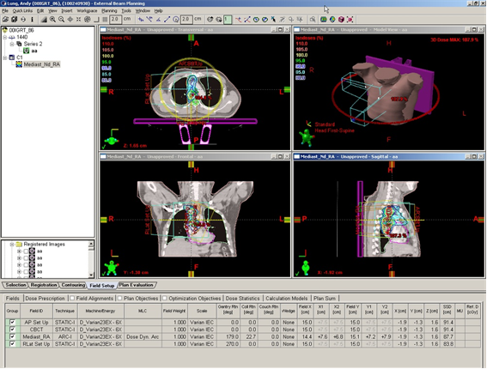
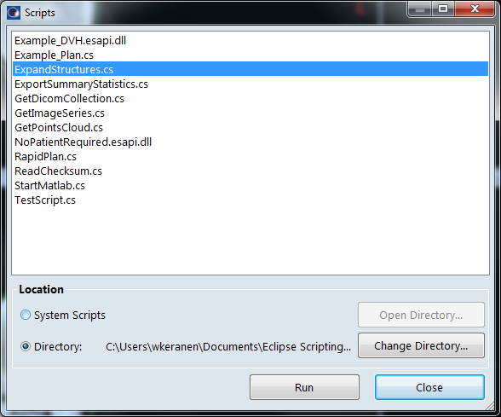
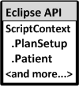
Single File Plug-in Script
Eclipse
Capability
Expanded
Script is compiled OTF and run in Eclipse Memory Space.
Notes:
In programming, when functionality is added to an application when the application is running it is usually called a “Plugin”. You have all the power of the C# language.
Single File Plugin does not need a development environment like Visual Studio to create. Can be created with notepad or any text editor.

Slide 9
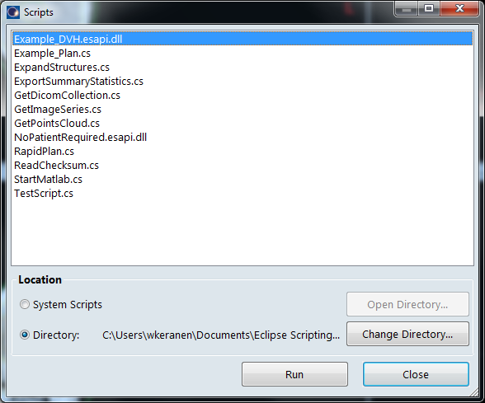

Binary Plug-in Script
Eclipse
Capability
Expanded
Script is compiled before it’s run in Eclipse Memory Space.
Notes:
Binary plug-in needed when sophisticated GUIs are needed to run while Eclipse is running, or when multiple code files are needed, generally for more complex scripts.
A DLL is just a zip file. Zip files combine several files into a single file. A DLL combines compiled code code files into a single file, so it delivers a package of code that can do whatever it is programmed to do.

Slide 10
Why Eclipse Scripting API ?
“Scripting” Implies
  No development environment needed.
  No compiling needed.
  Run on the fly, while application is open.
  Less formal development.
  Programmer fun!

Slide 11
Scripting APIs available in v11
Product | Description
Eclipse Scripting API (ESAPI)* | Read-only Eclipse Scripting API
* Also available in v13

Slide 12
Eclipse Scripting API v11 & V13 : Clinical
Nothing extra: License comes with Eclipse.
Online Help and Script Wizard Installed on Eclipse Workstation.
Reference Guide on MyVarian.

Slide 13
ESAPI v11 & V13 : Sample Use Cases
Reporting: Replace TML reports.
2nd Checks and QA applications.
  Push Eclipse Data to another system for a 2nd MU check; + 2nd Check for SRS Beams.
  MLC position verification & check.
Commissioning : verify dose data, CT density, alignments, structure volumes.
Research: Export Eclipse data as VTK

Slide 14
Eclipse Scripting API v11/v13 Capability
Images, 3D & 2D
Structure models
Surface data as triangle mesh.
Plans, fields, and accessories.
Doses, including their volumetric representations.
DVHs, and a bit more…

Slide 15





Eclipse Scripting API v11/13: DVH, Dose
DVH statistics and DVH curve data
Direct lookups for V20, D95 etc
Low level access to voxels
Interpolated dose profiles

Slide 16

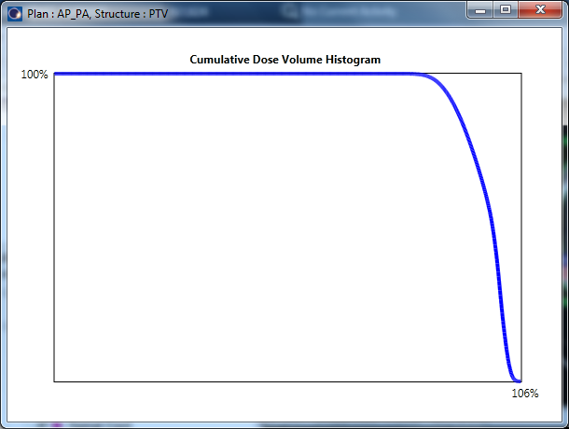

ESAPI Example: Accessing DVH Engine
Example_DVH
Scripts can easily invoke DVH calculation.
Creates a WPF graph that displays DVH curve
Notes:
If you choose to install the ESAPI examples, you get these two.

Slide 17
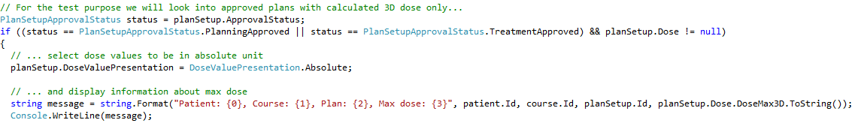

ESAPI Example: Data Mining :
Example_Patients: standalone executable ESAPI script can open the datamodel of any patient in the database.
Reports the maximum dose (in Gy) of all plans approved during the last 6 months
Notes:
This is an Installed Example. The black window is called the “Command Prompt”, also called a “Console Window”.

Slide 18
On to V13
As of January 2014:
V13 is released, installed at two sites in Europe, is pending 510 K approval in US.

Slide 19
Scripting APIs available in v13
Product | Description
Eclipse Scripting API (ESAPI) | Read-only Eclipse Scripting API
Eclipse Scripting API for Research Users* | Read/write ESAPI + Optimization + Dose Calc.
SmartAdapt Scripting API* | Read-only Registration, Imaging, and Treatment Information API.
Portal Dosimetry Scripting API* | Read-only Portal Dosimetry API
* New in v13

Slide 20
ESAPI v13: New Optimization Support
New API Class | Description
Fluence | Represents the fluence for a beam. The resolution in the fluence matrix is 2.5 mm in x and y directions. In the fluence matrix, x dimension is the number of columns, and y dimension is the number of rows.
OptimizationObjective | Provides a common base type for all structure-specific optimization objectives.
OptimizationSetup | Gives access to the optimization parameters and objectives.
OptimizationParameter | Provides a common base type for all optimization parameters.
Notes:
Version 11 and Version 13 of the clinical Eclipse Scripting API are very similar. The following slides highlight the differences.

Slide 21
ESAPI v13: New Optimization Support
New API Method | Description
Beam.GetOptimalFluence | Gets the optimal fluence for this beam. Returns null if optimal fluence does not exist.
PlanSetup.OptimizationSetup | Provides access to optimization objectives and parameters.

Slide 22
ESAPI v13: New Brachy Support
New API Class | Description
BrachyPlanSetup | Represents a brachytherapy treatment plan. BrachyPlanSetup
BrachySolidApplicator | Represents a brachytherapy solid applicator part, such as a tandem or ovoid in a Fletcher Suit Delclos (FSD) applicator set. This class holds only the metadata related to the solid applicator part, and links to the catheters that are part of the solid applicator.
BrachyTreatmentUnit | Represents a brachytherapy afterloader.

Slide 23
ESAPI v13: New Brachy Support (2)
New API Class | Description
Catheter | Represents a brachytherapy catheter or an applicator channel centerline. Catheters are associated with a brachytherapy treatment unit, a channel number, and possibly a unique identifier of the solid applicator part they belong to. Most notably, catheters encapsulate the shape of the applicator channel centerline and its source positions.
RadioactiveSource | Represents a radioactive source installed into a brachytherapy treatment unit or a seed of a seed collection.

Slide 24
ESAPI v13: New Brachy Support (3)
New API Class | Description
RadioactiveSourceModel | The radioactive source model represents the details of the radioactive source used in brachytherapy. It encapsulates the source isotope, dimensions, and dose calculation parameters.
SeedCollection | Represents a collection of brachytherapy seed positions. Each position is also associated with a radioactive source.
SourcePosition | Represents a brachytherapy source dwell position in a catheter or a seed position in a seed collection.

Slide 25
New in v13: ESAPI for Research Users
Very interesting new features available for Research Users on Research System.
  Research Partners who have an MRA.
  Requires a special license.
PdM (me) distributes the Reference Guide and Online Help.
Notes:
Now show the Eclipse Scripting API for Research users online help, show the Beam.SetOptimalFluence.

Slide 26
ESAPI for Research : Research System
New features require separate v13 Aria database installed and configured for non-clinical research use.
  Database is flagged as ’Research’ by Varian service at time of install.
  Not possible to set plans to ”Treatment Approved”.
  Plans get additional ’research’ indication when exported via DICOM.

Slide 27
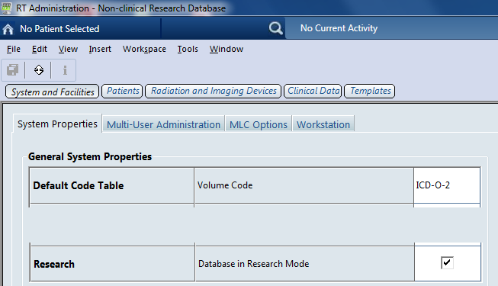
ESAPI for Research : Research System
Notes:
Once this flag is on, the title bar shows “Non-clinical Research Database”.

Slide 28
ESAPI Research Features : Plans
Write access to plans:
  Add/modify courses, plans, beams
  Add/modify optimization objectives and fluences
Script the optimization engine.
Execute LMC.
Start dose calculations.

Slide 29
ESAPI Research Features : Structures
Write access to structures:
  Add structures, modify contours
  Execute boolean operators and margin
    AND, OR, XOR, NOT
    Margin (double margin)

Slide 30
ESAPI Research Features : Structures
AddStructure, Or, Margin
Notes:
After this slide, demo script “ExpandStructures.cs” with patient “Brain Case, demo”.

Slide 31


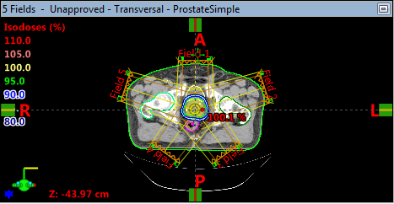
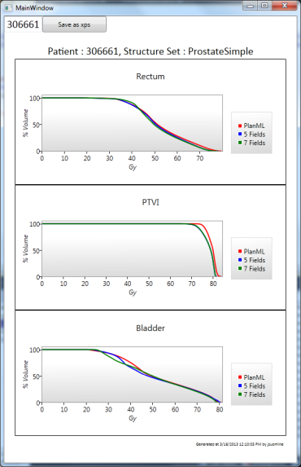
Demo 1 : Plan Automation
Standalone script creates two plans: one with 5 and another with 7 IMRT fields.
Optimization objectives are set.
Optimization, LMC and Final Dose Calculation are executed.
All data saved to ARIA db.
A report is generated (in xps format).
Notes:
additional demos if you are interested.

Slide 32
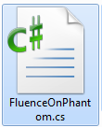
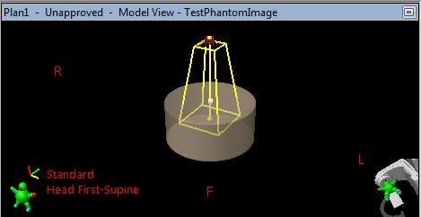
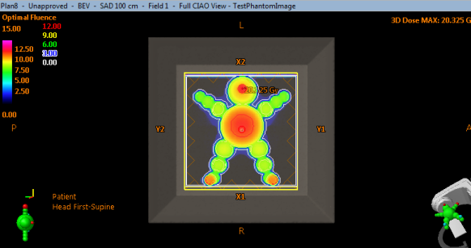
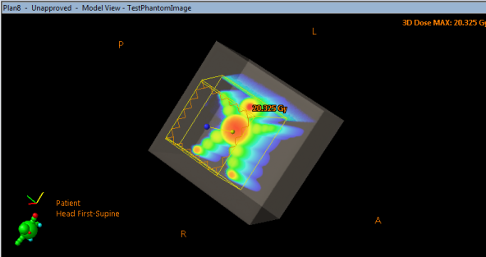
Demo 2 : Create Phantom and Fluence
Plugin script that creates a cylinder shaped phantom and assigns HU.
A plan with one static beam is created.
Fluence is set.
Notes:
additional demos if you are interested.

Slide 33
SmartAdapt Scripting API v13 Capability
SmartAdapt, SmartSegmentation, Contouring, & Registration share this Scripting API.
Basic RT: Images, 3D & 2D, Structure models, Plans, Treatment Records.
Deformable Vector Field (DVF)
Registrations, both Rigid and Deformable.
Navigate from source to target image, source to target match points.
Transform points and contours w/ reg.

Slide 34
SmartAdapt v13 API Capability
New API Class | Description
MIRSNonRigidRegistration | Represents a non-rigid registration in MIRS. Wraps a spatial registration of type NonRigidRegistration.
MIRSRegistration | Represents a rigid or non-rigid registration in MIRS.
MIRSRigidRegistration | Represents a rigid registration in MIRS. Wraps a spatial registration of type RigidRegistration.
MIRSImage | Represents a 3D image in the MIRS application. Wraps an image of type Image.
…. And a lot more ! … See SmartAdapt online help.

Slide 35
PortalDosimetry v13 Scripting Capability
Basic RT: Images, 3D & 2D
Structure models
Plans, Treatment Records.
Predicted and measure dose images
Portal Dose Evaluation Tests.
Portal Dosimetry Analysis.

Slide 36
PortalDosimetry v13 API Capability
New API Class | Description
DoseImage | Represents a dose image (portal dose or predicted dose) in the Portal Dosimetry application. Wraps an image of type ImageRT.
EvaluationTest | Represents a dose evaluation test. Note that values in percent must be in 0 .. 1 (meaning 0 to 100 percent).
PDAnalysis | Represents a Portal Dosimetry analysis, a comparison or a dose constancy check.
PortalDoseImage | Represents a portal dose image in the Portal Dosimetry application.
…. And a lot more ! … See PortalDosimetry online help.

Slide 37
Summary: 3 Clinical Scripting APIs in v13
Product | Description
Eclipse Scripting API (ESAPI) | Read-only Eclipse Scripting API
SmartAdapt Scripting API | Read-only Registration, Imaging, and Treatment Information API.
Portal Dosimetry Scripting API | Read-only Portal Dosimetry API

Slide 38
Summary: Research Scripting API in v13
Product | Description
Eclipse Scripting API for Research Users | Read/write ESAPI + Optimization + Dose Calc.

Slide 39
FYI : Other APIs available in v11 & v13
Product | Description
Eclipse Algorithm API (EAAPI) (Research Only) | C++ API for developing dose calc and optimization algorithms in Eclipse.
DICOM DB Daemon | Very wide read and write pipe to RT information. Also scriptable.
Dynamic Documents Service | Web service that lets programmers get / add dynamic docs to aria.
Notes:
TBD: v13 links not yet available.
EAAPI: Search MyVarian for the reference guide.
DICOM DB Daemon: http://www.varian.com/media/oncology/services_and_support/pdf/dicom/SystemServer11.pdf
Dynamic Documents Web Service:
User guide for the new service:
https://myvarian.com/system/files/100061927-Rev%2001-Varian%20Document%20Service%20User%20Guide%20-%20Version%201.0.pdf?download=1
Installation and configuration guide for the service.
https://myvarian.com/system/files/100061926-01-Rev%2001-Varian%20ARIA%20Document%20Service%20Installation%20Instructions%20and%20Configuration%20Guide%20Ver%2011.pdf?download=1

Slide 40
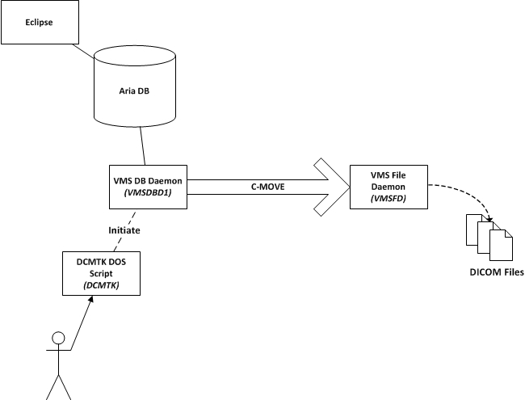
DICOM Scripting w/ VMS DB Daemon

Slide 41
DICOM Scripting w/ VMS DB Daemon
  Example:
  Move treatment records for a given patient and date from VMSDBD1 to VMSFD:
  …\dcmtk>movescu -v -aet DCMTK -aec VMSDBD1 -aem VMSFD -S -k "0008,0052=TREATMENTRECORD" -k "0010,0020=QASRSWL1" -k "3008,0250=20130801" 198.214.124.167 105

Slide 42
How to get help with Scripting?
Reference Guides on My.Varian.com.
Online Help installed on Eclipse.
Use the Scripting Wizard to get started.
www.variandeveloper.com
eclipsedeveloper@varian.com
…for harder questions!

