Slide 1
Assignment 5
Gene Expression
Due date: 2/20/2026 11:59 PM

Slide 2
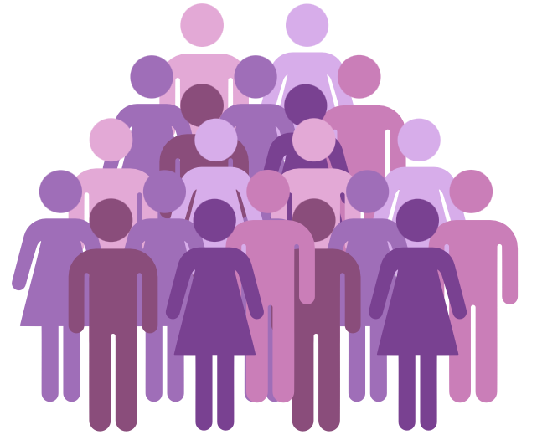

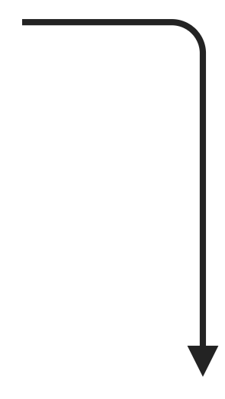
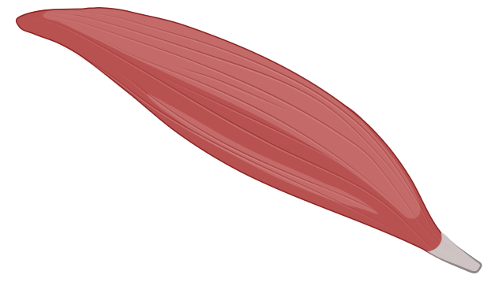

Premise
We have 20 subjects who are at a high risk for developing type 2 diabetes
  We put them on a year-long exercise regimen
We have muscle biopsies from each subject before beginning the exercise regimen and after one year (2 time points)
High risk T2D individuals
(N = 20)
1-year
Exercise regimen
Before exercise
(20 samples)
After exercise
(20 samples)

Slide 3
Premise
We want to characterize their skeletal muscle transcriptomes and hope to better understand the genetic underpinnings of insulin signaling and insulin sensitivity after exercise in human skeletal muscle.
Before exercise
(20 samples)
After exercise
(20 samples)
RNA-seq

Slide 4
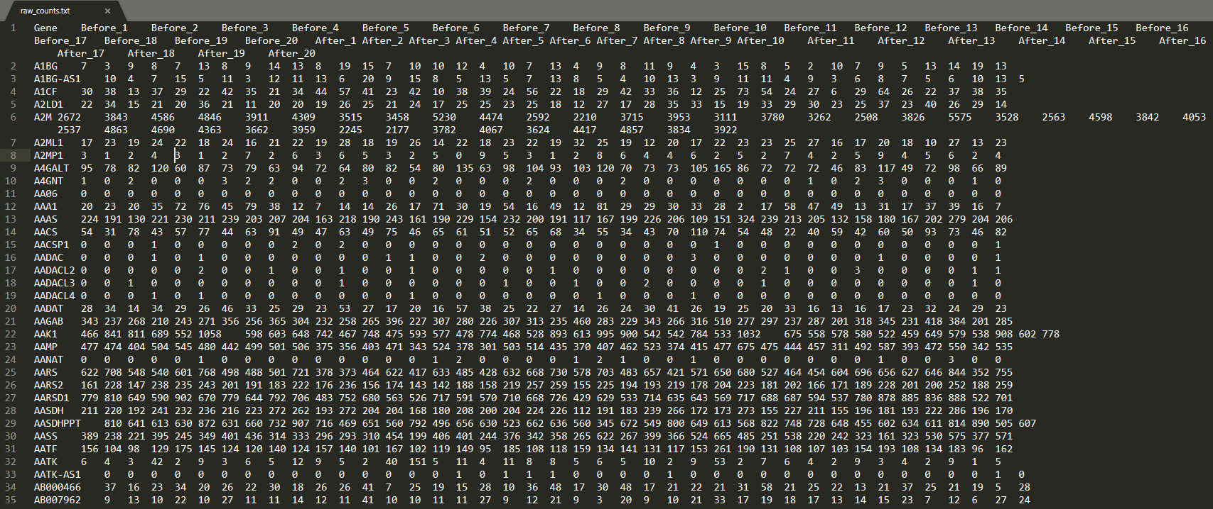
Important Files
raw_counts.txt
  RNA-Seq count data from the muscle biopsies before and after the exercise regime for the 20 individuals
  Look at the data to get an rough idea
  Do not copy this file to your folder to save space
Samples
Genes
Raw counts

Slide 5
Important Files
raw_counts.txt
  RNA-Seq count data from the muscle biopsies before and after the exercise regime for the 20 individuals
  Look at the data to get an rough idea (How many columns? Rows? What does those columns/rows mean?)
  Do not copy this file to your folder to save space
gene_expression.py
  Python script that you will need to complete
  Read through this script, see what is completed, what do you need to do
README.txt
  README to answer the questions in the assignment

Slide 6
Assignment Overview
Part 0: Functions
  Partially completed
  Look for TODO comments if you forget what things we want you to do or comment
Part 1: Data filtering
Part 2: Data visualization
Part 3: Data normalization
Part 4: Data exploration
Extra Credit

Slide 7
Part 0 – Functions (Setting up for success)
Make script exit if the number of input parameters is incorrect
translate_dictionary (Fill in the code for the function)
  Translate a dictionary (as input) from a dictionary of counts by sample for genes to a dictionary of counts of genes for each sample
  {gene:[list of counts by sample]} to {sample:[list of counts by gene]}.
upper_quartile_norm (Comment the function to explain what each line does)
fishers_linear_discriminant (Create and comment the function)
  Note: Remember that functions should be able to work using different data sets, so make sure
  that your function would work with data from a different experiment with different numbers of before and after samples.
Notes:
if (len(sys.argv) != 2): # 2 parameters, script name and input file
sys.exit(__doc__)

Slide 8
Tips and Tricks: FUNCTIONS ARE YOUR FRIENDS
Functions allow you to re-run the same code over and over again
  Computer scientists are lazy and you should be too with your code!
  Why copy paste if you can just call a function?
You can provide functions with arguments to make them versatile
  If only one small thing (like the data) is changing, use function arguments to run the same code on different objects
When debugging functions help in determining which part of your code is breaking
As a general rule: Functions are really good at one thing, break up your steps into functions
TIP: You can write more functions than we specifically ask for if it is helpful to you
Some simple tutorial for function in Python:https://www.w3schools.com/python/python_functions.asp

Slide 9

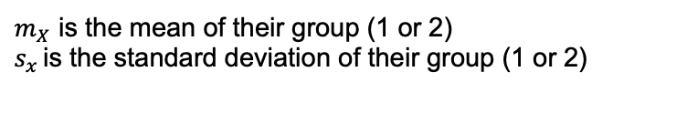



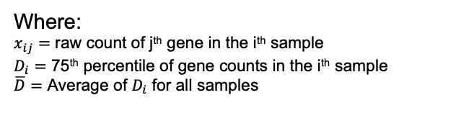

Important Formulas
Counts per million (also known as reads per million)
Upper Quartile Normalization
Fisher’s Linear Determinant
$$\frac{x_{ij}}{N_{i}}∗{10}^{6}$$
Where:
$$N_{i}$$
Where:
$x_{ij}=$ raw count of j^{th} gene in the i^{th} sample
$D_{i}=$ 75th percentile of gene counts in the i^{th} sample
$\overline{D}$ $=$ Average of $D_{i}$ for all samples
$$Upper Quartile Normalized Count= \frac{x_{ij}}{D_{i}}∗\overline{D}$$
Where:
FLD= $\frac{{(m_{2}−m_{1})}^{2}}{s_{1}^{2}+s_{2}^{2}}$
$m_{X}$ is the mean of their group (1 or 2)
$s_{x }$is the standard deviation of their group (1 or 2)

Slide 10
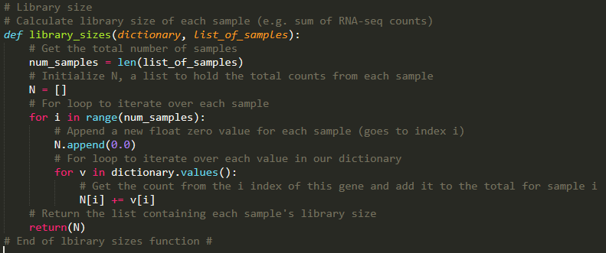
An example of a function used in this assignment

Slide 11
Tips and Tricks:
1 is different than 1.0
Int and float are different and sometimes incompatible

Slide 12
Part 1- Data filtering
Remove genes that have zero counts in all samples
  Create a dictionary with genes that pass your filter
  TIP: create a new dictionary for each filtering step
  DO NOT ALTER THE ORIGINAL DATA FILE
Calculate the counts per million (cpm) of each gene left in your data
  Use the counts_per_million function to your data that passed the filter
Remove genes that have 20 or more samples with cpm < 1
  Create a dictionary of genes that pass your second filter
  NOTE: this should be a dictionary of raw counts, not cpm. You are just doing the filtering based on cpm.

Slide 13
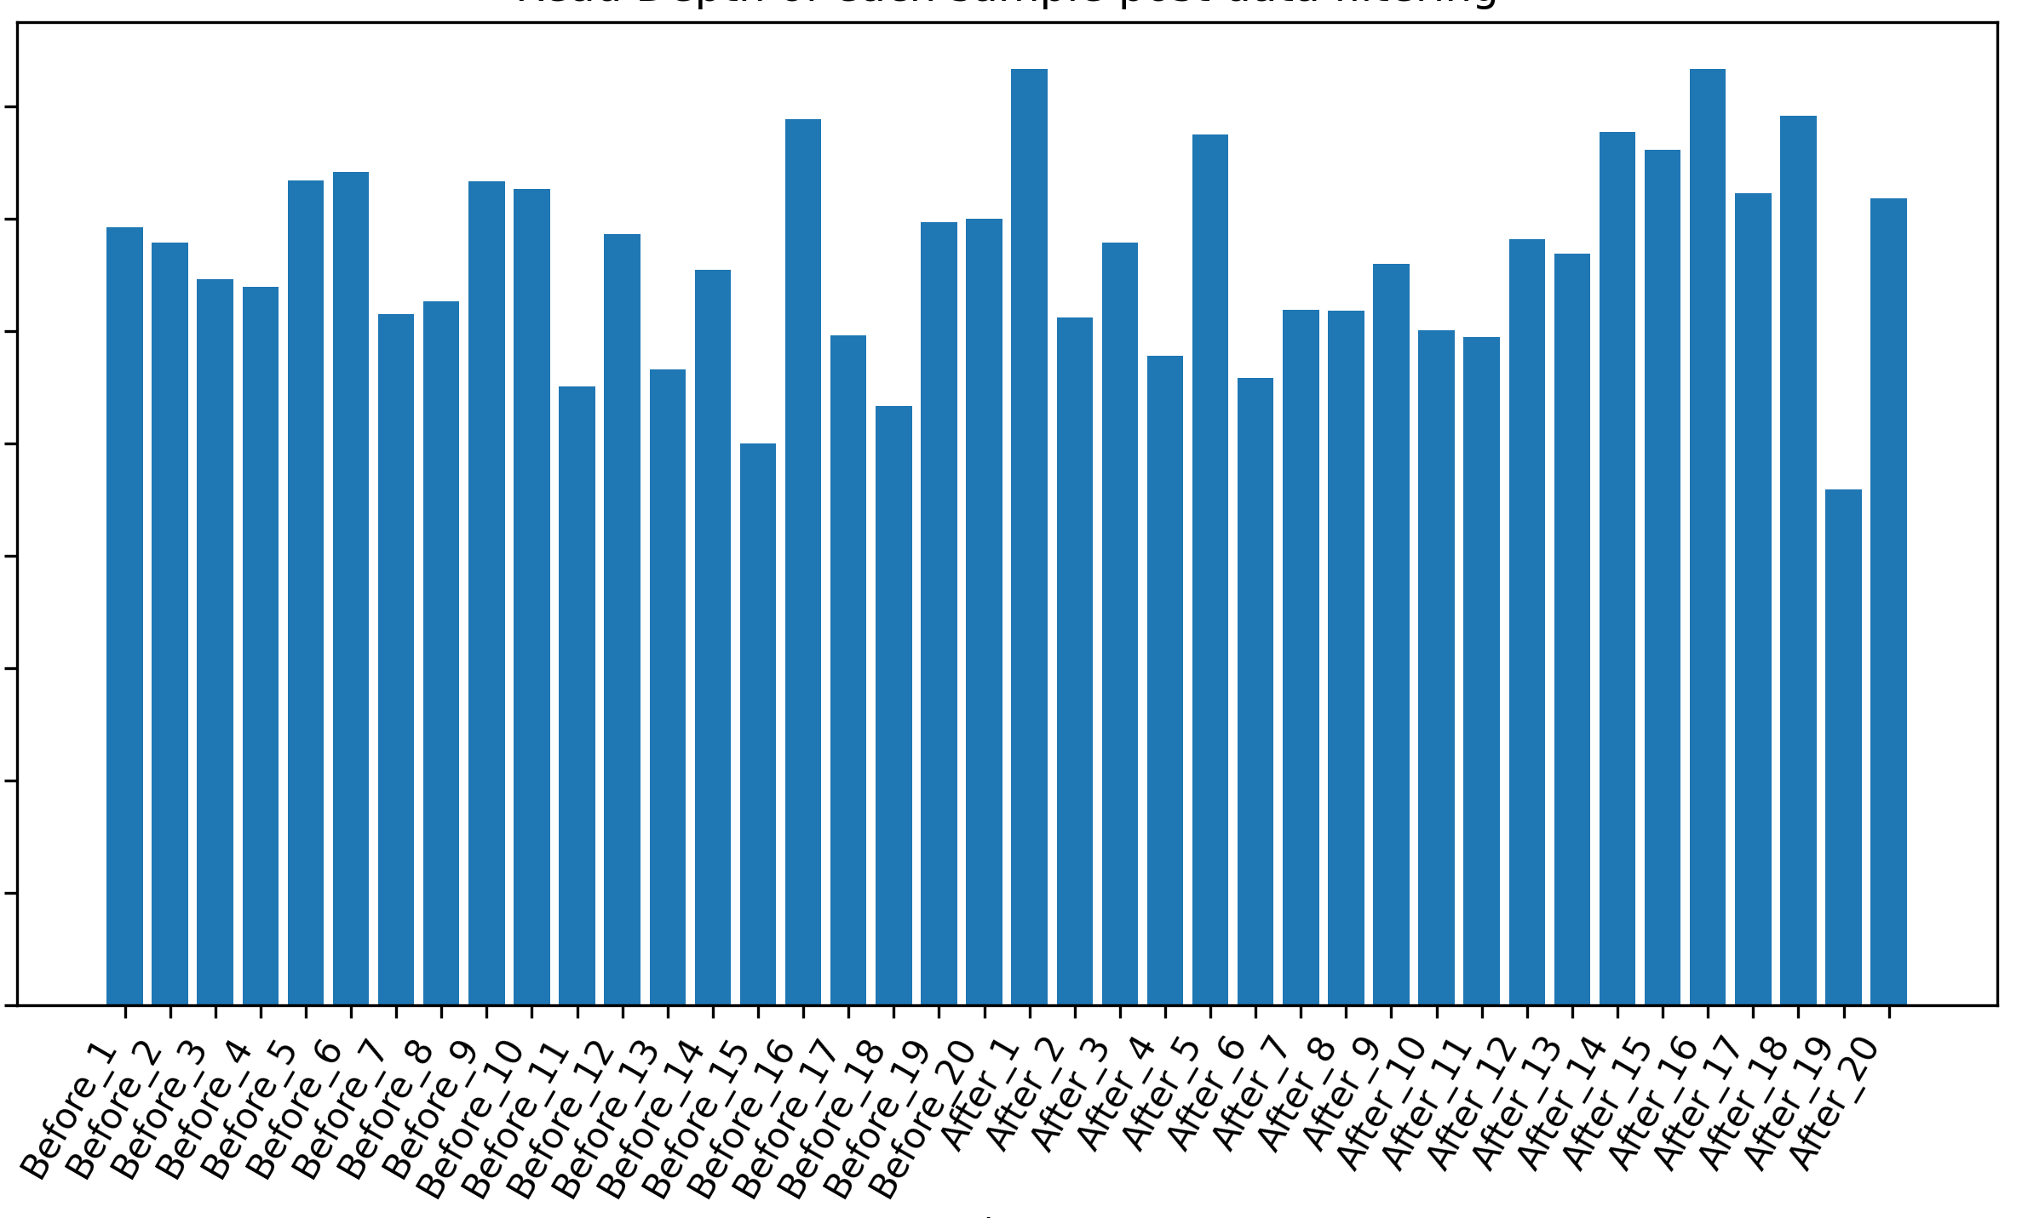
Part 2 - Data visualization
Plot the library sizes (total counts) for each sample using the genes that passed your filters in Part 1
Use the matplotlib library in python to plot things
Make sure your plot has labeled axes!
Save this plot as library_size.png
Y axis
X axis

Slide 14

Graphing in Python
https://matplotlib.org/gallery/index.html
https://matplotlib.org/api/pyplot_summary.html
Ask Google about detailed questions : )
Or others if you are more comfortable with:
Ggplot
Pandas
etc...

Slide 15
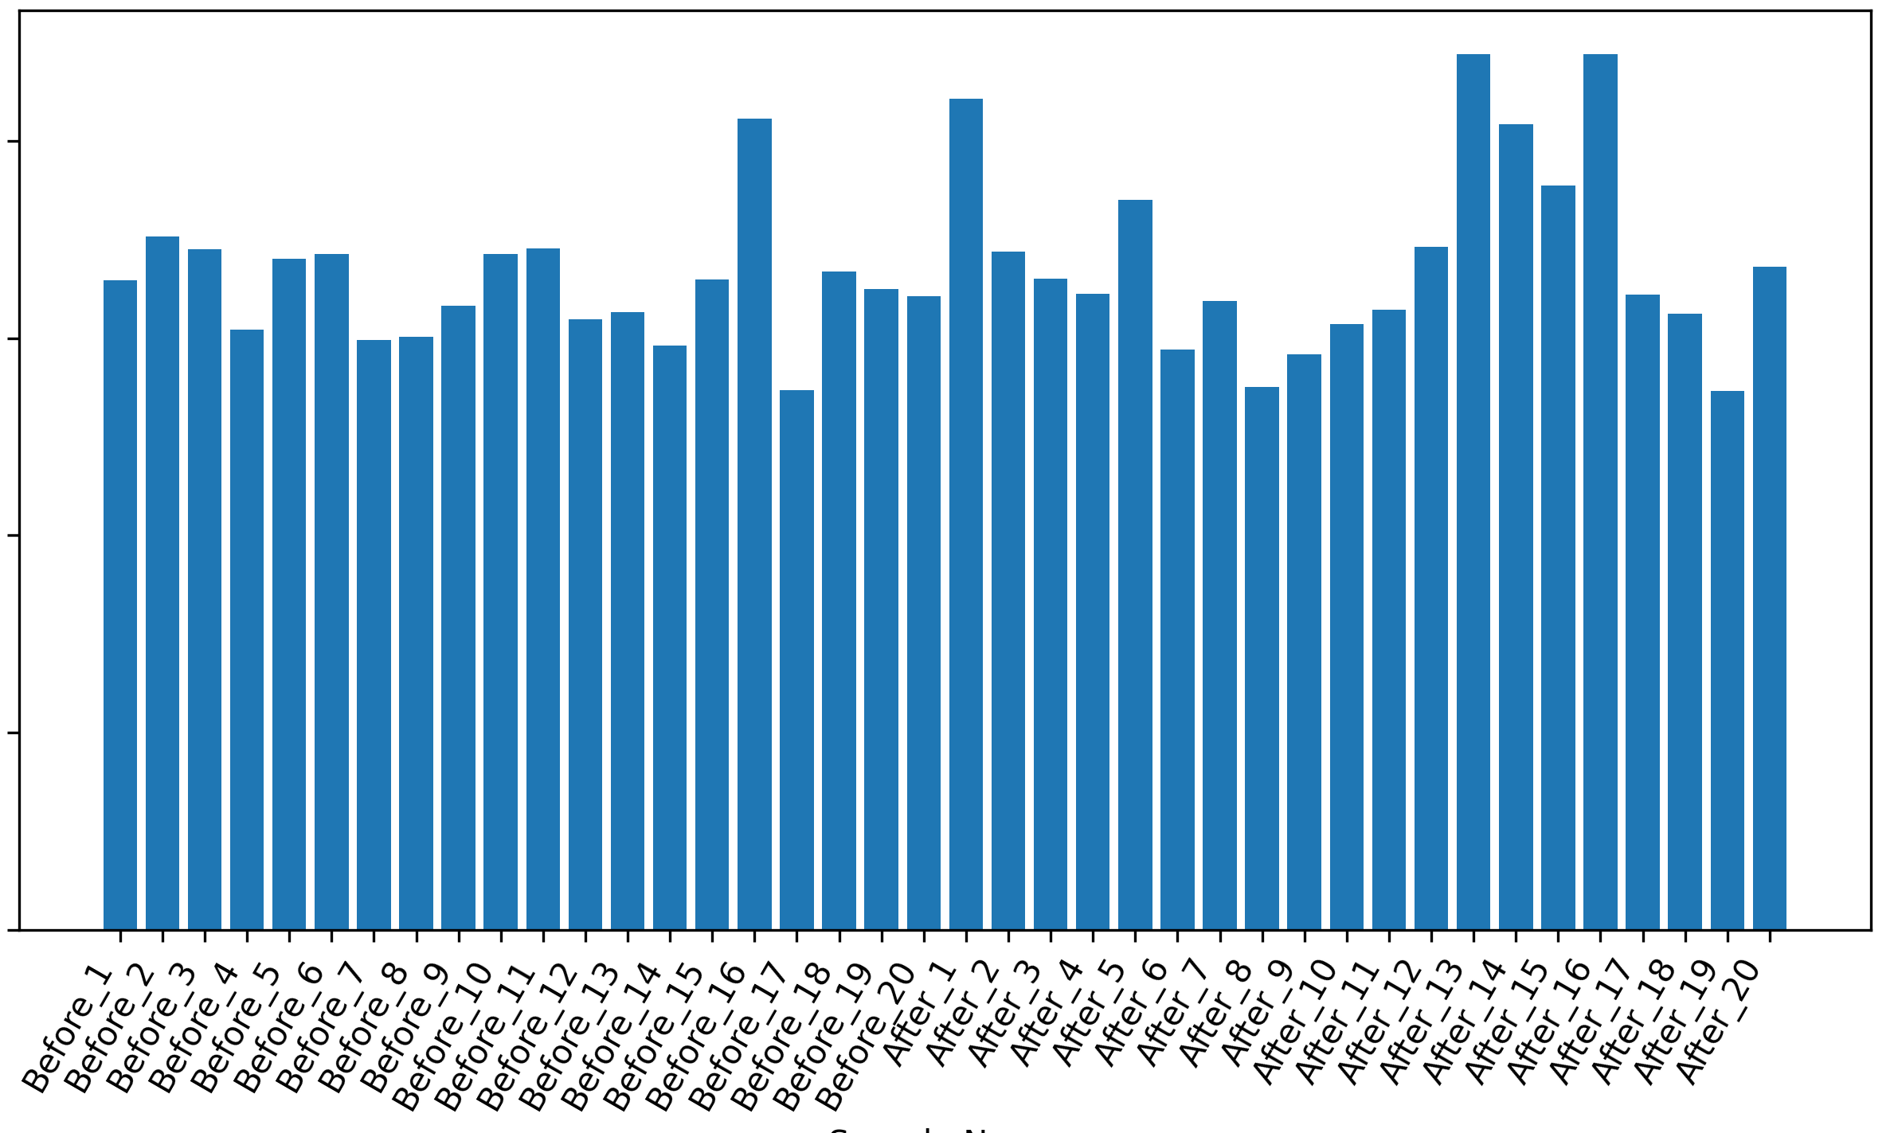
Part 3 - Data normalization
Use the upper_quartile_norm function to normalize the data you have from Part 1
Plot the normalized library sizes (total counts)
  TIP: Look at your code from Part 2 to make this easier!
  (optional) TIP: Make a function to plot your data
Save the plot as
library_size_normalized.png
Y axis
X axis

Slide 16
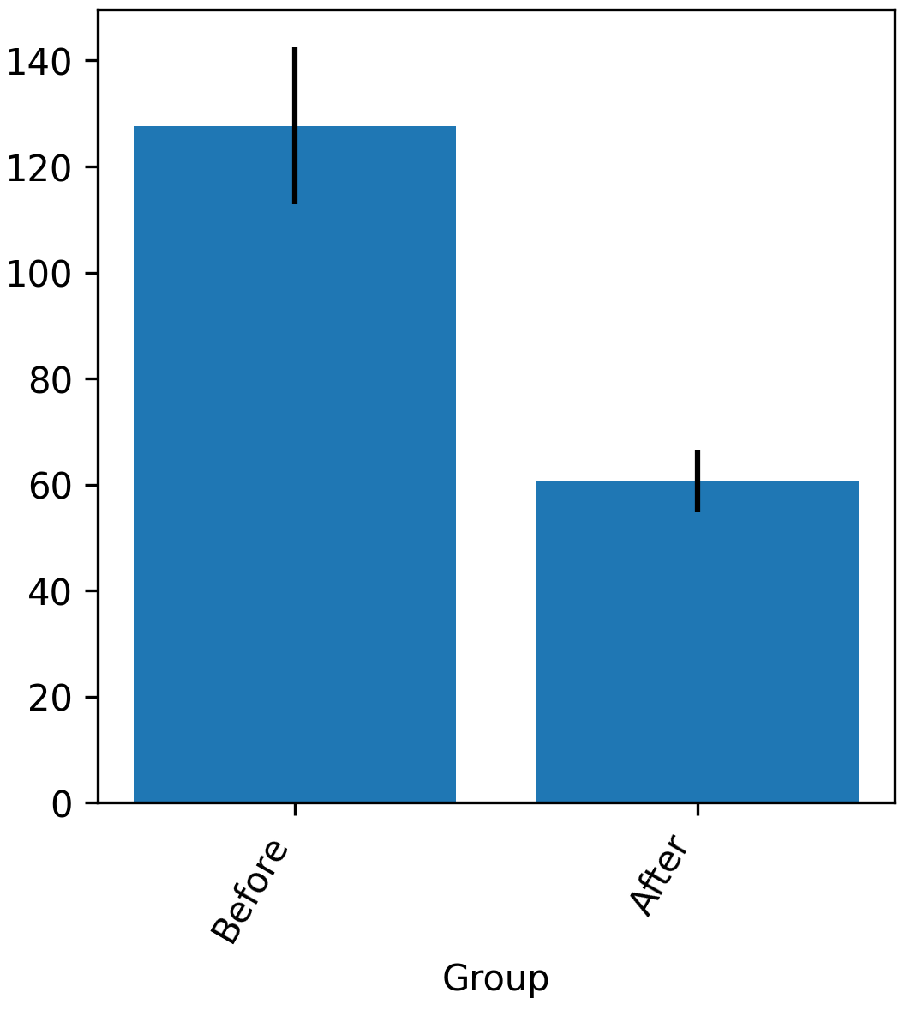
Part 4 - Data exploration
Use Fisher’s Linear Discriminant (FLD) to identify genes that are differentially expressed between the Before and After groups
  Use the fishers_linear_discriminant function you wrote in Part 0
  Output the genes with the ten highest FLD values (include gene name and FLD values)
  Pick a gene to explore further, and generate a bar graph of the upper quartile normalized mean expression level in each group.
Save the plot as mean_expression.png
NOTE: when calculating FLD for each gene,
remember to split the expression values into
group 1 (Before) and group 2 (After)
Before
After

Slide 17
What to turn in
Edited script: gene_expression.py
Output files
  library_size.png
  library_size_normalized.png
  mean_expression.png
Your README.txt with the answers to the questions and the commands you used to answer the questions
Extra credit only: dendrogram.png + completed “Extra credit” in gene_expression.py)
(Assignment instruction did not specify clustering method, so students could feel free to use any.)
REMEMBER TO COMMENT YOUR CODE
(for accurate grading and for your future self!)

Slide 18
Suggestions
Discuss questions with classmates (but no copying)
Google and AI are your best friends!
Post questions on Piazza

