Slide 1
Assignment 9
Variant Analysis
3/21/25

Slide 2
Assignment Details
Assignment 9 due 11:59PM March 27th
Goal: gain proficiency in analyzing potential pathogenic variants derived from genome sequencing data
Use bcftools to analyze variants
Search the Genome Aggregation Database (gnomAD) to find variant information
Perform a Fisher’s exact test

Slide 3
Part 0 – Before you start
Decompress the .gz file using the gunzip command
gunzip example.vcf.gz
Test to make sure bcftools is running in the docker
Run the Docker container using our image
bsub -Is -q general-interactive -G compute-workshop -a 'docker(takinwe1/bio5488:0.0)' /bin/bash (
Activate the conda environment
conda activate bio5488
Check to make sure bcftools is accessible
bcftools --version
If you get a conda error, specify the path to the tool rather than activating conda
/opt/conda/envs/bio5488/bin/bcftools

Slide 4
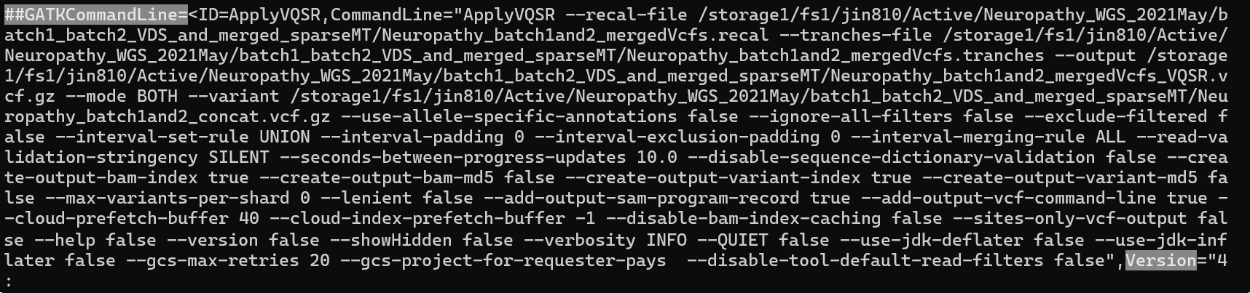
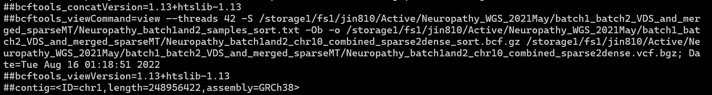
Part 1 – VCF Header
Use the less or head command to look for the GATK version and information on the reference genome in the VCF header

Slide 5
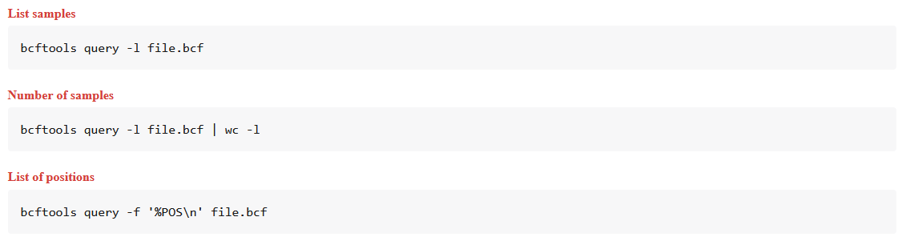
Part 1 – bcftools
bcftools, part ot he samtools suite, are utilities for manipulating VCF and BCF (binary variant call format) files
See the manual for commands to use to find the number of samples
https://samtools.github.io/bcftools/bcftools.html
https://samtools.github.io/bcftools/howtos/query.html

Slide 6
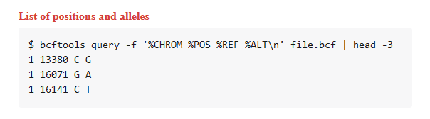
Part 2 – VCF Contents
Use bcftools to parse through the VCF file and get information about the position of the variant & the REF and ALT alleles
Again, see
https://samtools.github.io/bcftools/howtos/query.html

Slide 7
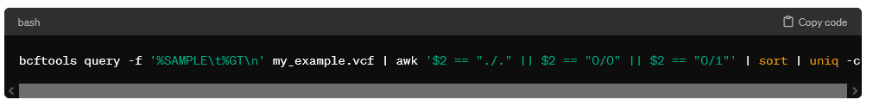
Part 2 – VCF Contents – Hints!
To count the genotypes present for the variant, look at the following three commands which can be assembled using the pipe sign |
bcftools query https://samtools.github.io/bcftools/howtos/query.html
uniq and sort https://www.redhat.com/sysadmin/uniq-command-lists

Slide 8
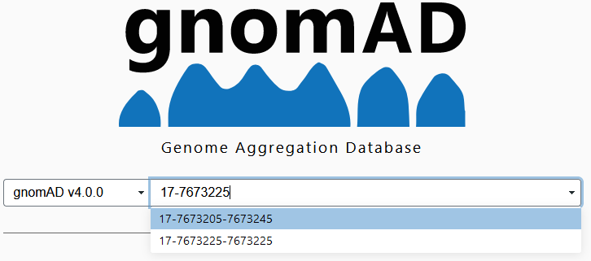
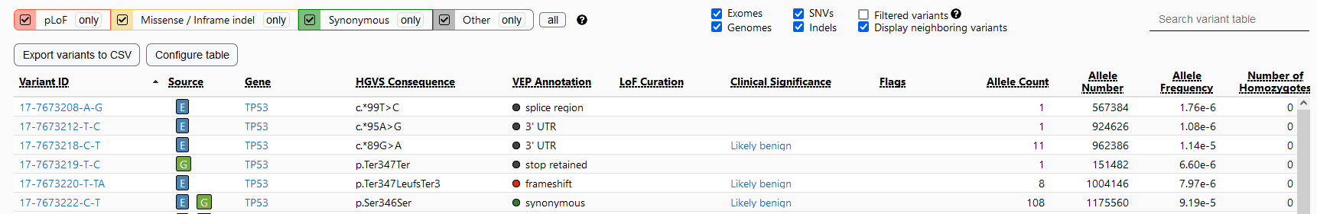
Part 3 – gnomAD
Search for the variant using the genomic loci you found in part 2 using the format CHROM-POS as in 17-7673225
You can also include the REF and ALT allele in your search as in 17-7673222-C-T
Note database version!

Slide 9
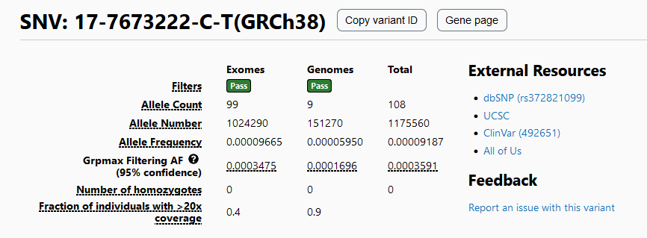

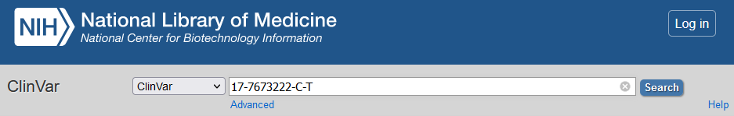
Part 3 – gnomAD & ClinVAR
Hover

Slide 10
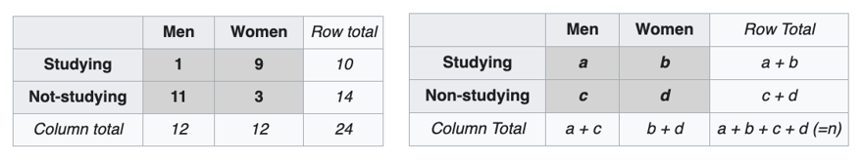
Part 4 – Two-tailed Fisher's exact test
A statistical test used to determine if there are non-random associations between two categorical variables
More information: https://en.wikipedia.org/wiki/Fisher%27s_exact_test
Hypothesis: the proportion of studying students is higher among the women than among the men

Slide 11
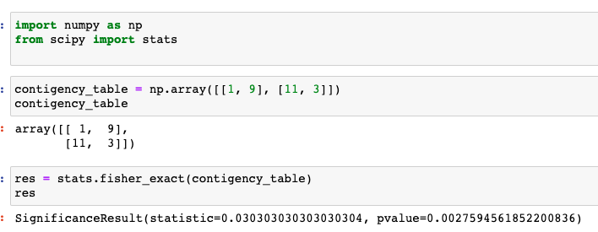
Part 4 – Two-tailed Fisher's exact test
Pay attention to order of a, b, c and d as you will refer to them in the equation

Slide 12
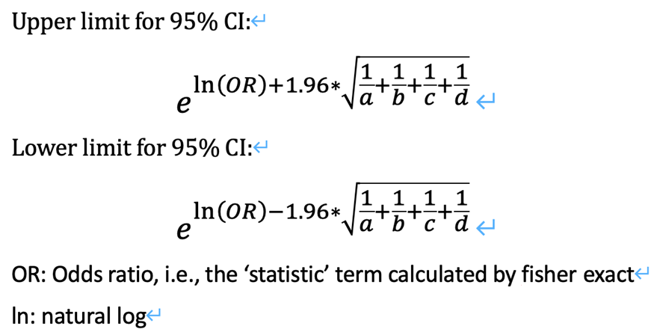
Part 4 – Calculate 95% confidence interval

Slide 13
Part 4 – Our Contingency Table
 | VCF File (case) | gnomAD (control)
Alternative allele # | A Number of 1 calls from part 2 question D | B Allele count on gnomAD webpage
Reference allele # | C Number of 0 calls from part 2 Question D | D Allele number on gnomAD – allele count (B)

Slide 14

The End!
Ask on Piazza!

