Slide 1
XV6 Virtual Memory

Slide 2
Paging provides a level of indirection for addressing
CPU -> MMU -> RAM
VA -> PA

Slide 3
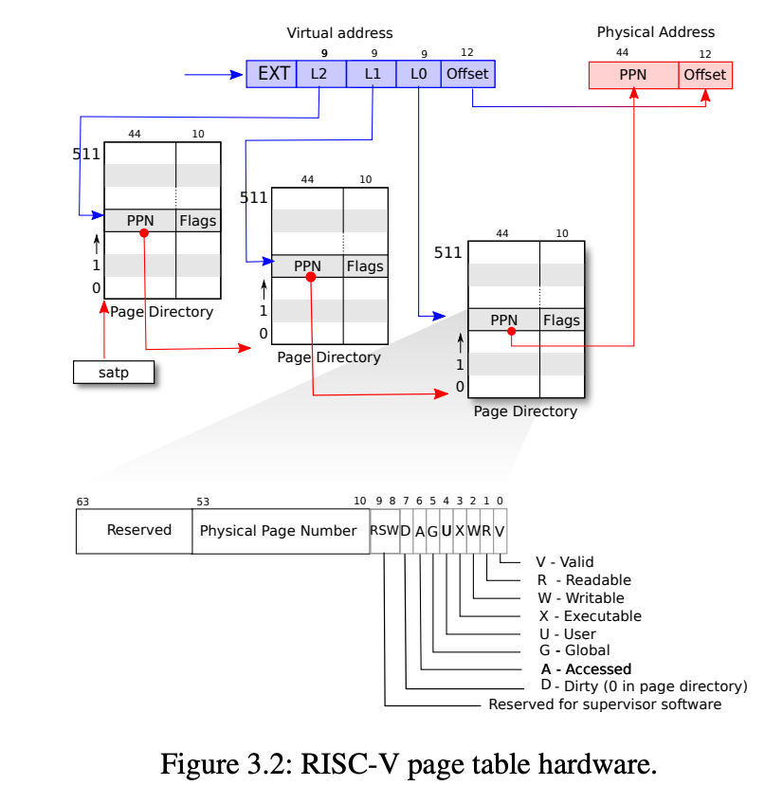
How a VA gets translated to PA?
use index bits of VA to find a page table entry (PTE) construct physical address using PPN from PTE + offset of VA

Slide 4
RISC-V VA index
RISC-V maps 4-KB “pages” and aligned — start on 4 KB boundaries 4 KB = 12 bits the RISC-V used in xv6 has 64-bit for addresses thus page table index is top 64-12 = 52 bits of VA except that the top 25 of the top 52 are unused no RISC-V has that much memory now can grow in future so, index is 27 bits

Slide 5
What is in PTE?
each PTE is 64 bits, but only 54 are used top 44 bits of PTE are top bits of physical address “physical page number” low 10 bits of PTE flags Present, Writeable, &c

Slide 6
Where does page table stored?
in RAM

Slide 7
Would it be reasonable for page table to just be an array of PTEs?
No. Waste lots of memory for small program. 2^27 entry * 64 bits = 1 GB per page table. If one address space per app, too much wasting!

Slide 8
How does RISC-V solve this?
RISC-V 64 uses a “three-level page table” to save space Each page directory page (PD) has 512 PTEs. PTEs point to another PD or is a leaf so 512512512 PTEs in total. PD entries can be invalid, and PTE pages do not exist. So a page table for a small app is small.

Slide 9
How can MMU figure out where the page table is?
Register satp holds the physical address of the root page table address. OS saves and rewrite satp when switching to another address space/application.

Slide 10
What if PTE V bit is not set, or R/W bit not set?
Page fault. Transfer to kernel. Kernel could output error, kill process, or install a PTE and resume. See: how to kill process, how to lazy allocate, how to copy on write.

Slide 11
VM in xv6
Each process has its own address space, and its own page table. Kernel switches page tables when switching processes.

Slide 12
Jump between user program and kernel
trampoline and trapframe aren’t writable by user process. both kernel and user map trampoline and trapframe page.
Two good reasons:
eases transition user -> kernel and back
kernel doesn’t map user applications
Not easy for kernel to r/w user memory. Need translate user virtual address to kernel virtual address But good for isolation (see spectre attacks)

Slide 13
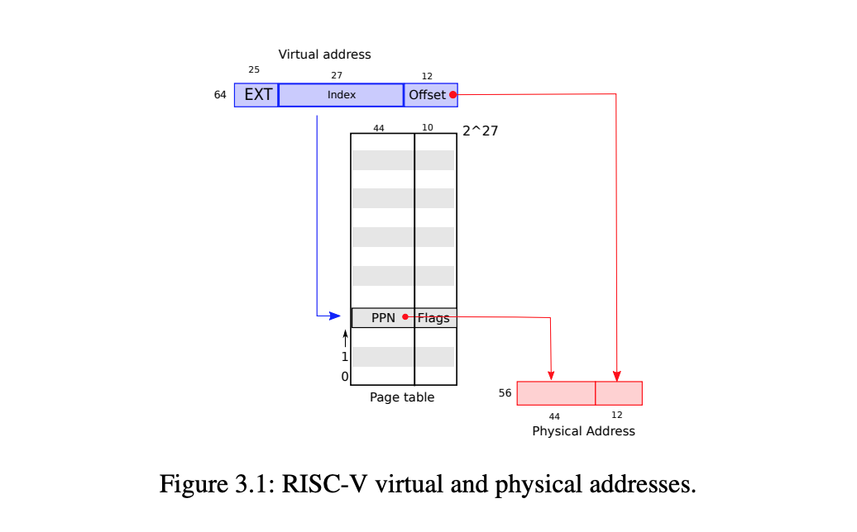
How to translate address
Notes:
a RISC-V page table is logically an array of 2^27 (134,217,728) page table entries (PTEs). The paging hardware translates a virtual address by using the top 27 bits of the 39 bits to index into the page table to find a PTE, and making a 56-bit physical address whose top 44 bits come from the PPN in the PTE and whose bottom 12 bits are copied from the original virtual address. Thus a page table gives the operating system control over virtual-to-physical address translations at the granularity of aligned chunks of 4096 (2^12) bytes. Such a chunk is called a page.

Slide 14
The total supported number of pages are: 2^27
Each size is 2^12.
GB size is 2^30.
MAXVA is actually one bit less than the max allowed by Sv39, to avoid having to sign-extend virtual addresses that have the high bit set.
#define MAXVA (1L << (9 + 9 + 9 + 12 - 1))
So the total virtual memory can support up to 2^(27+12-30 - 1) => 2^8.
The available virtual memory is 256 GB.

Slide 15
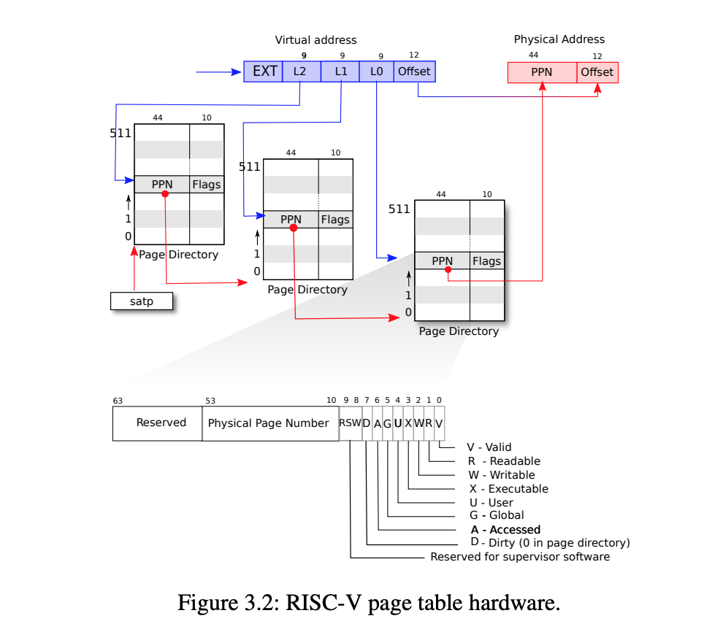

Slide 16
Page Fault and Swap
Page can store in disk, if memory is running out of space. Page Table will have bit indicate page is valid but not present. When reference a not in memory page, the handler will generate a page fault. Memory and disk can swap pages whenever needed.

Slide 17
Setup kernel address space
shift a physical address to the right place for a PTE. #define PA2PTE(pa) ((((uint64)pa) >> 12) << 10)
Create PTEs for virtual addresses starting at va that refer to physical addresses starting at pa. va and size might not be page-aligned.

Slide 18
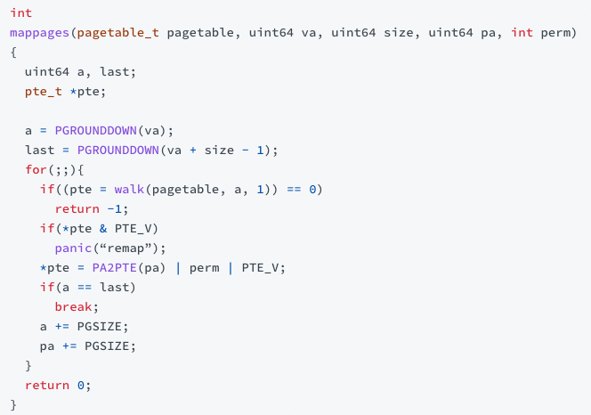
Code: Map physical address to virtual address

Slide 19
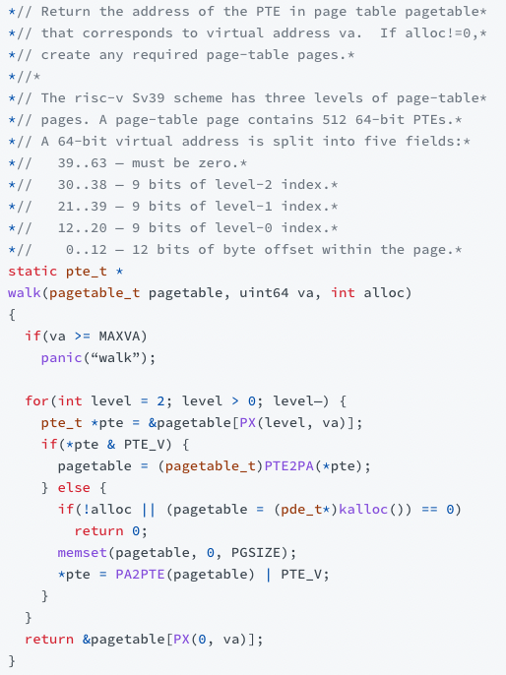

Code: Walk the Pagetable to find PTE
Notes:
PX changes va to the current index based on level. & 0x111111111 to set rest to 0s. The loop checks PTE entry, if it is valid, transform the PTE entry to physical address, and assign to pageable array. If not valid, alloca new page table, convert the physical address to PTE format, and assign to PTE’s content. Finally, returns the PTE address of level 0 for given VA.

Slide 20
Key Features
The purpose of virtual memory is isolation.
Each process has its own address space.
Lazy/on-demand page allocation.
Guard page to protect against stack overflow
one zero-filled page
Share kernel page tables in XV6
Copy-on-write fork
Demand paging: on page fault, read the page from file and update page table entry.
Memory-mapped files: Can read and write part of file. Can pay-in pages on demand, and page-out if memory is full. (Code it up!)
exec nows loads entire file to memory, files reading is slow, and some parts are never used. The solution is to use demand paging (Code it up!)

