Slide 1
Erasure Coding in Distributed Storage
Dec, 12, 2006
Jin Li / Principal Researcher
Notes:
My topic today is erasure coding in distributed storage.

Slide 2

What is Erasure Resilient Coding
Original data:
1
2
3
k
k messages
ERC:
1
2
3
k
k+1
n
At a certain
instance
X
X
X
X
X
X
Peer may fail (temporarily or permanently) during the access. However, as
long as there are k piece of data available, the reconstruction will be successful.
Slide: <number>
Notes:
Erasure resilient coding (or ERC) is a well known mathematical tool that protect data erasures in storage and transmission. With ERC, we combine the original k piece of data

Slide 3
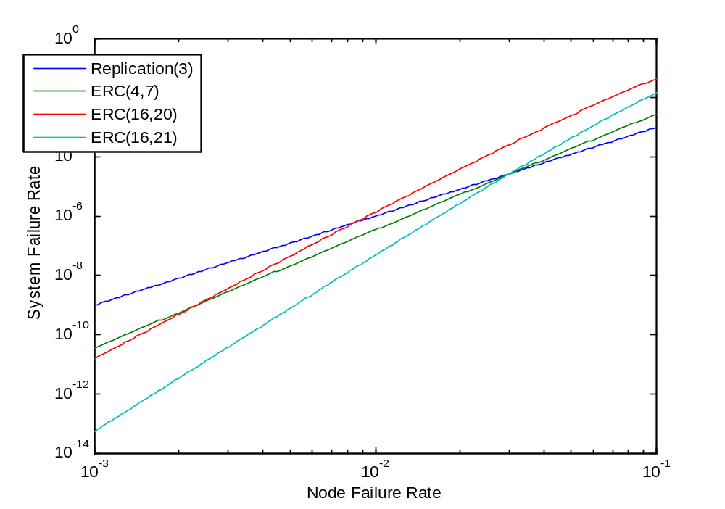
Pros & Cons of ERC Storage
Less space in ERC storage
  E.g. 16/20 vs. 3-replica
    ERC 20/16 = 125% vs. 3-replica 3/1 = 300%
    42% space cost of replica
Challenges in ERC based Storage
  More I/O overhead, complexity in update
  E.g. 16/20 vs. 3-replica
    5 writes + 4 reads vs. 3 writes,
    15% more read assuming 1% of failure.

Slide 4
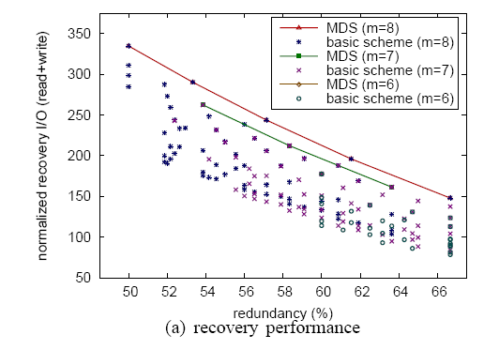
Advanced ERC Code: 2D ERC & Pyramid ERC
x₁₁
x₁₂
x_{1k}
y₁₁
y₁₂
y₁₄
Data Center 1
x₂₁
x₂₂
x_{2k}
y₂₁
y₂₂
y₂₄
Data Center 2
x_{j1}
x_{j2}
x_{jk}
y_{j1}
y_{j2}
y_{j4}
Data Center j
z₁
z₂
z_{j}
Data Center
j+1
Better I/O & redundancy
Tradeoff!
Slide: <number>

Slide 5
Consistency in ERC Storage
Node life cycle
  Fresh : live & up-to-dates.
  Dead : not functional.
  Stale : live but outdated (node should
  perform a data recovery operation).
  Each ERC frag carries one status info for each original data chunk it is associated with.
  Read accessibility
  Data is safe in the storage as long as there are k fresh nodes.
  In 2D ERC or pyramid ERC, a coding group is functional if it has k fresh nodes.
  Write accessibility
    Write success can be confirmed as long as there are still k fresh nodes following the write
      So 0 failure → only need 1 node to confirm, other node can do delay write
      1 failure → need 2 nodes to confirm, etc..
Fresh
Node life
cycle
Stale
Dead
Slide: <number>

Slide 6
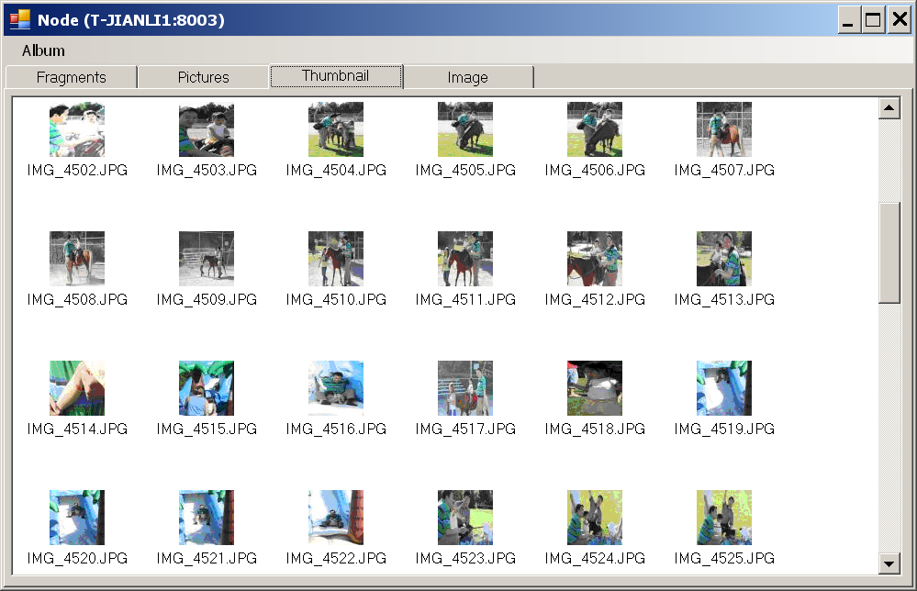
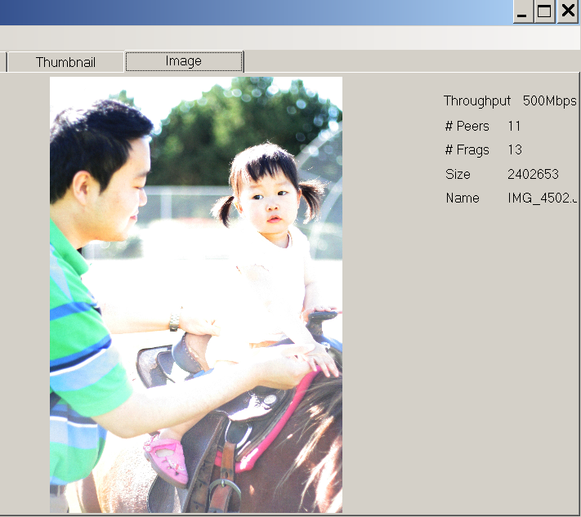
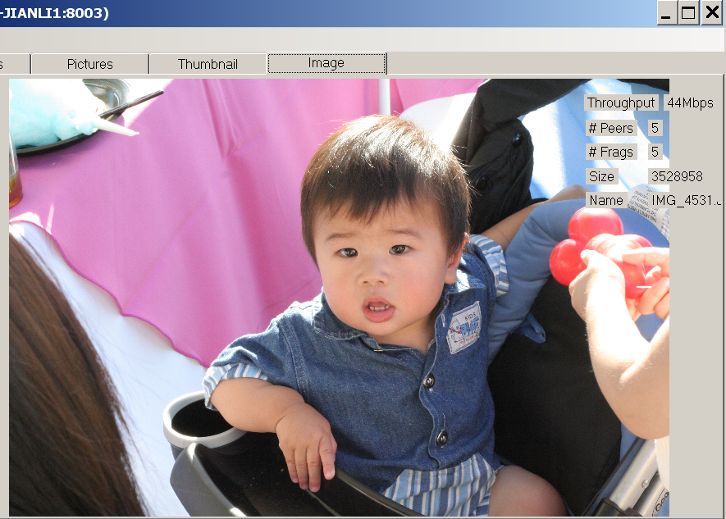
A Prototype
ERC recover
systematic recover
Slide: <number>

