Slide 1






Animal to animal variability
Example with two mice
Mouse 1
Mouse 2
Cluster 3
0.4
0.2
0.4
$$w_{3,1}$$
0.6
0.15
0.25
0.3
0.5
0.2
Cluster 4
$$w_{4,2}$$
Cluster 2
$$w_{2,1}$$
0.3
0.5
0.2
Cluster 2
$$w_{2,2}$$
Cluster 1
0.3
0.3
0.4
$$w_{1,1}$$
Cluster 1
0.3
0.3
0.4
$$w_{1,2}$$
Region 1
Region 2
Region 3
Region 1
Region 2
Region 3

Slide 2
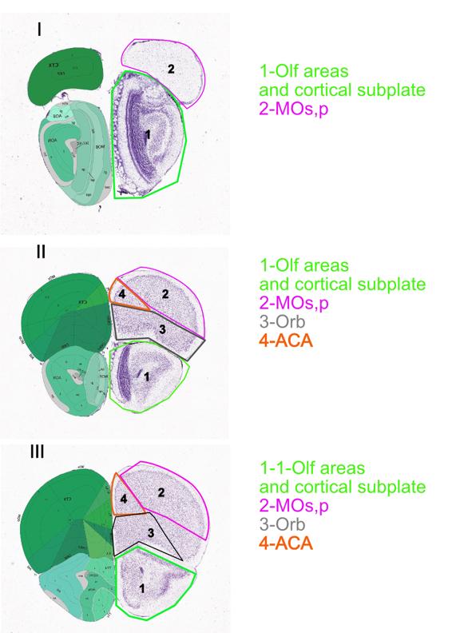
Source of noise
Real counts
Region 1
Region 2
Region 3
Region 4
Neuron 1
10 | 9 | 10 | 2
Observed counts
9 | 1 | 0 | 1
0 | 8 | 1 | 0
1 | 1 | 8 | 0
0 | 0 | 0 | 2
Neuron 1
10 | 10 | 9 | 3

Slide 3
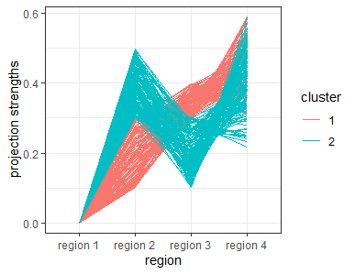
Uneven projection strength of neurons with the same targets
Example with two clusters

Slide 4
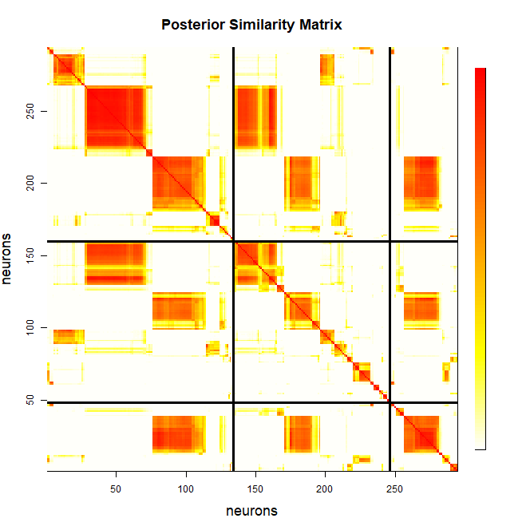
1
Mouse 1
0
Mouse 1
Mouse 2
Mouse 3

Slide 5
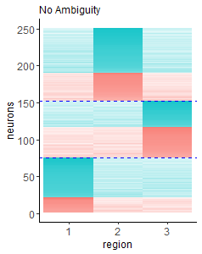
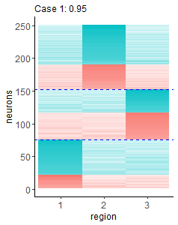
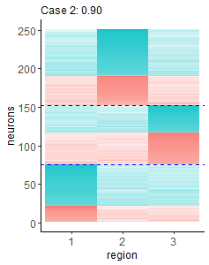
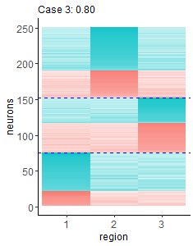
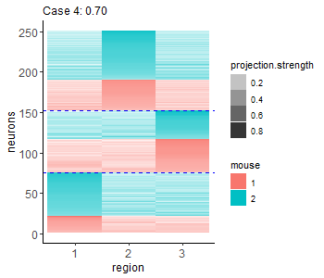

Slide 6
