Slide 1
Hans (visual cortex) data
Brain Regions:
Li
LM
AL
AM
PM
RL

Slide 2
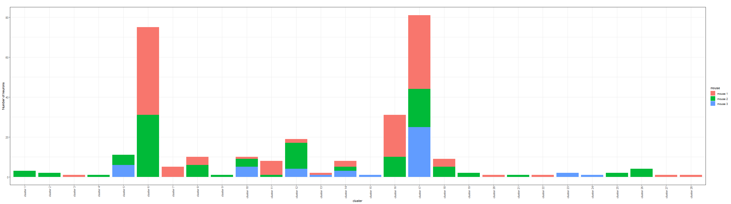
Bayesian Result – minVI to obtain point estimates of neuron allocations
There are 28 clusters (motifs) in total:

Slide 3
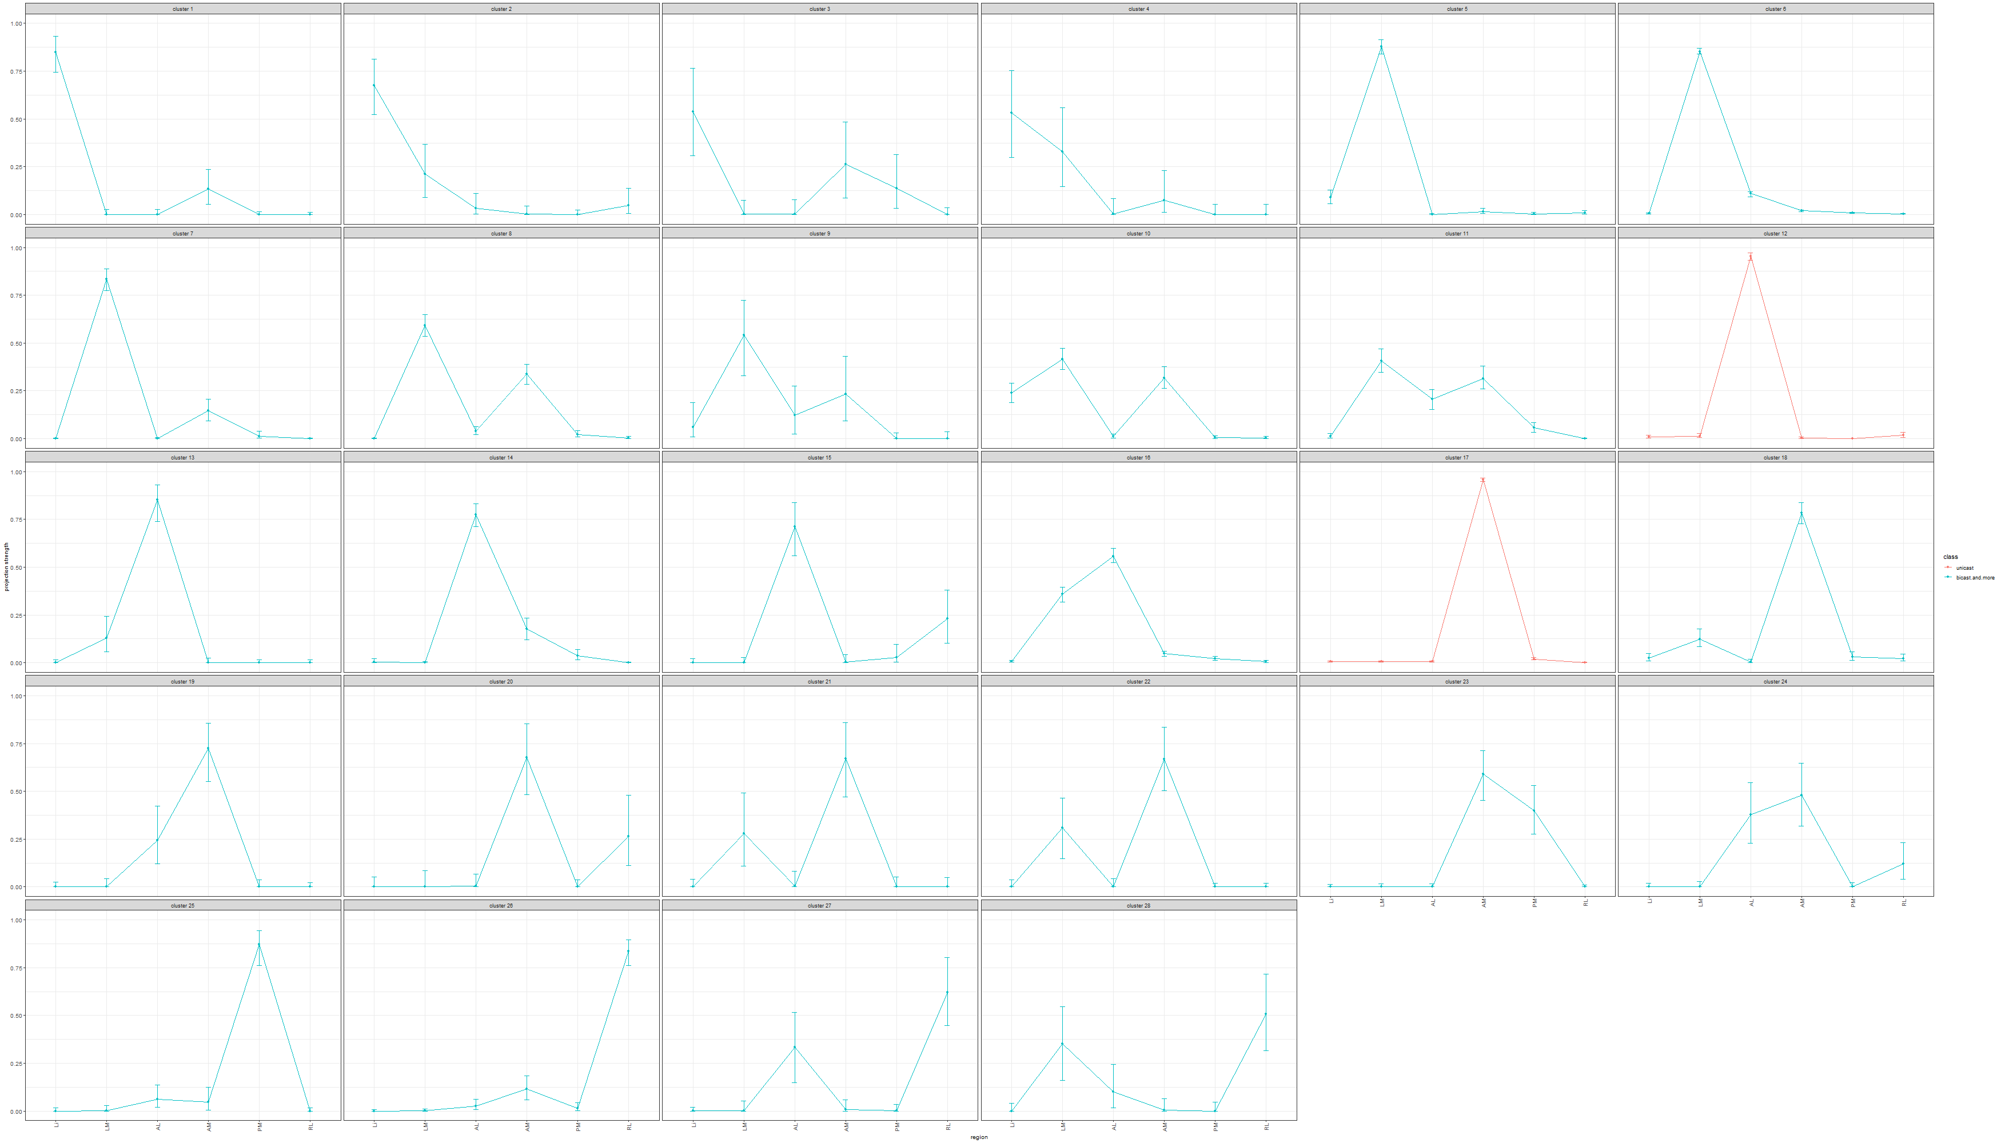
Estimated projection probability of neurons in each cluster with error-bars, color-coded by the number of projecting regions of each cluster:

Slide 4
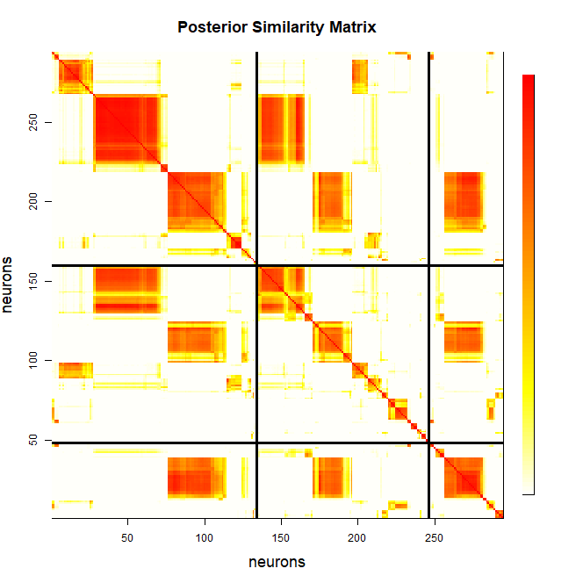
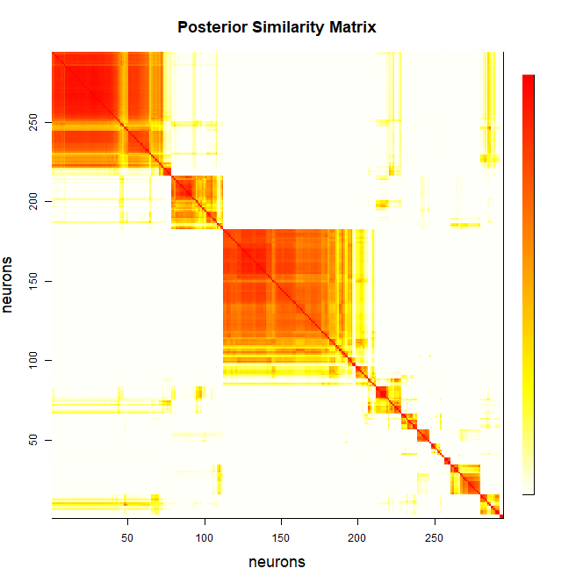

Slide 5
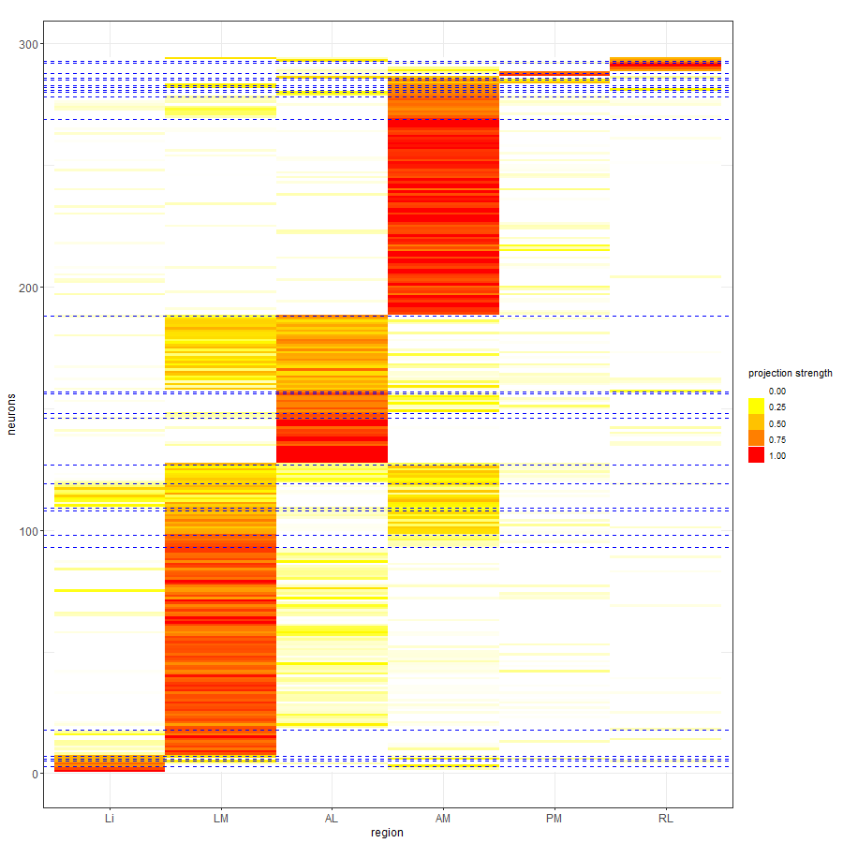

Slide 6
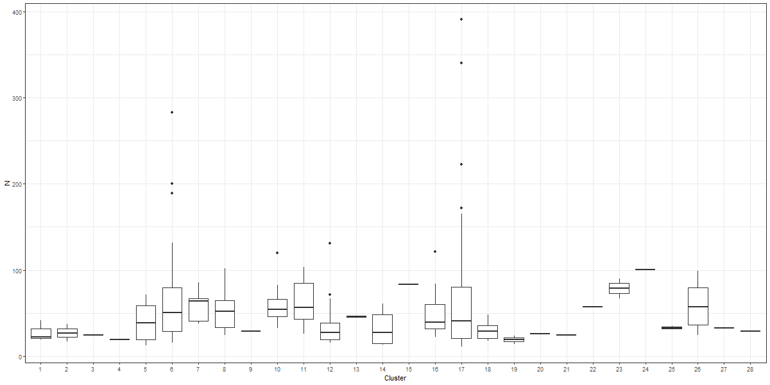
Distribution of the sum of counts across all brain regions for neurons within each cluster.

Slide 7
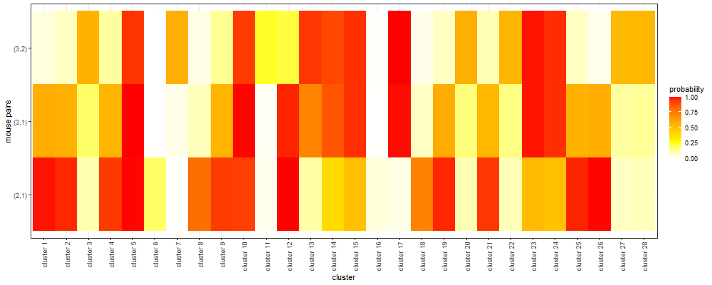
Comparison of allocation proportions across any two mice

Slide 8
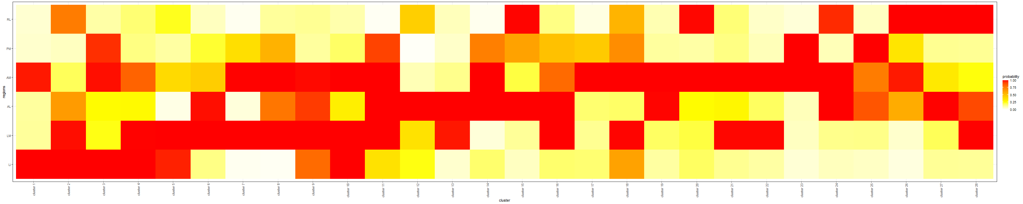
Probability of having the projection strength greater than 0.01 for each cluster and region:

Slide 9
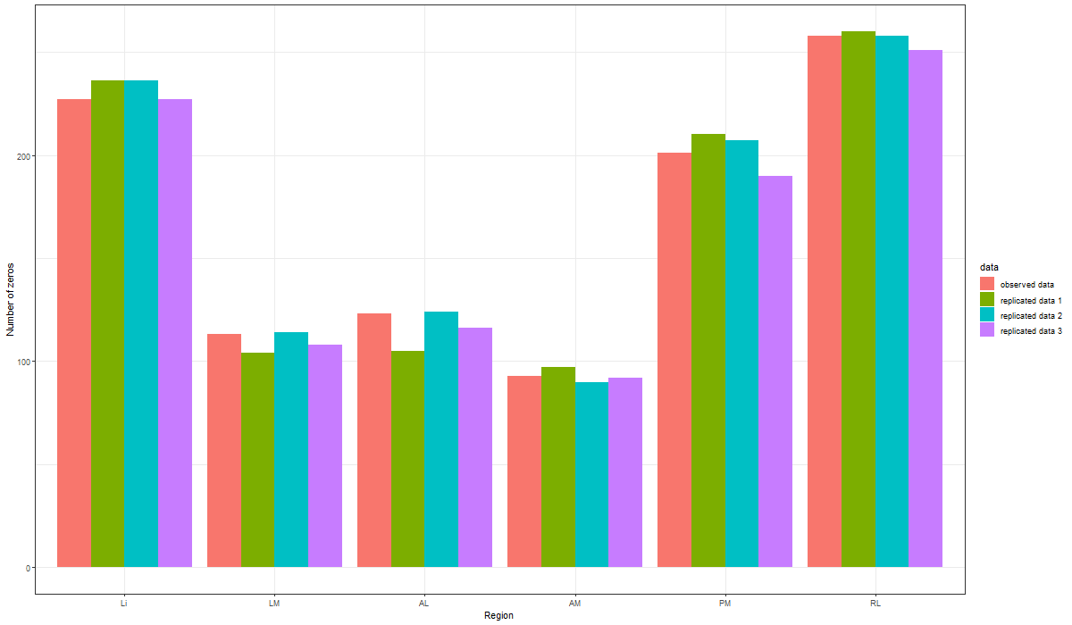
Posterior Predictive Checks: Comparing observed Barseq data against replicated data

Slide 10
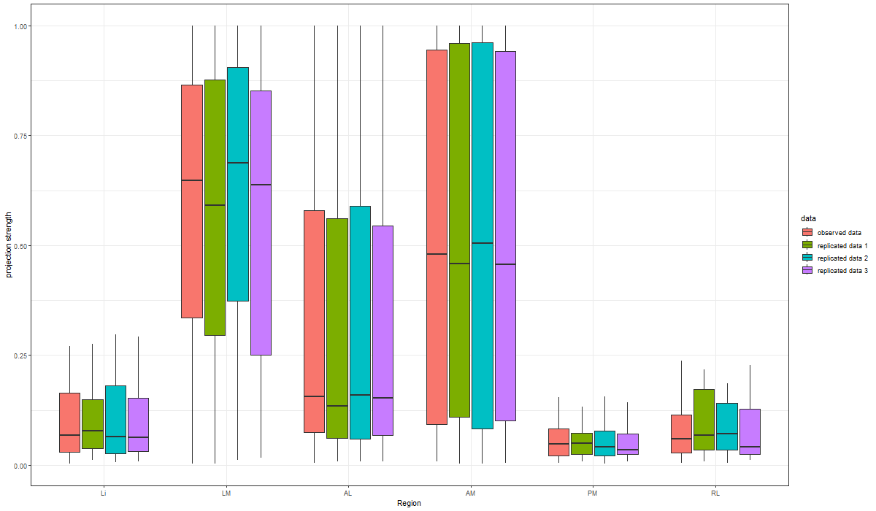

Slide 11
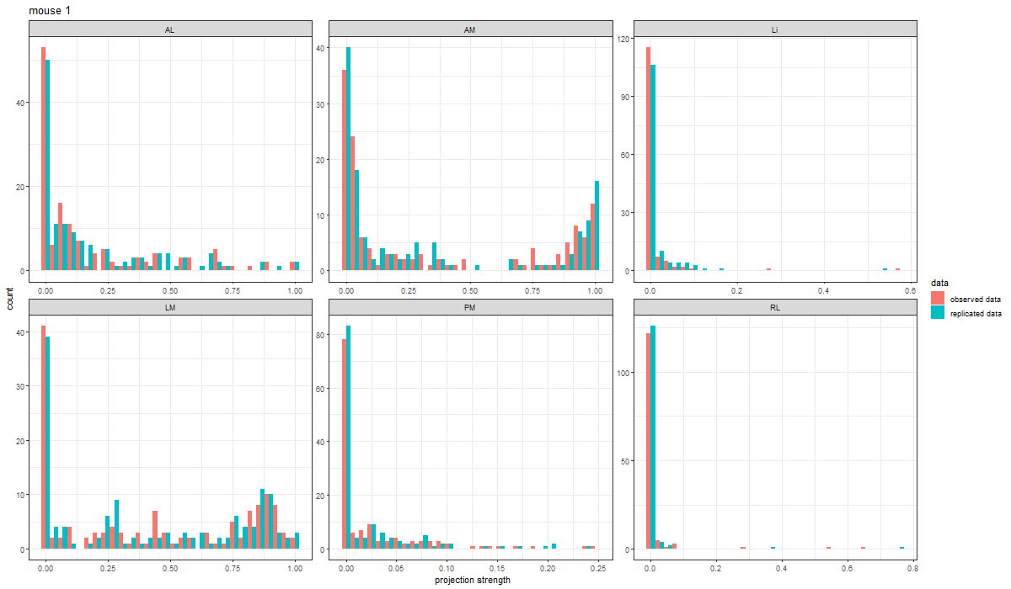
We can also carry out posterior predictive check with a single set of replicated data. Below we present the findings for mouse 1. The same comparison could be carried out to all the remaining mice as well.

Slide 12
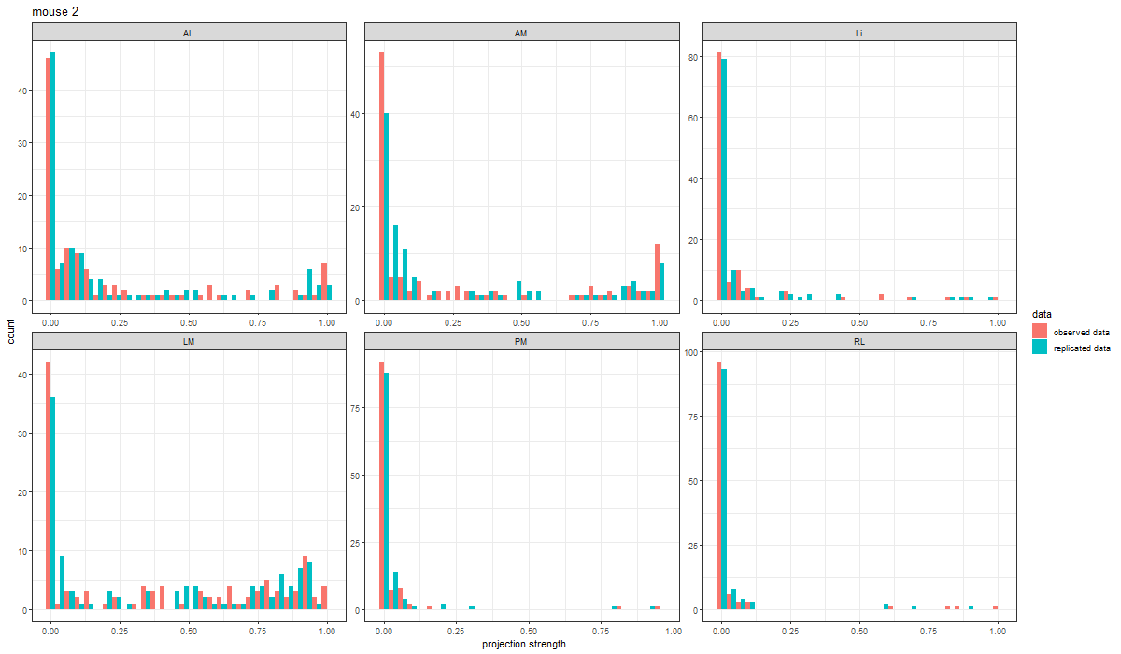

Slide 13
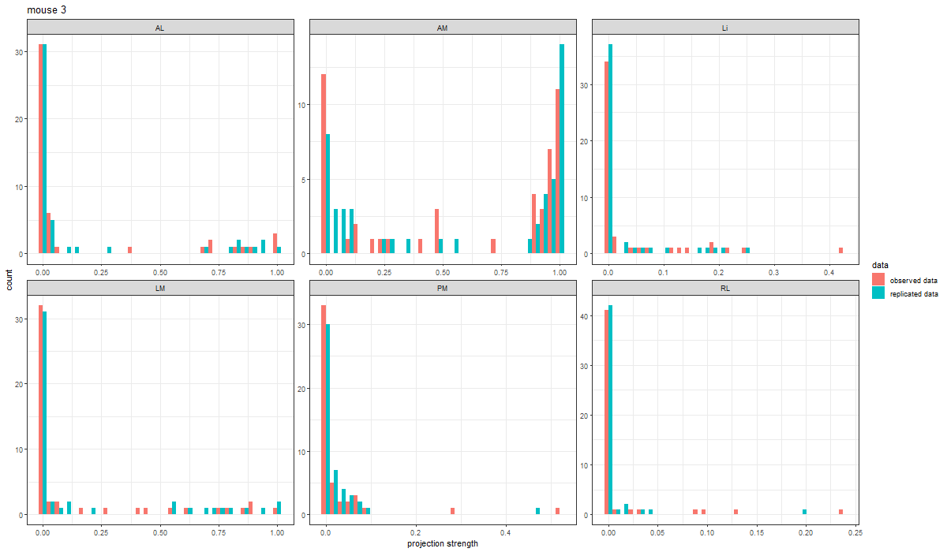

Slide 14
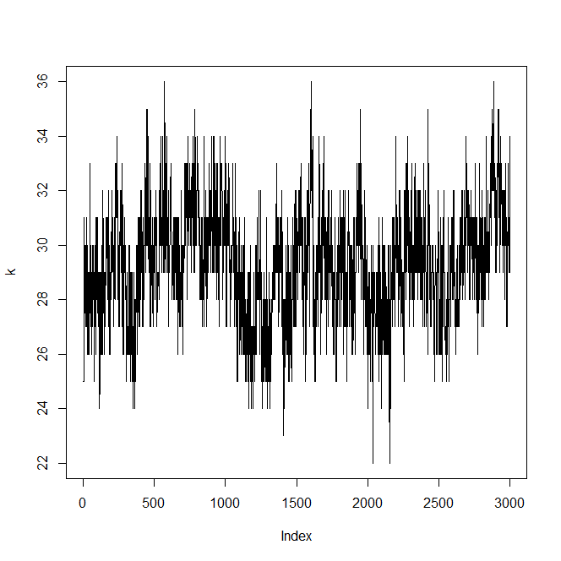
Trace of total number of clusters

Slide 15
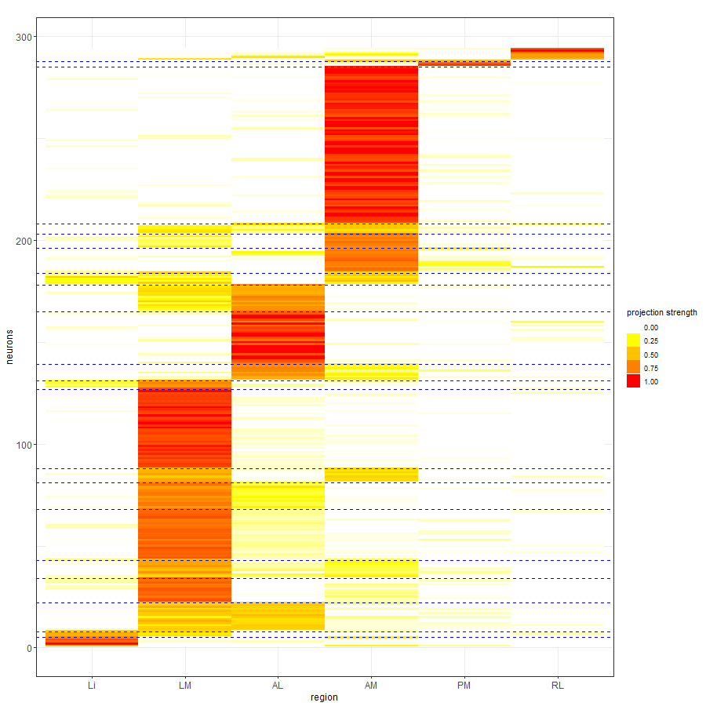
K-means with 20 clusters: Neurons are reordered by the k-means allocation.

Slide 16
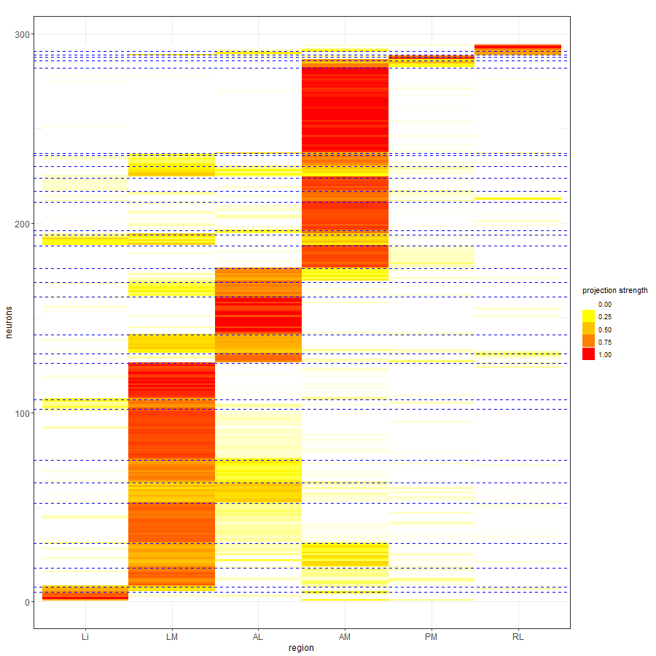
K-means with 30 clusters: Neurons are reordered by the k-means allocation.

Slide 17
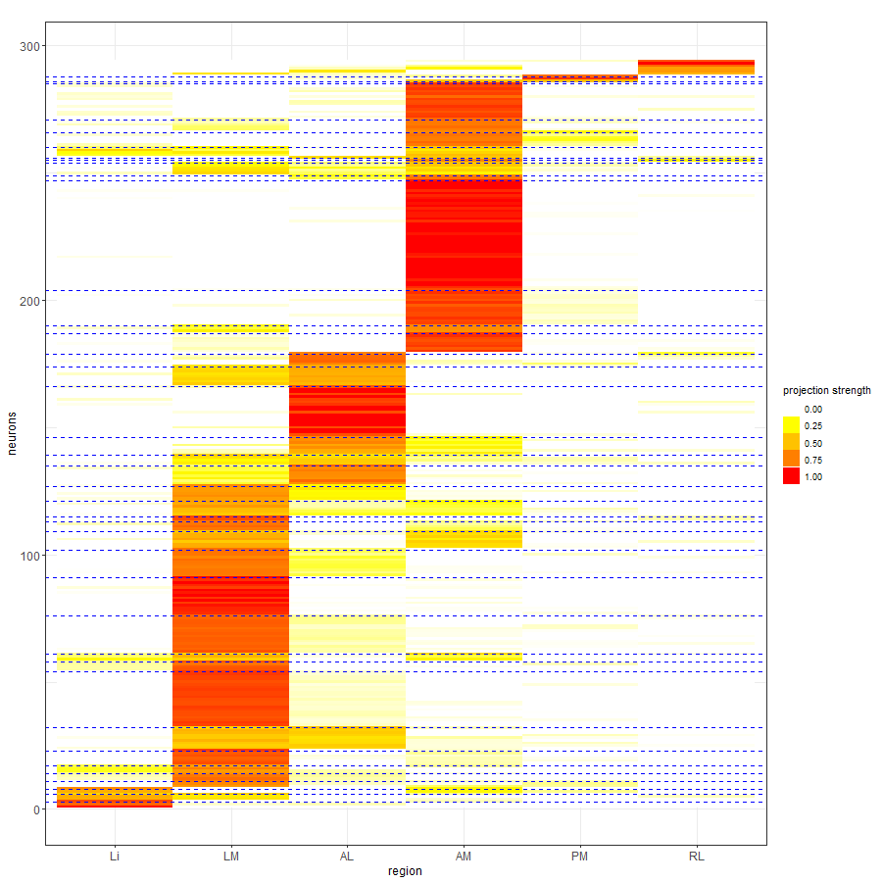
K-means with 40 clusters: Neurons are reordered by the k-means allocation.

Slide 18
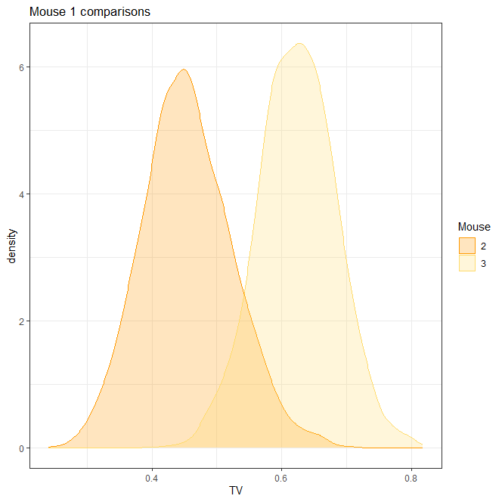
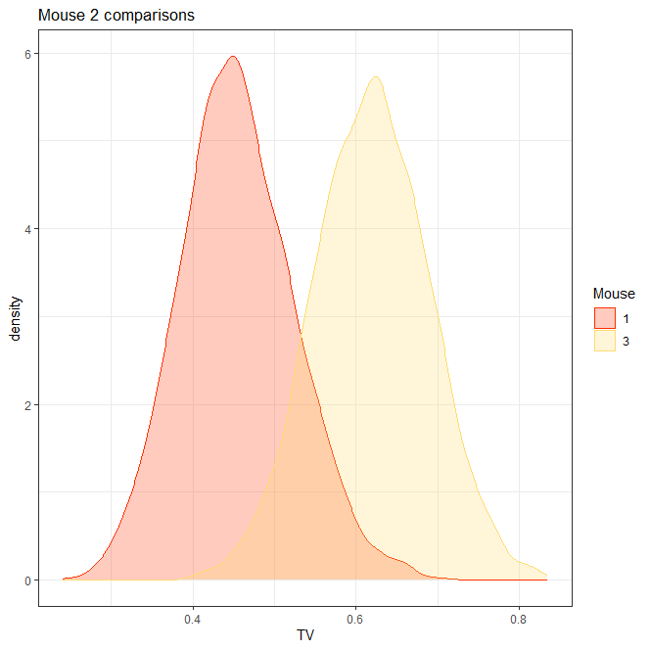
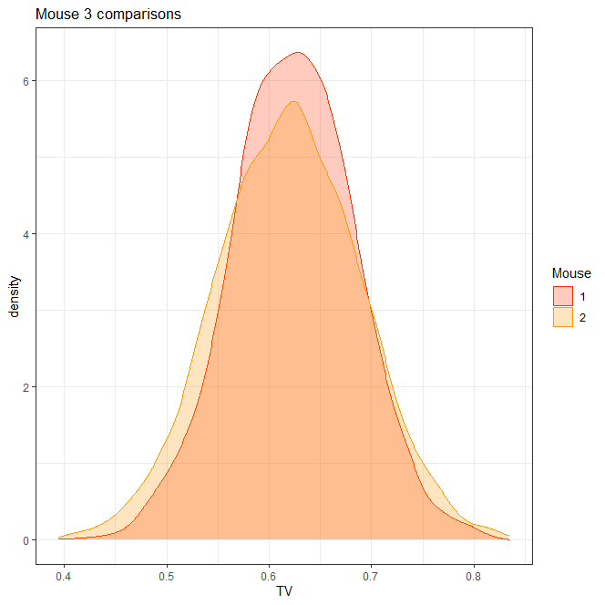

Slide 19
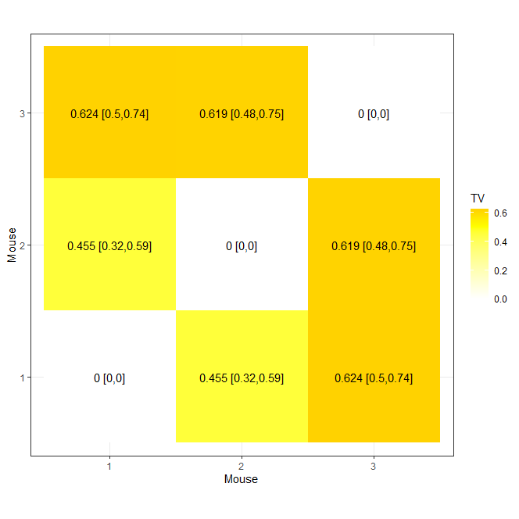

Slide 20
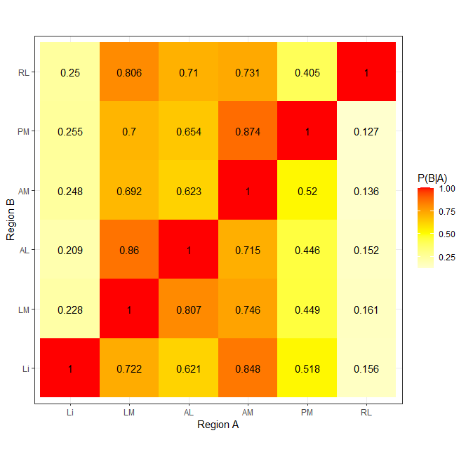
Posterior conditional projection probability (mouse 1)

Slide 21
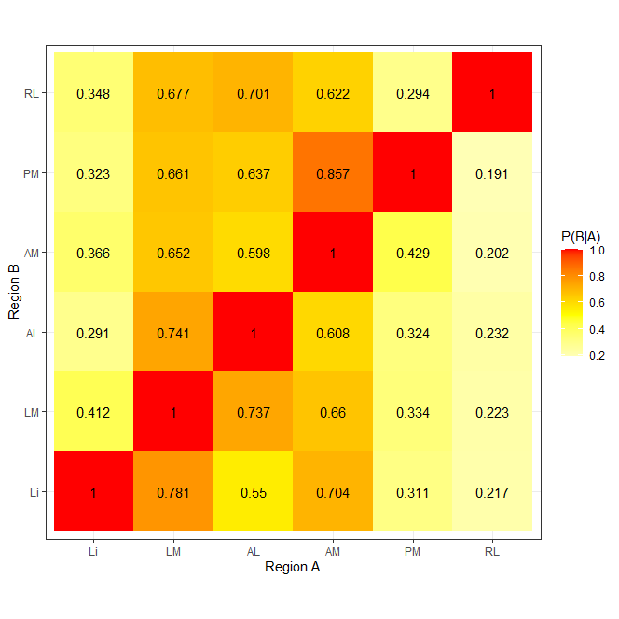
Posterior conditional projection probability (mouse 2)

Slide 22
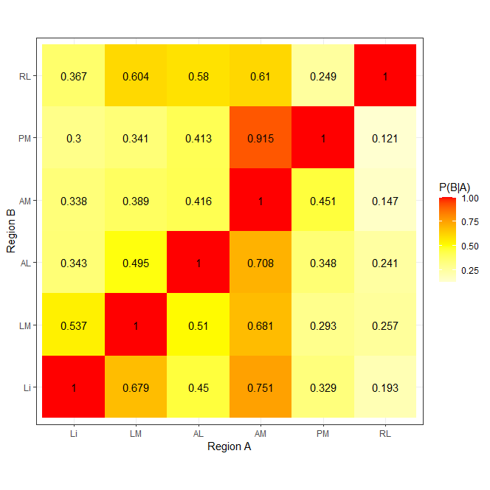
Posterior conditional projection probability (Mouse 3)

Slide 23
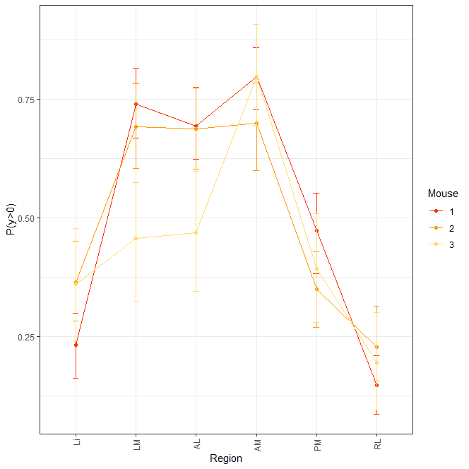
Posterior probability of projecting to a brain region

