Slide 1
Barseq data
Brain Regions:
OFC
Motor
Rstr
SSctx
Cstr
Amyg
VisIp
VisC
AudC
Thal
Tect

Slide 2
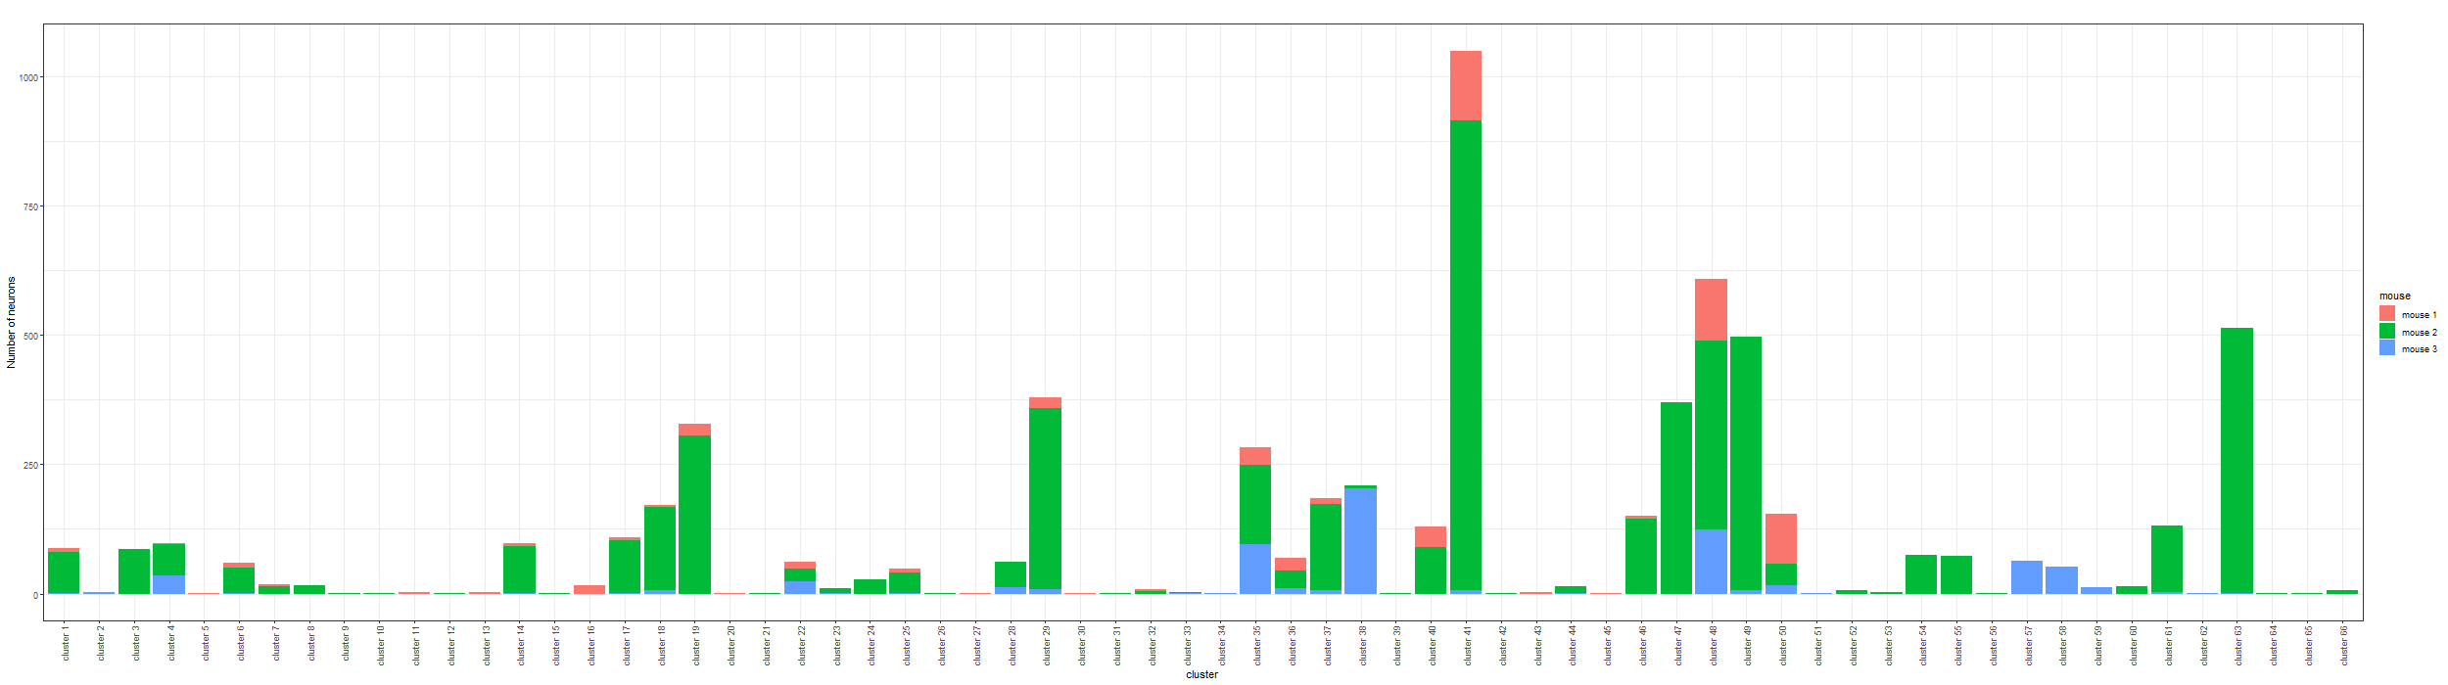
Bayesian Result – minVI to obtain point estimates of neuron allocations
There are 66 clusters (motifs) in total:

Slide 3
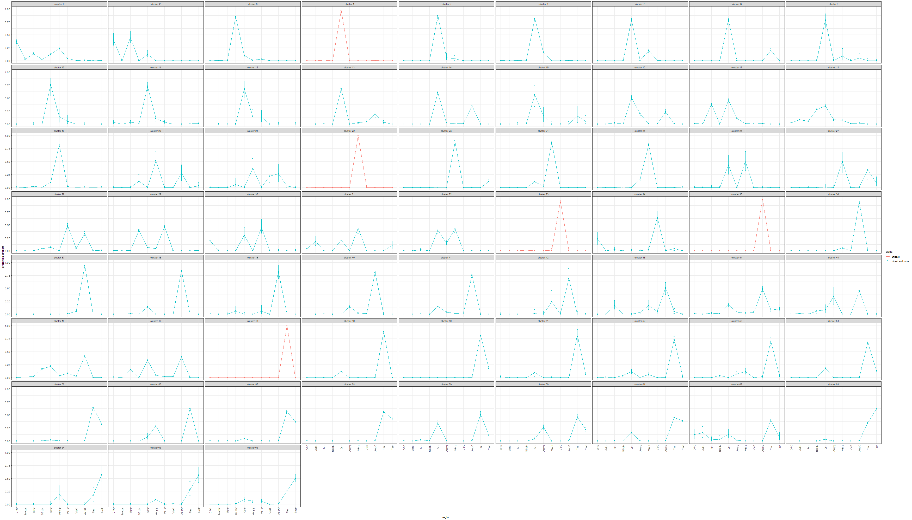
Estimated projection probability of neurons in each cluster with error-bars, color-coded by the number of projecting regions of each cluster:

Slide 4
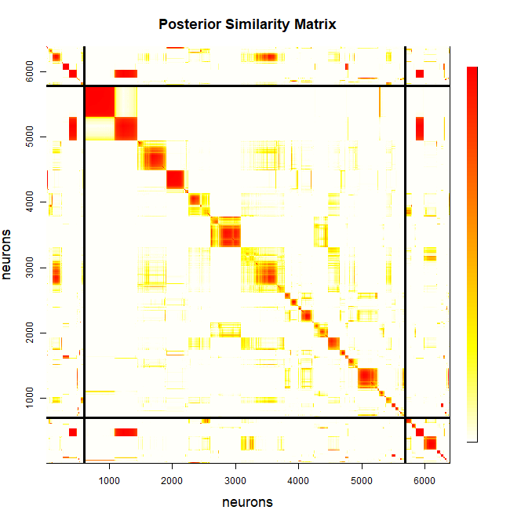
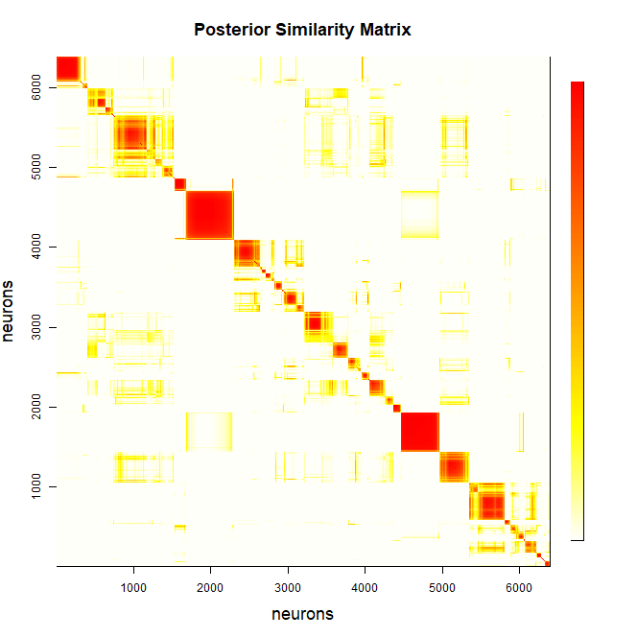

Slide 5
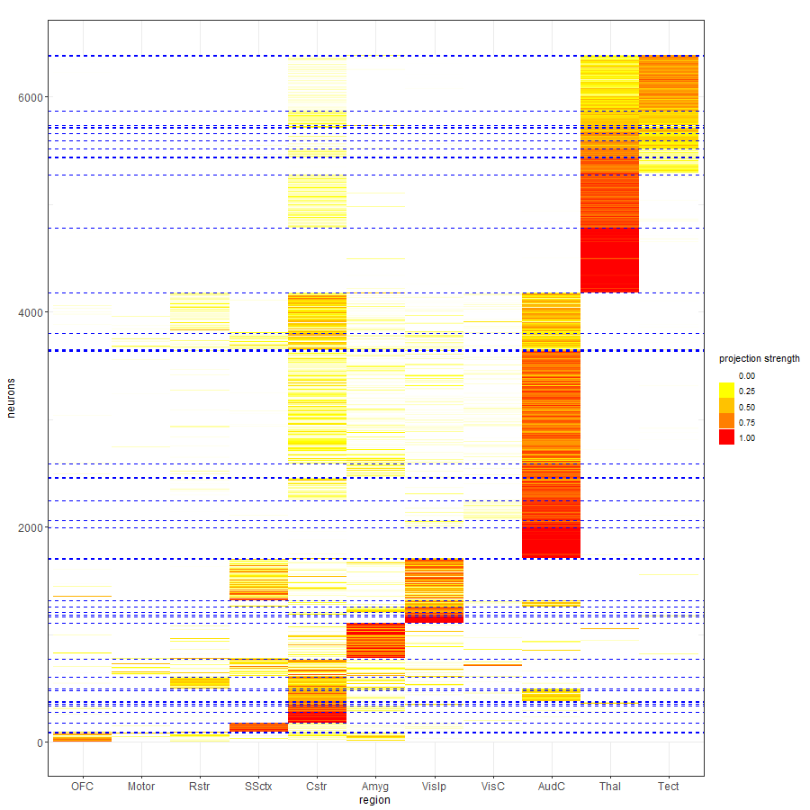

Slide 6
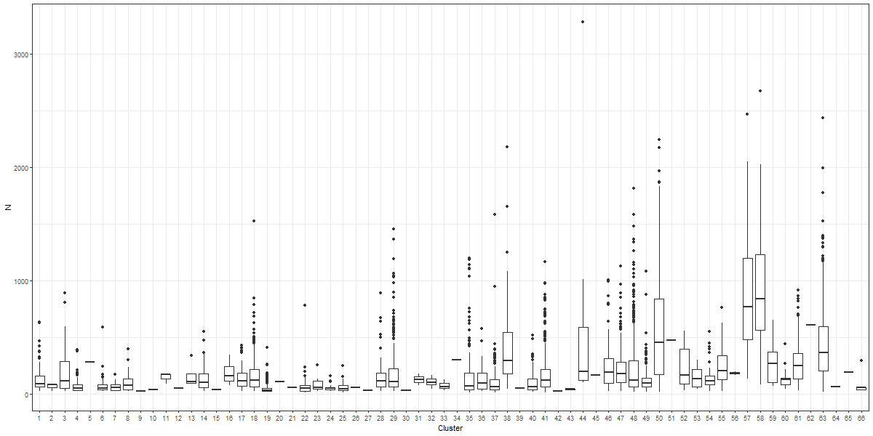
Distribution of the sum of counts across all brain regions for neurons within each cluster.

Slide 7
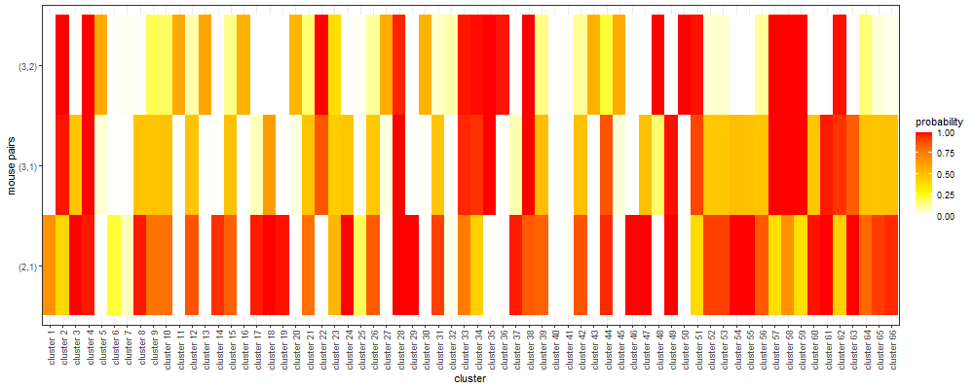
Comparison of allocation proportions across any two mice

Slide 8
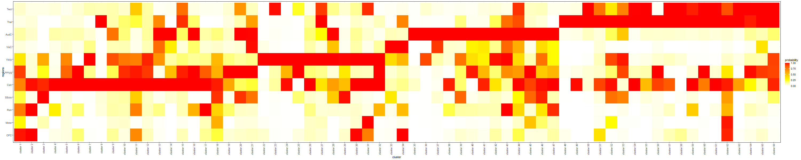
Probability of having the projection strength greater than 0.01 for each cluster and region:

Slide 9
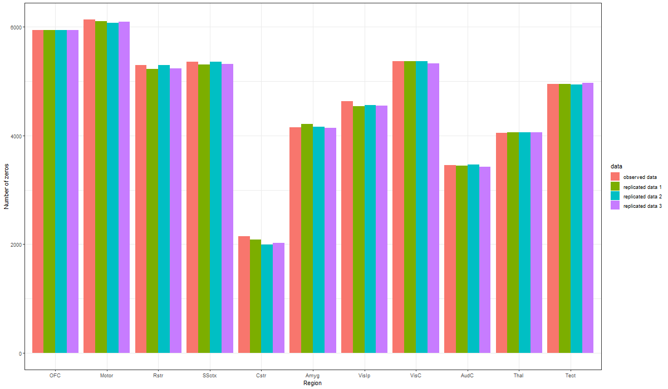
Posterior Predictive Checks: Comparing observed Barseq data against replicated data

Slide 10
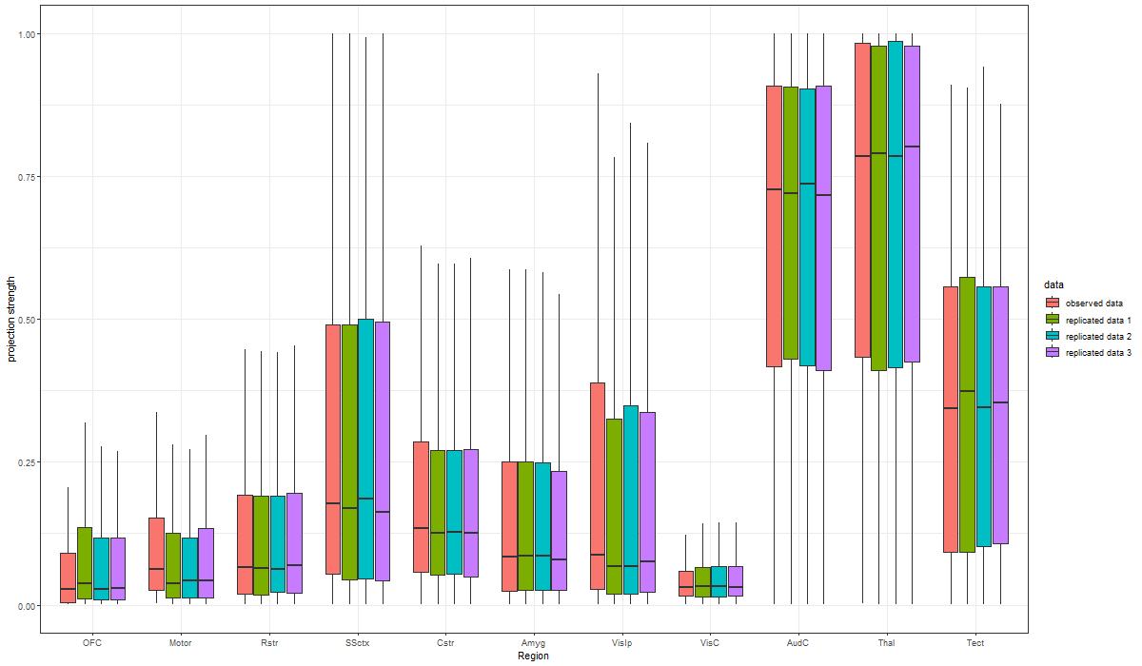

Slide 11
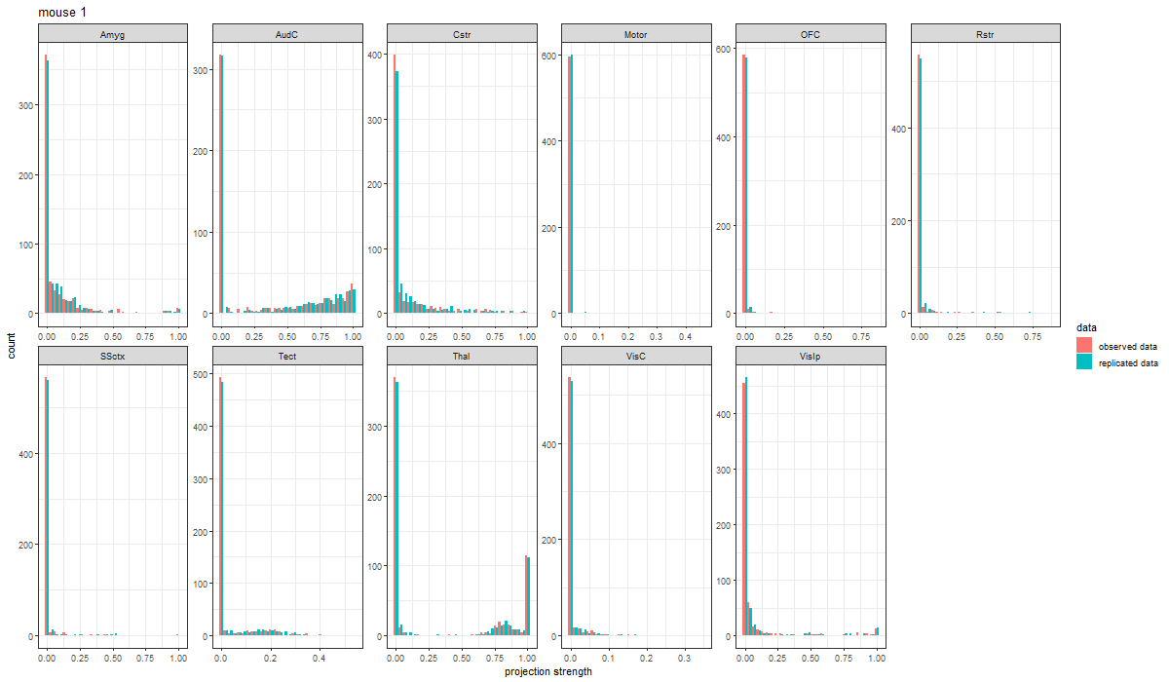
We can also carry out posterior predictive check with a single set of replicated data. Below we present the findings for mouse 1. The same comparison could be carried out to all the remaining mice as well.

Slide 12
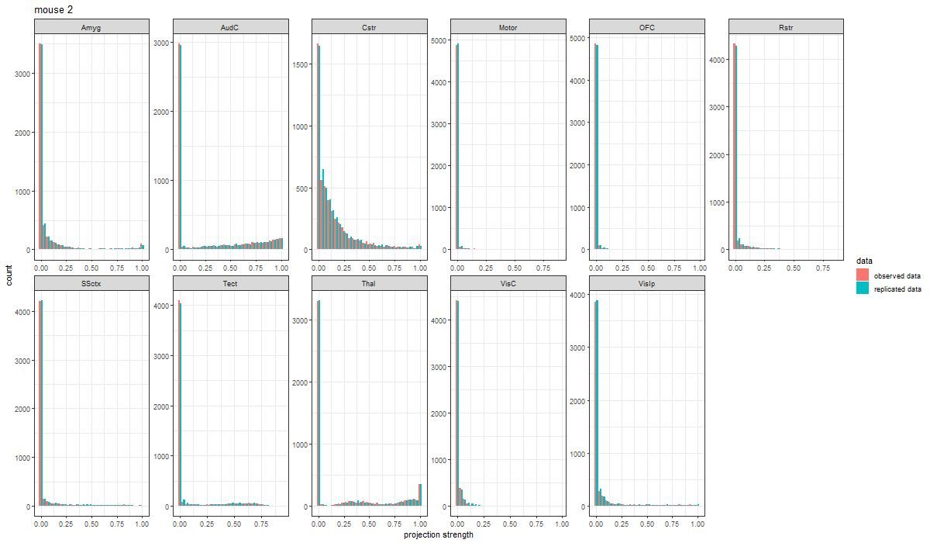

Slide 13
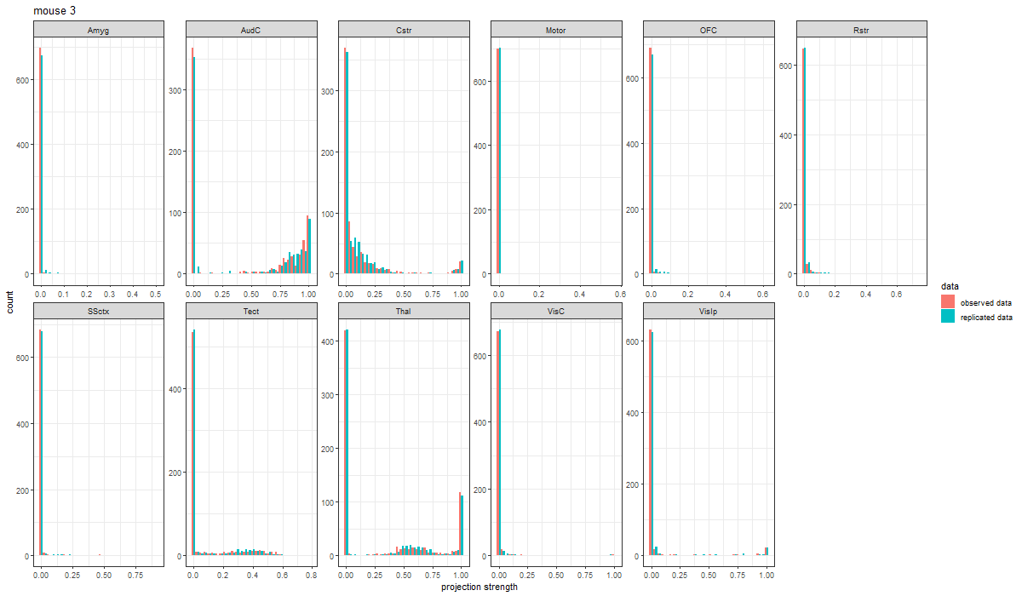

Slide 14
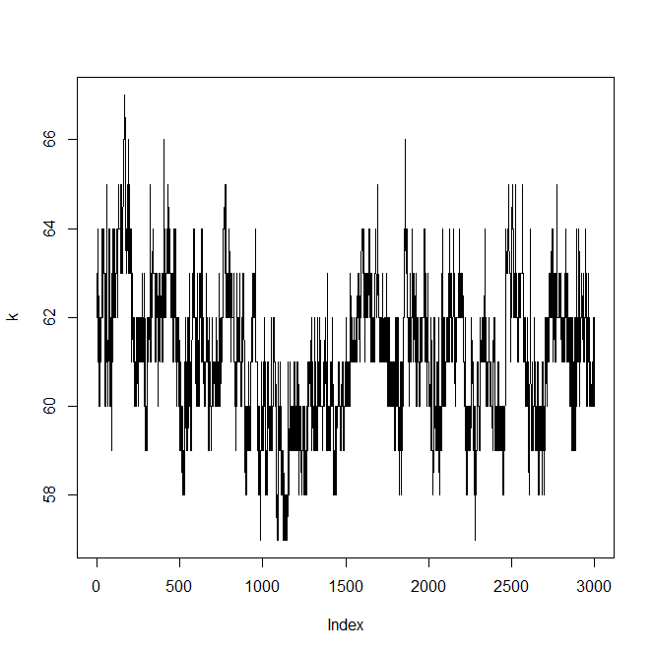
Trace of total number of clusters

Slide 15
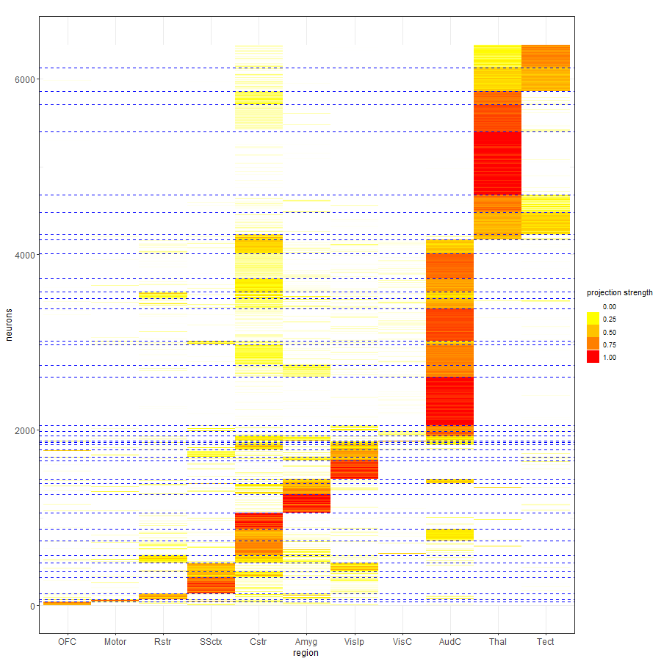
K-means with 40 clusters: Neurons are reordered by the k-means allocation.

Slide 16
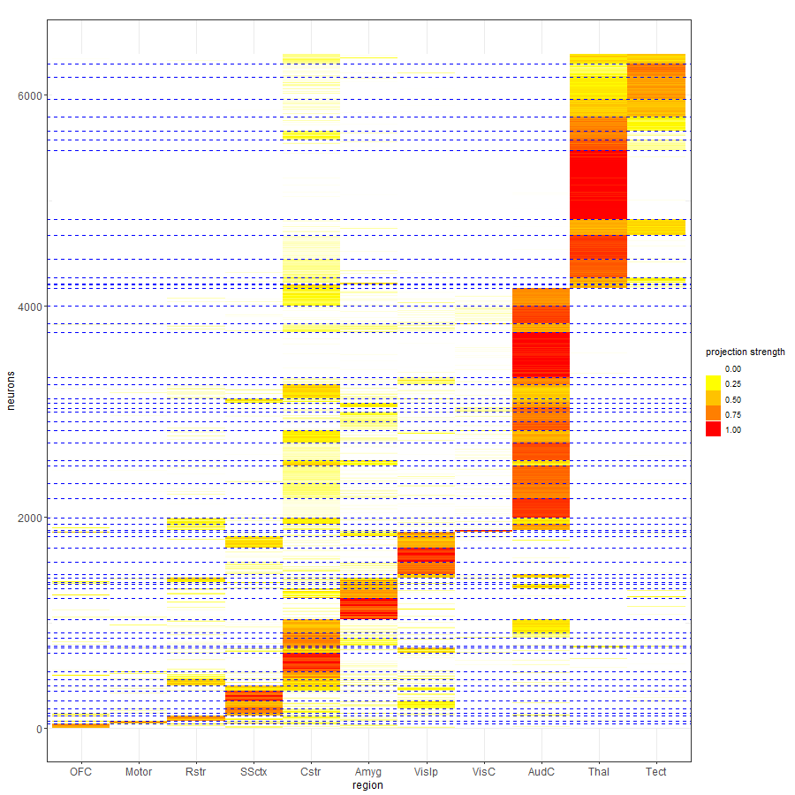
K-means with 60 clusters: Neurons are reordered by the k-means allocation.

Slide 17
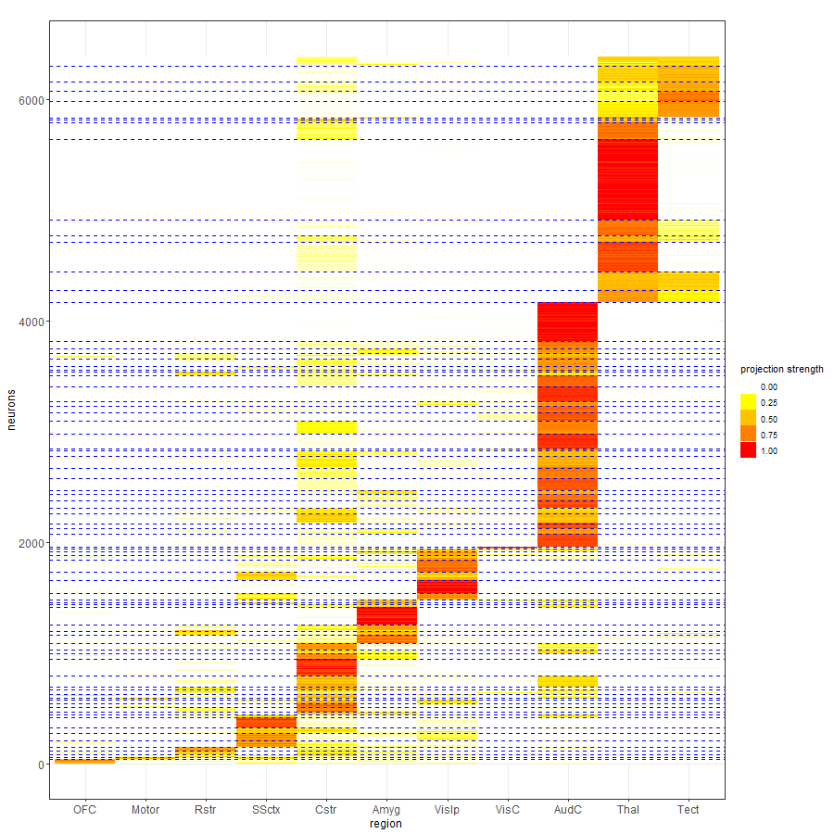
K-means with 80 clusters: Neurons are reordered by the k-means allocation.

Slide 18
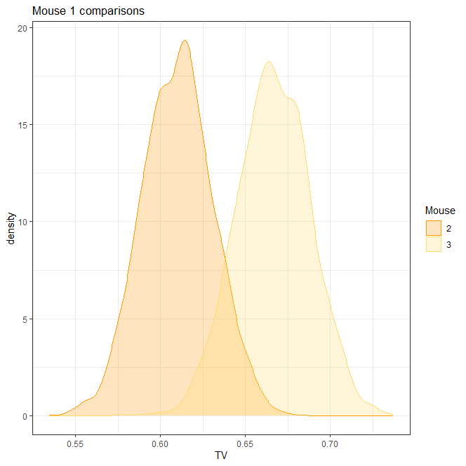
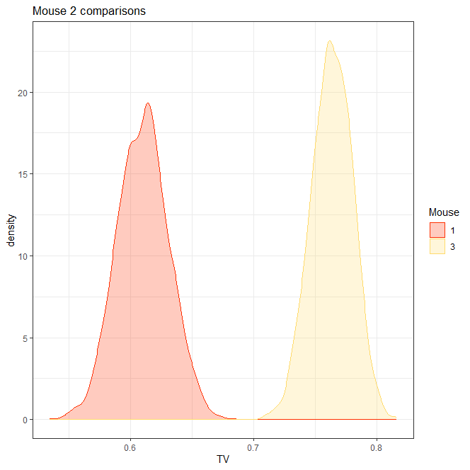
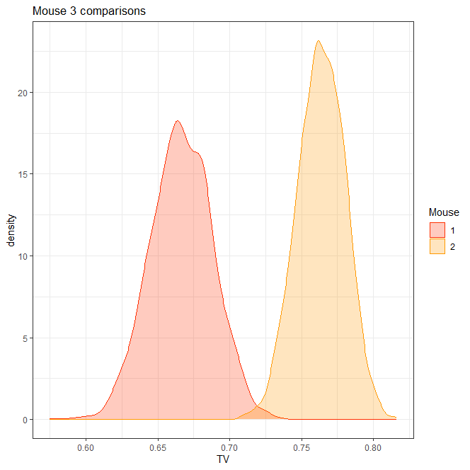

Slide 19
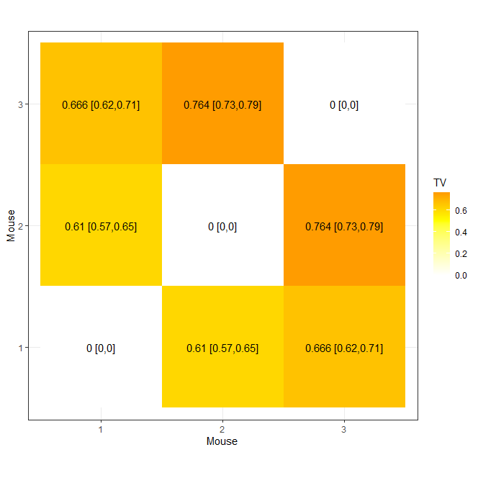

Slide 20
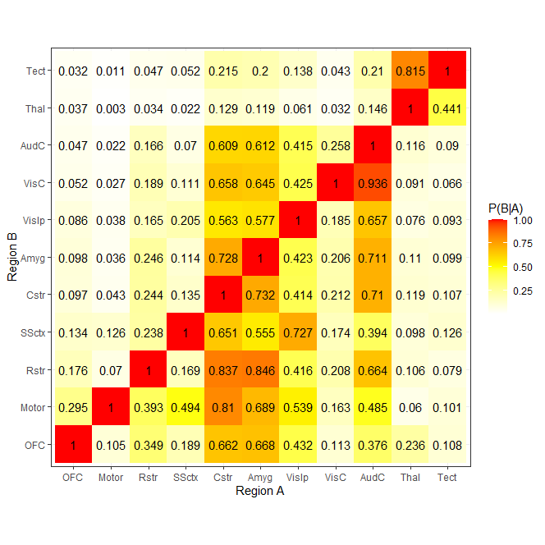
Conditional probability of projecting to region B, given it projects to region A, for mouse 1

Slide 21
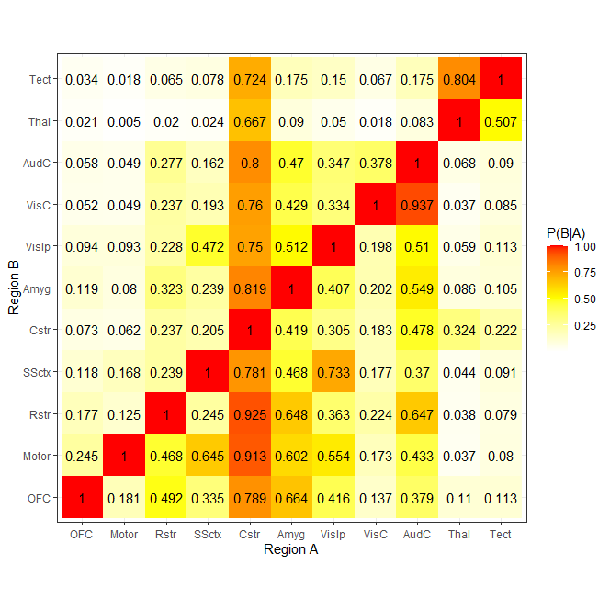

Slide 22
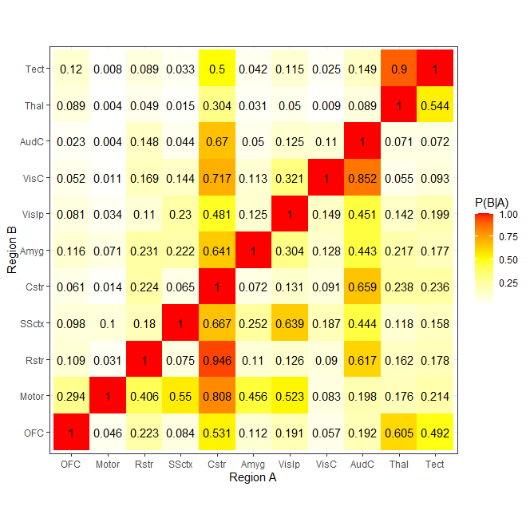

Slide 23
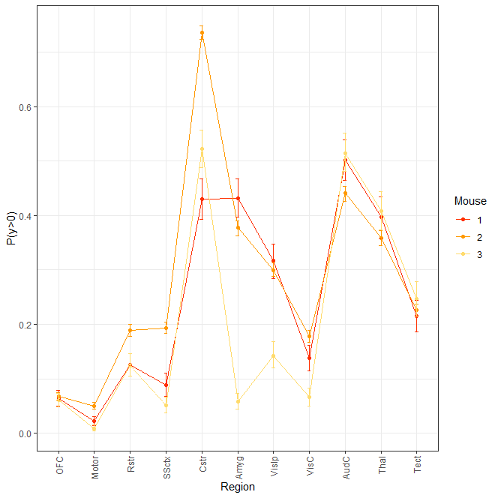
Probability of projecting to a brain region for each mouse

