Slide 1
EC data – new
Brain regions:
PFC
ORB
MO
SS
ACA
PTL
VIS
RSC

Slide 2
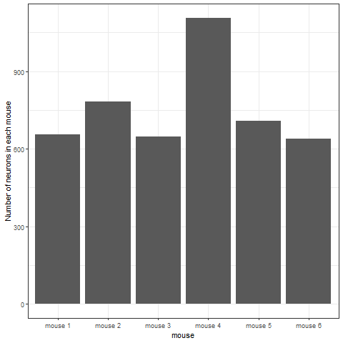
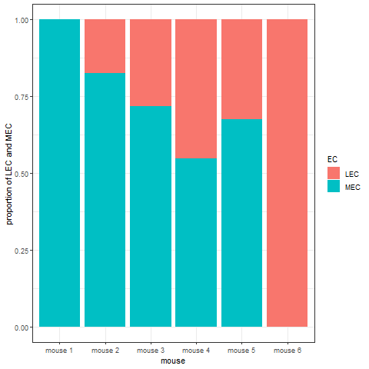

Slide 3
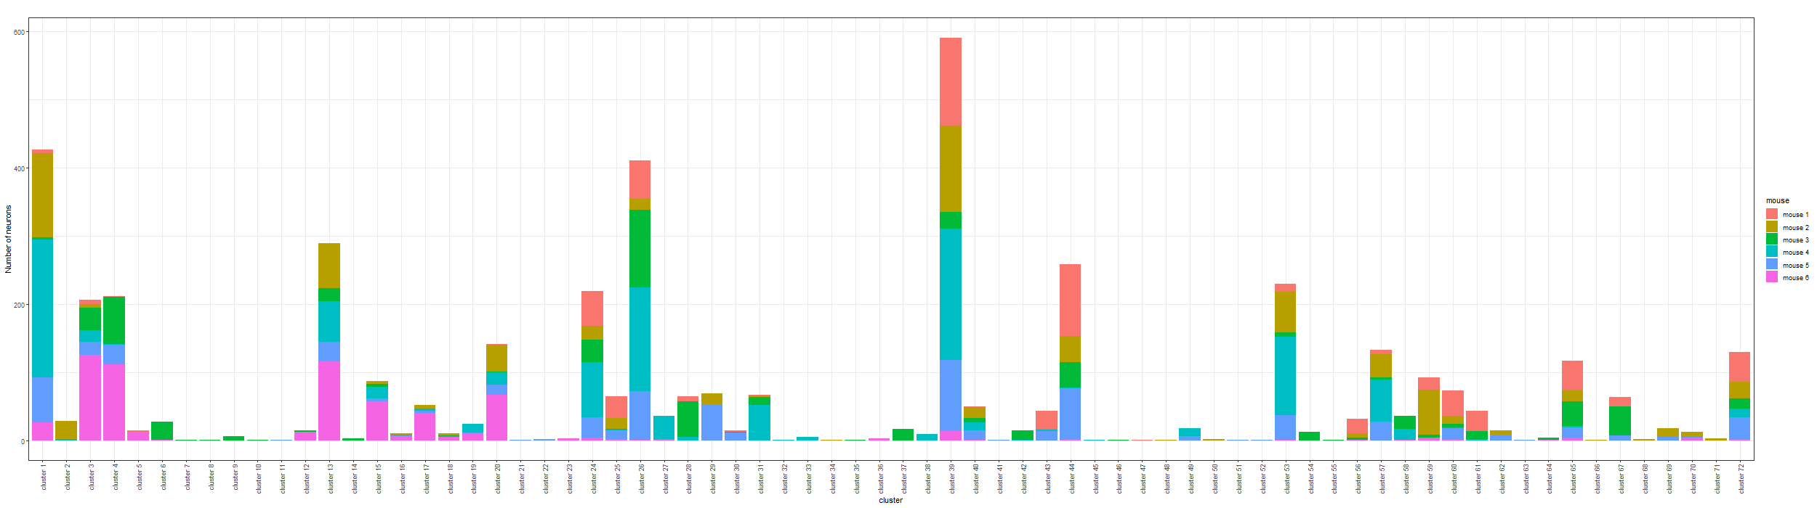
Bayesian Result
There are 72 clusters (motifs) in total:

Slide 4
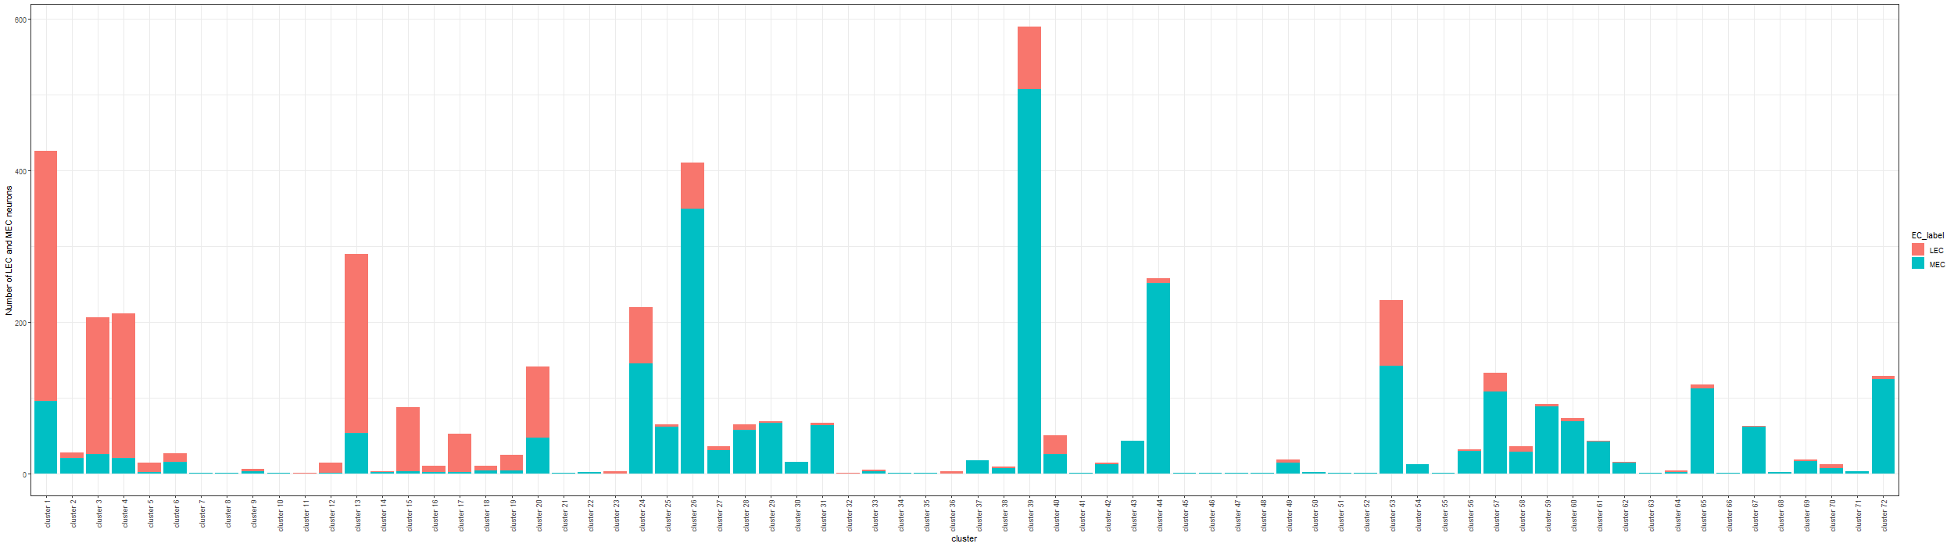
Total number of LEC and MEC neurons in each cluster:

Slide 5
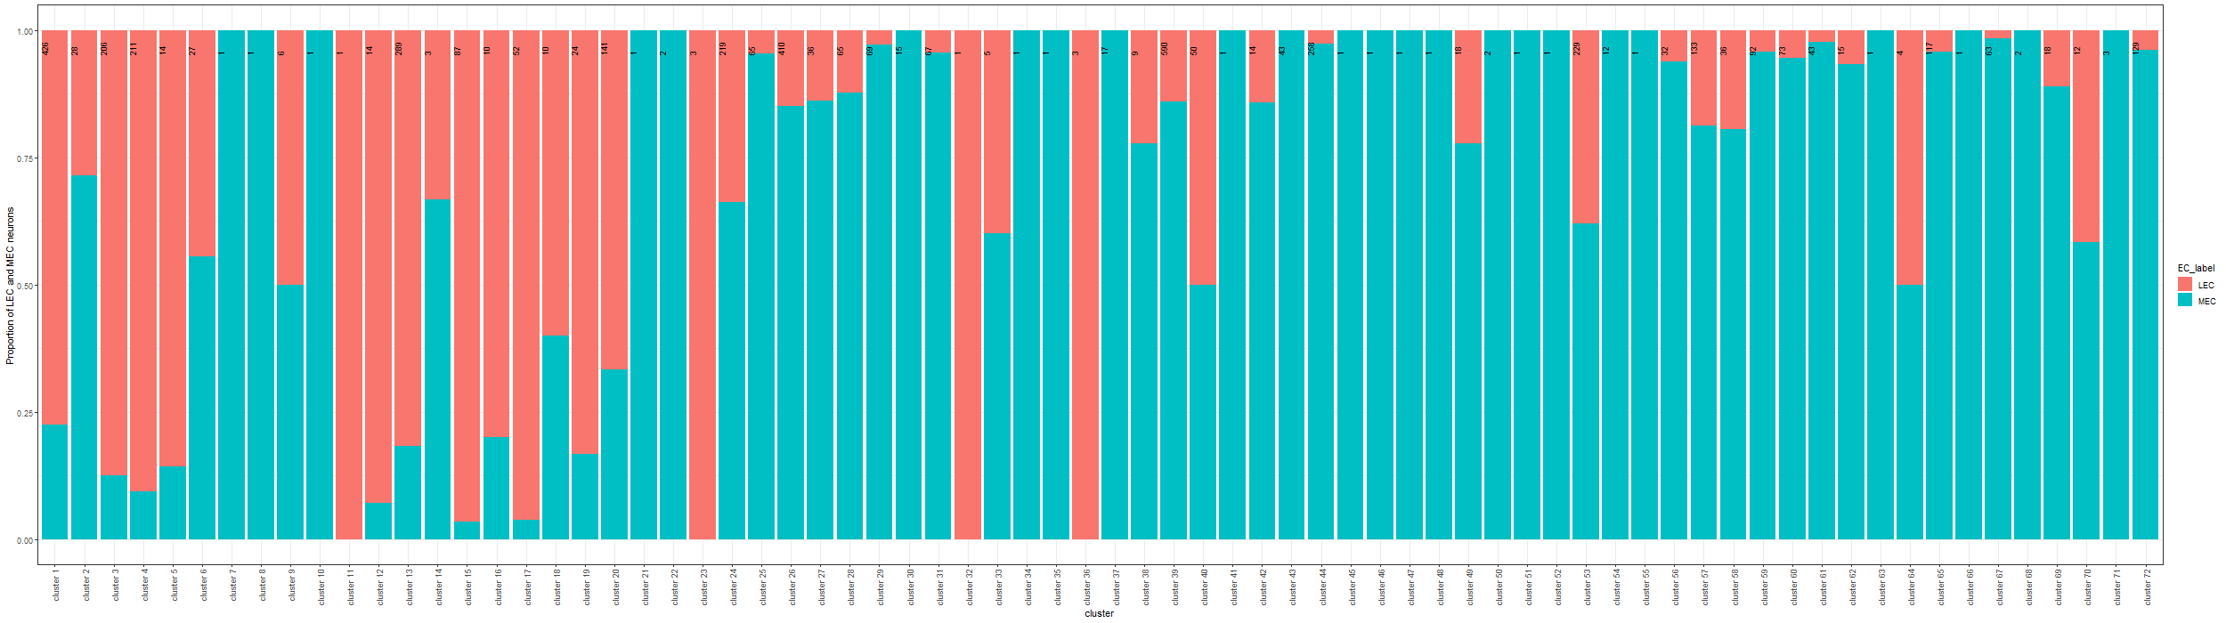
Proportion of LEC and MEC neurons in each cluster:

Slide 6
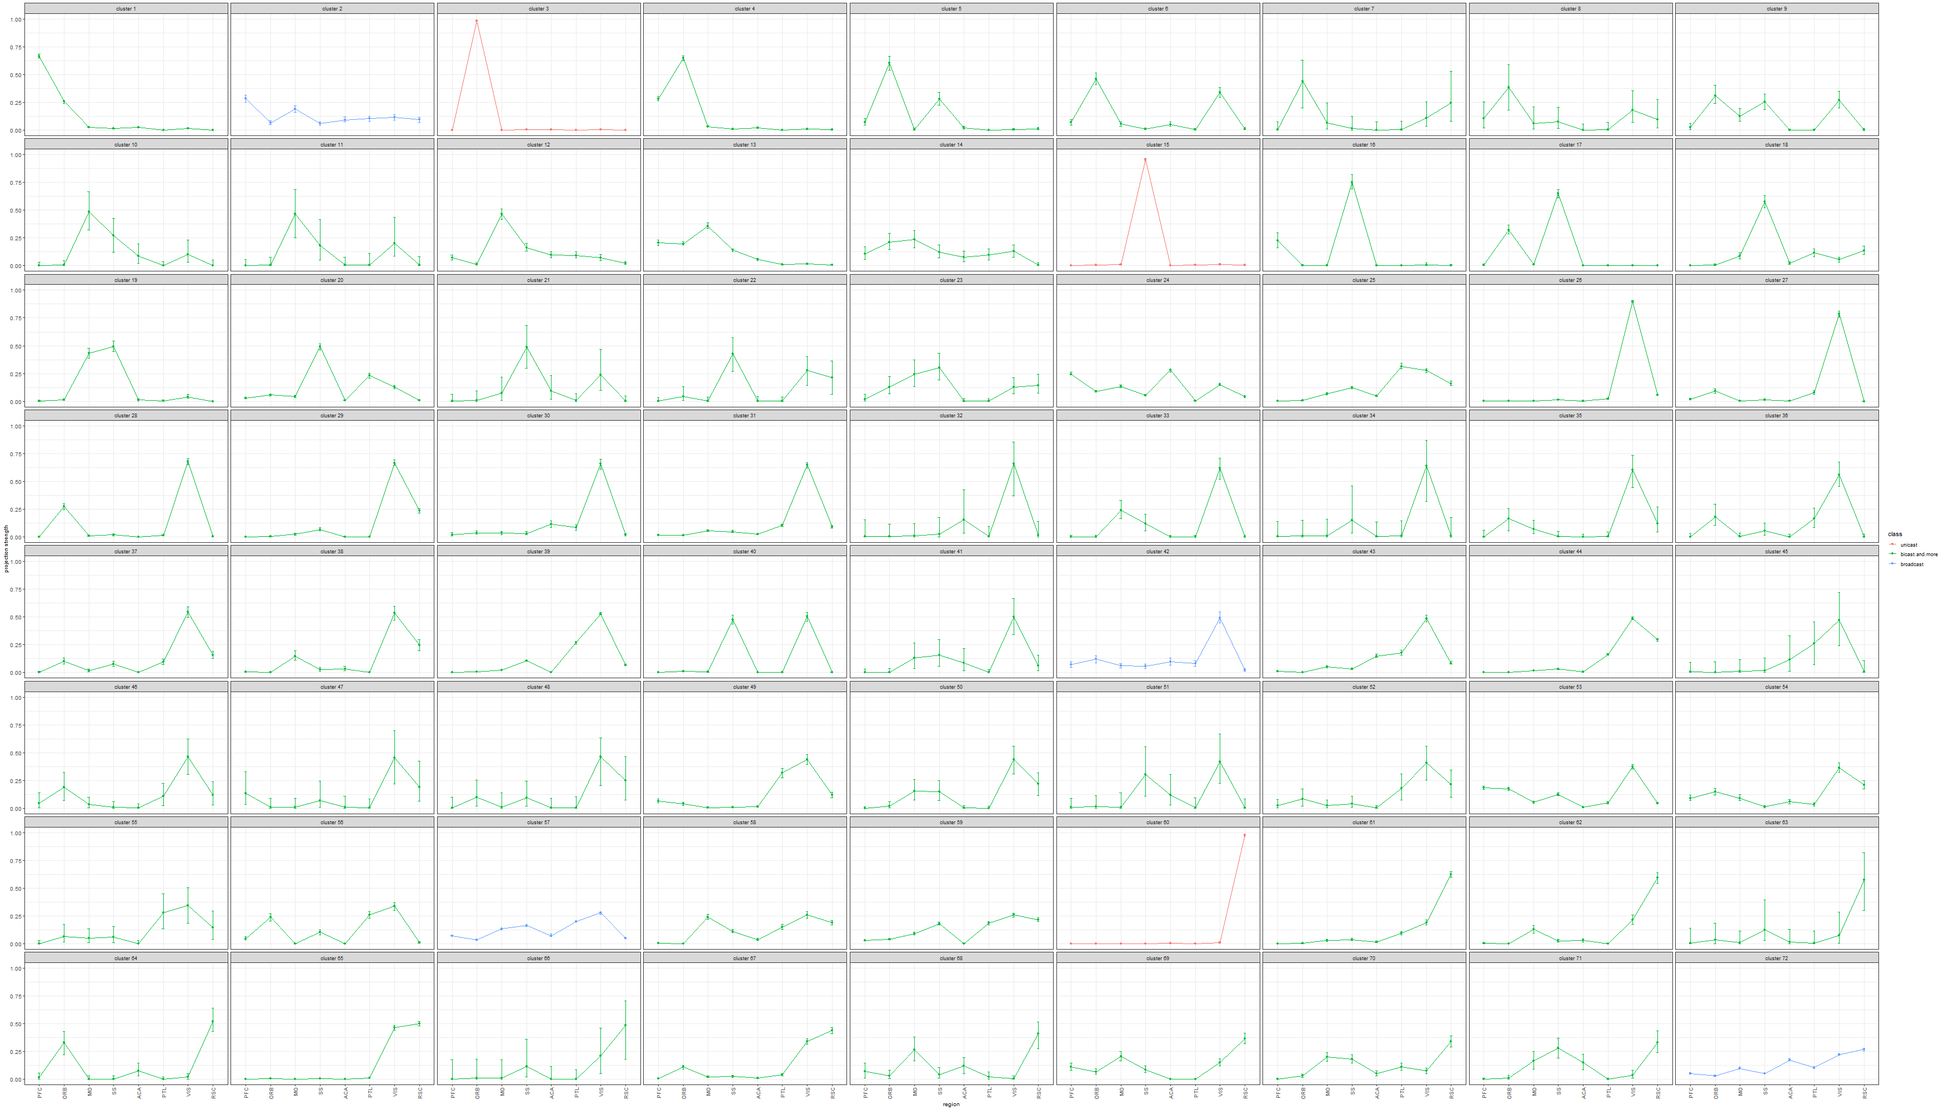
Estimated projection probability of neurons in each cluster with error-bars, color-coded by the number of projecting regions of each cluster:

Slide 7
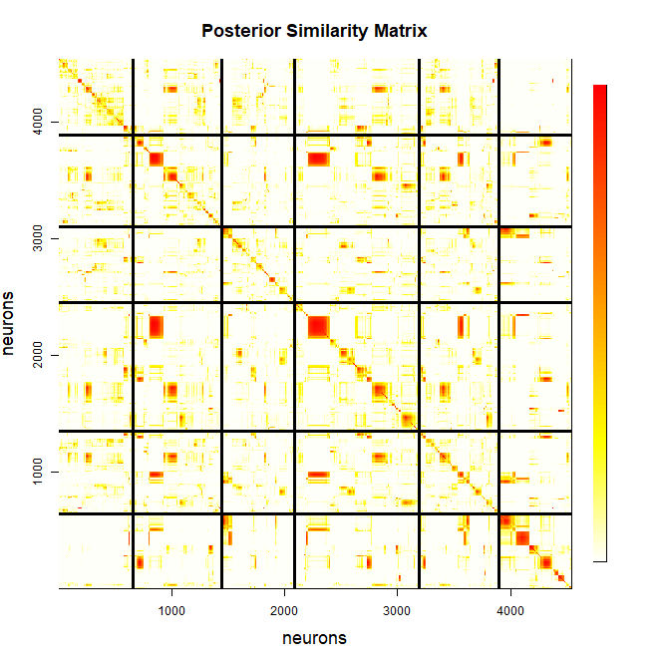
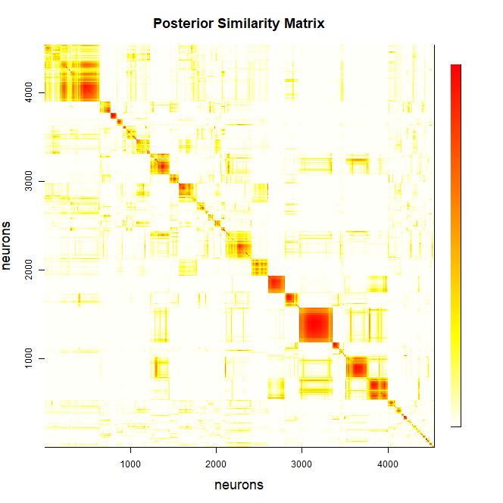
Heatmap of posterior similarity matrix

Slide 8
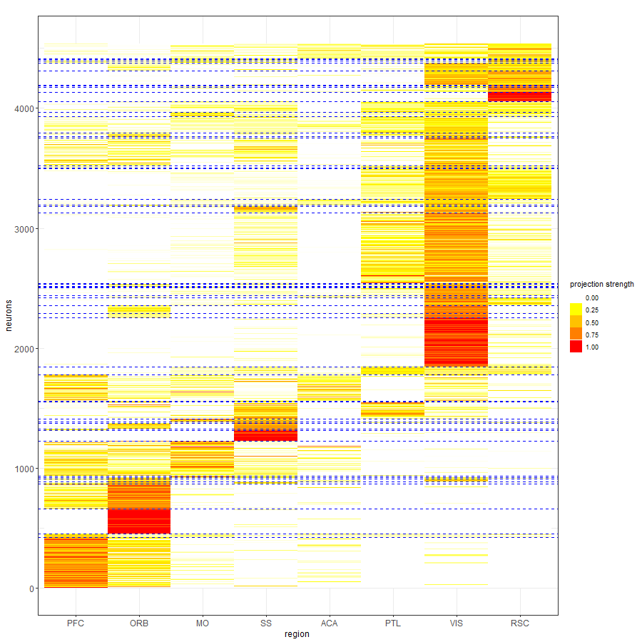
Projection strength of neurons, reordered by the allocations.

Slide 9
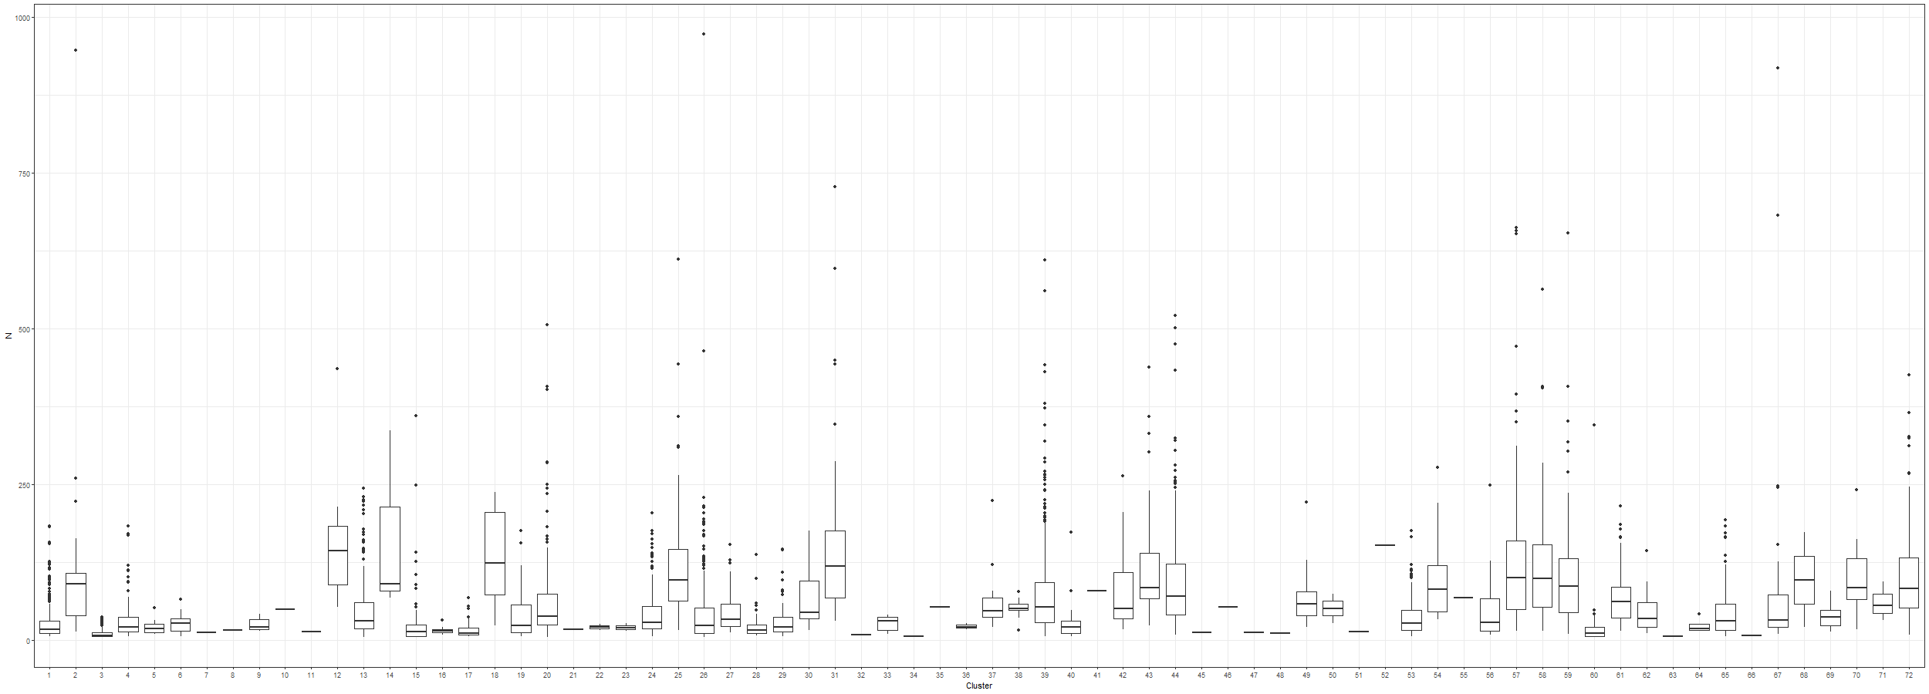
Distribution of the sum of counts across all brain regions for neurons within each cluster:

Slide 10
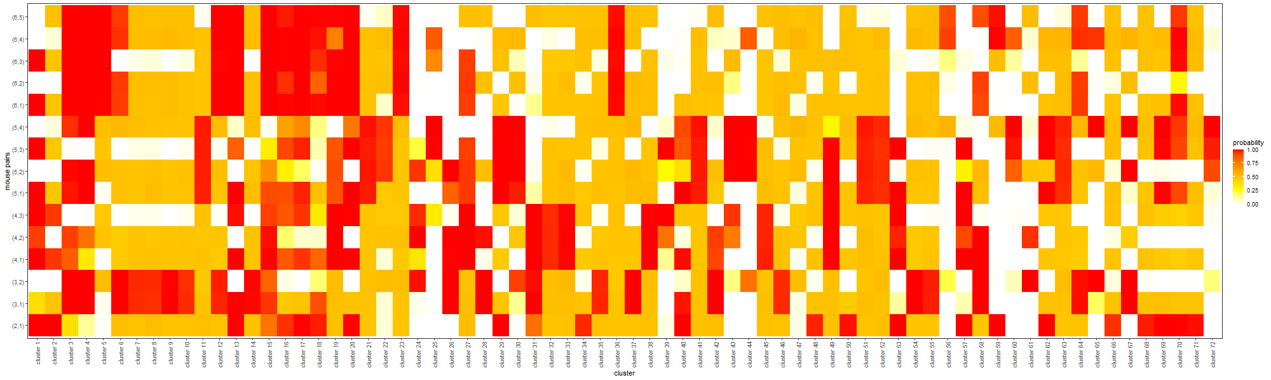
Comparison of allocation proportions across any two mice:

Slide 11
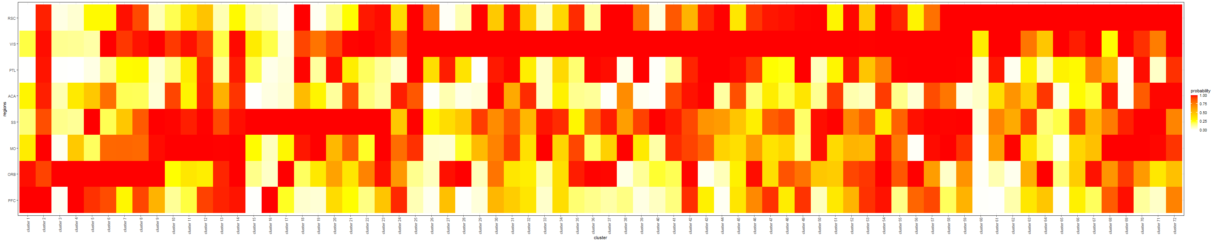
Probability of having the projection strength greater than 0.01 for each cluster and region:

Slide 12
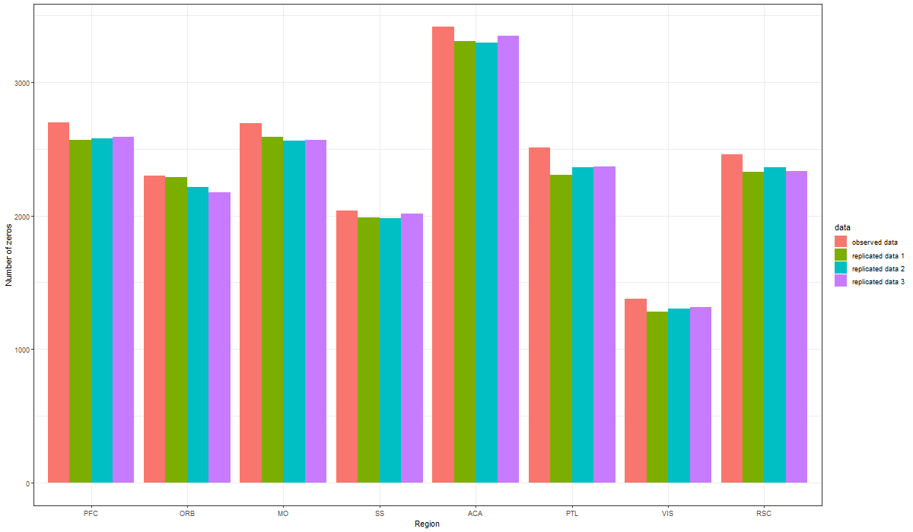
Posterior predictive check with three replicated datasets: (number of zeros of each region). This is used to assess the fit of the model to the data.

Slide 13
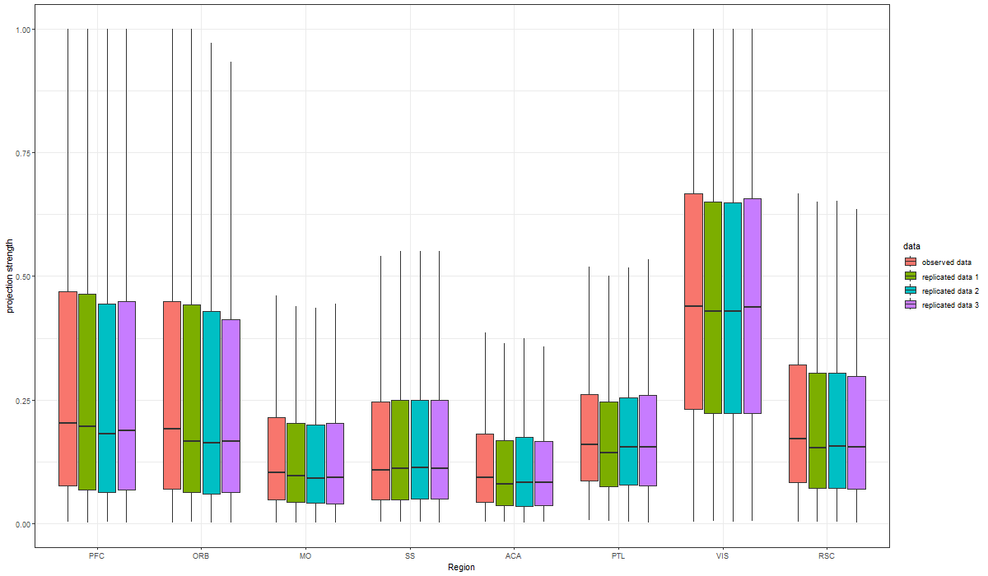
Distribution of non-zero projection strengths for the observed and replicated data.

Slide 14
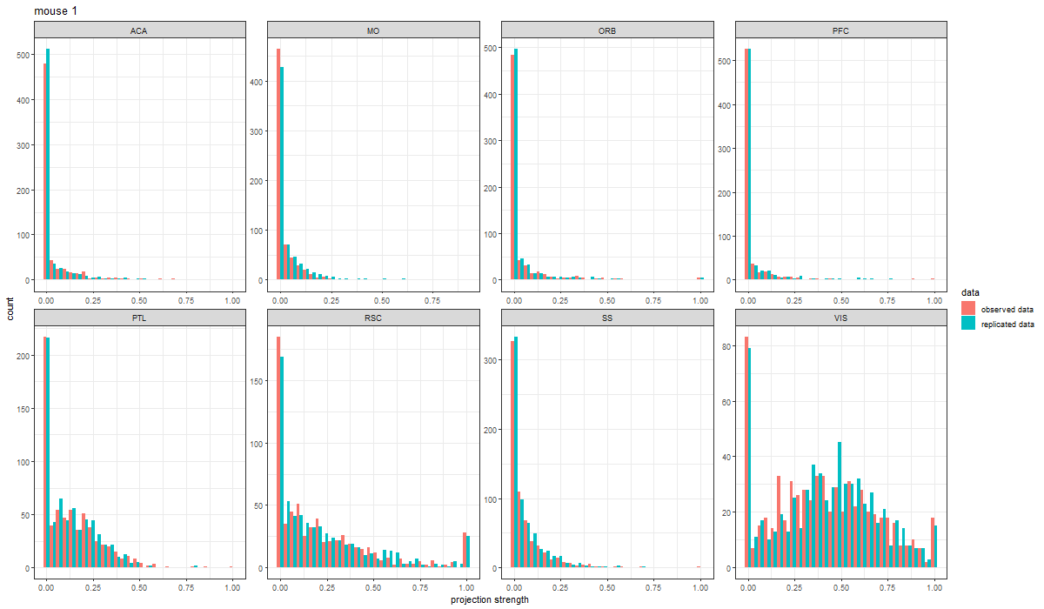
We can also carry out posterior predictive check with single replicated dataset. Figure below compares the distribution of projection strengths of neurons in mouse 1.

Slide 15
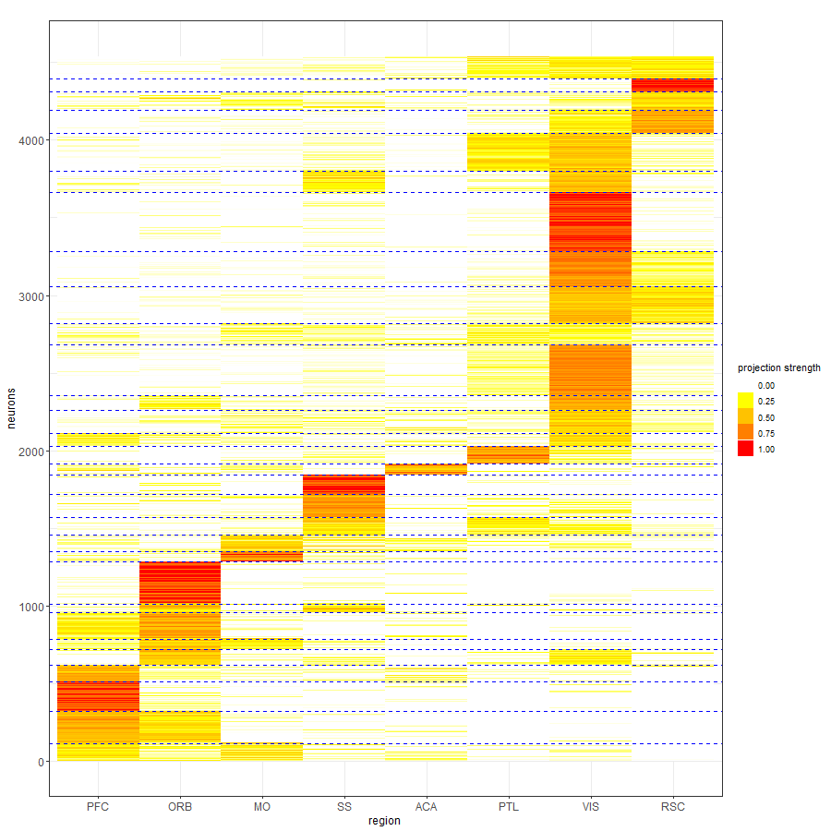
k-means with 30 clusters

Slide 16
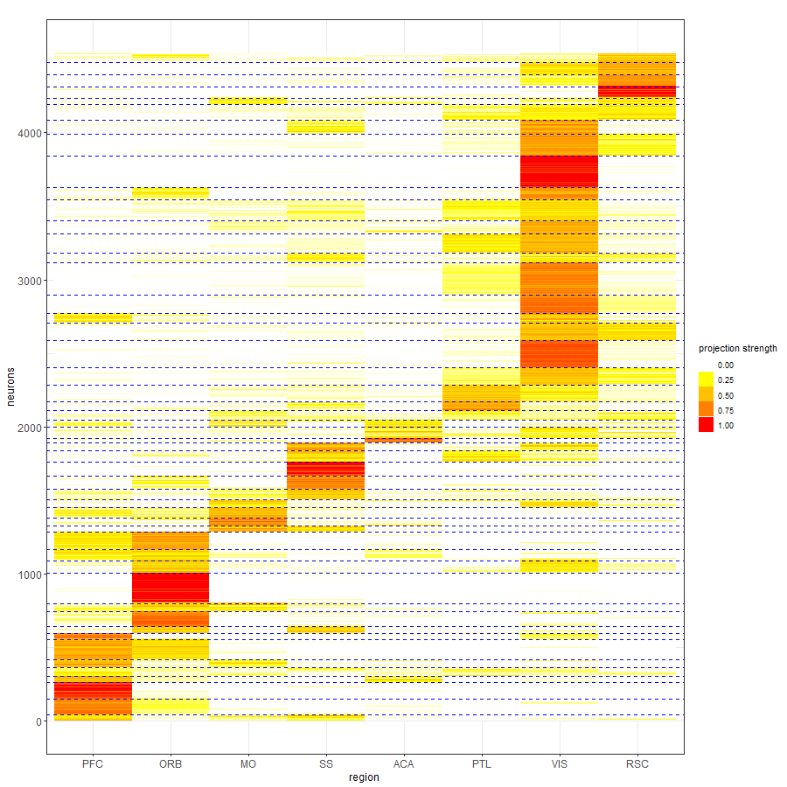
k-means with 50 clusters

Slide 17
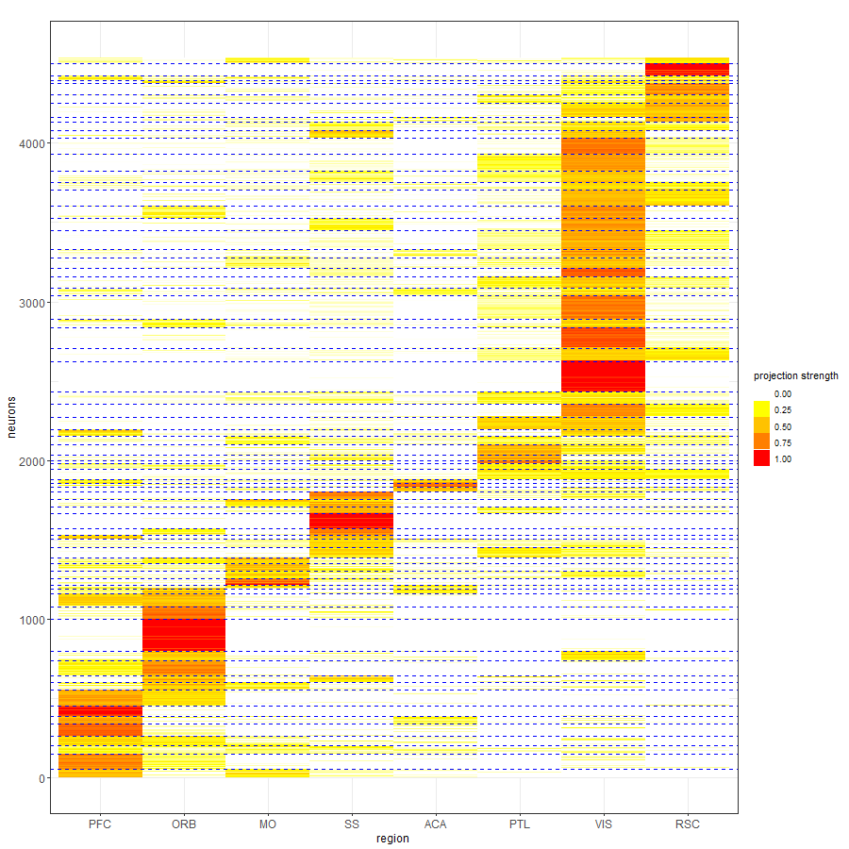
k-means with 70 clusters

Slide 18
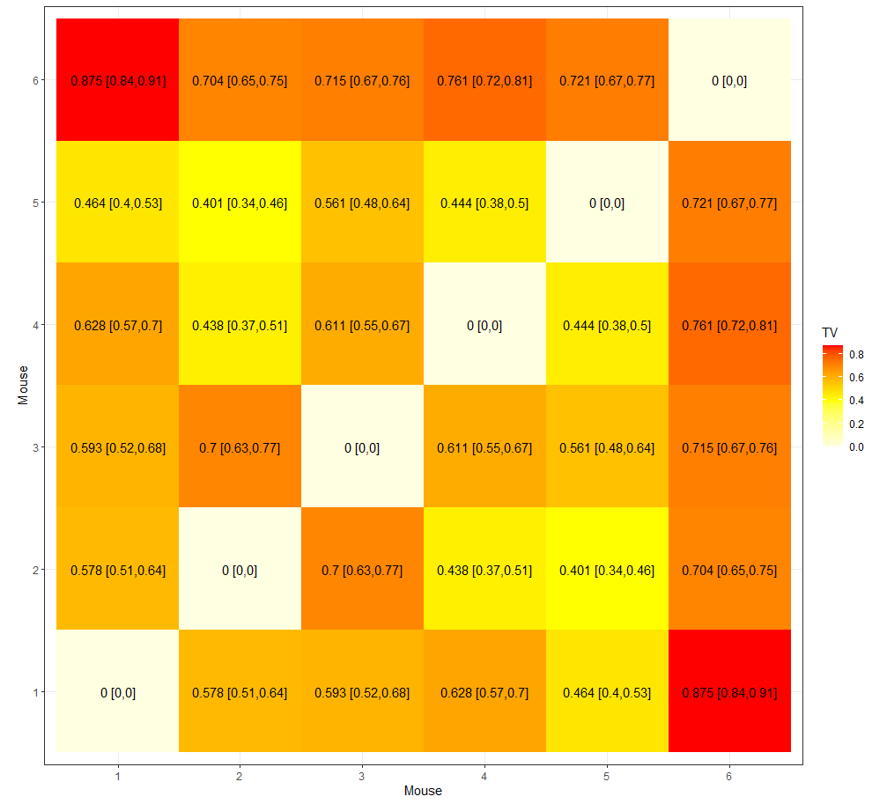
Posterior expected total variation distance between the mixing measures for all mouse pairs:
Ranges from 0 and 1, with 0 for equivalence and 1 if there is no overlap in the support (i.e. no overlap in the projection motifs)

Slide 19
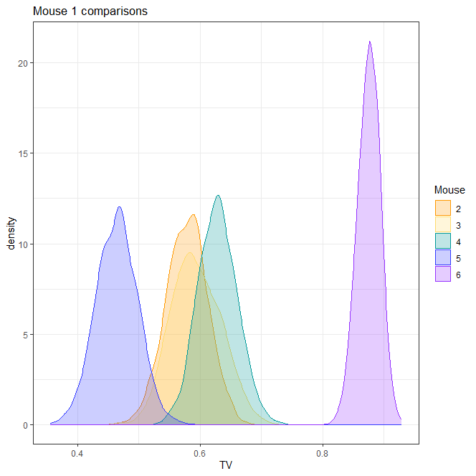
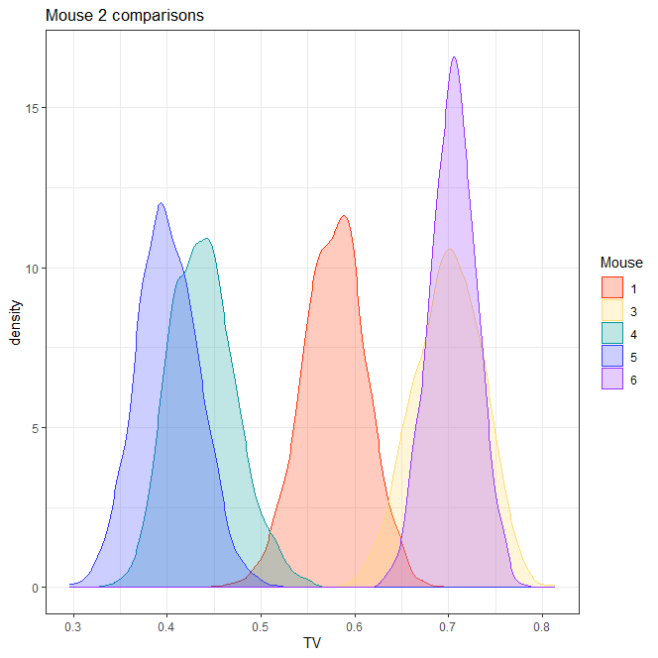
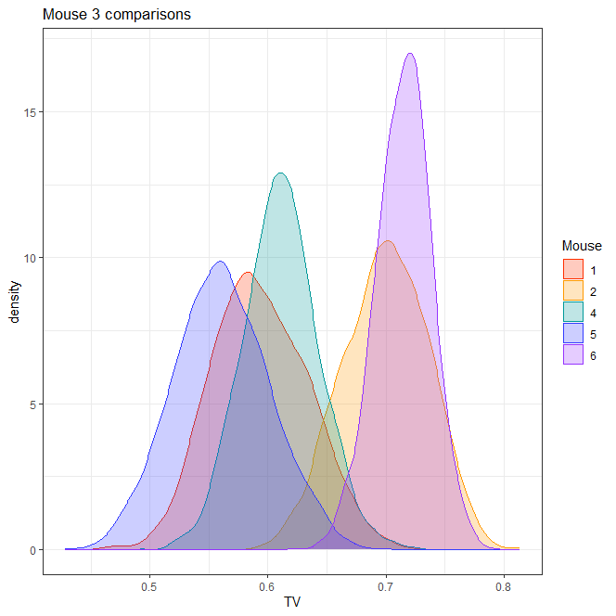
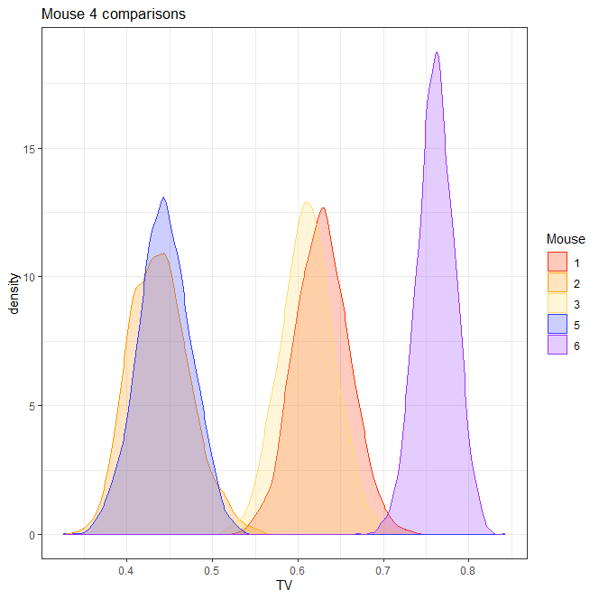
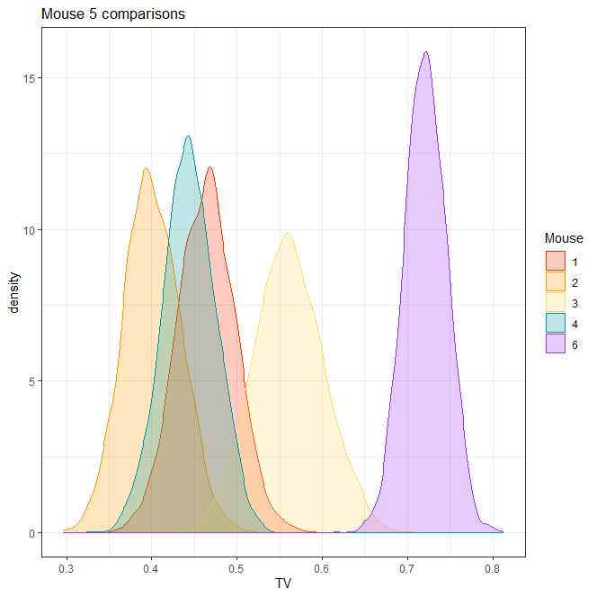
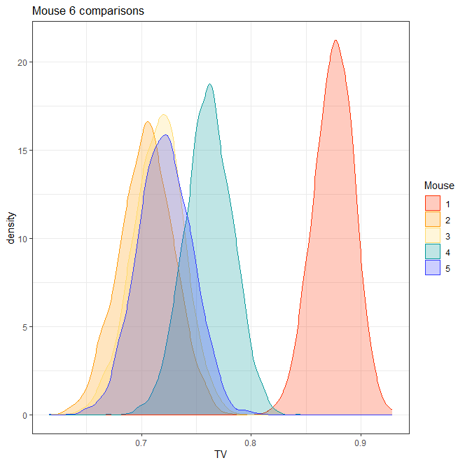

Slide 20
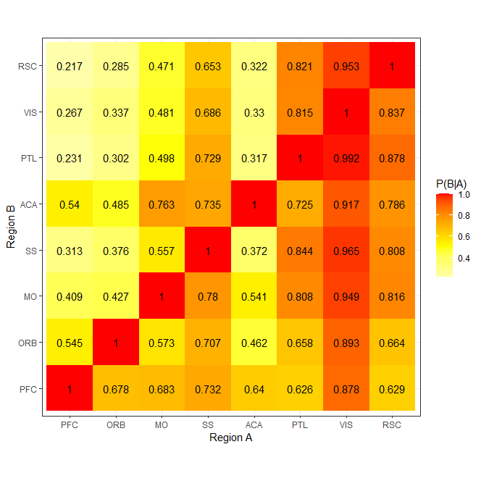
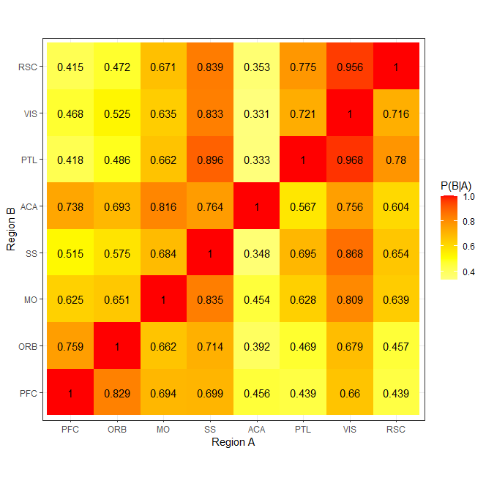
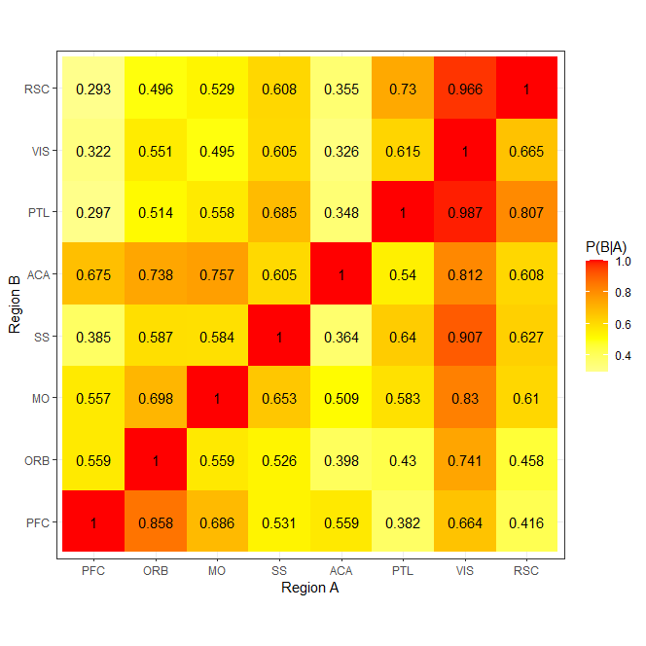
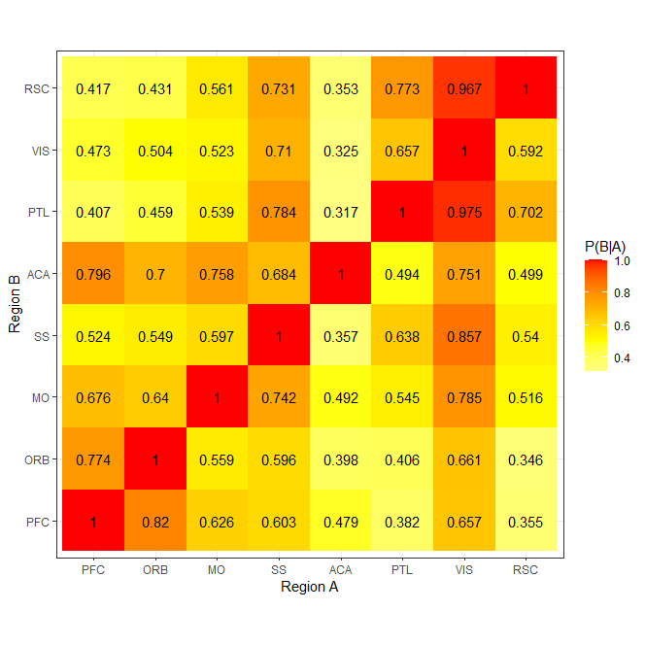
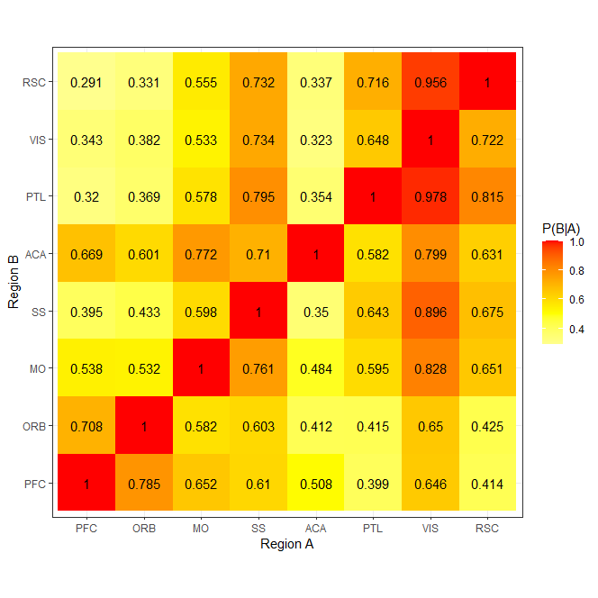
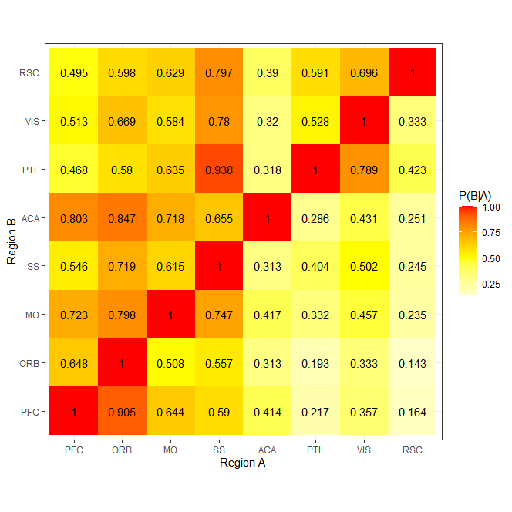
Posterior probability of projecting to region B given it projects to region A

Slide 21
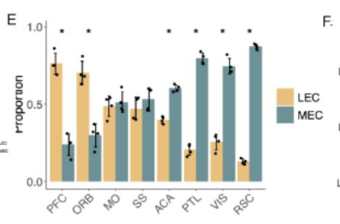
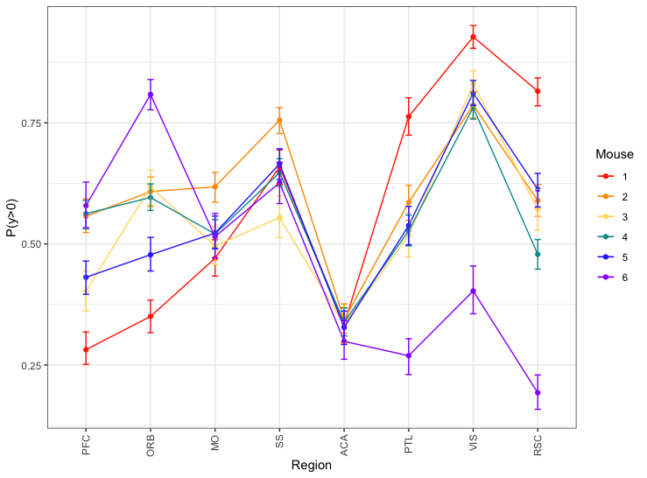
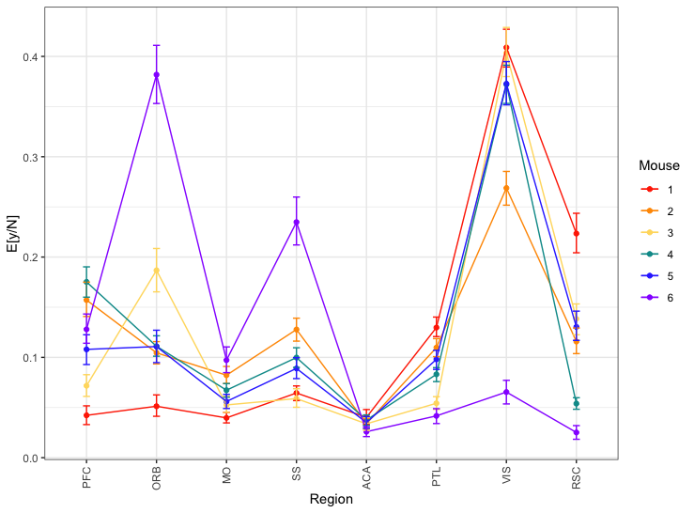

Slide 22
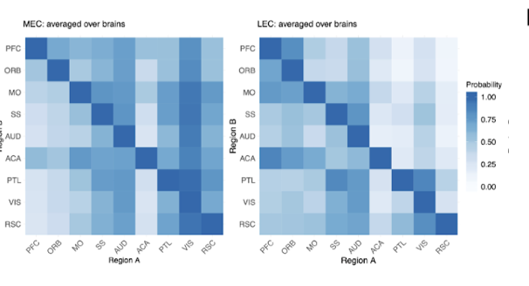
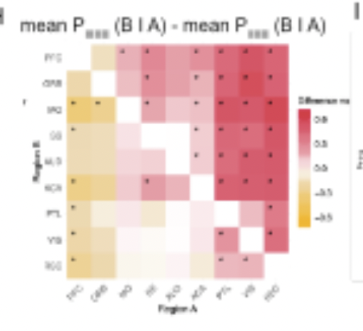
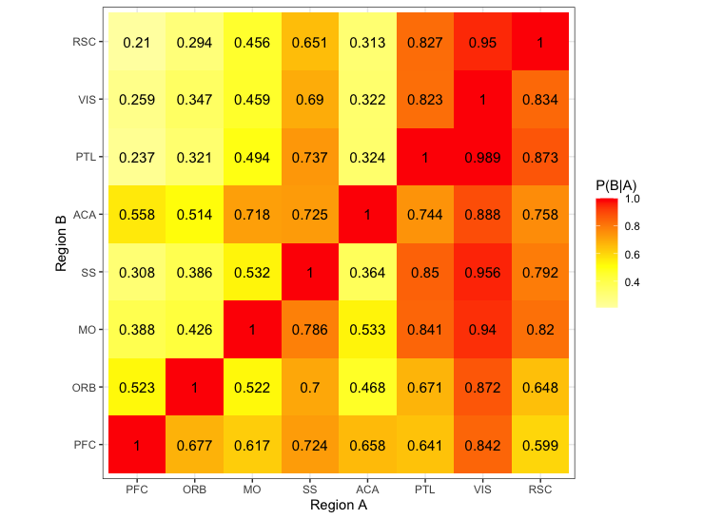
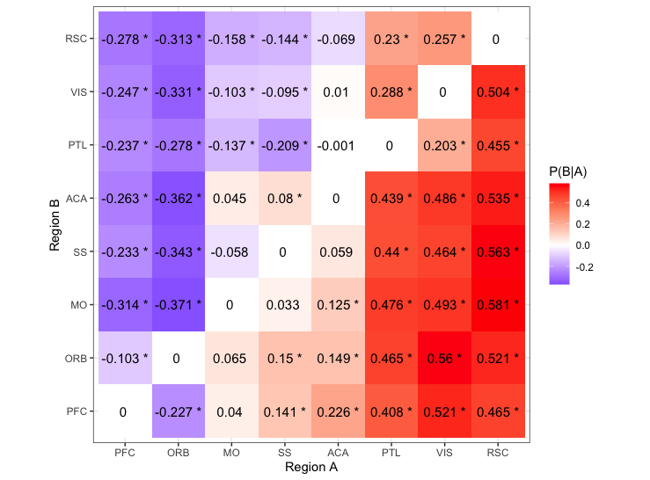
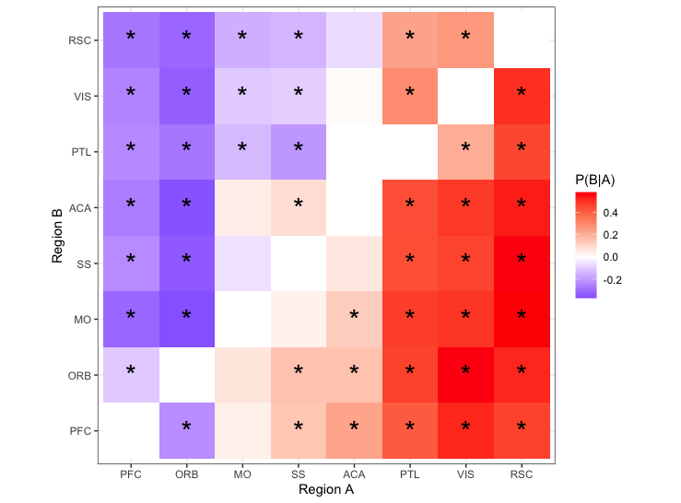

Slide 23
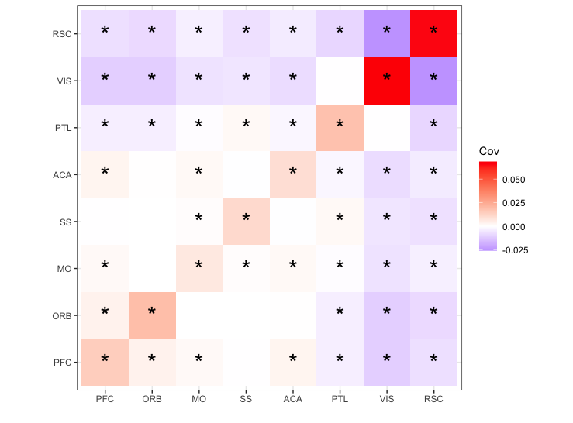
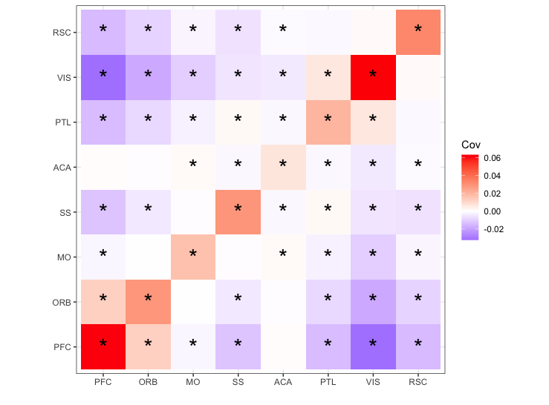
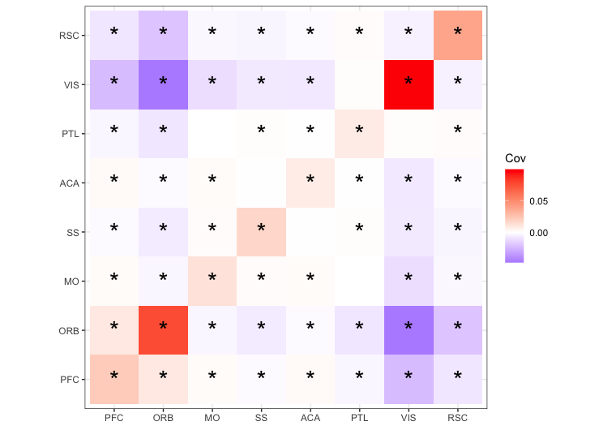
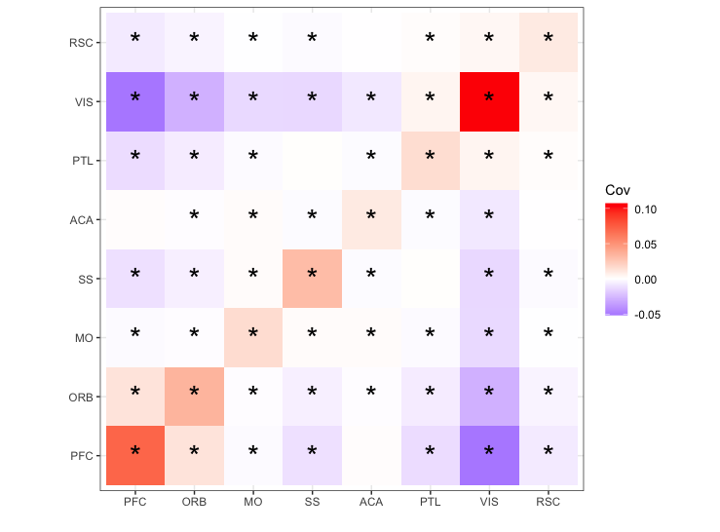
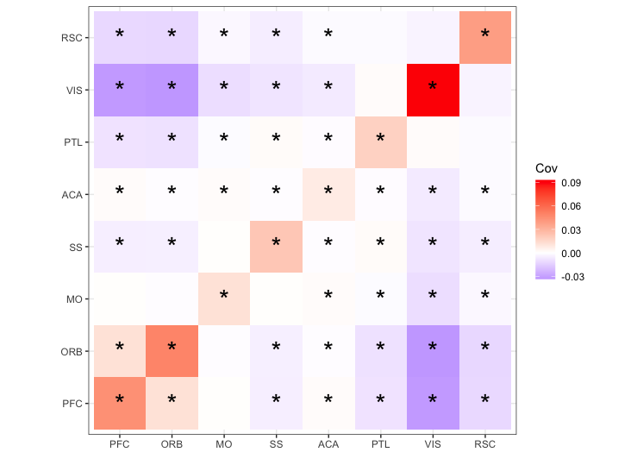
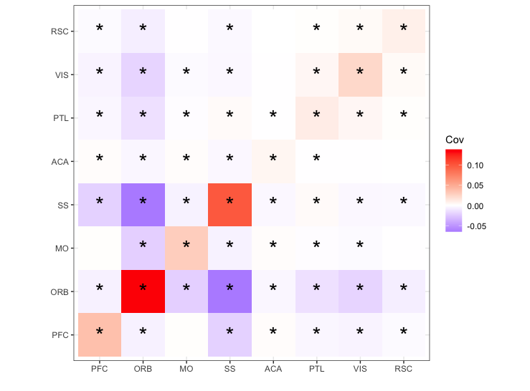
Estimated Covariance of projection strength between two regions, with stars indicating 95% CI not containing zero

Slide 24
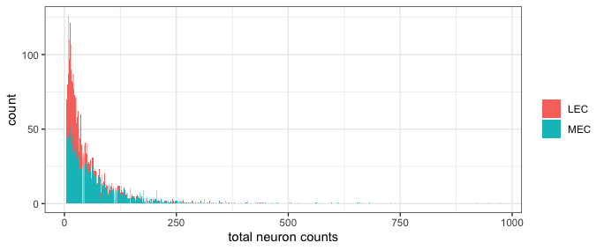
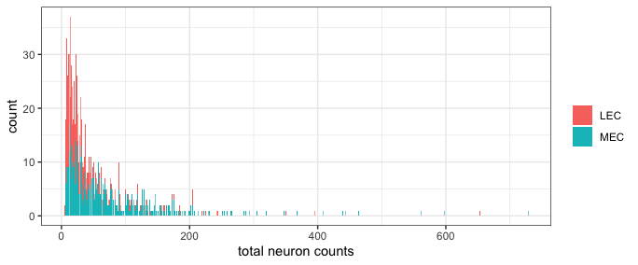
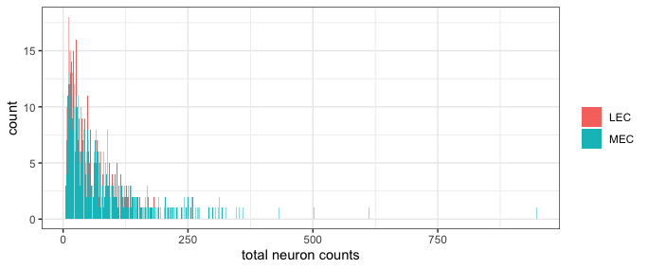
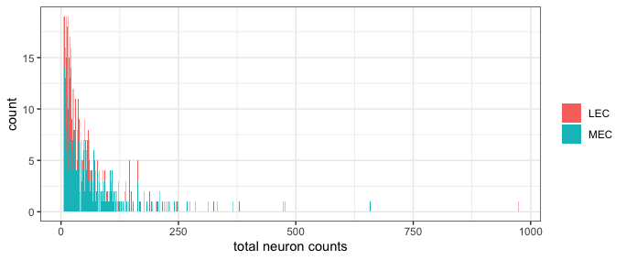
Bar plot of total counts of neurons. MEC neurons have higher total counts, is this influencing the observation that MEC neurons project more broadly when binarizing the data?

