Slide 1
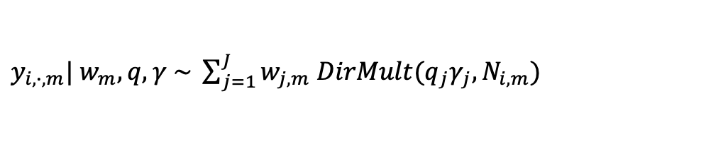
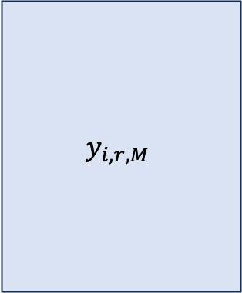

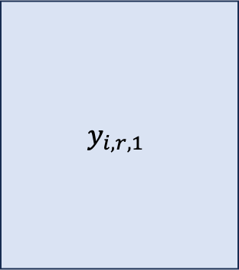






Hierarchical Model
$$1 ⋯ R$$
$$1 ⋯ R$$
$$y_{i,r,M}$$
$$1$$
$$⋮$$
$$n_{1}$$
$$y_{i,r,1}$$
$$1$$
$$⋮$$
$$n_{M}$$
$y_{i,∙,m}| w_{m}, q,γ \sim \sum_{j=1}^{J}{w_{j,m} DirMult(q_{j}γ_{j}, N_{i,m})}$
…
Mouse-level parameters
…
$$w_{1}| w \sim Dir(αw)$$
$$w_{m}| w \sim Dir(αw)$$
$$w\sim Dir(\frac{α_{0}}{J},…,\frac{α_{0}}{J})$$
$$q_{j}\sim Dir\left(α_{1},…,α_{R}\right)$$
$$γ_{j}\sim Gam\left(a_{γ},b_{γ}\right)$$
Global parameters

Slide 2
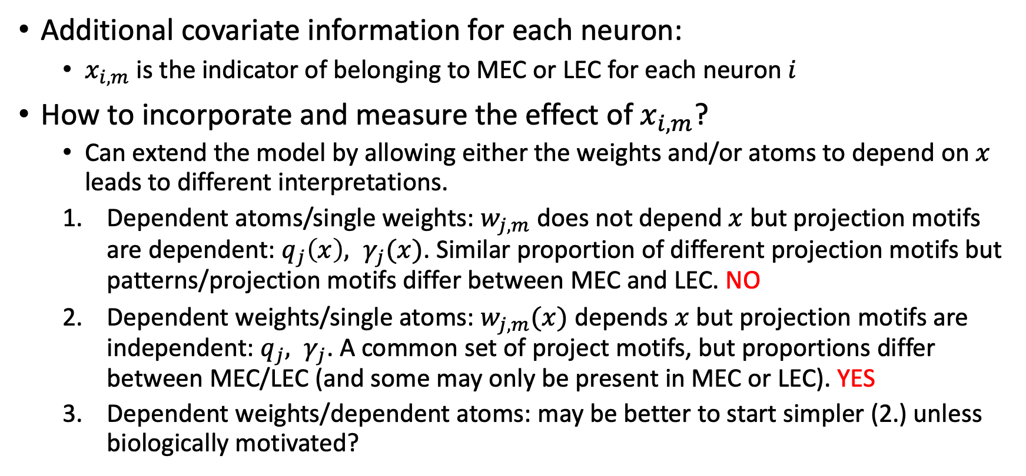
Incorporating covariates
Additional covariate information for each neuron:
$x_{i,m}$ is the indicator of belonging to MEC or LEC for each neuron $i$
How to incorporate and measure the effect of $x_{i,m}$?
Can extend the model by allowing either the weights and/or atoms to depend on $x$ leads to different interpretations.
Dependent atoms/single weights: $w_{j,m}$ does not depend $x$ but projection motifs are dependent: $q_{j}\left(x\right), γ_{j}(x)$. Similar proportion of different projection motifs but patterns/projection motifs differ between MEC and LEC. NO
Dependent weights/single atoms: $w_{j,m}(x)$ depends $x$ but projection motifs are independent: $q_{j}, γ_{j}$. A common set of project motifs, but proportions differ between MEC/LEC (and some may only be present in MEC or LEC). YES
Dependent weights/dependent atoms: may be better to start simpler (2.) unless biologically motivated?

Slide 3
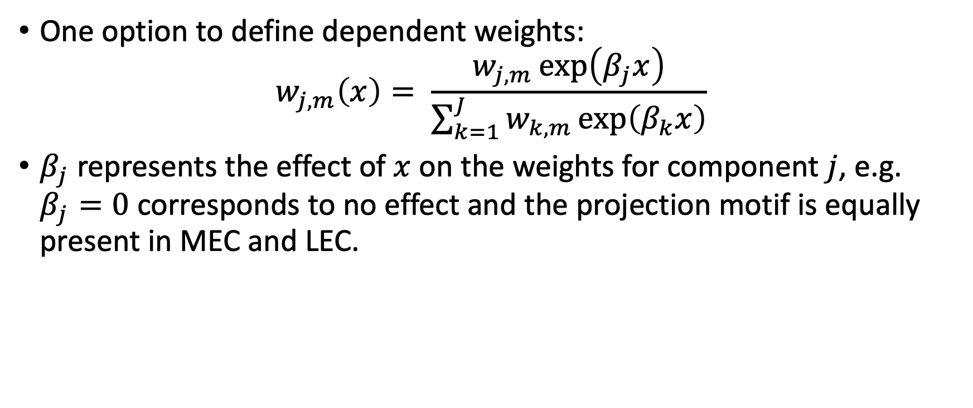
Dependent Weights
One option to define dependent weights:
$$w_{j,m}\left(x\right)= \frac{w_{j,m}\exp\left(β_{j}x\right)}{\sum_{k=1}^{J}{w_{k,m}\exp\left(β_{k}x\right)}}$$
$β_{j}$ represents the effect of $x$ on the weights for component $j$, e.g. $β_{j}=0$ corresponds to no effect and the projection motif is equally present in MEC and LEC.

Slide 4
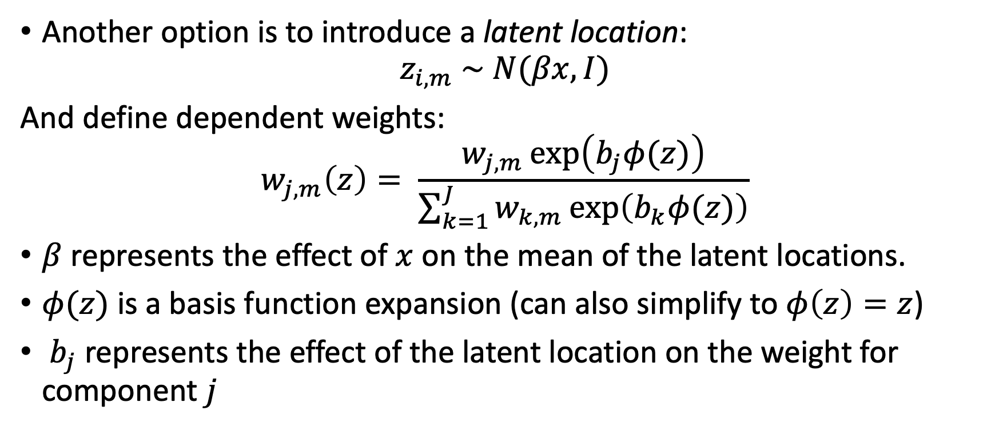
Dependent Weights
Another option is to introduce a latent location:
$$z_{i,m} \sim N(βx, I)$$
And define dependent weights:
$$w_{j,m}\left(z\right)= \frac{w_{j,m}\exp\left(b_{j}φ(z)\right)}{\sum_{k=1}^{J}{w_{k,m}\exp\left(b_{k}φ(z)\right)}}$$
$β$ represents the effect of $x$ on the mean of the latent locations.
$φ(z)$ is a basis function expansion (can also simplify to $φ\left(z\right)=z$)
$b_{j}$ represents the effect of the latent location on the weight for component $j$

