Slide 1
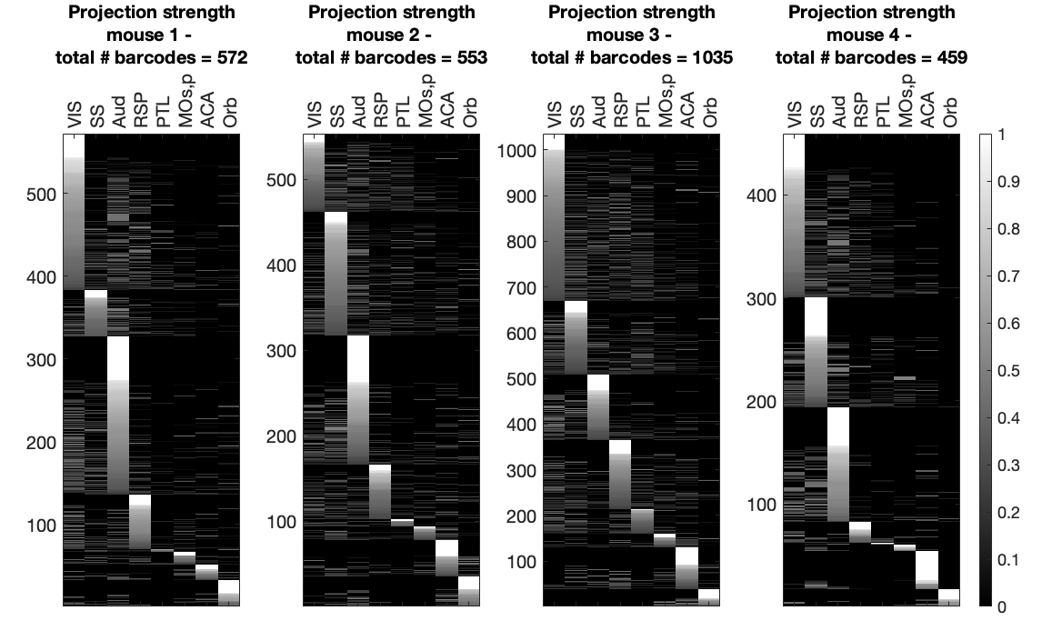
Projection strength graphs for each mouse (n=4).

Slide 2


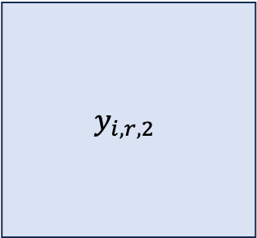


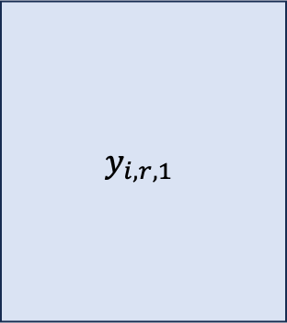




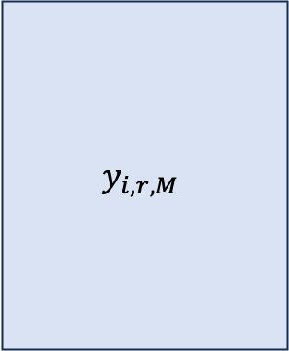

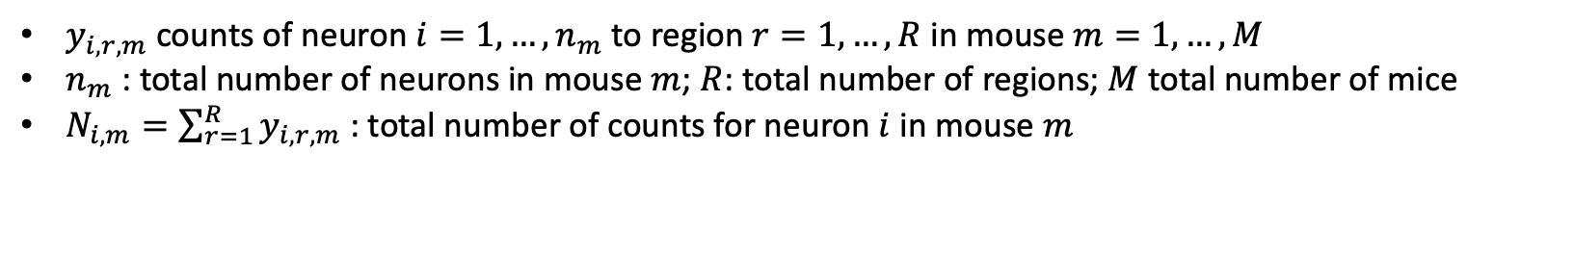
Notation
$$1 ⋯ R$$
$$1 ⋯ R$$
$$y_{i,r,M}$$
$$1$$
$$⋮$$
$$n_{1}$$
$$y_{i,r,1}$$
$$1$$
$$⋮$$
$$n_{M}$$
$$1 ⋯ R$$
$$1$$
$$⋮$$
$$n_{2}$$
$$y_{i,r,2}$$
…
$$Y_{1}$$
$$Y_{2}$$
$$Y_{M}$$
$y_{i,r,m}$ counts of neuron $i=1,…, n_{m}$ to region $r=1,…,R$ in mouse $m=1,…,M$
$n_{m}$: total number of neurons in mouse $m$; $R$: total number of regions; $M$ total number of mice
$N_{i,m}=\sum_{r=1}^{R}{y_{i,r,m}}$: total number of counts for neuron $i$ in mouse $m$

Slide 3
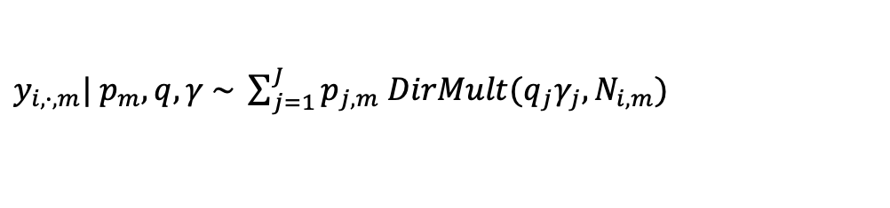


Multilevel Model
$$1 ⋯ R$$
$$1 ⋯ R$$
$$y_{i,r,M}$$
$$1$$
$$⋮$$
$$n_{1}$$
$$y_{i,r,1}$$
$$1$$
$$⋮$$
$$n_{M}$$
$y_{i,∙,m}| p_{m}, q,γ \sim \sum_{j=1}^{J}{p_{j,m} DirMult(q_{j}γ_{j}, N_{i,m})}$
…
Mouse-level parameters
…
$$p_{M}| p \sim Dir(αp)$$
$$p_{1}| p \sim Dir(αp)$$
$$p \sim Dir(\frac{α_{0}}{J},…,\frac{α_{0}}{J})$$
$$q_{j}\sim Dir\left(α_{1},…,α_{R}\right)$$
$$γ_{j}\sim Gam\left(a_{γ},b_{γ}\right)$$
Global parameters

Slide 4
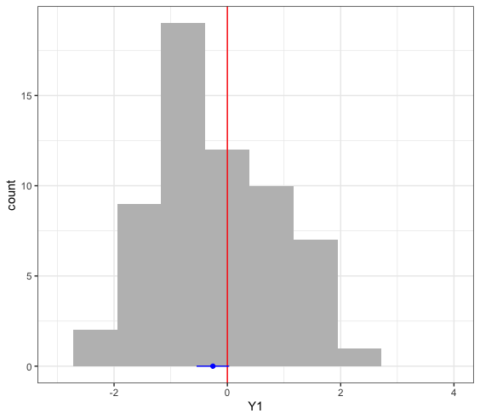
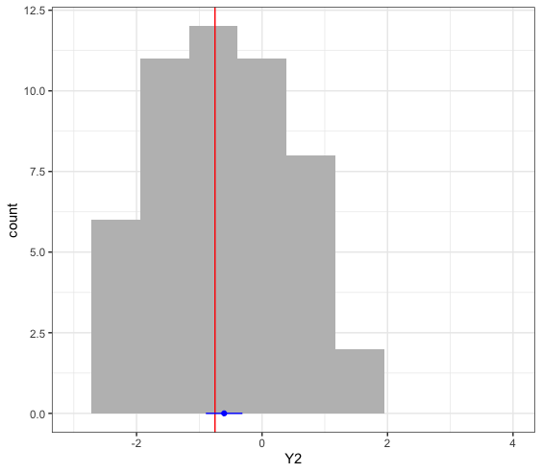
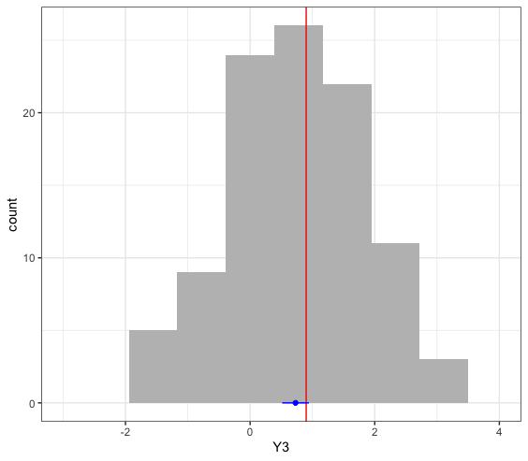
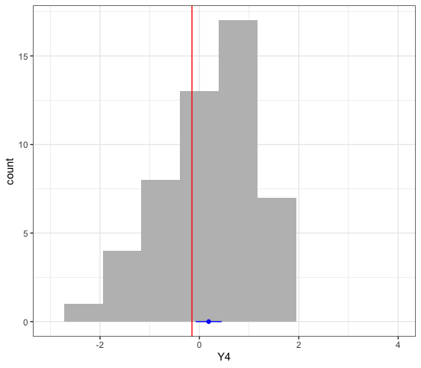
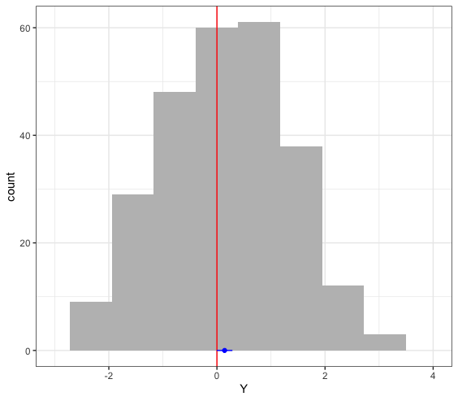





Why Multilevel?
$$y_{i,1}\sim N(μ_{m},σ^{2})$$
$$y_{i,2}\sim N(μ_{m},σ^{2})$$
$$y_{i,3}\sim N(μ_{m},σ^{2})$$
$$y_{i,M}\sim N(μ_{m},σ^{2})$$
$$μ_{m}=μ+ε_{m}$$
Why not pool?
Overestimated variance
Why not individual?
Less data, less efficient

Slide 5
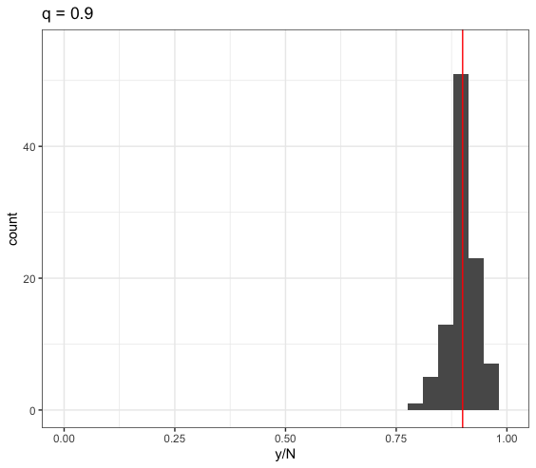
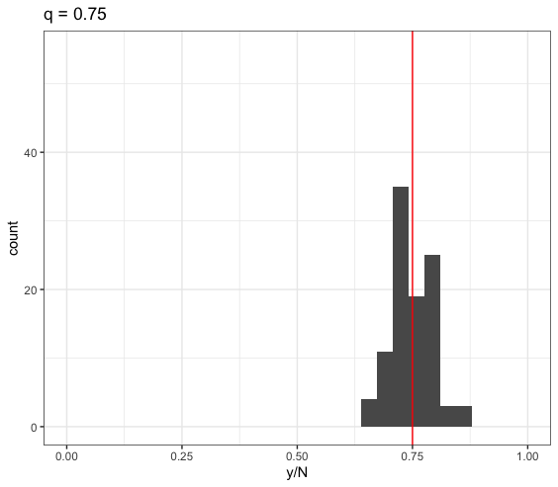
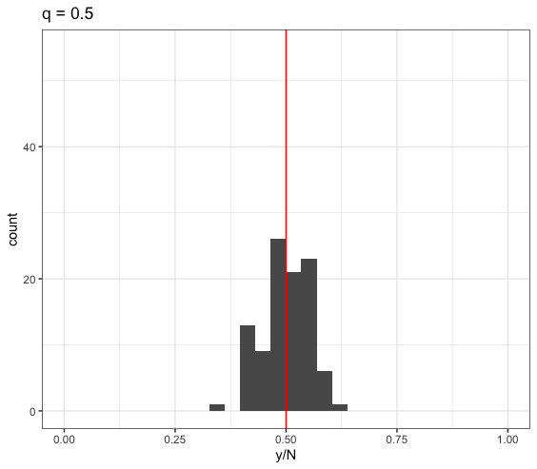
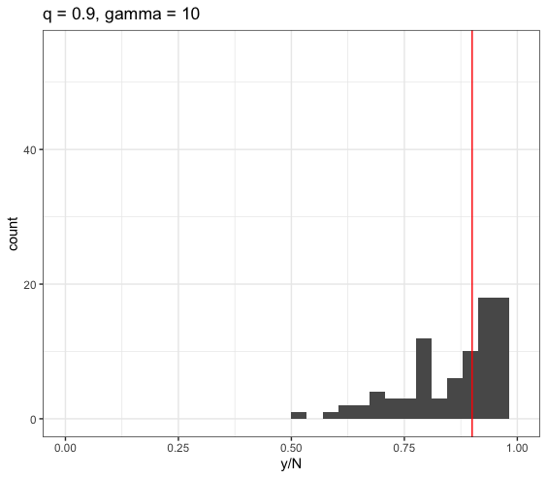
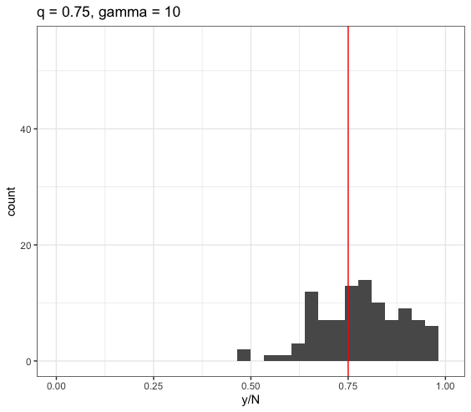
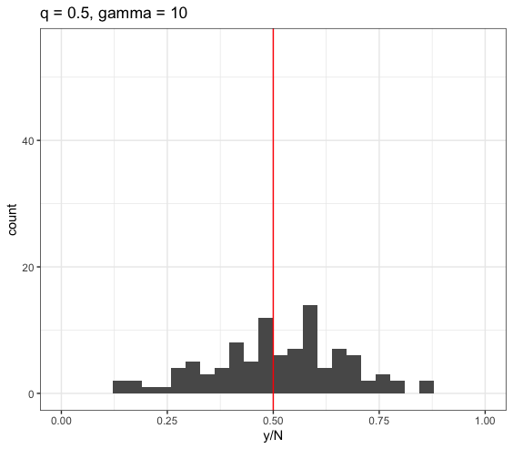
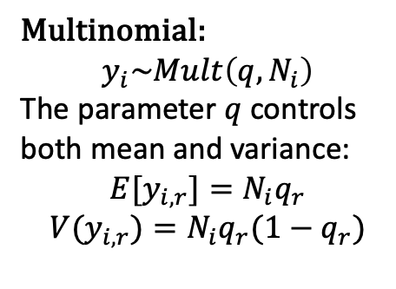
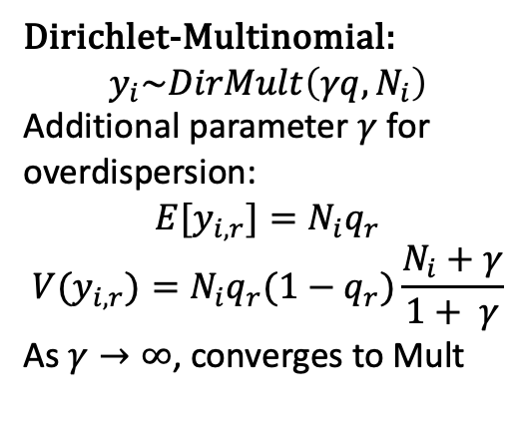
Modelling Discrete Data (R=2)
Multinomial:
$$y_{i}\sim Mult\left(q,N_{i}\right)$$
The parameter $q$ controls both mean and variance:
$${E[y}_{i,r}]=N_{i}q_{r}$$
$${V(y}_{i,r})=N_{i}q_{r}(1−q_{r})$$
Dirichlet-Multinomial:
$$y_{i}\sim DirMult\left(γq,N_{i}\right)$$
Additional parameter $γ$ for overdispersion:
$${E[y}_{i,r}]=N_{i}q_{r}$$
$${V(y}_{i,r})=N_{i}q_{r}(1−q_{r})\frac{N_{i}+γ}{1+ γ}$$
As $γ→∞$, converges to Mult

Slide 6
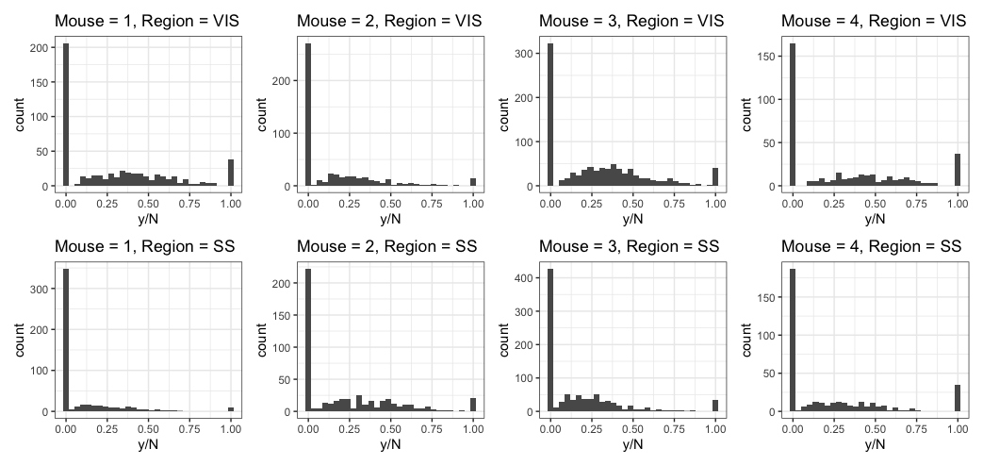
MAPseq Data
Multimodality in projections Mixtures of DirMult
Small differences across mice Multilevel model

Slide 7
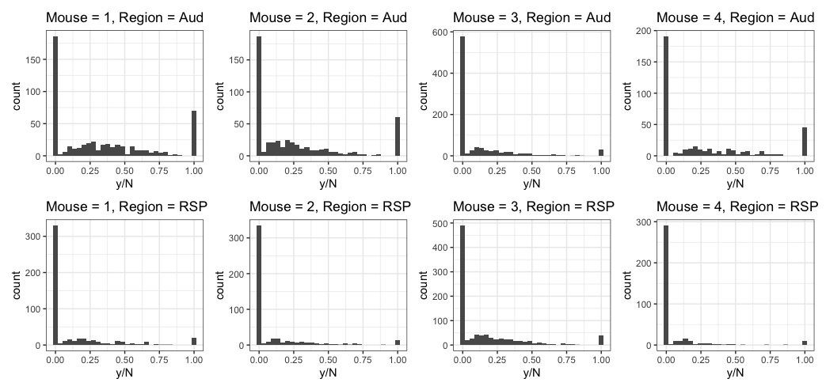
MAPseq Data

Slide 8
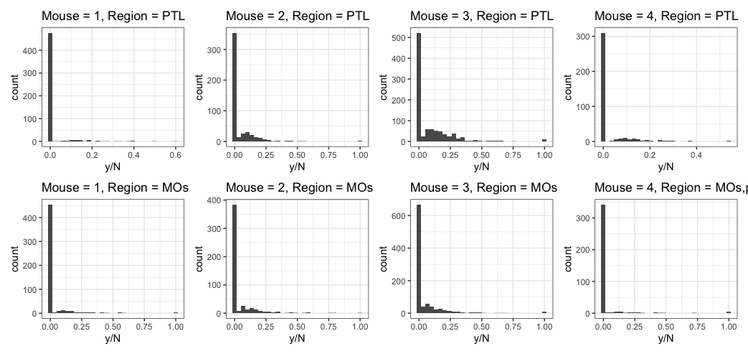
MAPseq Data

Slide 9
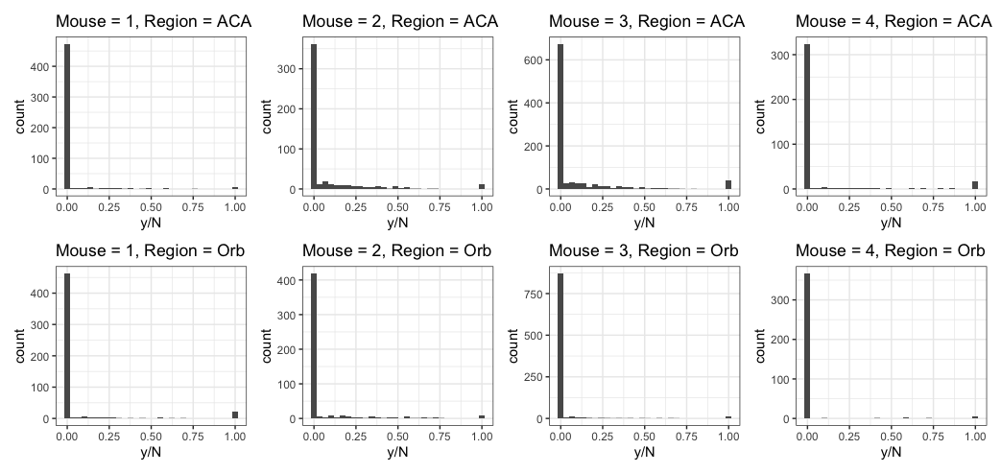
MAPseq Data

Slide 10
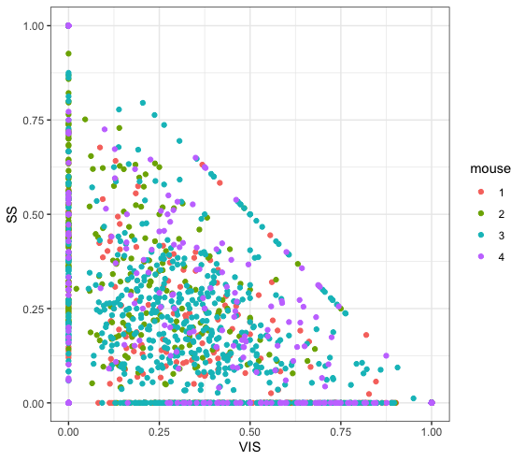
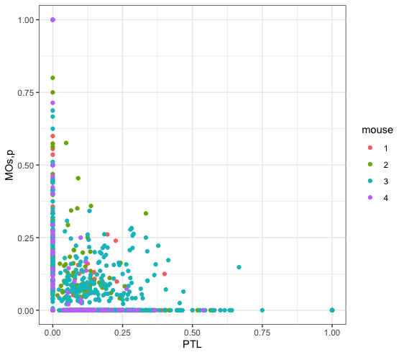
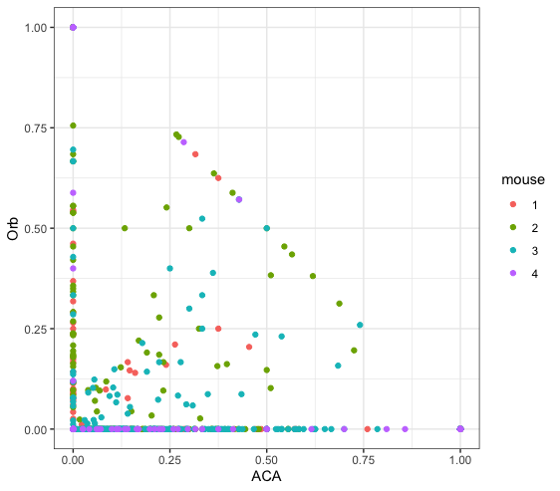
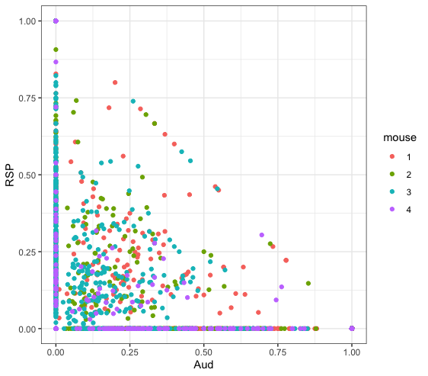
MAPseq Data

Slide 11
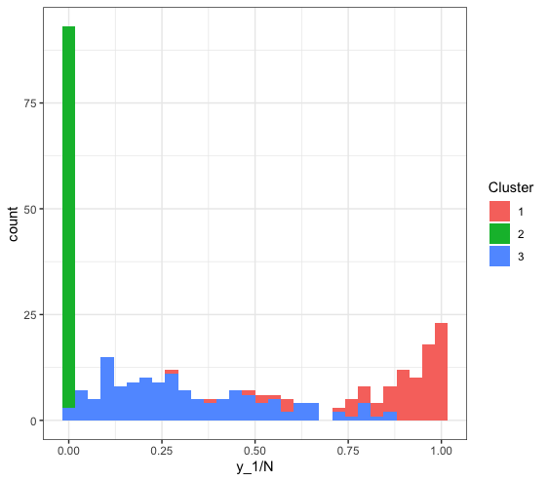
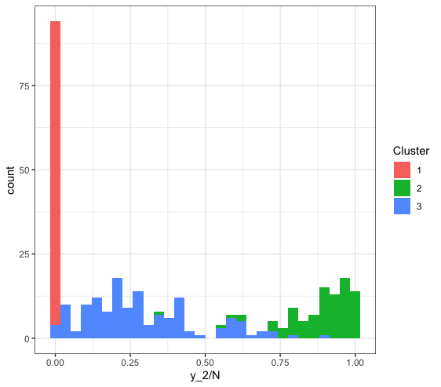
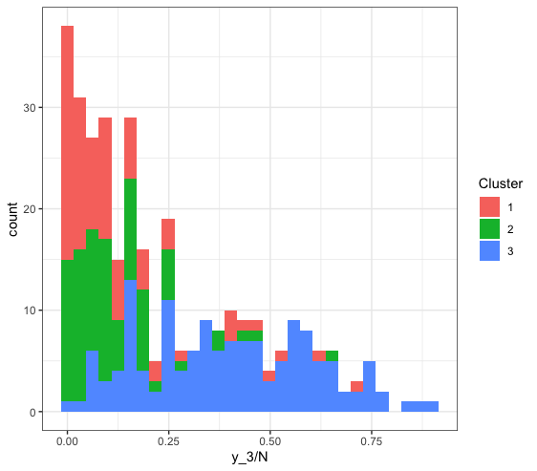
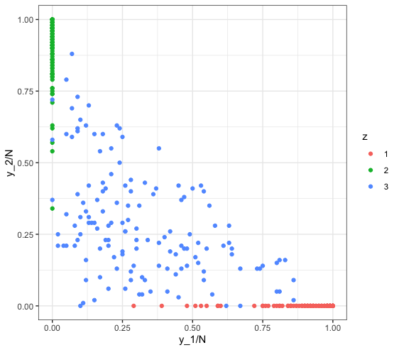
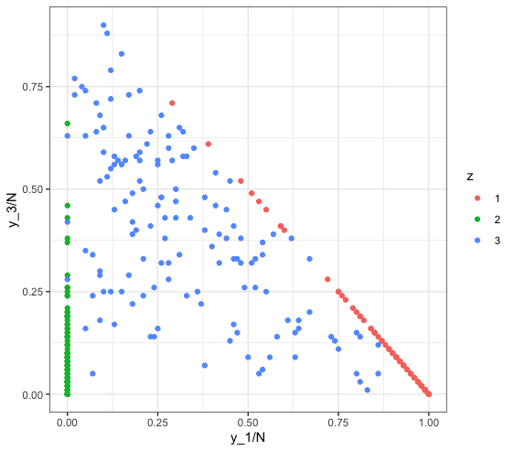
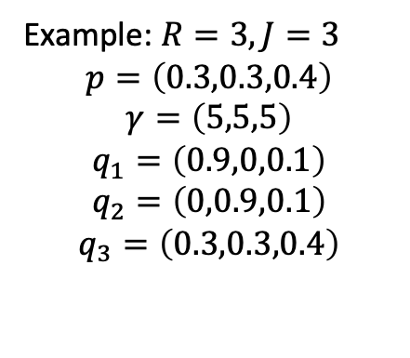
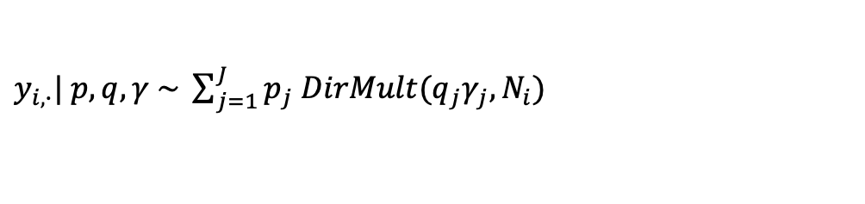
Mixtures of Dirichlet-Multinomials
$y_{i,∙}| p, q,γ \sim \sum_{j=1}^{J}{p_{j} DirMult(q_{j}γ_{j}, N_{i})}$
Example: $R=3, J=3$
$$p=\left(0.3,0.3,0.4\right)$$
$$γ=\left(5,5,5\right)$$
$$q_{1}=\left(0.9,0,0.1\right)$$
$$q_{2}=\left(0,0.9,0.1\right)$$
$$q_{3}=\left(0.3,0.3,0.4\right)$$

Slide 12
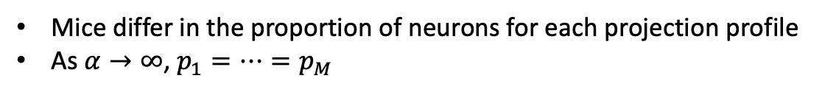
Multilevel Model: Mouse-level Parameters
$$1 ⋯ R$$
$$1 ⋯ R$$
$$y_{i,r,M}$$
$$1$$
$$⋮$$
$$n_{1}$$
$$y_{i,r,1}$$
$$1$$
$$⋮$$
$$n_{M}$$
$y_{i,∙,m}| p_{m}, q,γ \sim \sum_{j=1}^{J}{p_{j,m} DirMult(q_{j}γ_{j}, N_{i,m})}$
…
Mouse-level parameters
…
$$p_{M}| p \sim Dir(αp)$$
$$p_{1}| p \sim Dir(αp)$$
Mice differ in the proportion of neurons for each projection profile
As $α→∞$, $p_{1}=…=p_{M}$

Slide 13

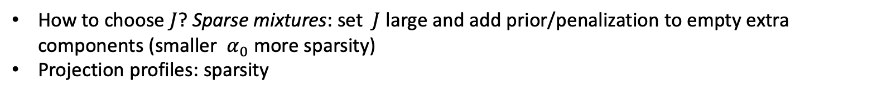

Multilevel Model: Global parameters
$y_{i,∙,m}| p_{m}, q,γ \sim \sum_{j=1}^{J}{p_{j,m} DirMult(q_{j}γ_{j}, N_{i,m})}$
Mouse-level parameters
…
$$p_{M}| p \sim Dir(αp)$$
$$p_{1}| p \sim Dir(αp)$$
$$p \sim Dir(\frac{α_{0}}{J},…,\frac{α_{0}}{J})$$
$$q_{j}\sim Dir\left(α_{1},…,α_{R}\right)$$
$$γ_{j}\sim Gam\left(a_{γ},b_{γ}\right)$$
Global parameters
How to choose $J$? Sparse mixtures: set $J$ large and add prior/penalization to empty extra components (smaller $α_{0}$ more sparsity)
Projection profiles: sparsity

Slide 14
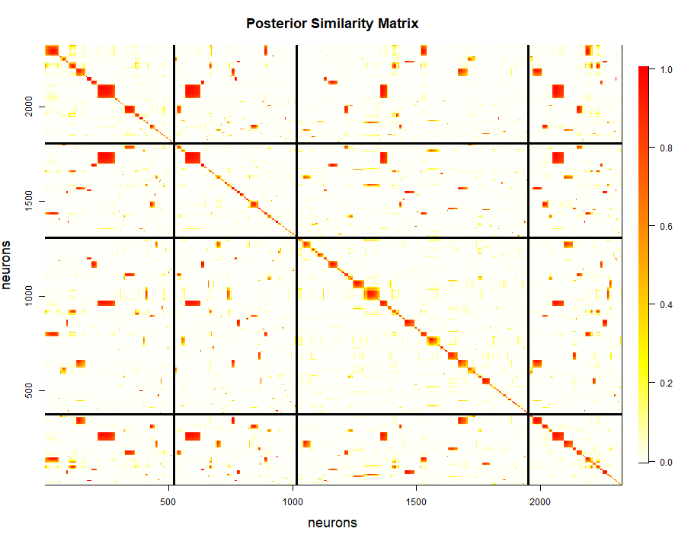
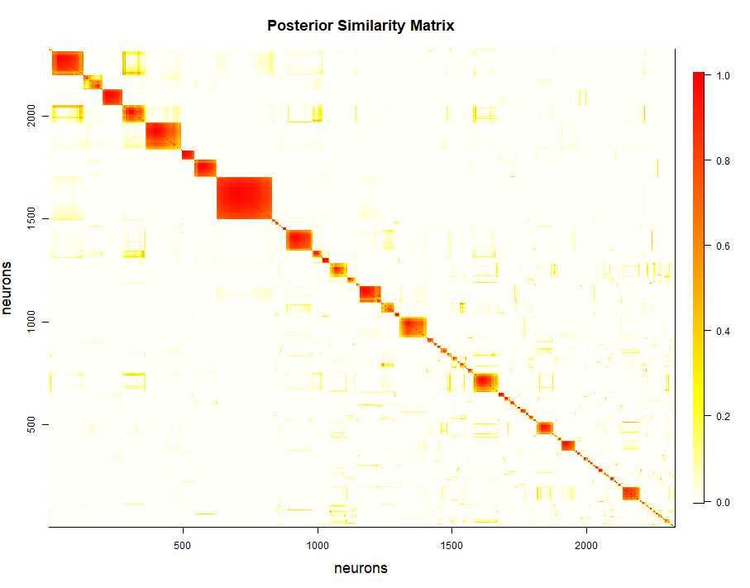
Posterior similarity matrix

Slide 15
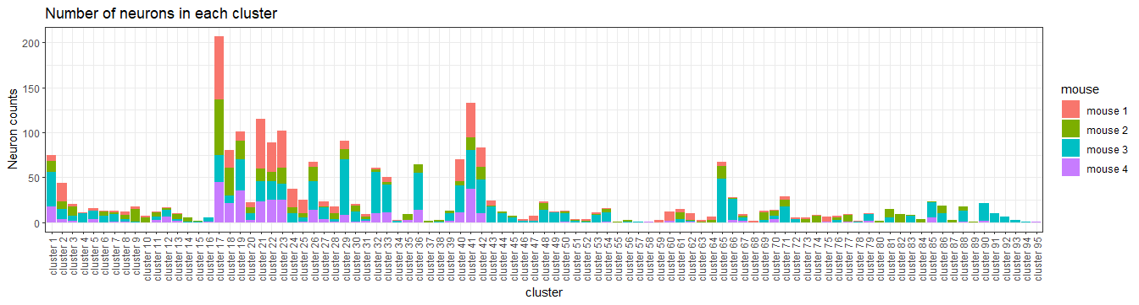
Frequency plot by allocations

Slide 16
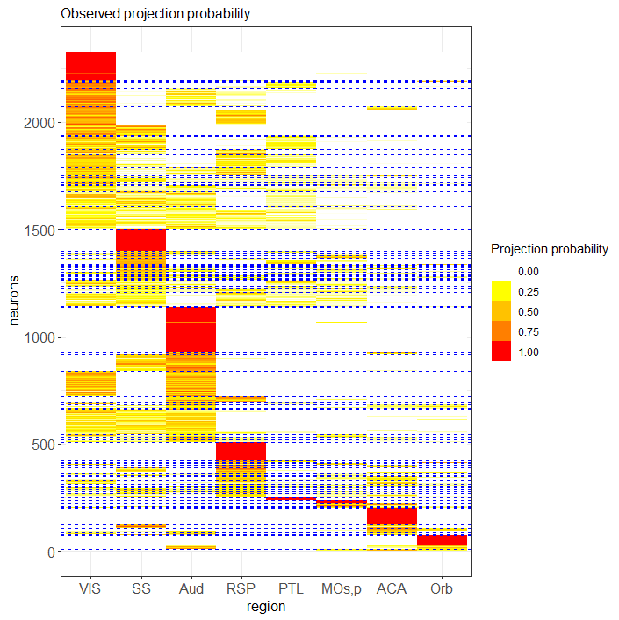
Observed projection probability by allocation

Slide 17
Objectives/Questions
Do neurons multicast, broadcast, unicast?
Group of neurons to back multicast to rsc, vis, ptl? (from mec?)
Group of neurons to frontal areas – pfc, orb, mo? (from lec?)
Group of neurons to both front and back – multicaster? (between mec and lec?)
Differences between mice?

Slide 18
Where each cluster projects (Next two slides):
There are seven possibilities:
Only to the front of the brain (6/95)
Only to the middle of the brain (3/95)
Only to the back of the brain (6/95)
To the front and middle of the brain (10/95)
To the middle and back of the brain (20/95)
To the front and back of the brain (14/95)
To the front, middle and back of the brain (36/95)
How many regions is each cluster projecting onto (Next two slides):
There are four possibilities:
Unicasting (8/95)
Bicasting (16/95)
Projection to more than three, but less than all regions (71/95)
Broadcasting (0/95)

Slide 19
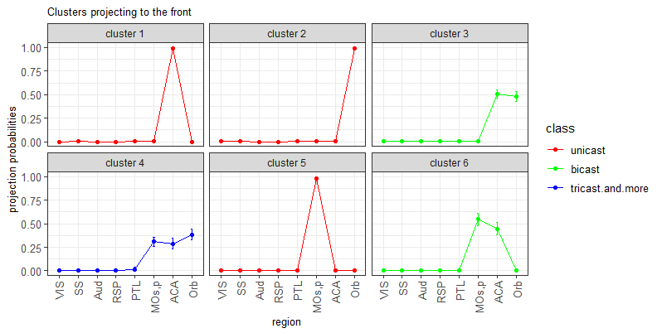
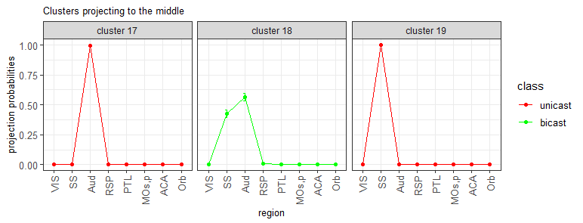
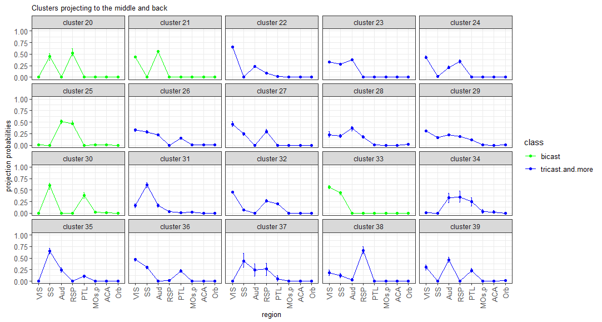
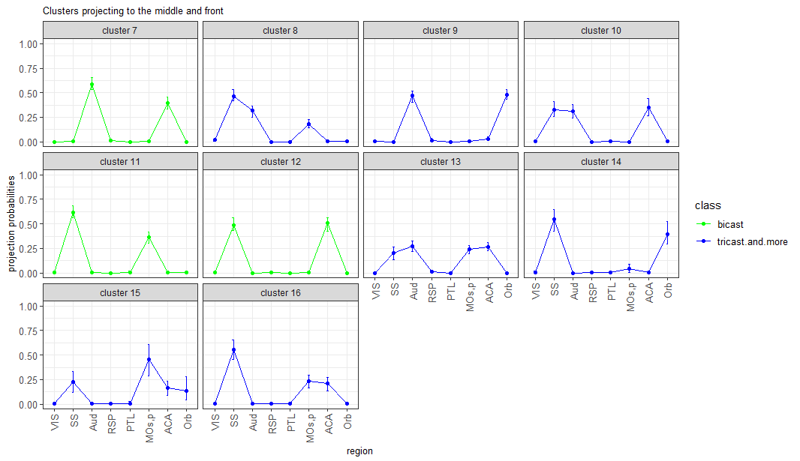

Slide 20
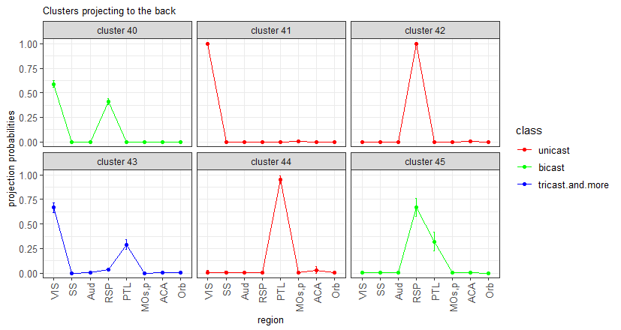
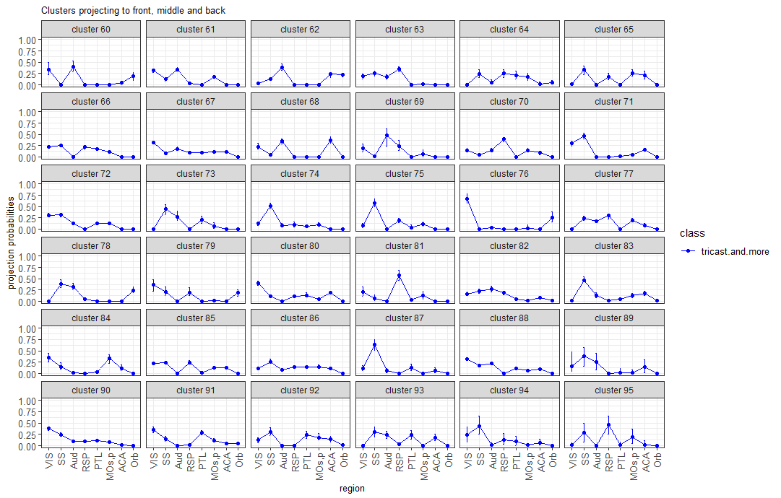
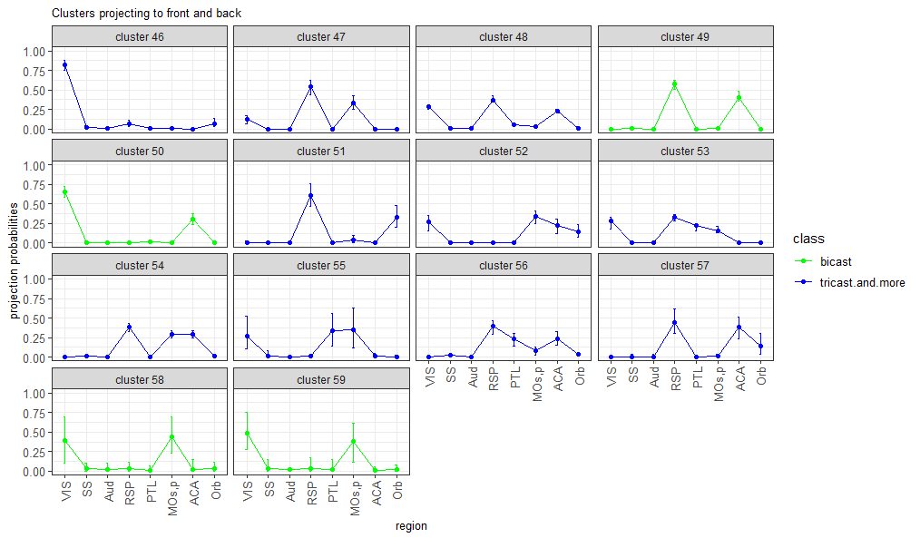

Slide 21
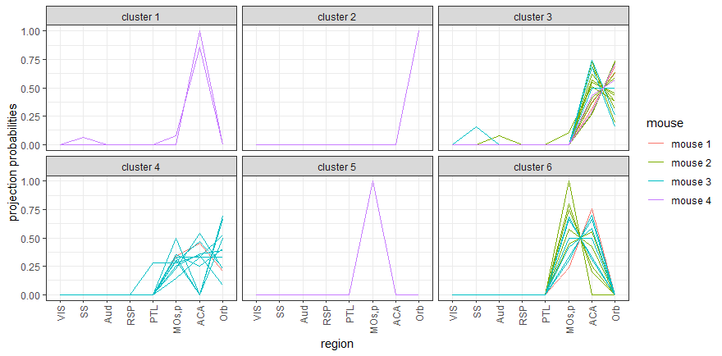
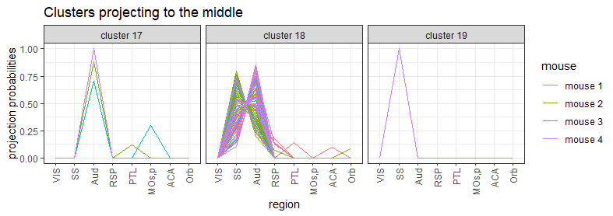
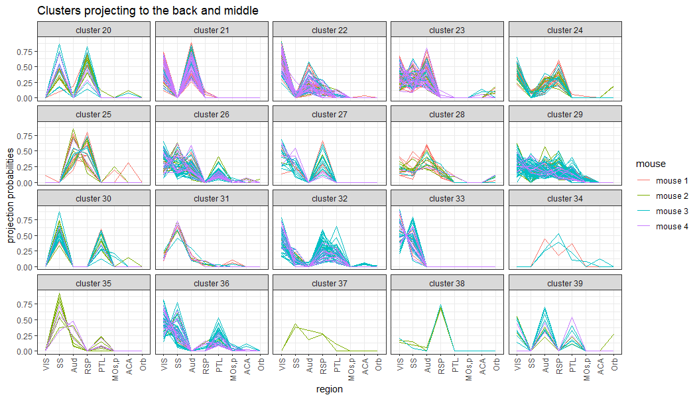


Slide 22




Slide 23





Slide 24




Slide 25


Posterior Predictive Checks
Boxplot below is based on zeros removed:

Slide 26

Alternatively, we could use histograms to carry out posterior predictive checks

Slide 27


Slide 28


Slide 29


