Slide 1
EC data
Brain regions:
PFC
ORB
MO
SS
AUD
ACA
PTL
VIS
RSC

Slide 2
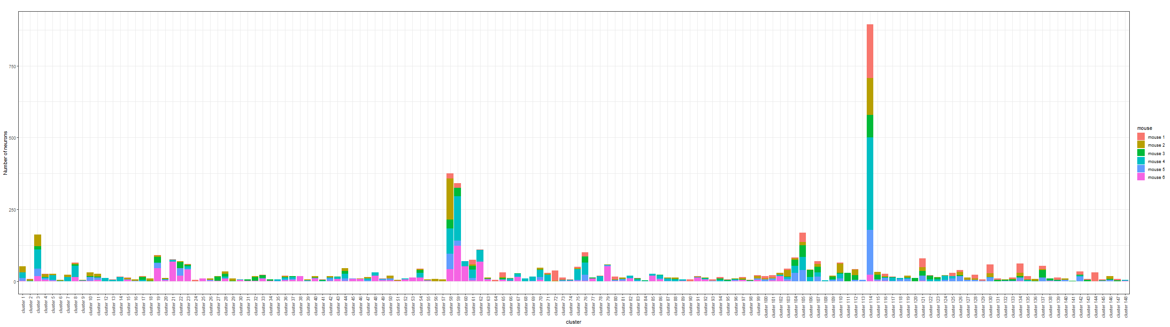
Bayesian Result – minVI to obtain point estimates of neuron allocations
There are 148 clusters (motifs) in total:

Slide 3
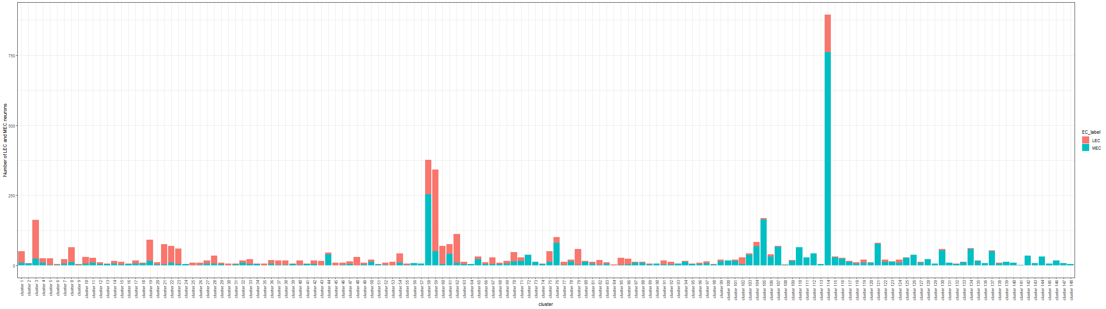
Total number of LEC and MEC neurons in each cluster:

Slide 4
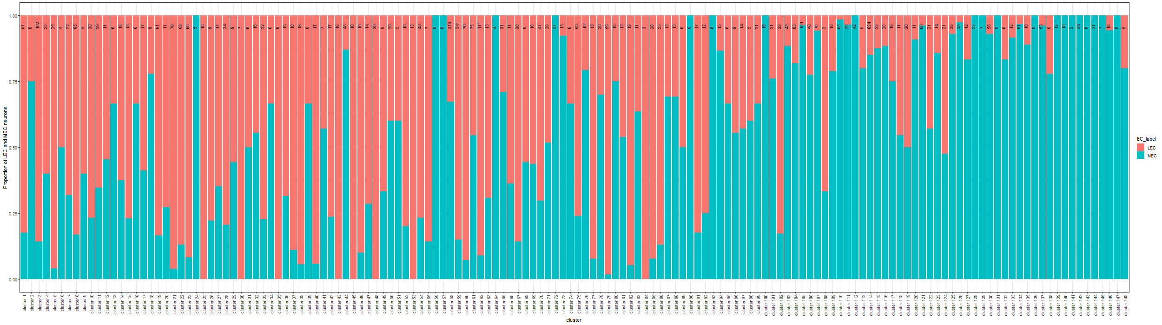
Proportion of LEC and MEC neurons in each cluster:

Slide 5
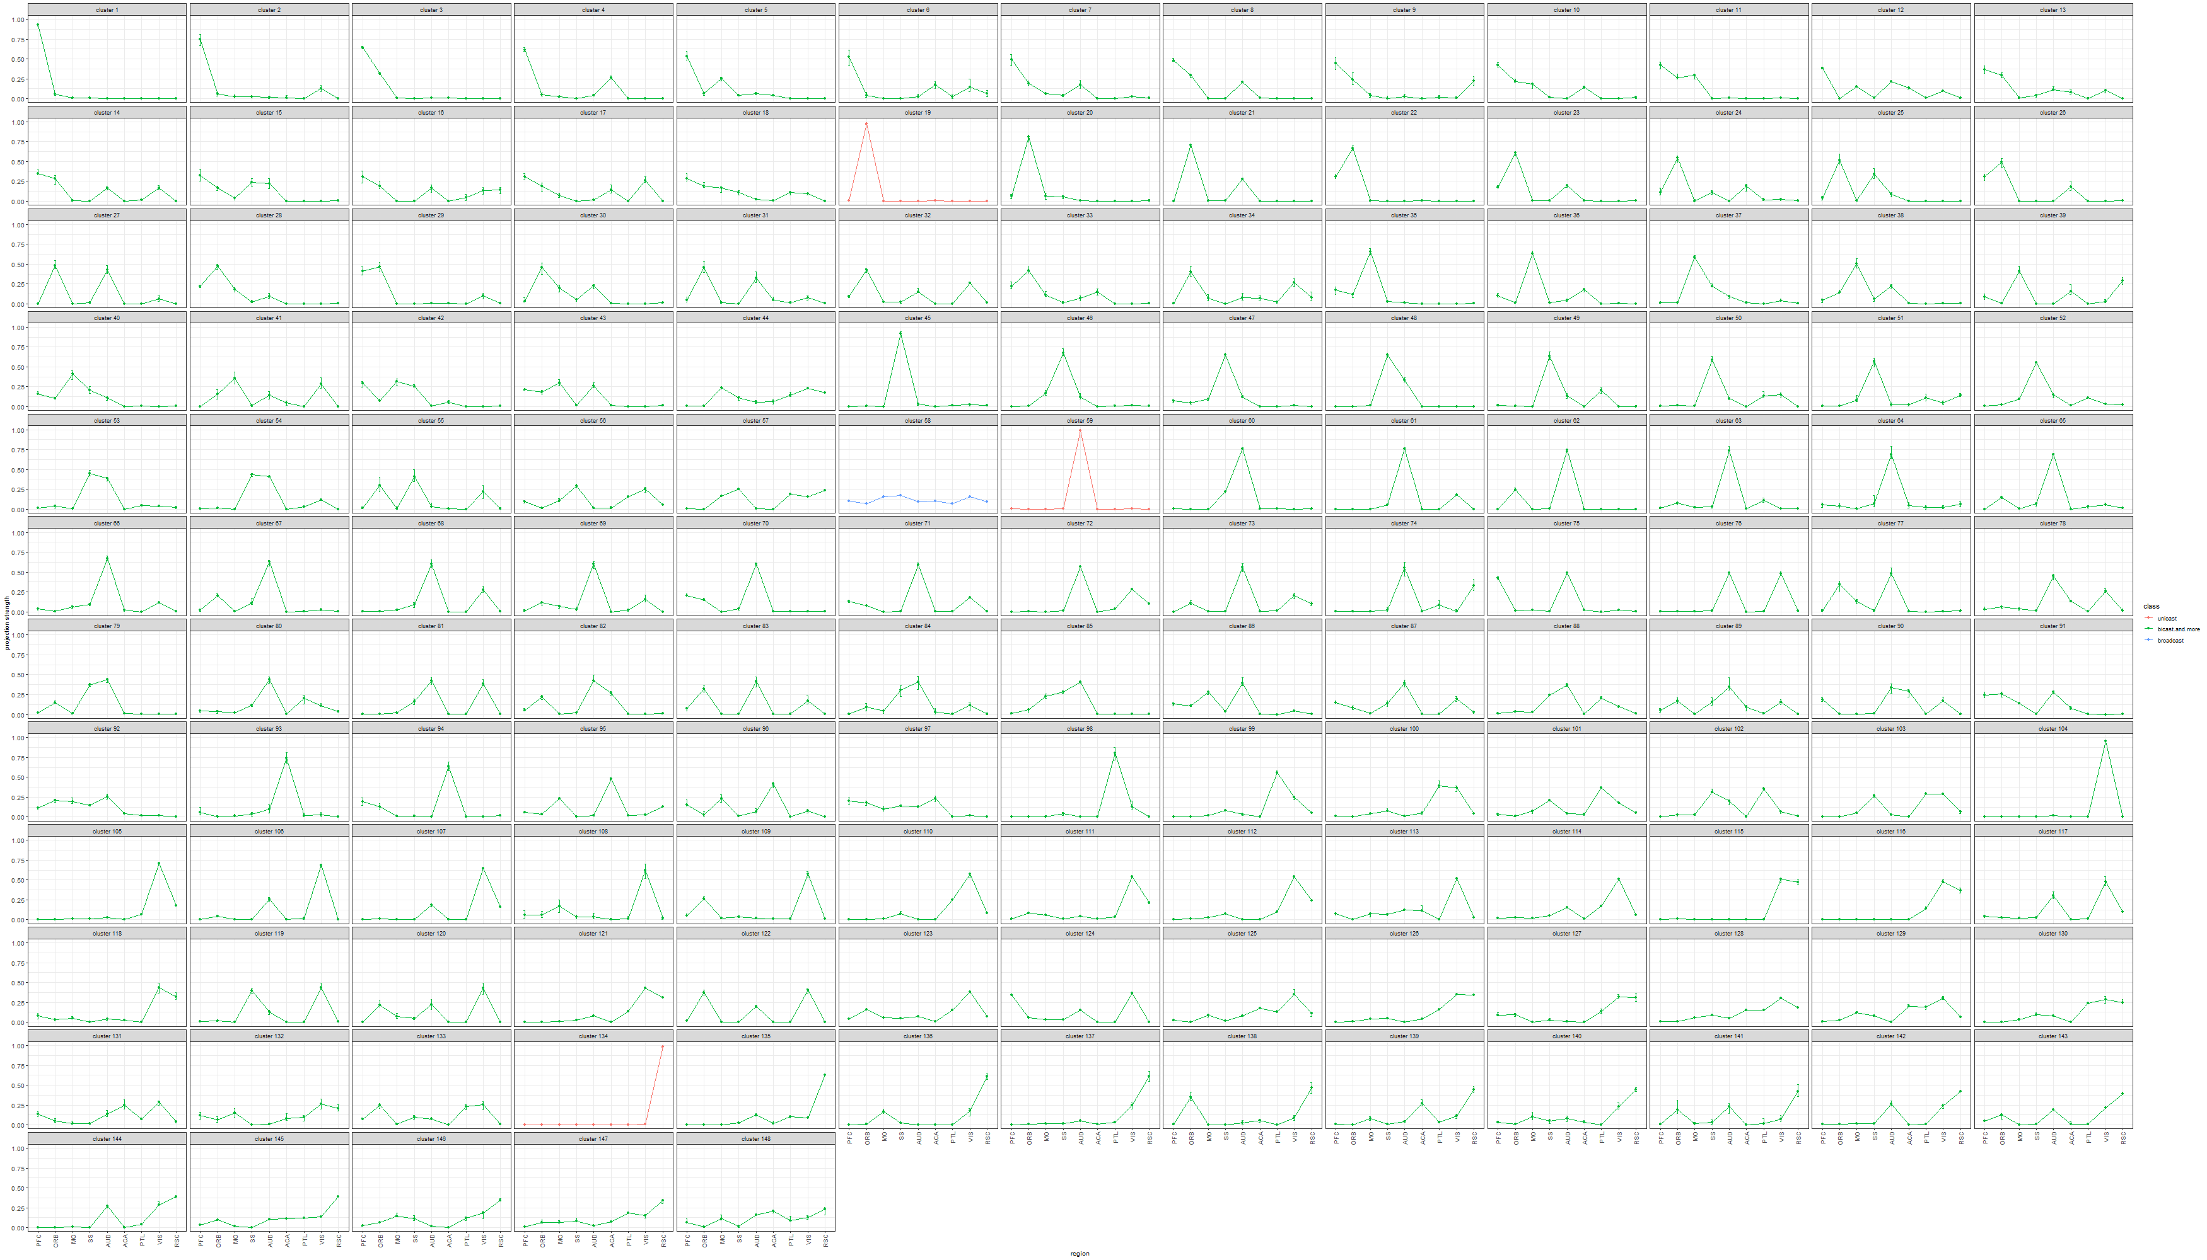
Estimated projection probability of neurons in each cluster with error-bars, color-coded by the number of projecting regions of each cluster:

Slide 6
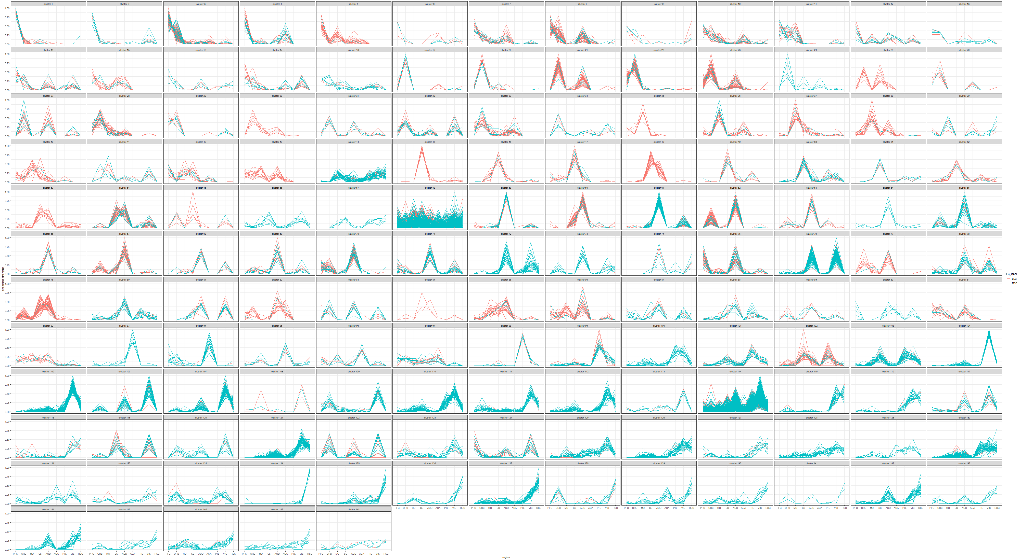
Projection probabilities of neurons in each cluster, color-coded by the EC:

Slide 7
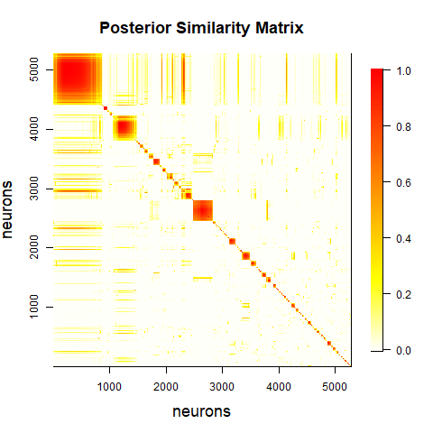
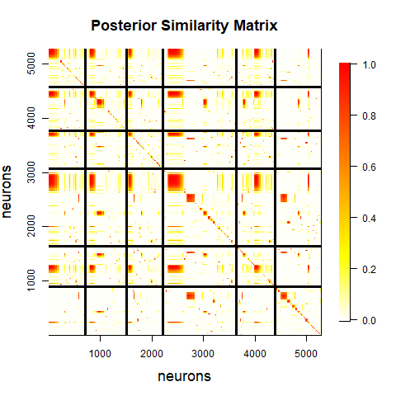
Heatmap of posterior similarity matrix: (right) distinguishes between neurons from different mice; visually there are three large clusters.

Slide 8
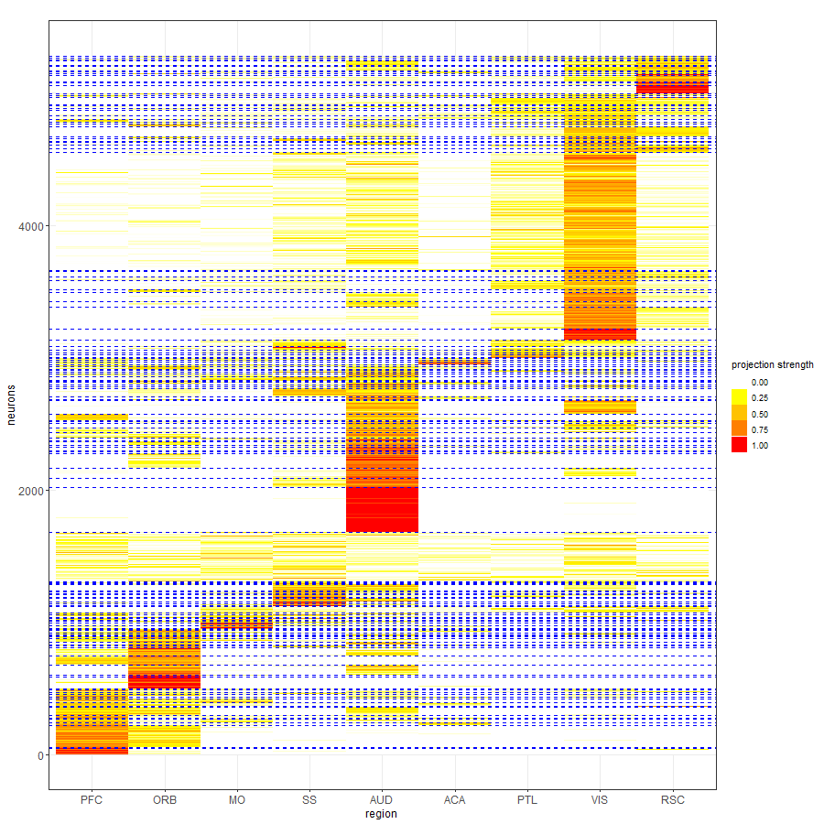
Projection strength of neurons, reordered by the allocations.

Slide 9
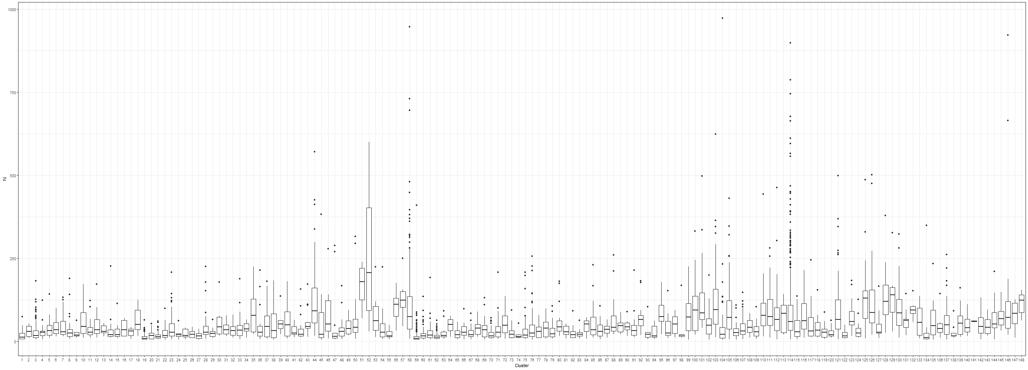
Distribution of the sum of counts across all brain regions for neurons within each cluster:

Slide 10
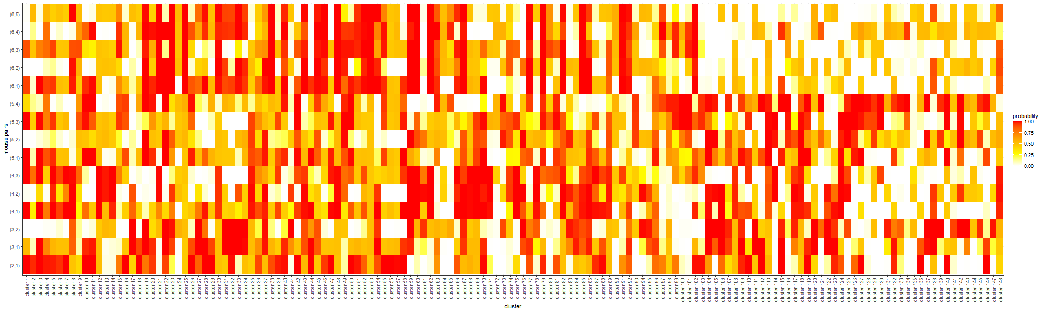
Comparison of allocation proportions across any two mice:

Slide 11
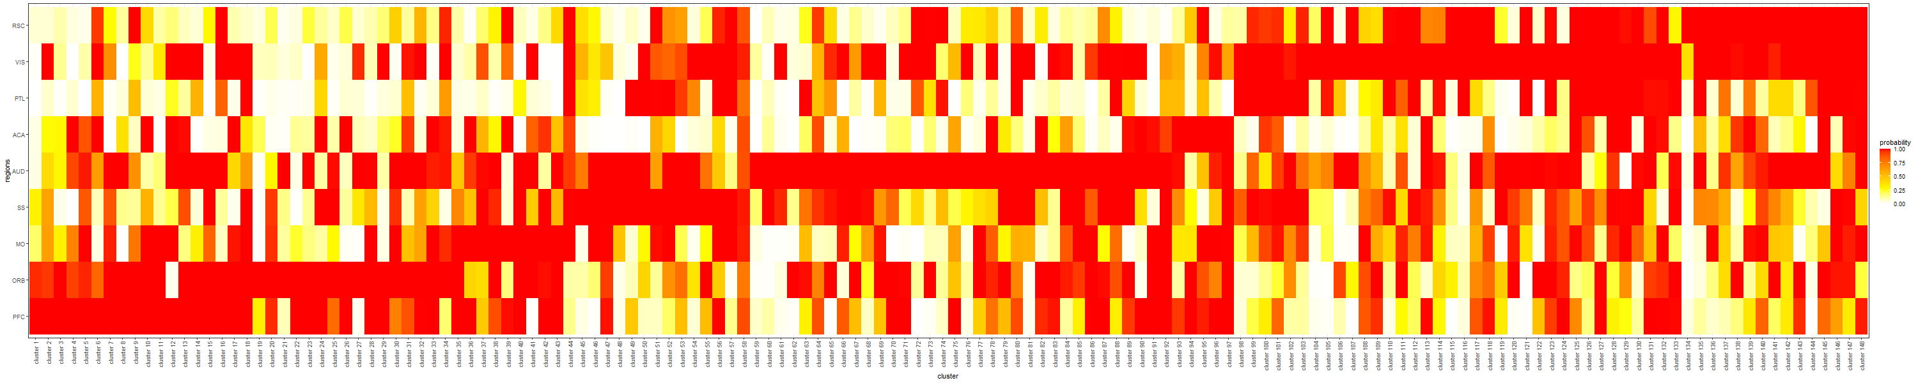
Probability of having the projection strength greater than 0.01 for each cluster and region:

Slide 12
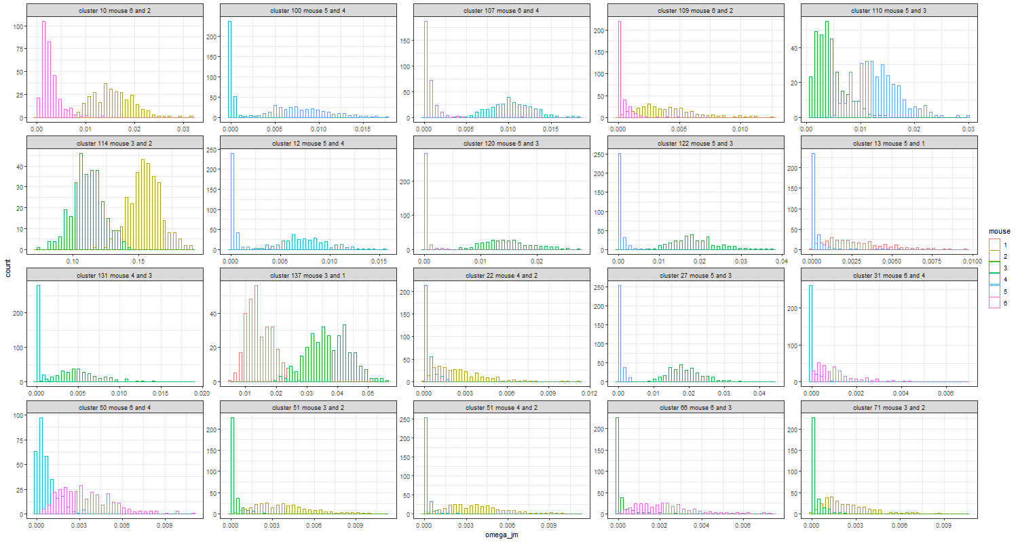
Example of significant difference in allocation proportions between mouse pairs:

Slide 13
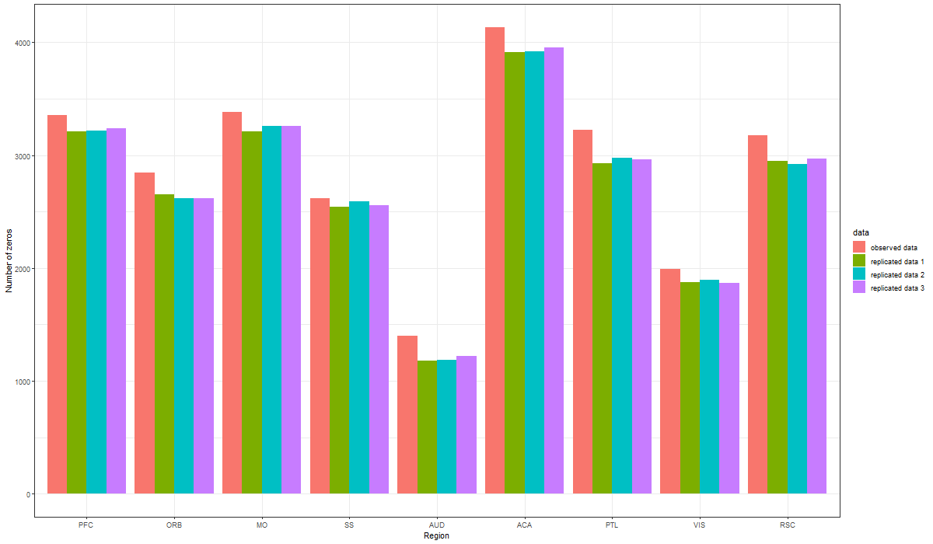
Posterior predictive check with three replicated datasets: (number of zeros of each region). This is used to assess the fit of the model to the data.

Slide 14
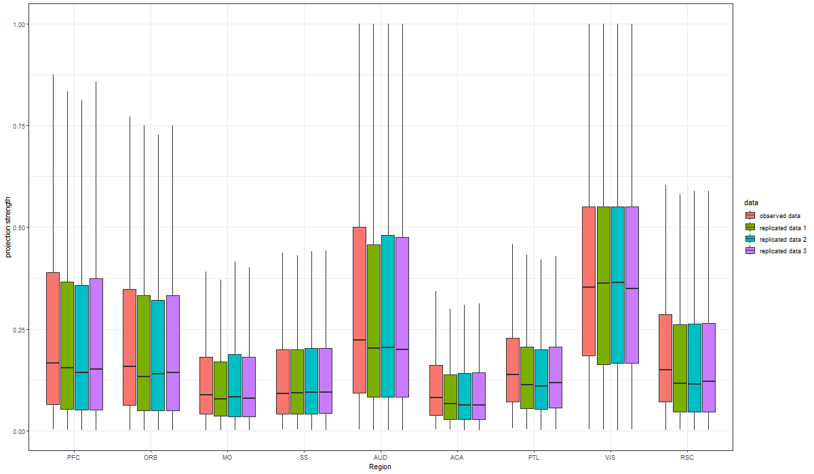
Distribution of non-zero projection strengths for the observed and replicated data.

Slide 15
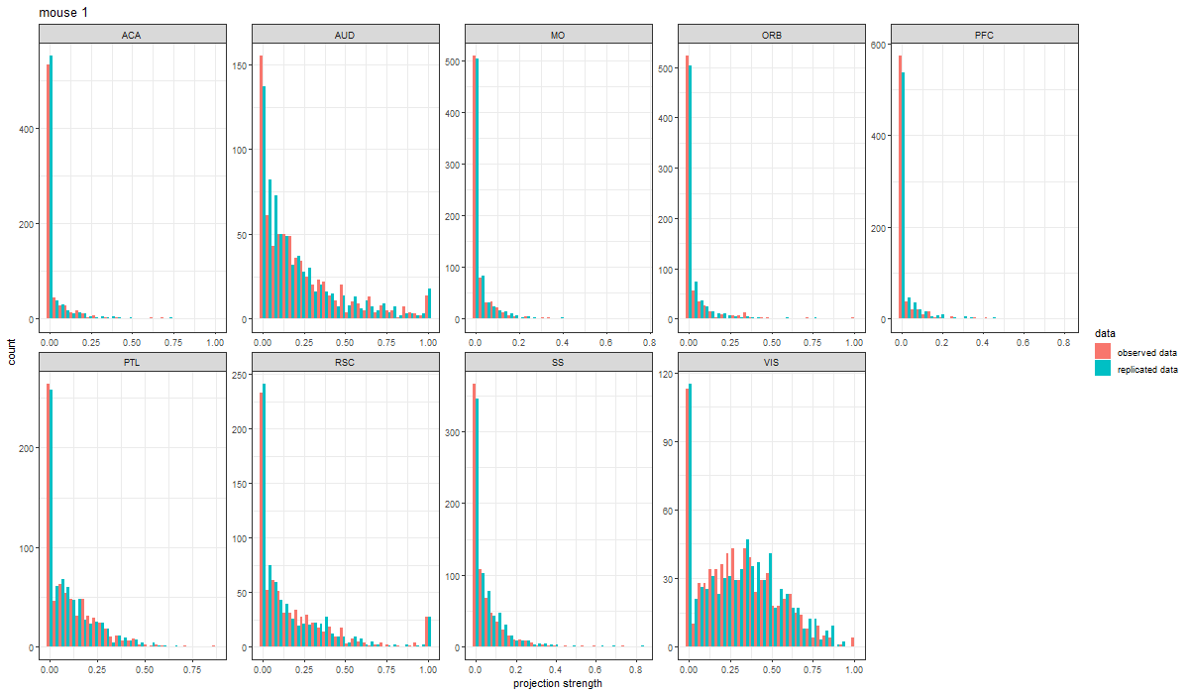
We can also carry out posterior predictive check with single replicated dataset. Figure below compares the distribution of projection strengths of neurons in mouse 1.

Slide 16
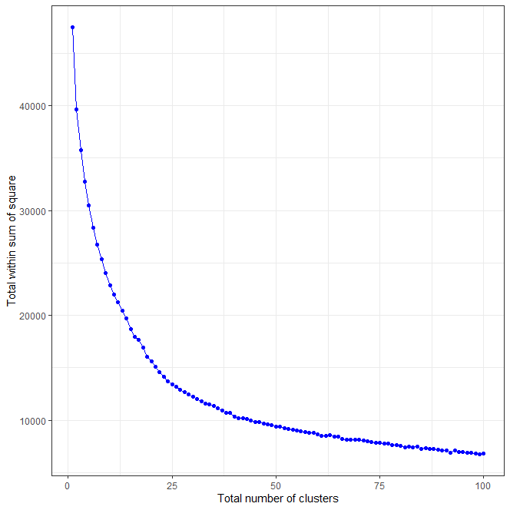
Here we present the relationship between the total number of clusters found by the k-means method and the total sum of square within each cluster.

Slide 17
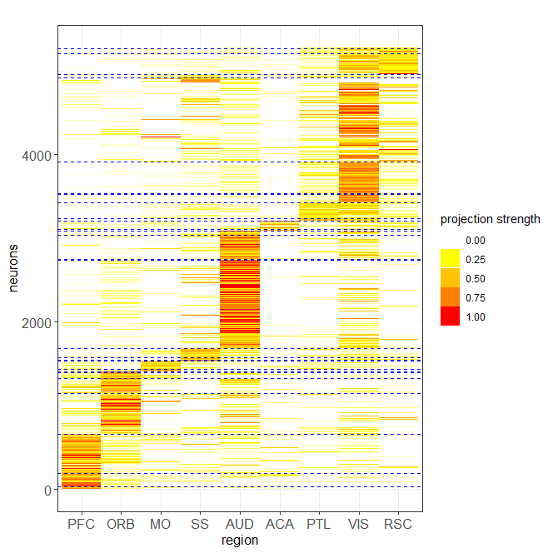
k-means with 30 clusters

Slide 18
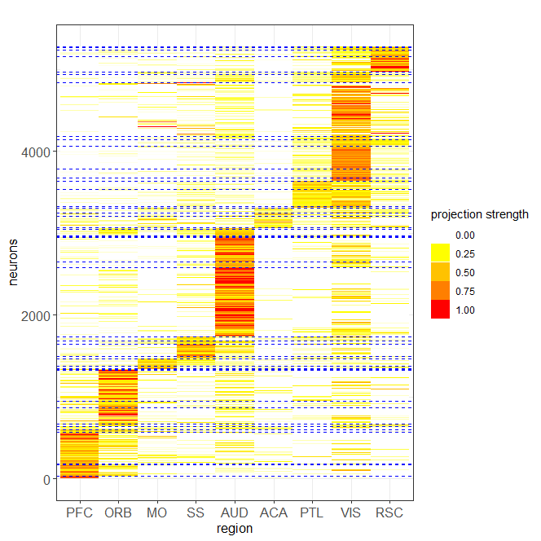
k-means with 50 clusters

Slide 19
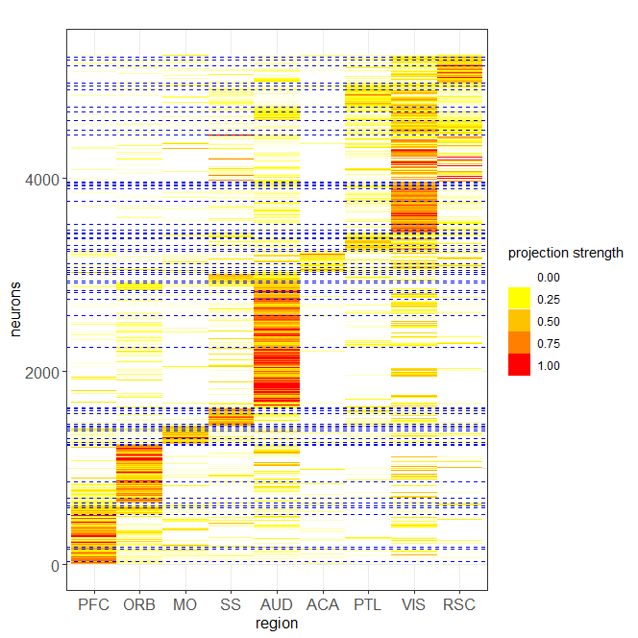
k-means with 70 clusters

Slide 20
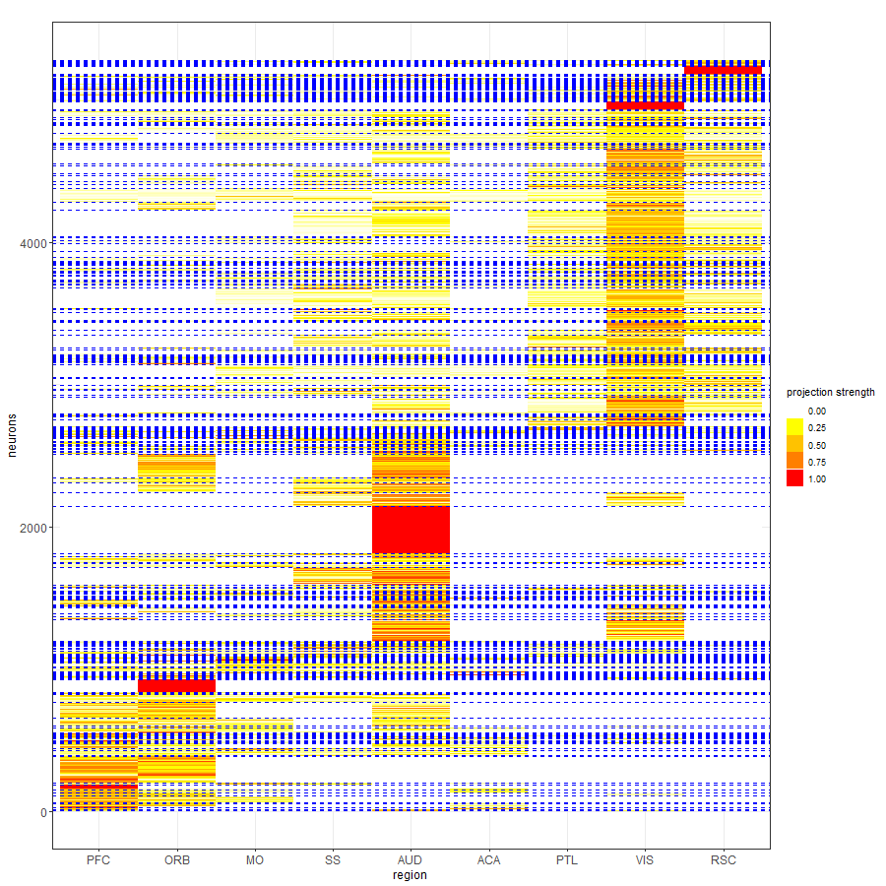
Heatmap of the Binomial model which detects 367 motifs:

Slide 21
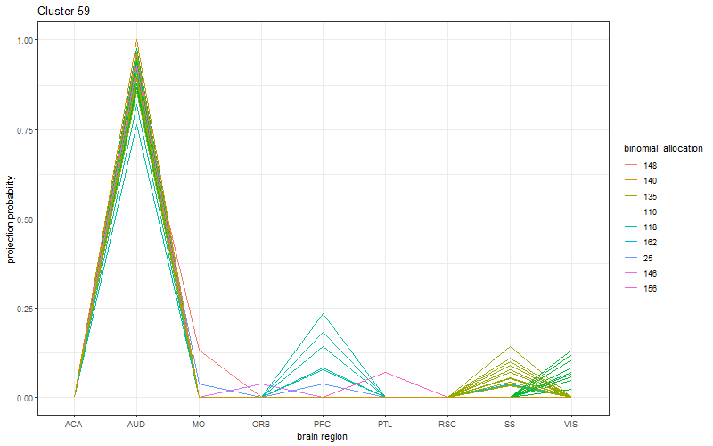
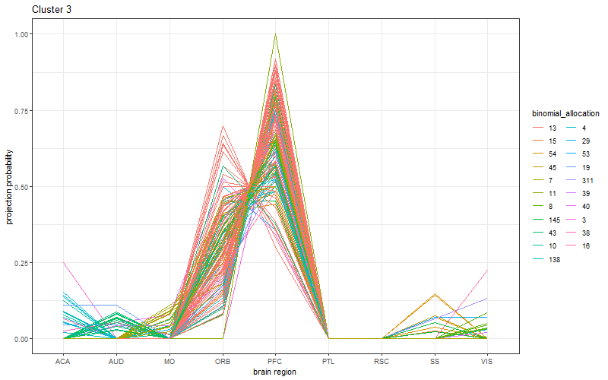
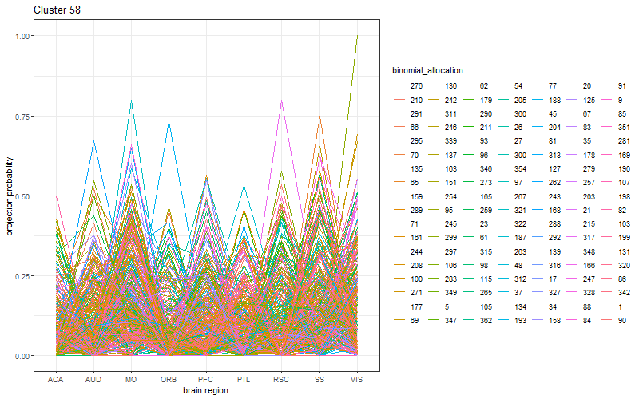
For some of the large Bayesian motifs, we present the projection strengths of each neuron to each region, color-coded by the corresponding Binomial allocations. There are seven motifs identified by the Bayesian model with more than 100 allocated neurons.

Slide 22
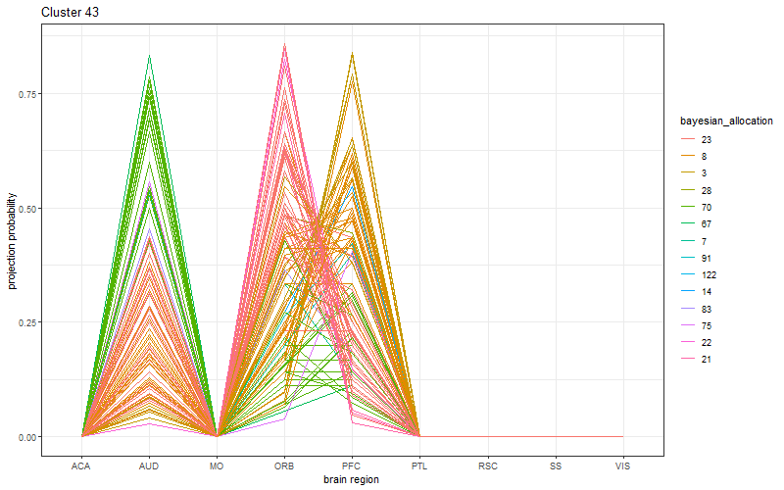
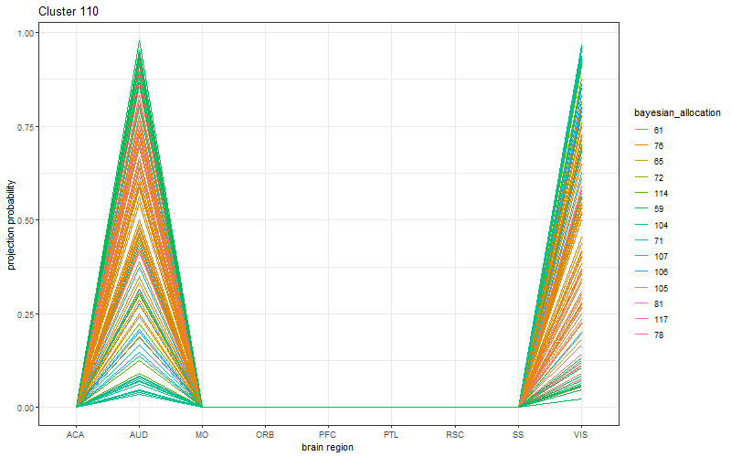
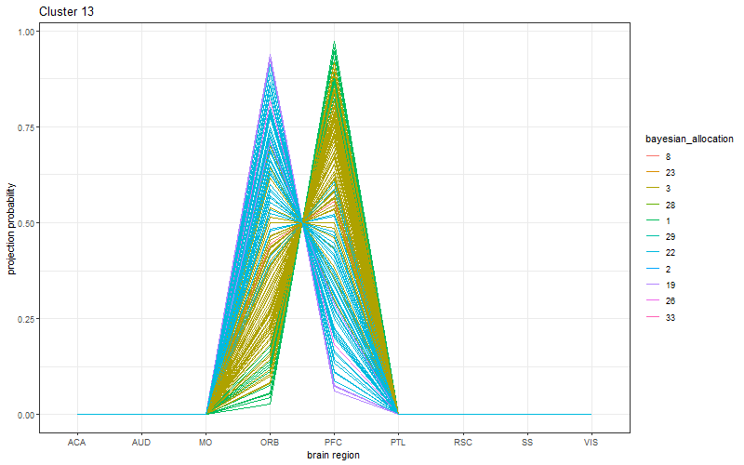
For some of the large Binomial motifs, we present the projection strengths of each neuron to each region, color-coded by the corresponding Bayesian allocations. There are ten motifs identified by the Binomial model with more than 100 allocated neurons.

Slide 23

Comparison of cluster estimates using VI (values shown are standardized to range [0,1])

