Slide 1
Barseq data
Brain Regions:
OFC
Motor
Rstr
SSctx
Cstr
Amyg
VisIp
VisC
AudC
Thal
Tect

Slide 2
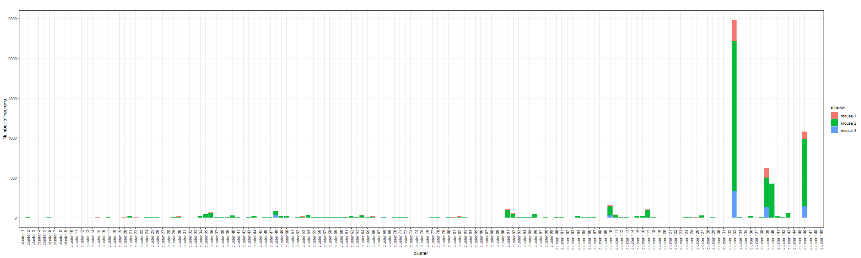
Bayesian Result – minVI to obtain point estimates of neuron allocations
There are 149 clusters (motifs) in total:

Slide 3
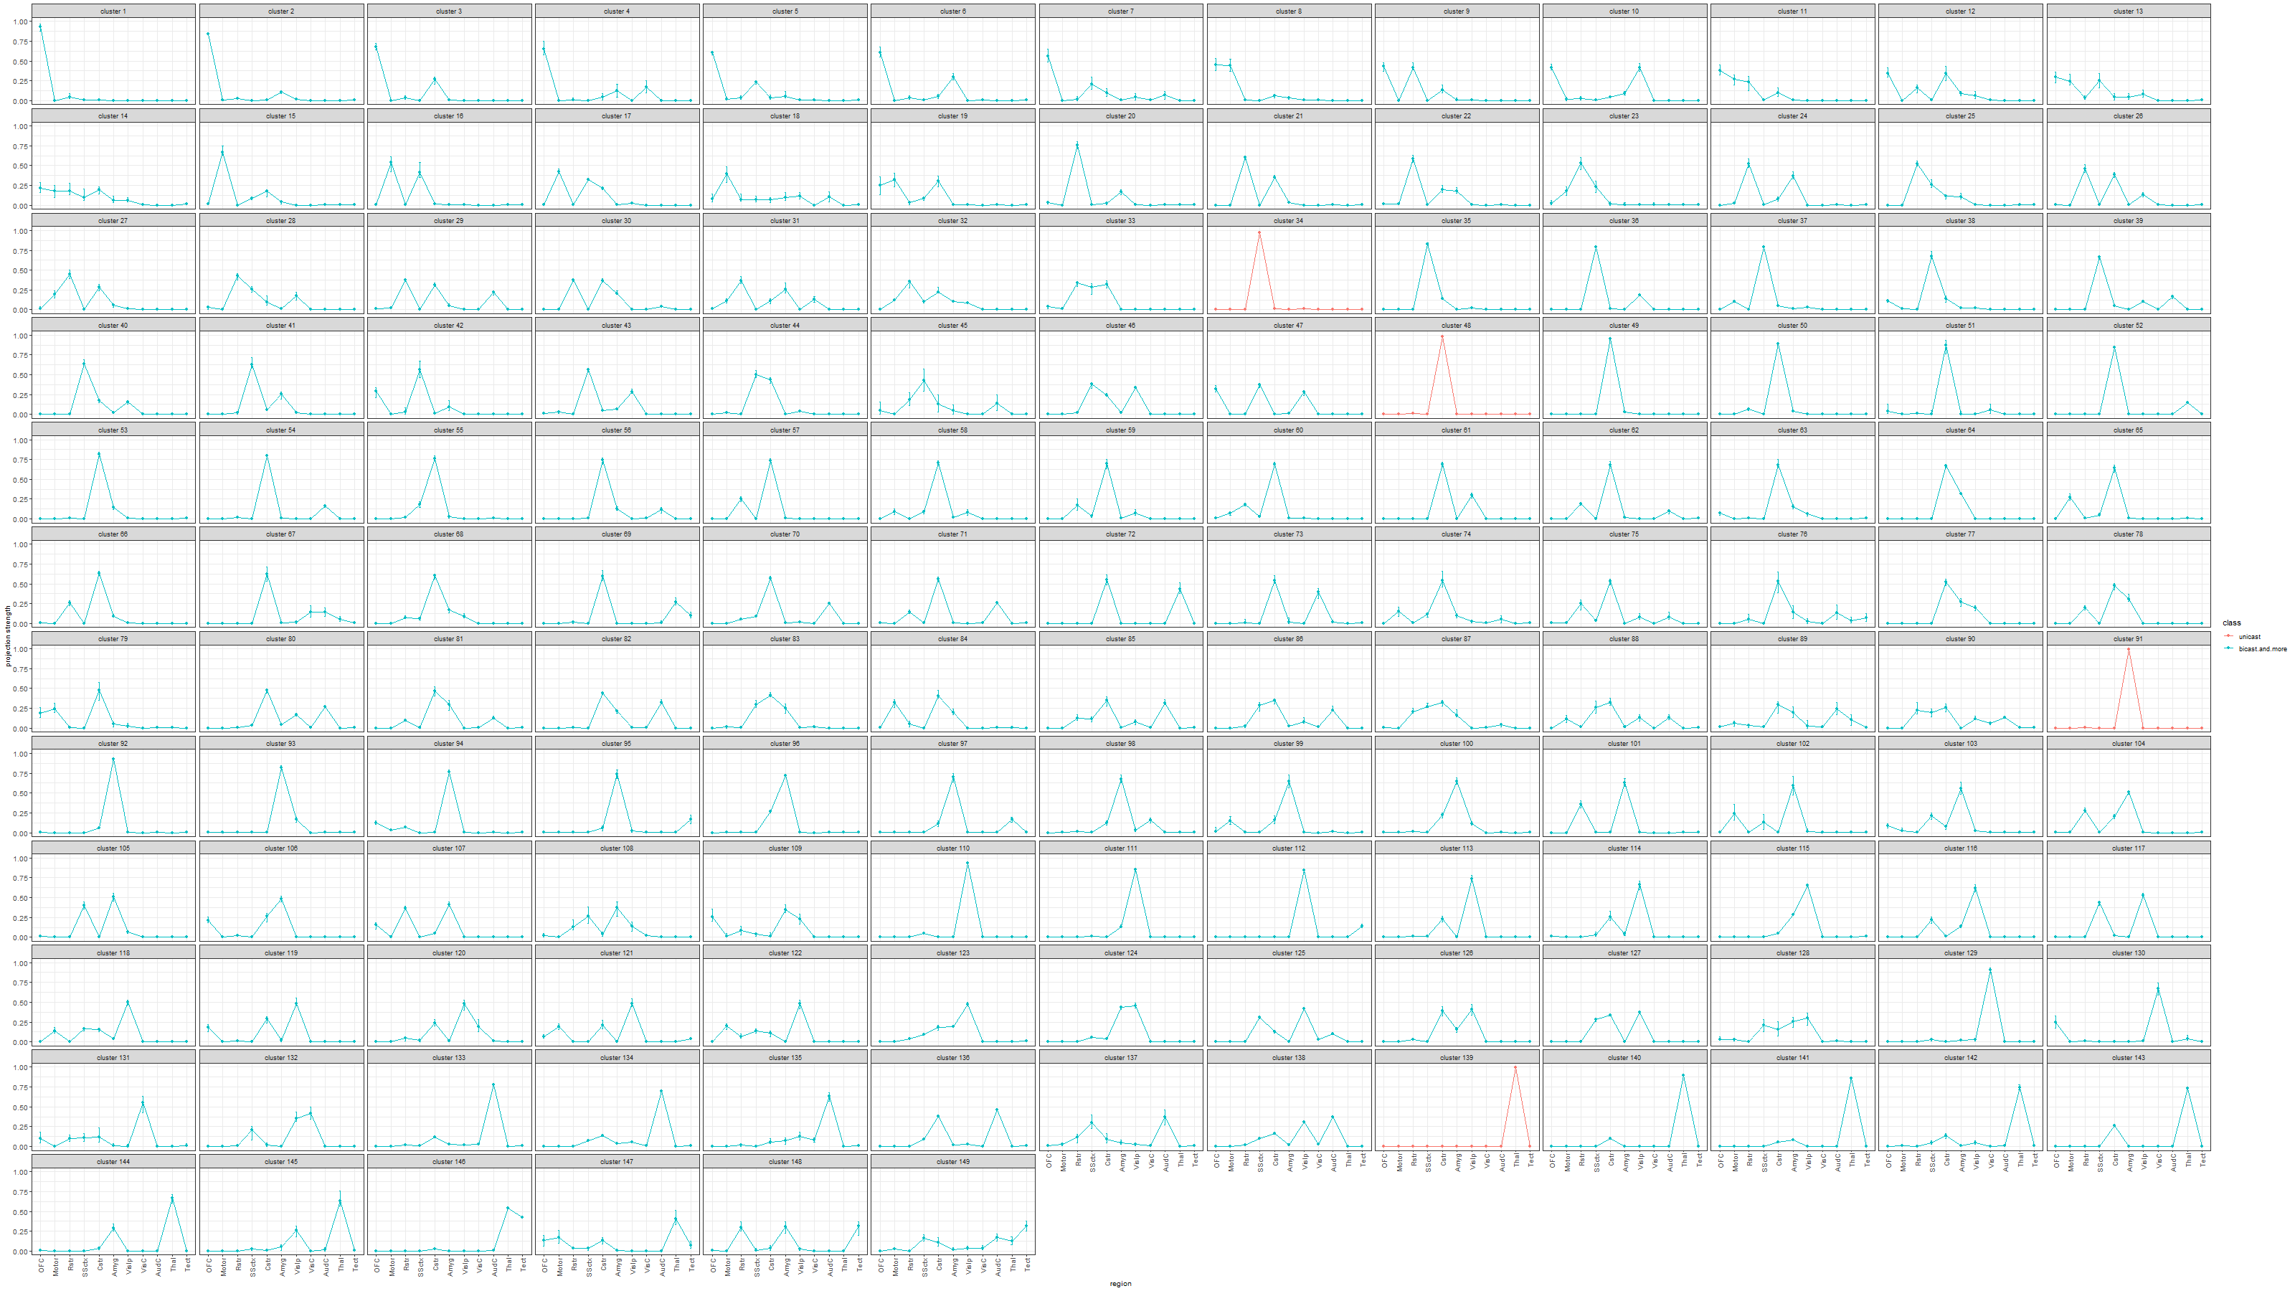
Estimated projection probability of neurons in each cluster with error-bars, color-coded by the number of projecting regions of each cluster:

Slide 4
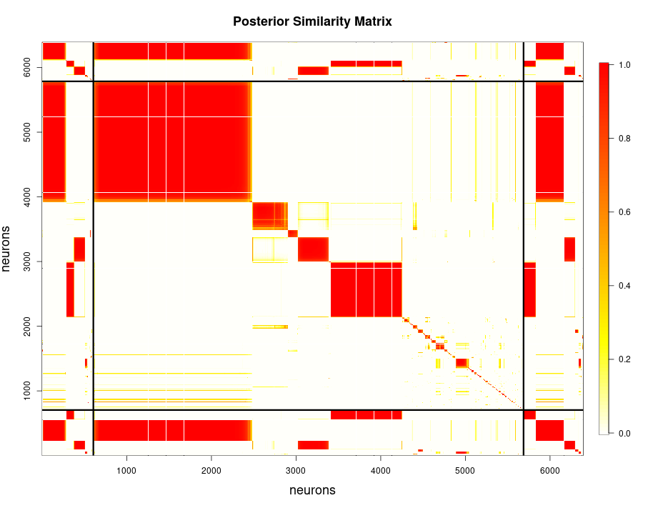
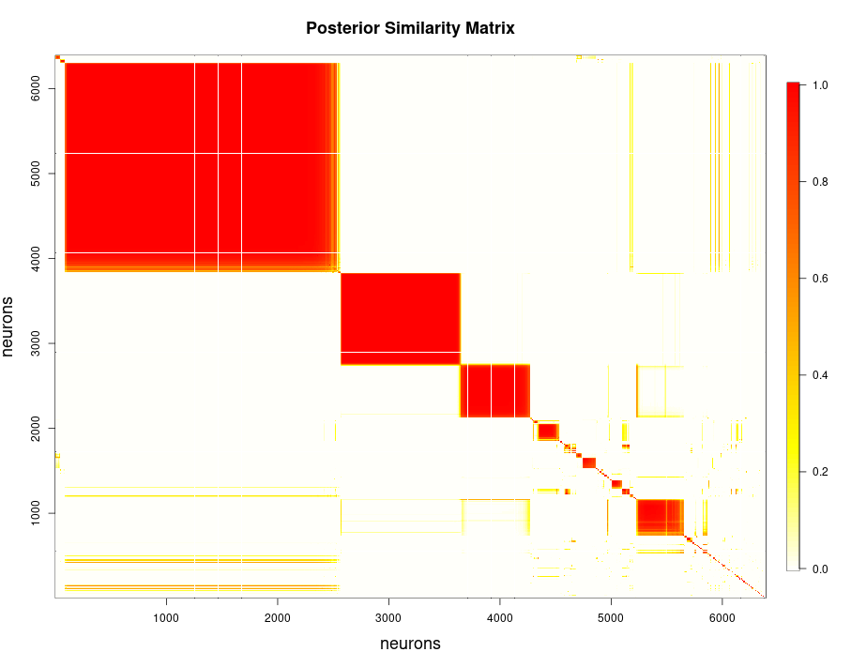

Slide 5
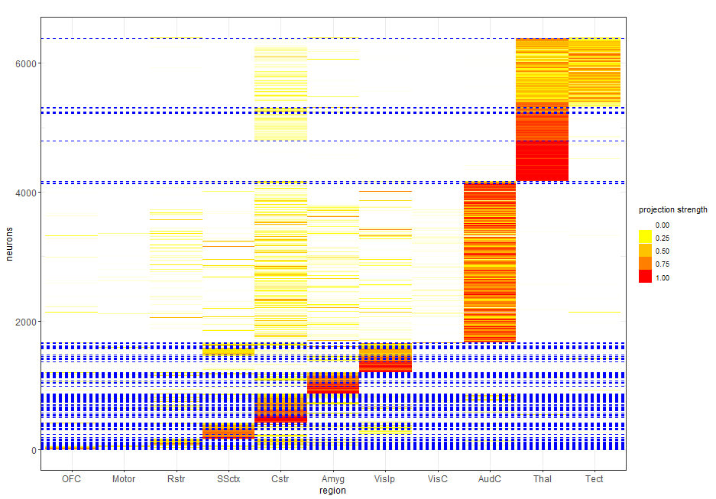

Slide 6
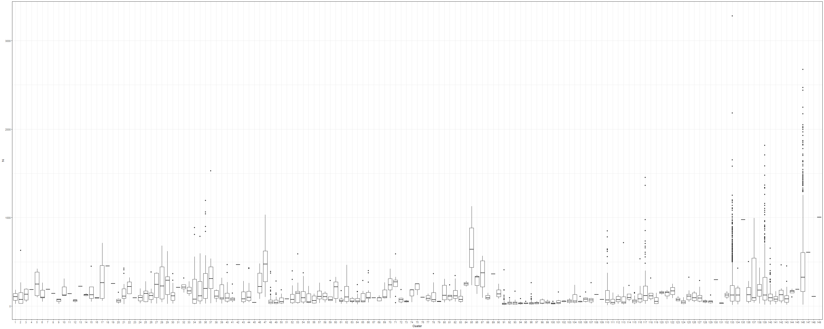
Distribution of the sum of counts across all brain regions for neurons within each cluster.

Slide 7
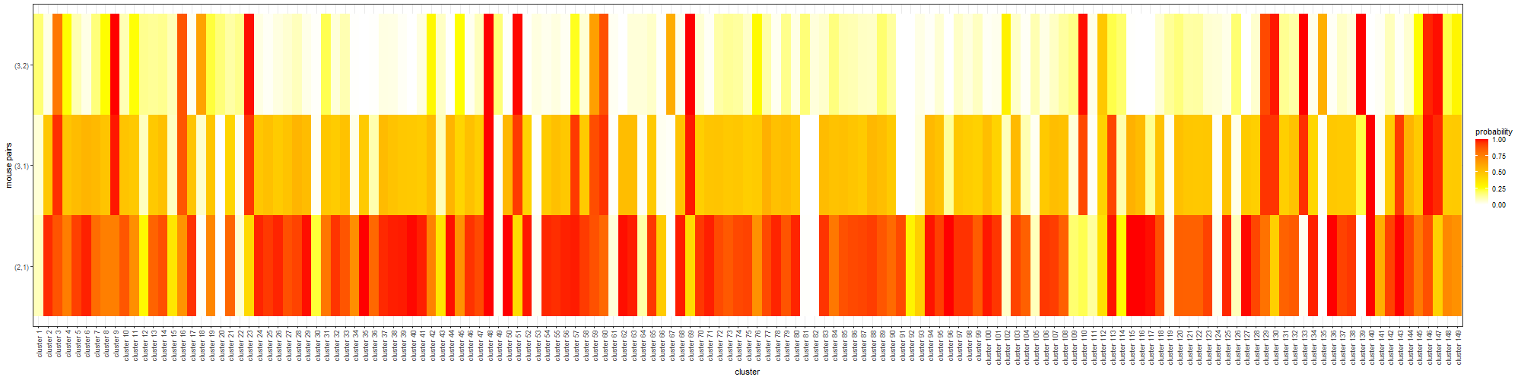
Comparison of allocation proportions across any two mice

Slide 8
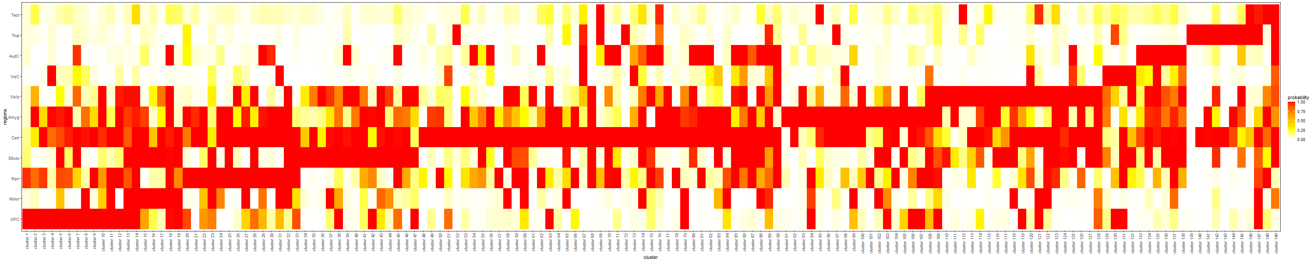
Probability of having the projection strength greater than 0.01 for each cluster and region:

Slide 9
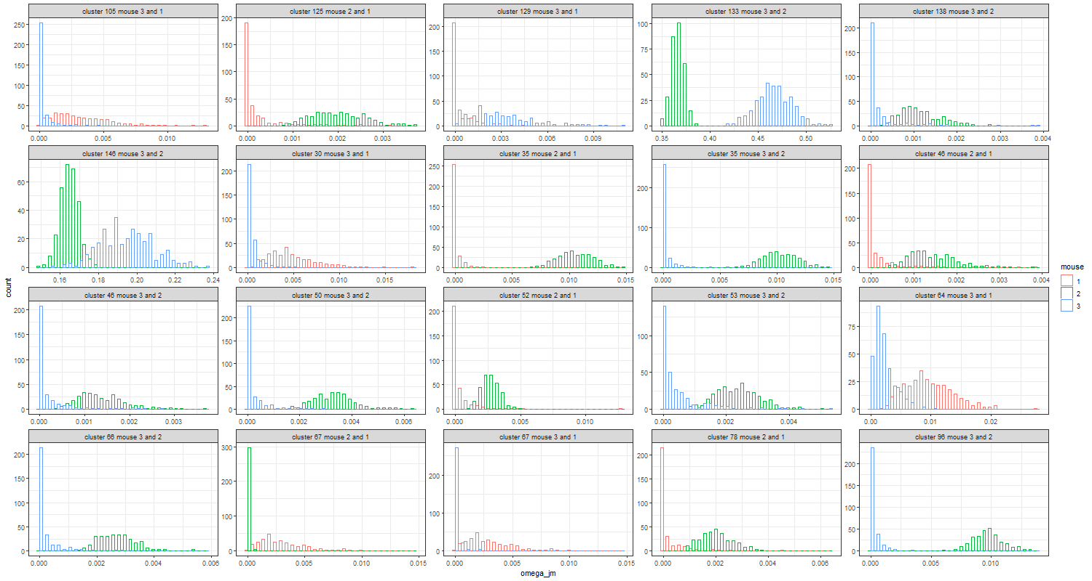
Example of significant difference in component probabilities between two mice:

Slide 10
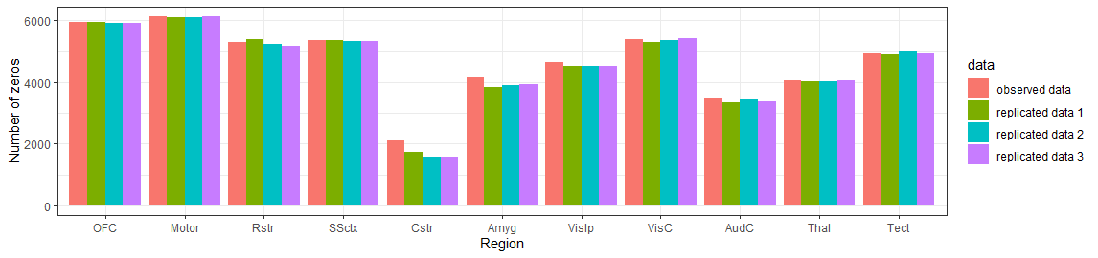
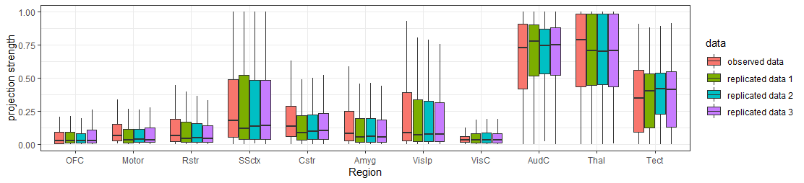
Posterior Predictive Checks: Comparing observed Barseq data against replicated data

Slide 11
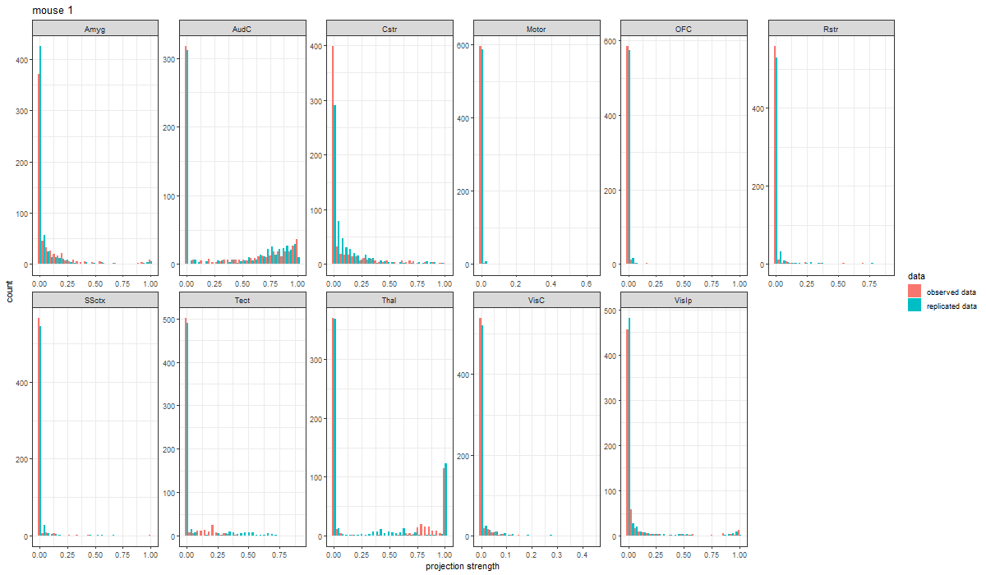
We can also carry out posterior predictive check with a single set of replicated data. Below we present the findings for mouse 1. The same comparison could be carried out to all the remaining mice as well.

Slide 12
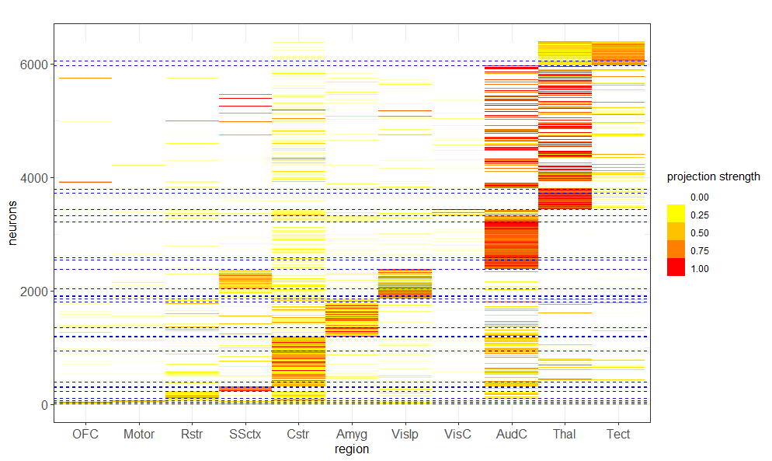
K-means with 30 clusters: Neurons are reordered by the k-means allocation.

Slide 13
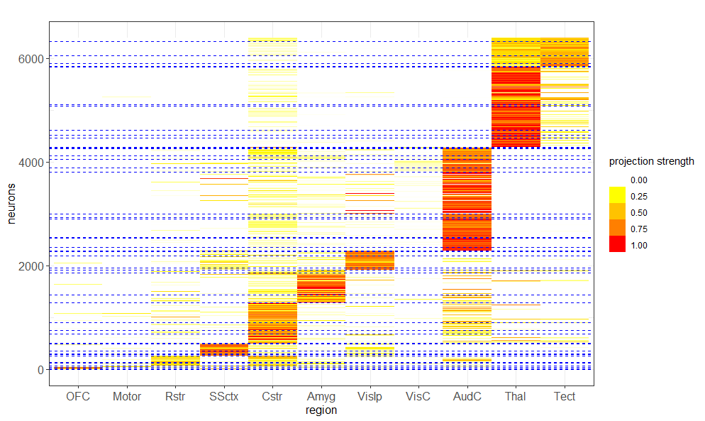
K-means with 50 clusters: Neurons are reordered by the k-means allocation.

Slide 14
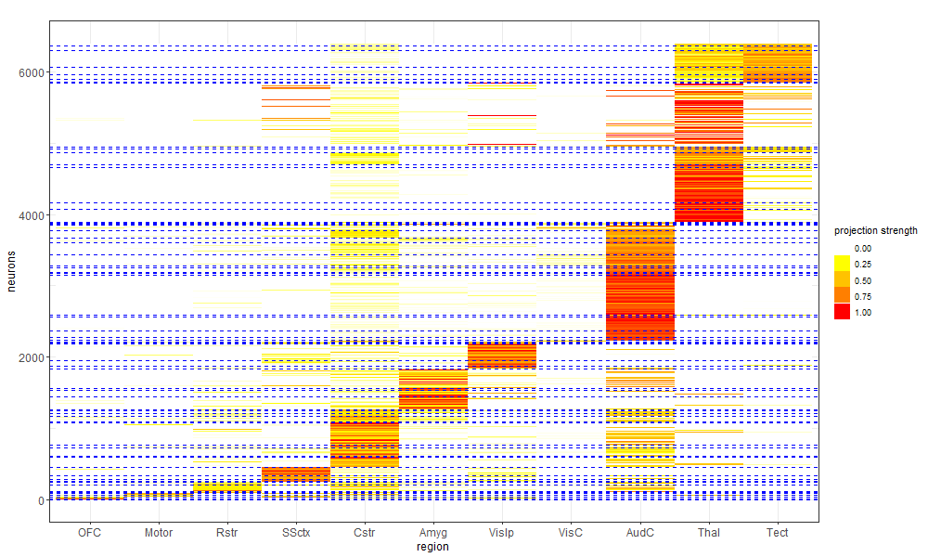
K-means with 70 clusters: Neurons are reordered by the k-means allocation.

Slide 15
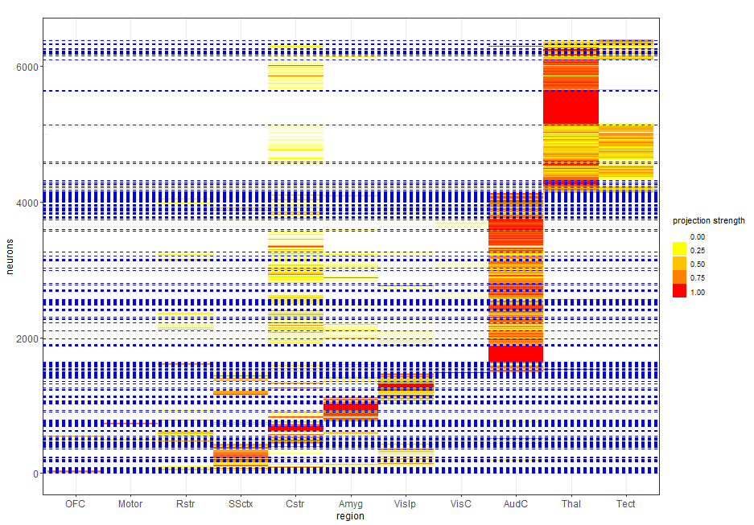
Binomial result

Slide 16

Variation of Information (standardized to values between 0 to 1) between clustering estimates

Slide 17
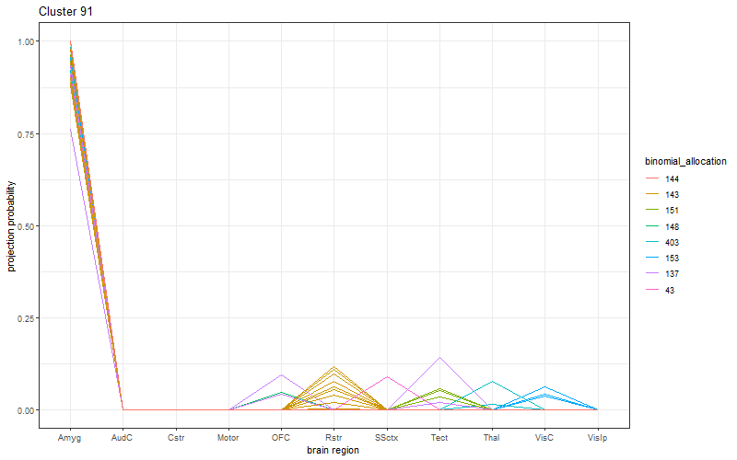
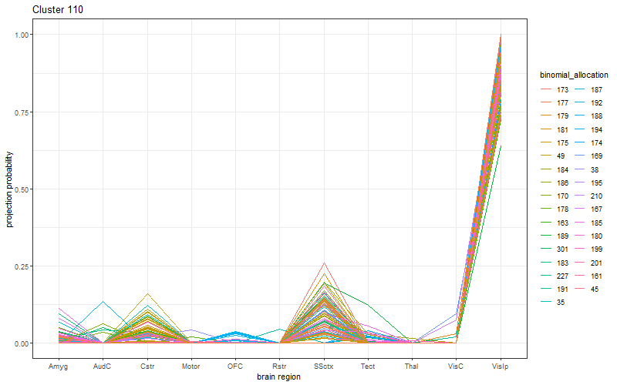
For some large Bayesian motifs, we plot the projection strength of neurons, color-coded by the corresponding Binomial motifs.

Slide 18
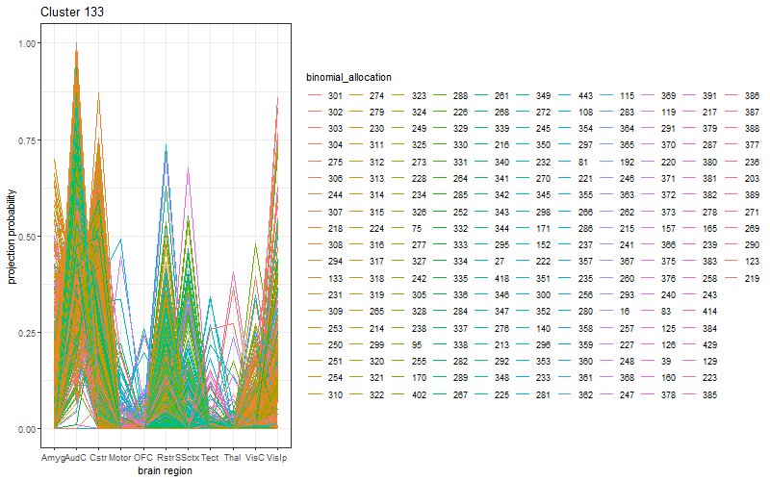
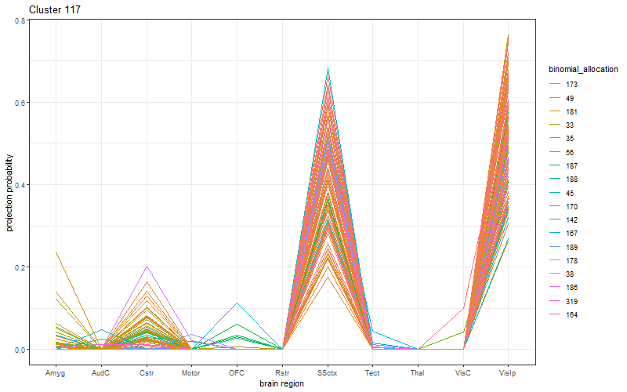

Slide 19
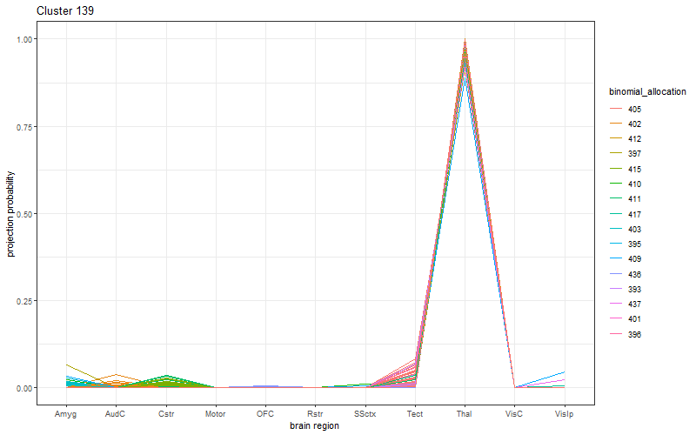
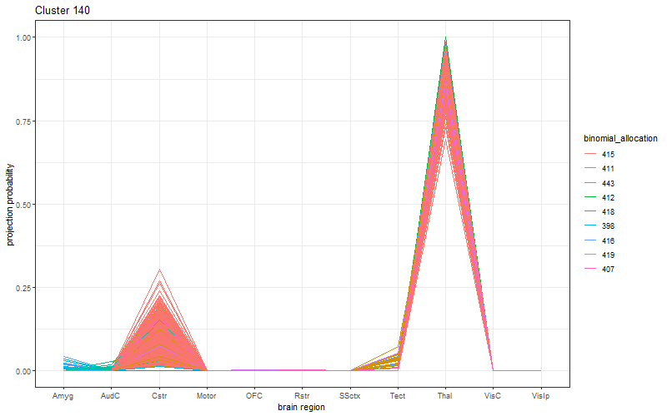

Slide 21
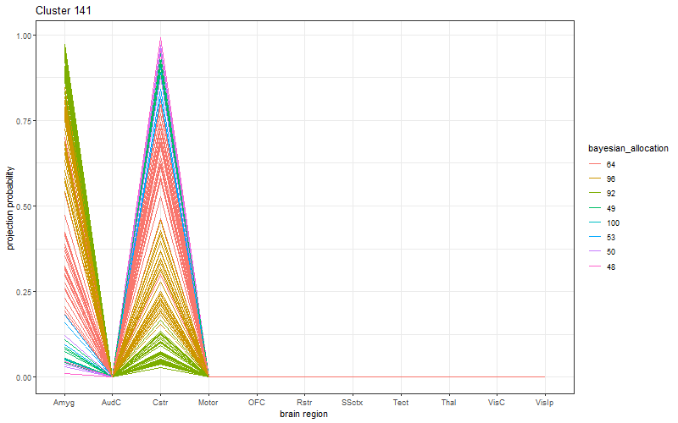
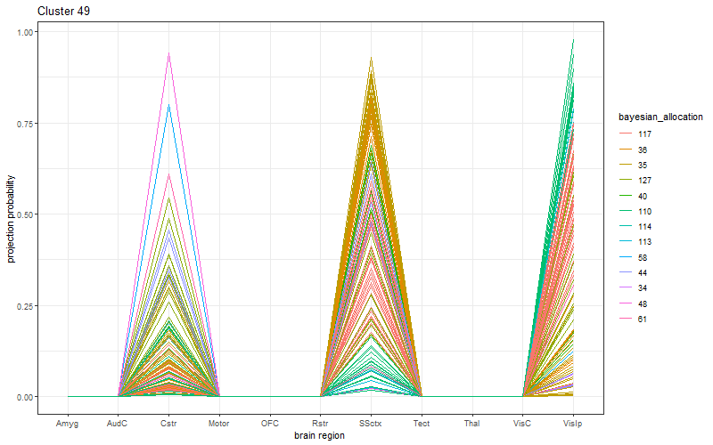
For some large Binomial motifs, we plot the projection strength of neurons, color-coded by the corresponding Bayesian motifs.
And there are 12 other Binomial motifs with more than 100 neurons.

