Slide 1
EC data
Brain regions:
PFC
ORB
MO
SS
AUD
ACA
PTL
VIS
RSC

Slide 3
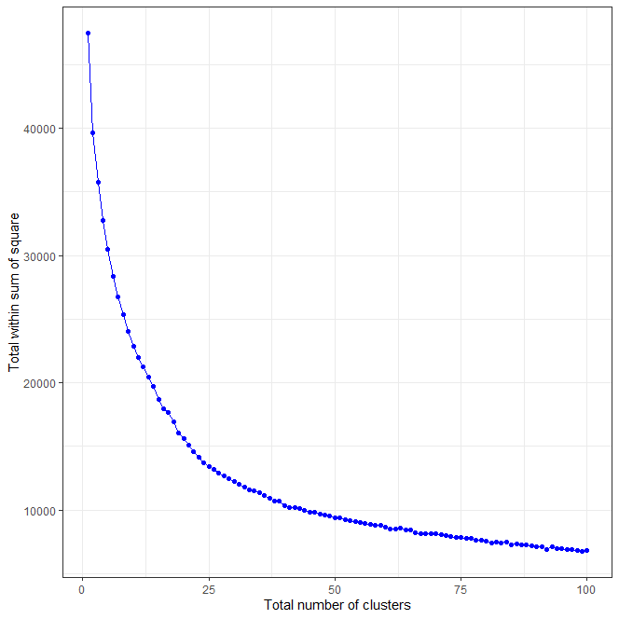

Slide 4
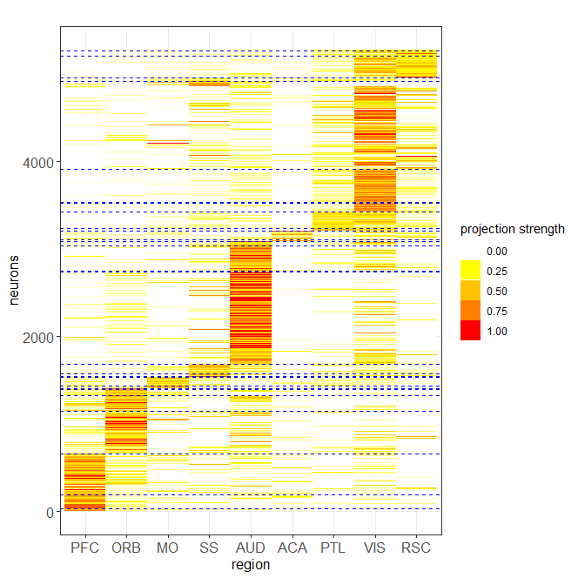
k-means with 30 clusters

Slide 5
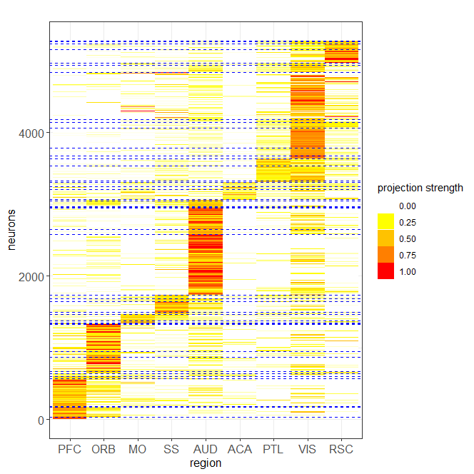
k-means with 50 clusters

Slide 6
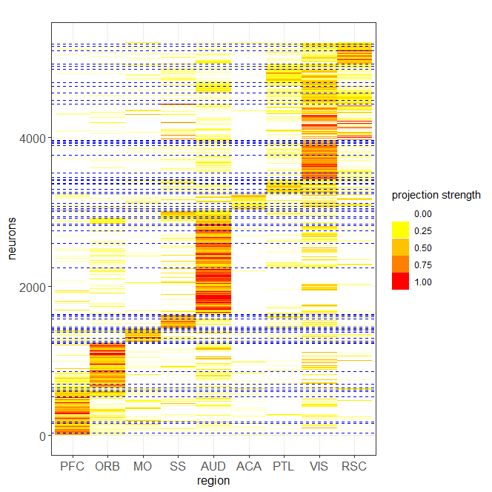
k-means with 70 clusters

