Slide 1
Barseq data
Brain Regions:
OFC
Motor
Rstr
SSctx
Cstr
Amyg
VisIp
VisC
AudC
Thal
Tect

Slide 2
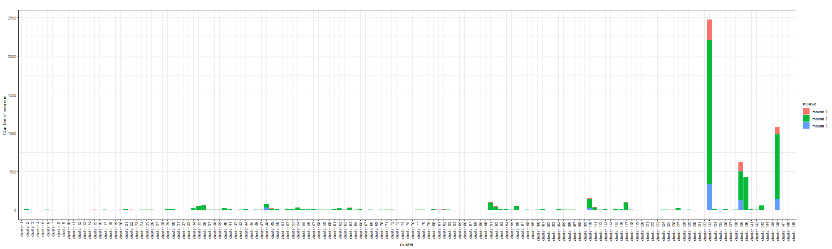
Bayesian Result – minVI to obtain point estimates of neuron allocations
There are 138 clusters (motifs) in total:

Slide 3
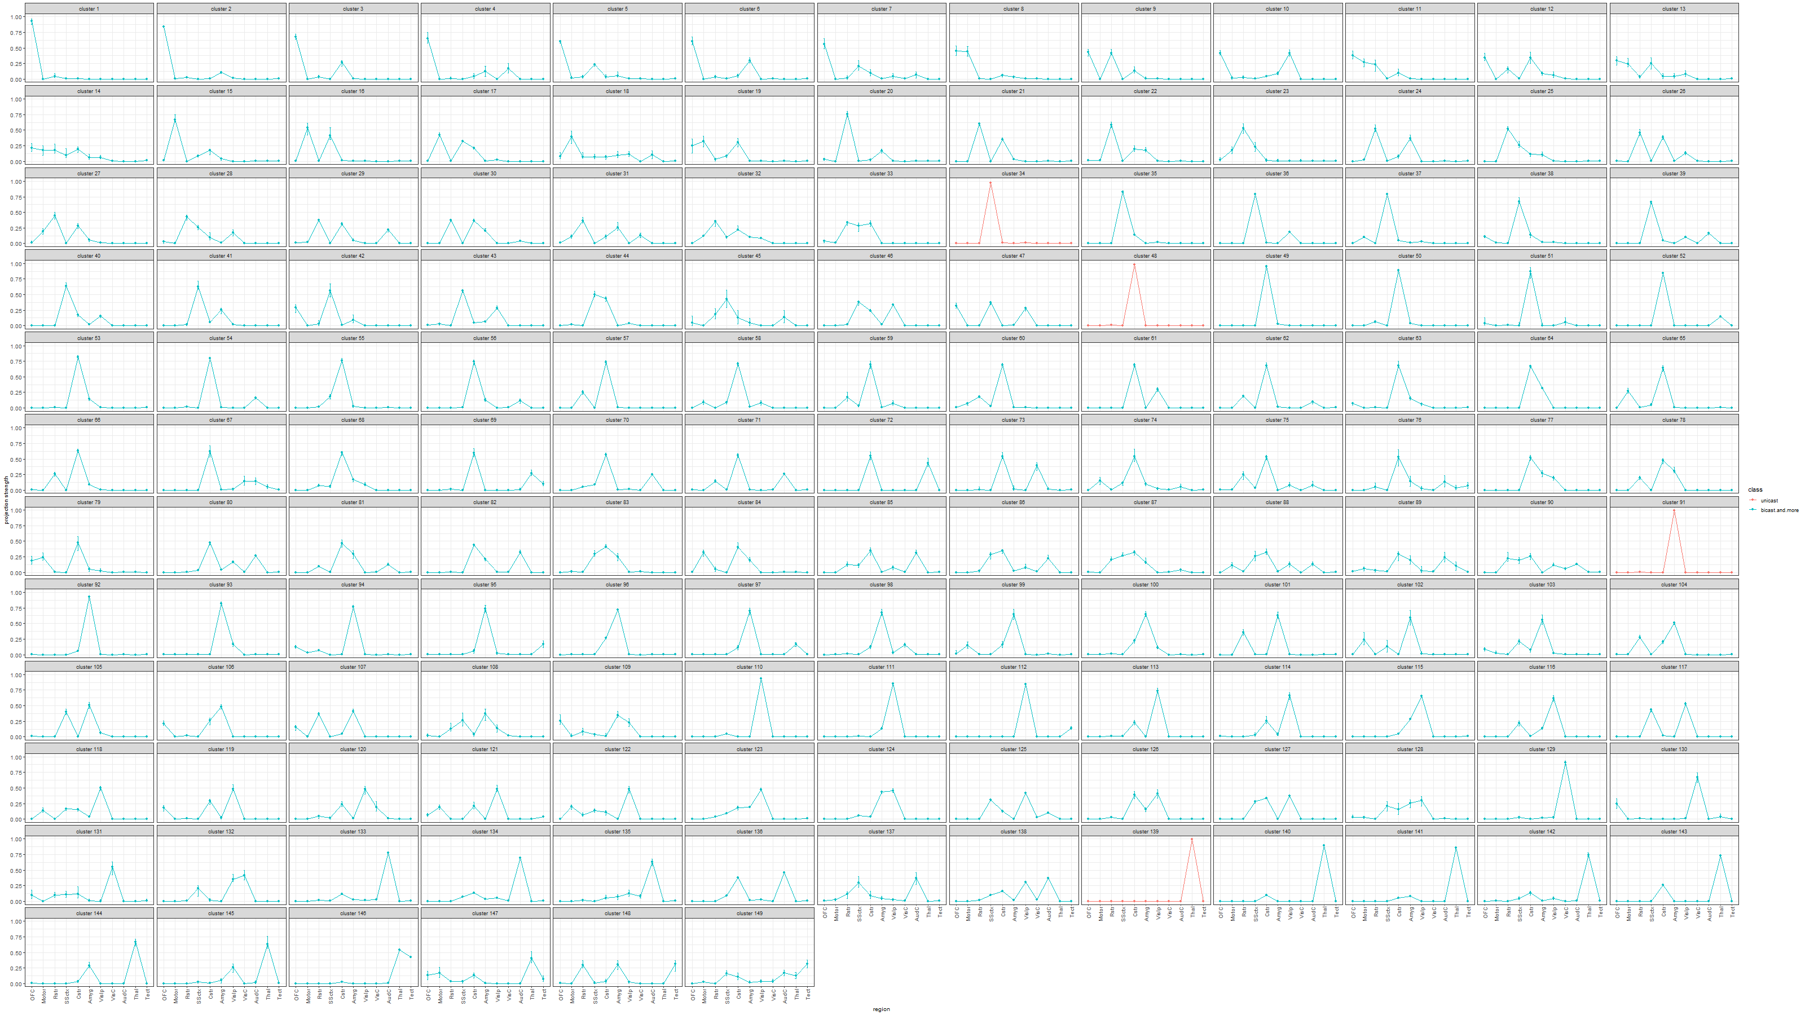
Estimated projection probability of neurons in each cluster with error-bars, color-coded by the number of projecting regions of each cluster:

Slide 4
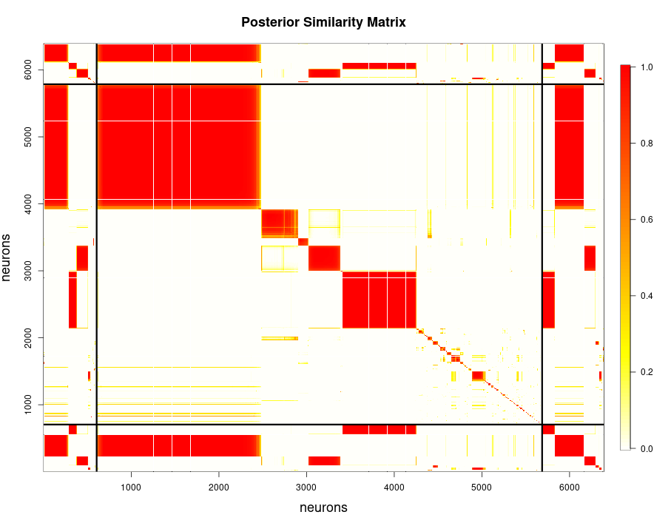
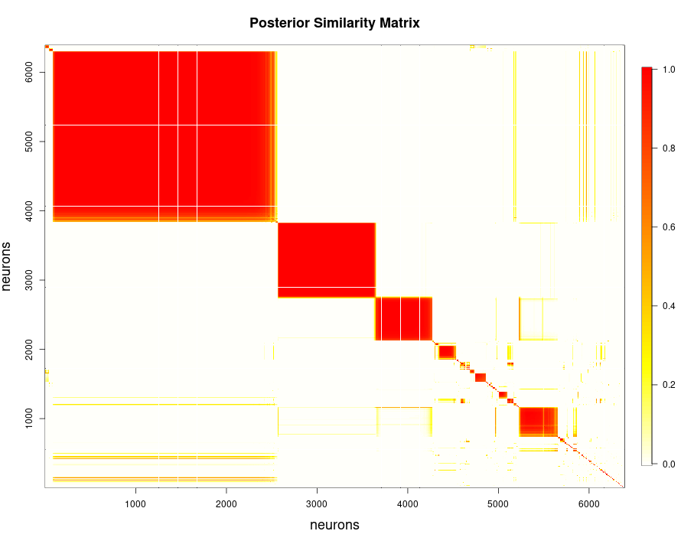

Slide 5
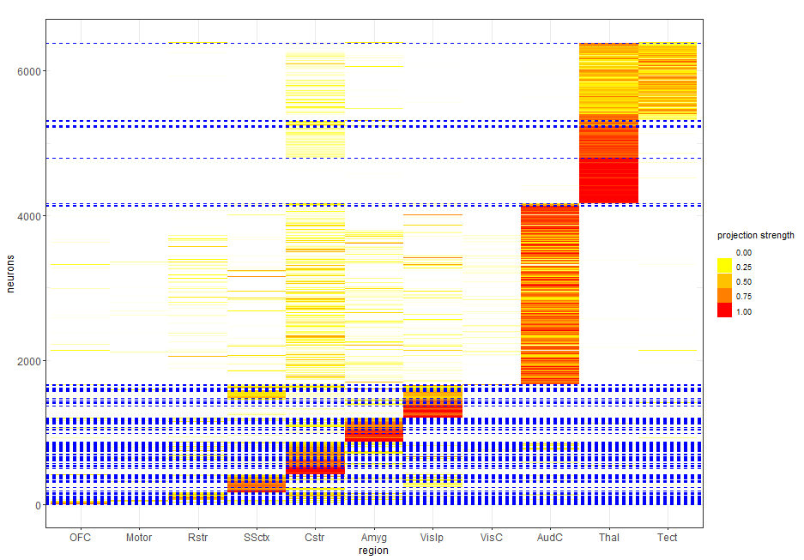

Slide 6
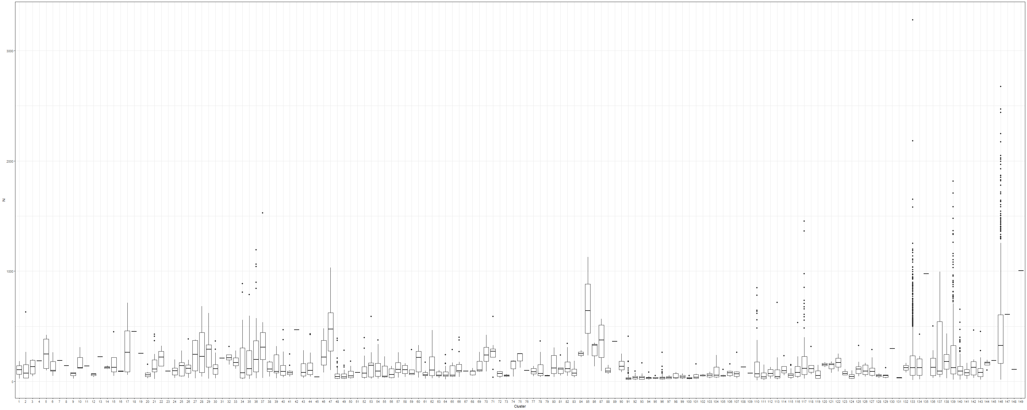
Distribution of the sum of counts across all brain regions for neurons within each cluster.

Slide 7
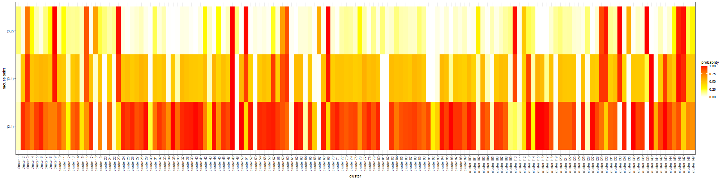
Comparison of allocation proportions across any two mice

Slide 8
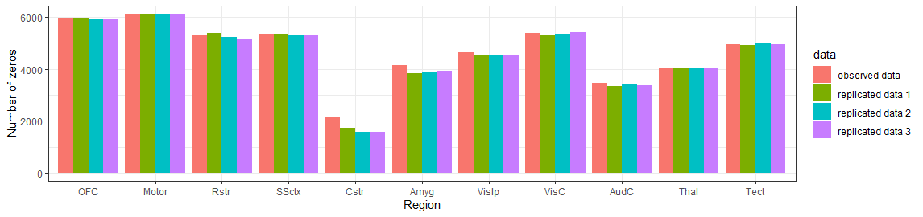
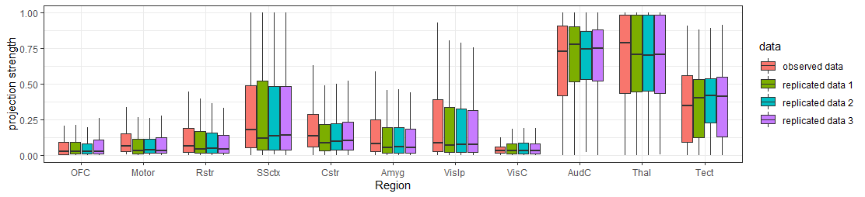
Posterior Predictive Checks: Comparing observed Barseq data against replicated data

Slide 9
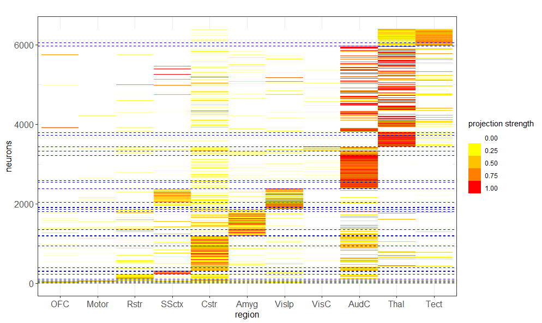
K-means with 30 clusters: Neurons are reordered by the k-means allocation.

Slide 10
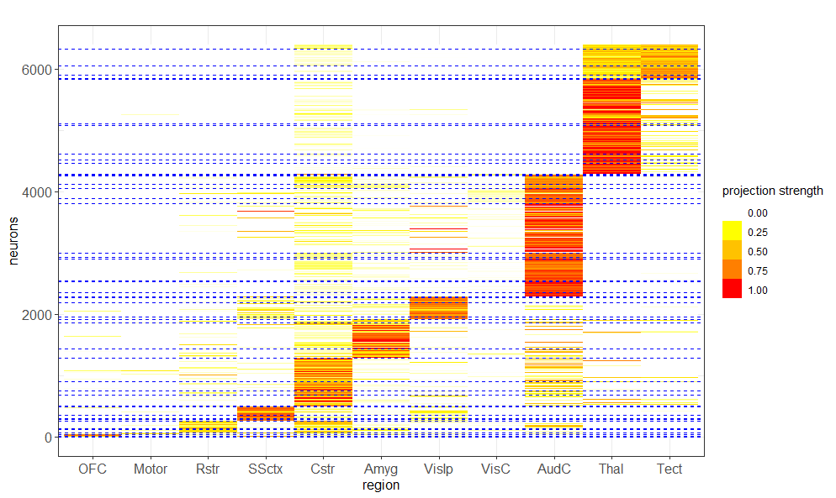
K-means with 50 clusters: Neurons are reordered by the k-means allocation.

Slide 11
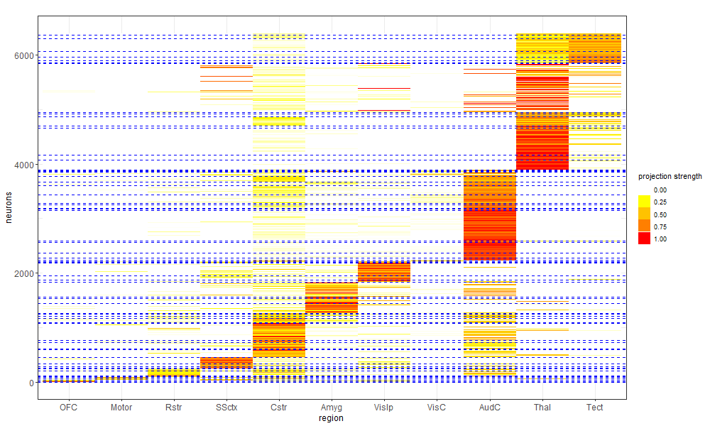
K-means with 70 clusters: Neurons are reordered by the k-means allocation.

Slide 12
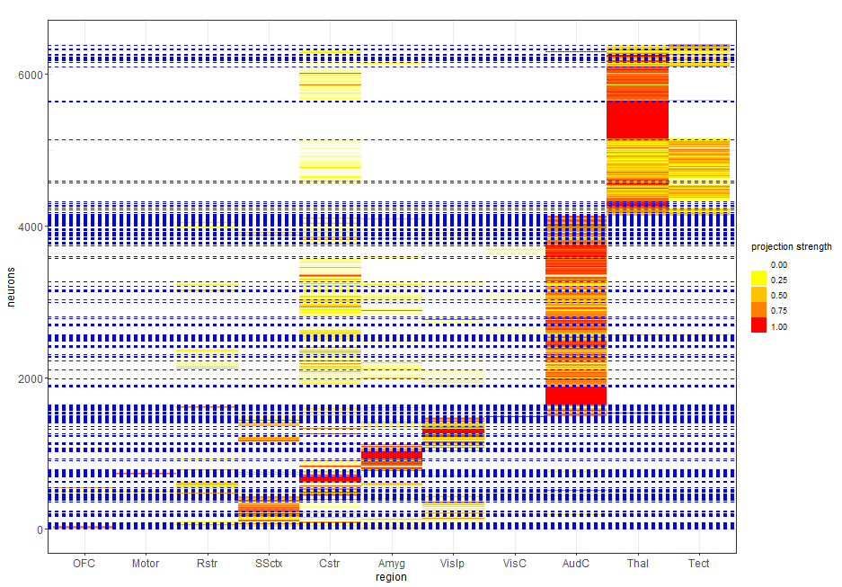
Binomial result

Slide 13

Variation of Information (standardized to values between 0 to 1) between clustering estimates

Slide 14
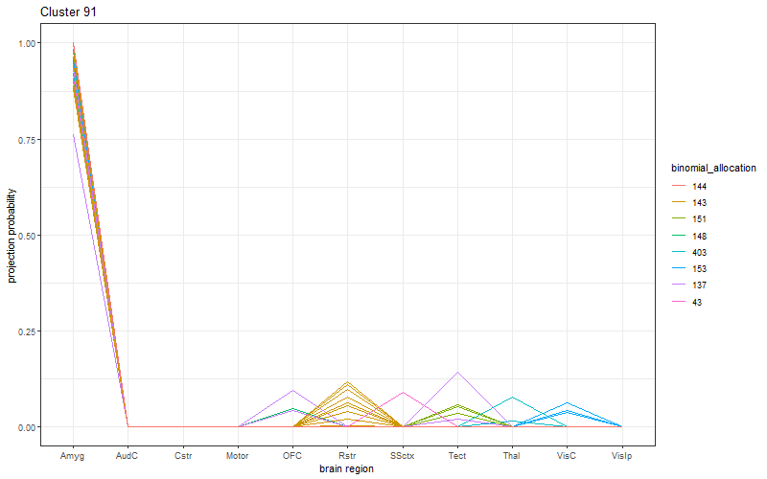
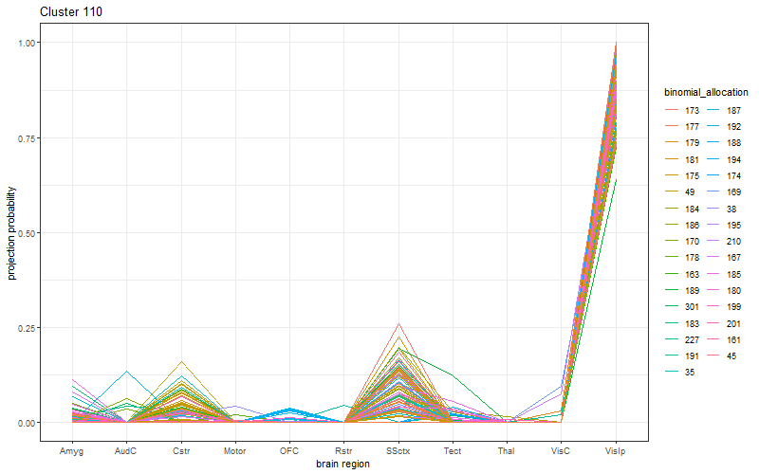
For some large Bayesian motifs, we plot the projection strength of neurons, color-coded by the corresponding Binomial motifs.

Slide 15
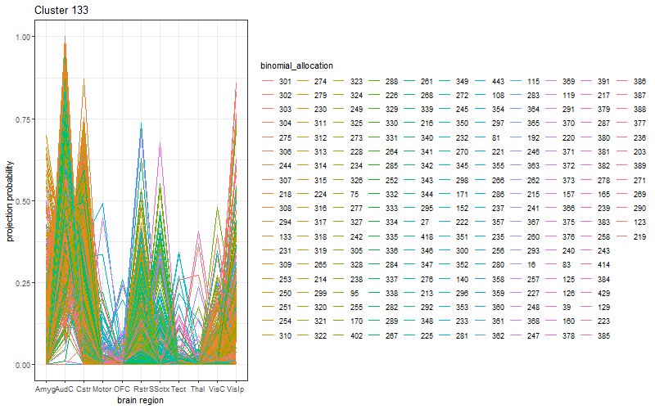
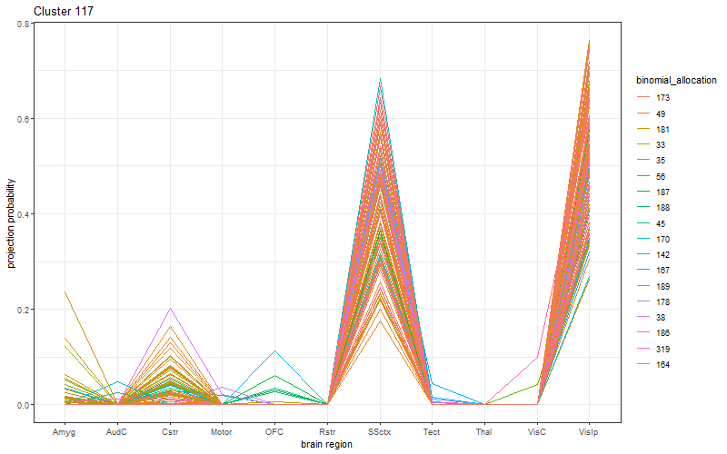

Slide 16
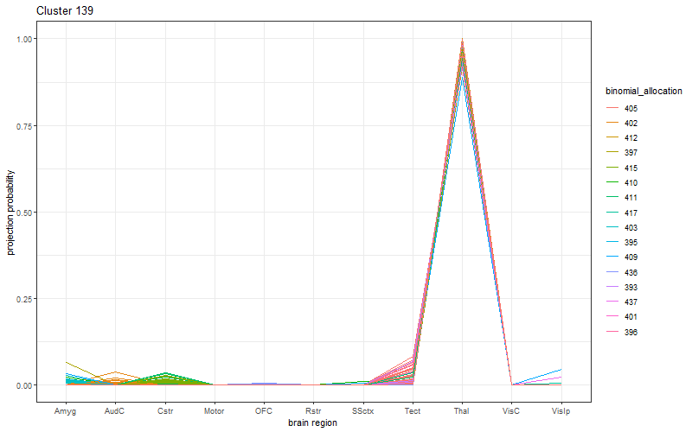
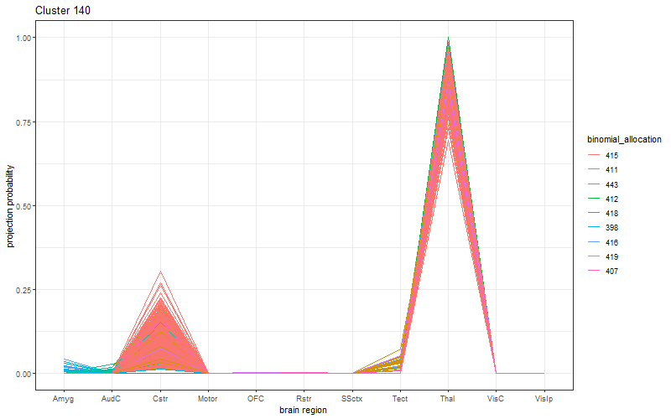

Slide 18
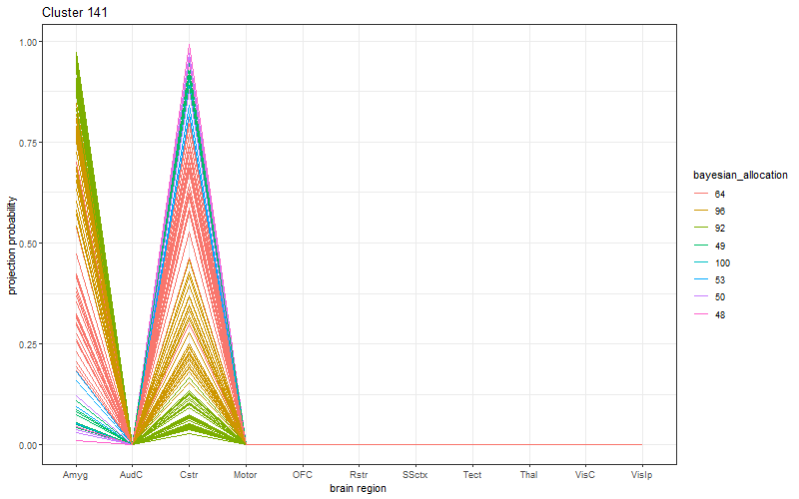
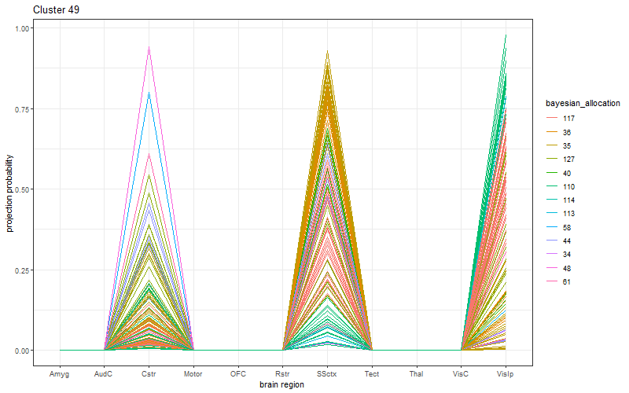
For some large Binomial motifs, we plot the projection strength of neurons, color-coded by the corresponding Bayesian motifs.
And there are 12 other Binomial motifs with more than 100 neurons.

