Slide 1
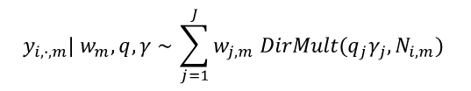
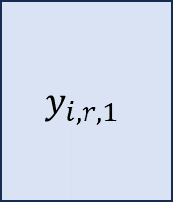

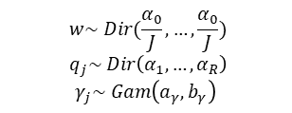
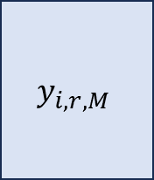



Brain slice of mouse 1
Brain slice of mouse M
Region A
Region A
Region B
Region B
Region C
……
Region C
Apply filtering
$$1 ⋯ R$$
$$1 ⋯ R$$
$$1$$
$$⋮$$
$$n_{1}$$
$$y_{i,r,1}$$
$$y_{i,∙,m}| w_{m}, q,γ \sim \sum_{j=1}^{J}{w_{j,m} DirMult(q_{j}γ_{j}, N_{i,m})}$$
$$1$$
$$⋮$$
$$n_{m}$$
$$y_{i,r,M}$$
……
Mouse-level parameters
$$w_{1}| w \sim Dir(αw)$$
……
$$w_{m}| w \sim Dir(αw)$$
$$w\sim Dir(\frac{α_{0}}{J},…,\frac{α_{0}}{J})$$
$$q_{j}\sim Dir\left(α_{1},…,α_{R}\right)$$
$$γ_{j}\sim Gam\left(a_{γ},b_{γ}\right)$$
Global parameters
Identify groups of neurons with similar projection patterns.
Classify projection regions of each cluster.
Measure similarity between neurons within each dataset and across multiple datasets.
Measure differences between mice.
Calculate the probability of projecting to region B given it projects to region A.
Estimate the posterior probability of projecting to each region for each mouse.
Estimate the projection strength of projecting to each region for each mouse.
Downstream Analysis

