Slide 1
EC data – new
Brain regions:
PFC
ORB
MO
SS
ACA
PTL
VIS
RSC

Slide 2
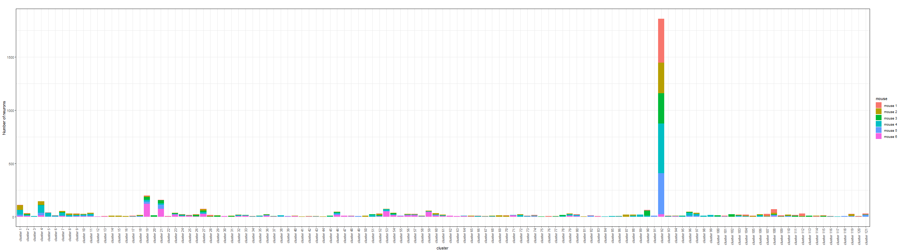
Bayesian Result
There are 121 clusters (motifs) in total:

Slide 3
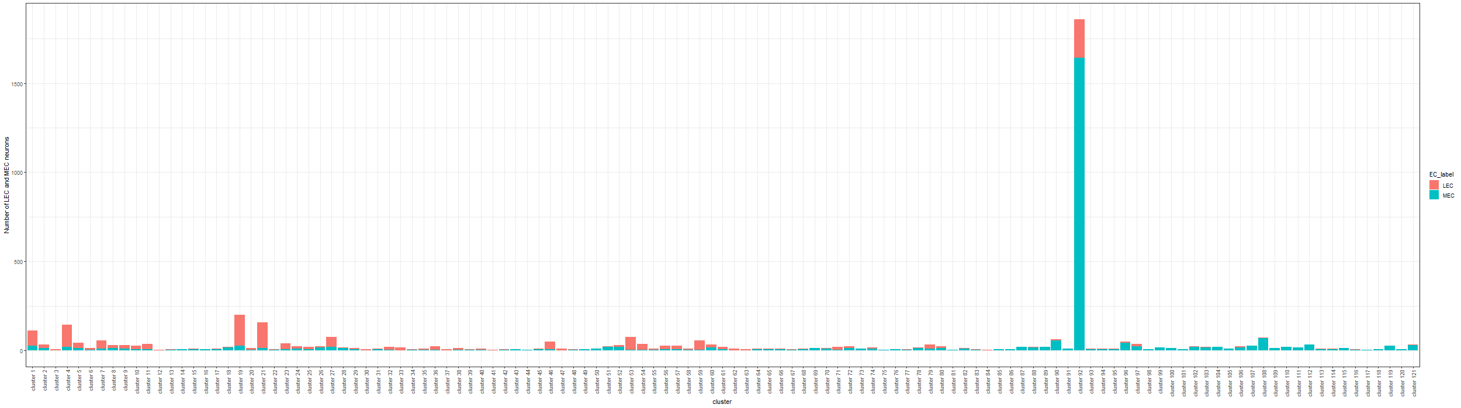
Total number of LEC and MEC neurons in each cluster:

Slide 4
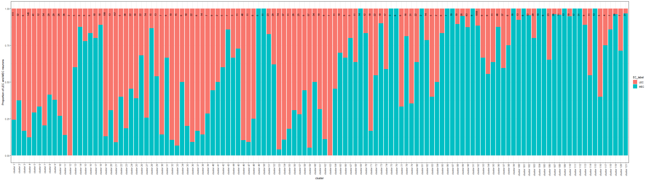
Proportion of LEC and MEC neurons in each cluster:

Slide 5
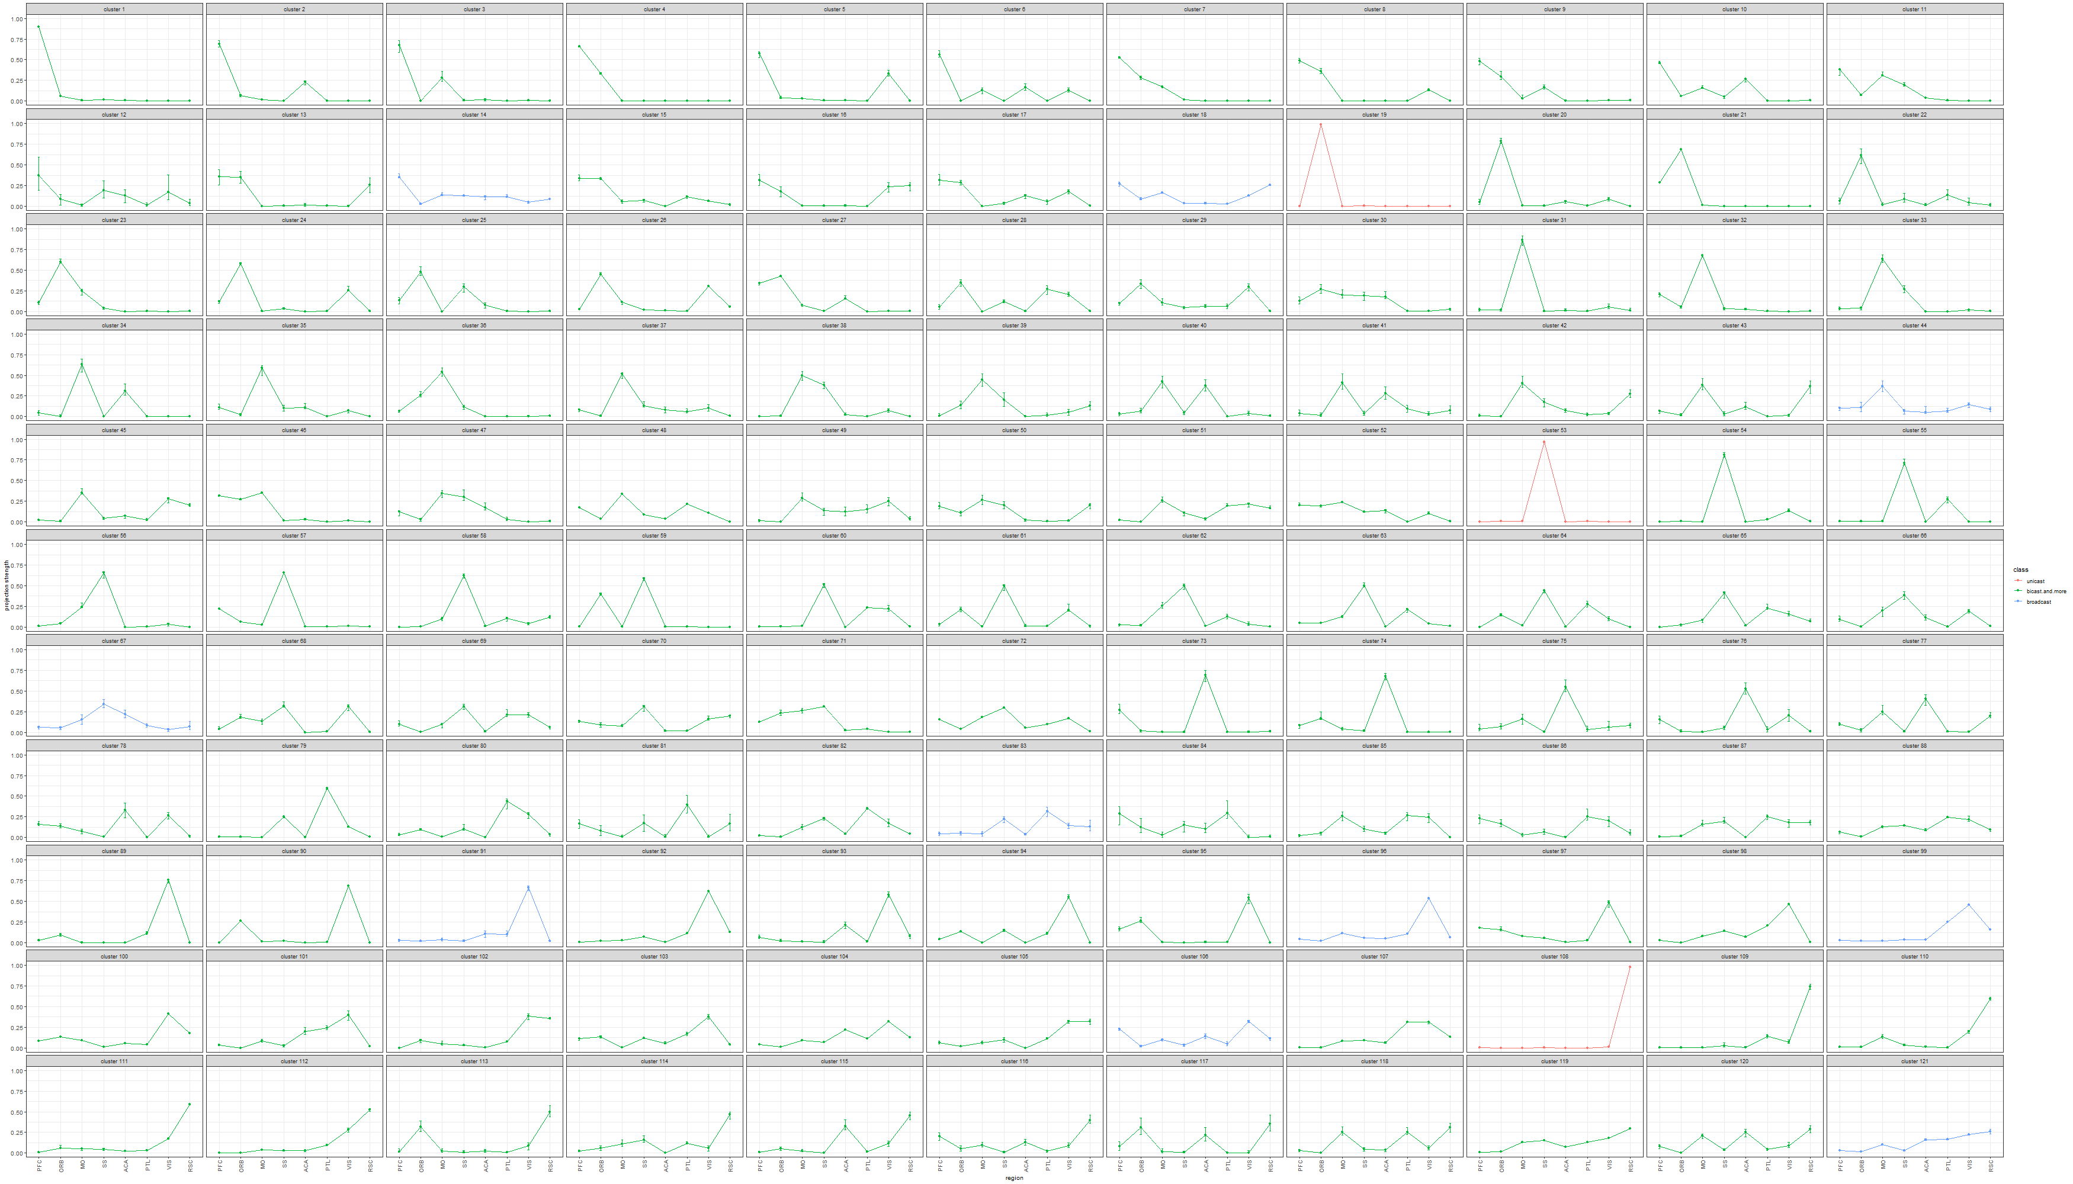
Estimated projection probability of neurons in each cluster with error-bars, color-coded by the number of projecting regions of each cluster:

Slide 6
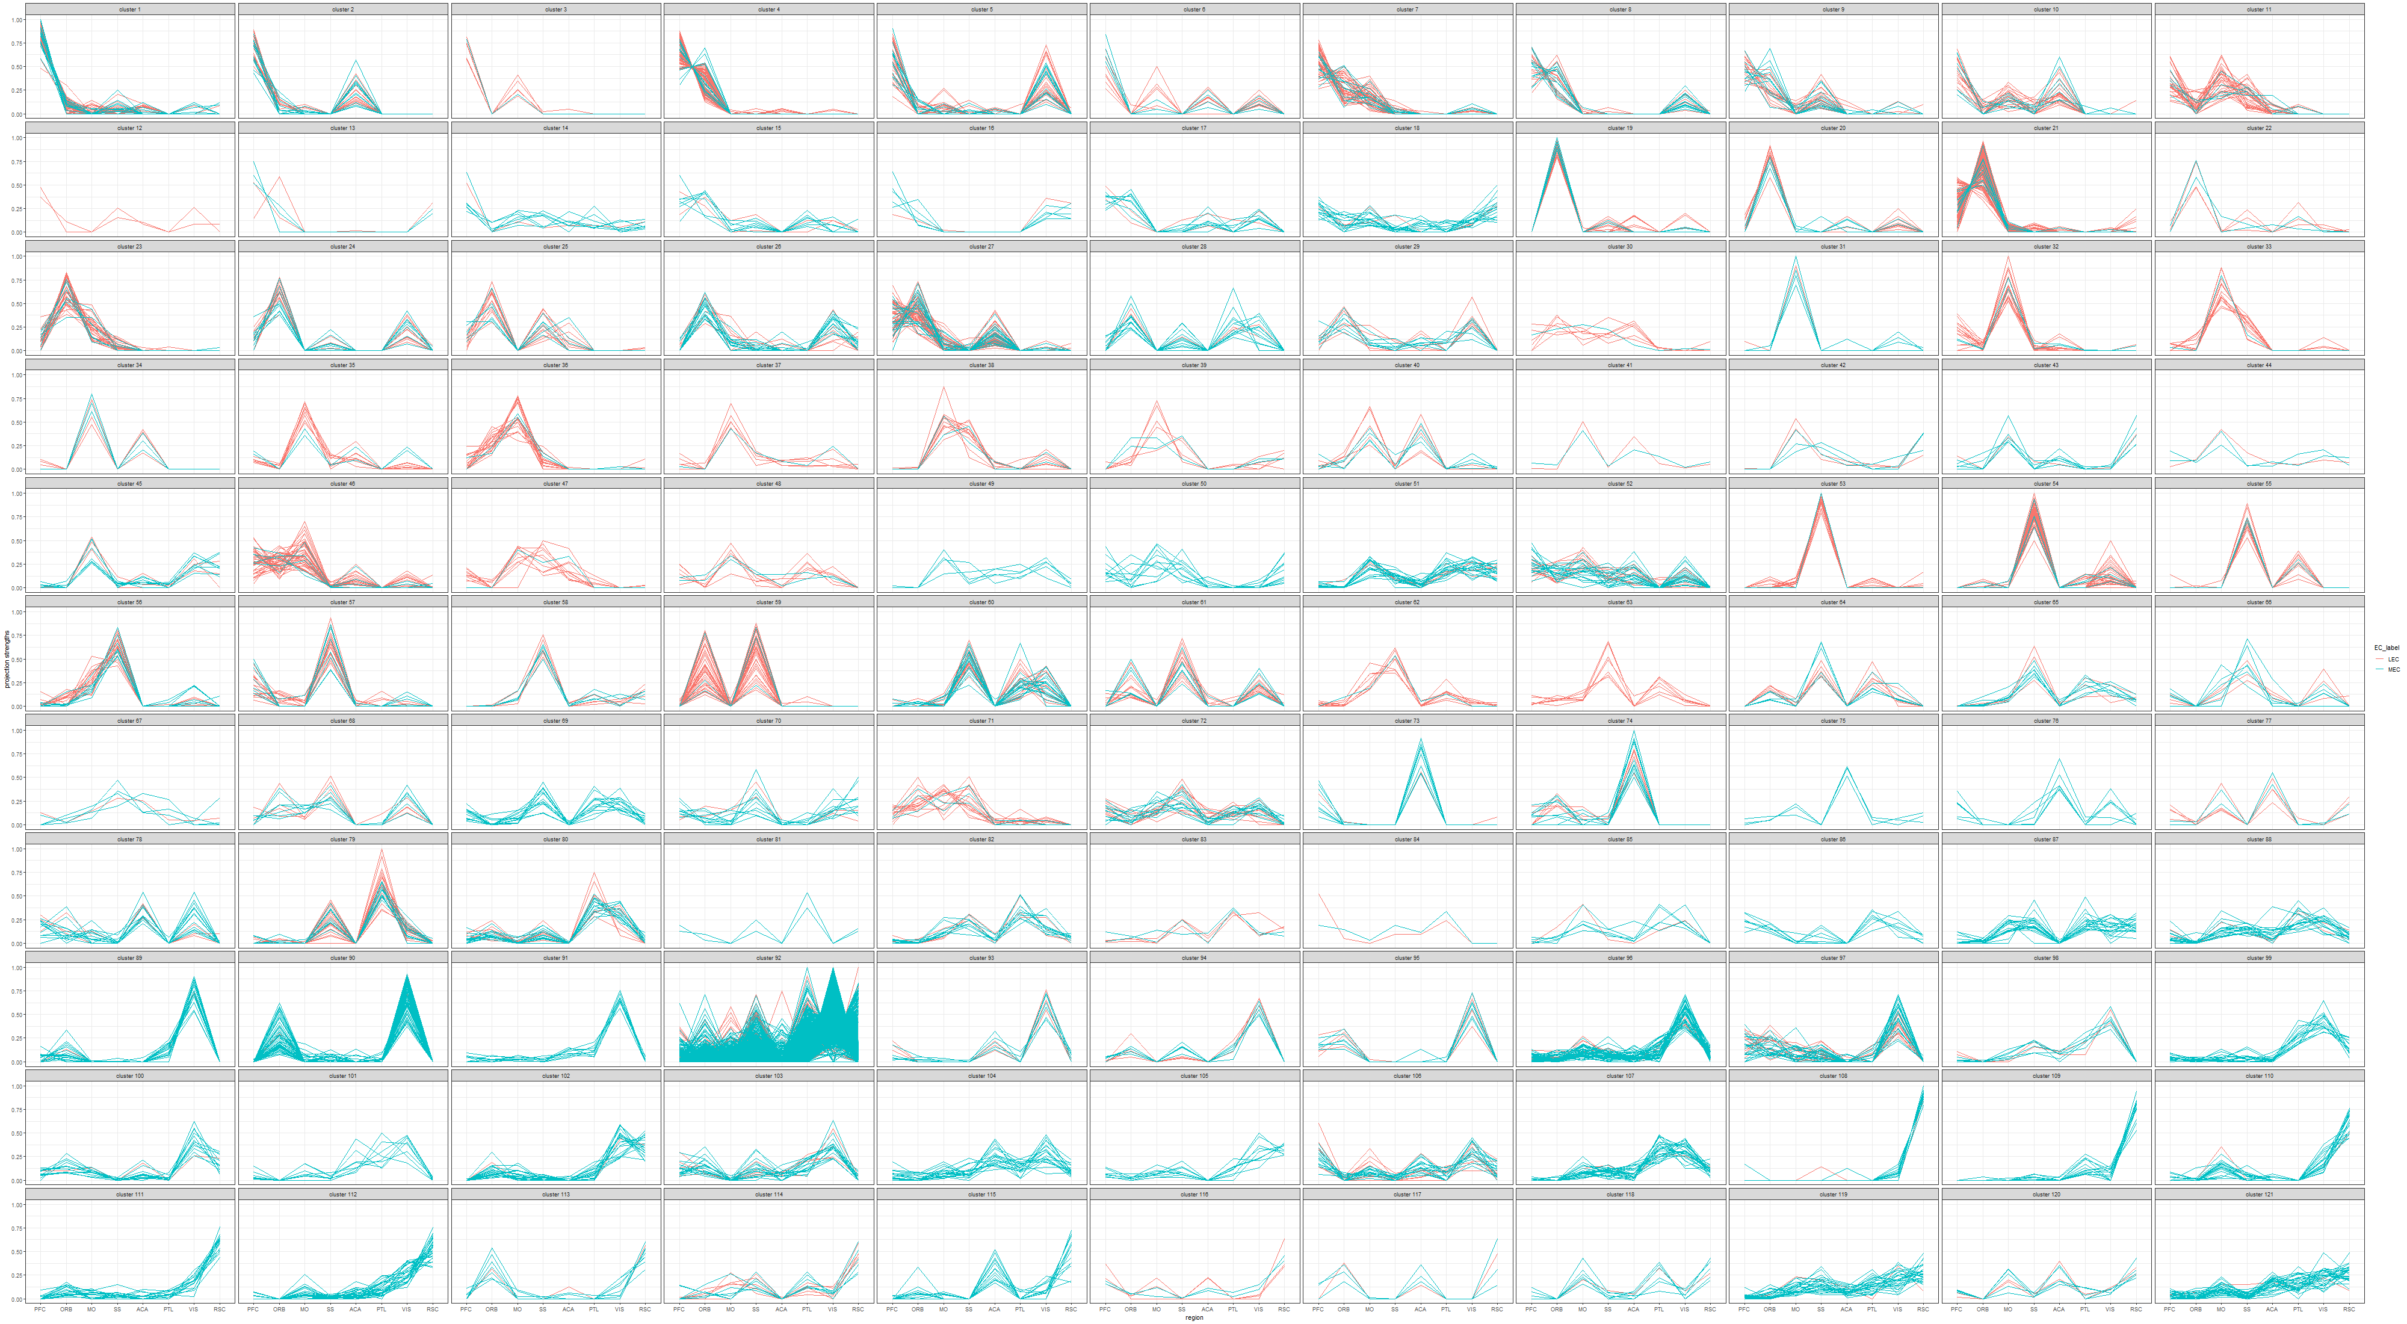
Projection probabilities of neurons in each cluster, color-coded by the EC:

Slide 7
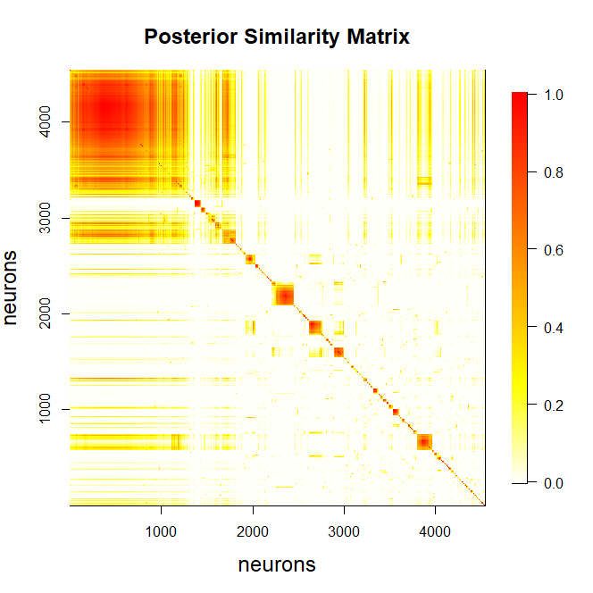
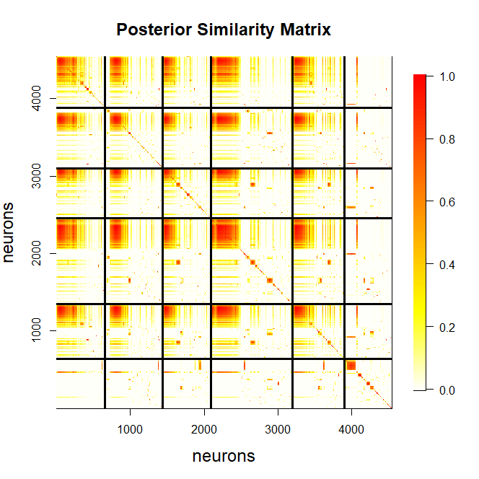
Heatmap of posterior similarity matrix

Slide 8
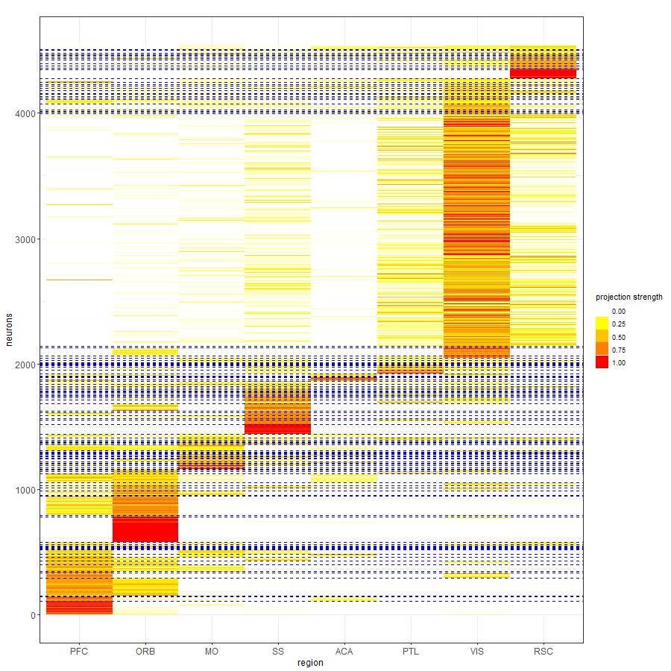
Projection strength of neurons, reordered by the allocations.

Slide 9
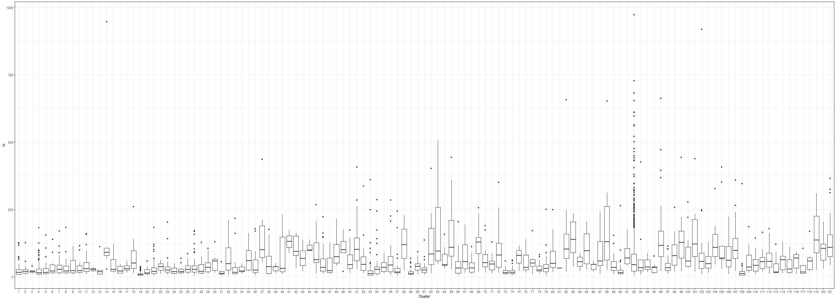
Distribution of the sum of counts across all brain regions for neurons within each cluster:

Slide 10
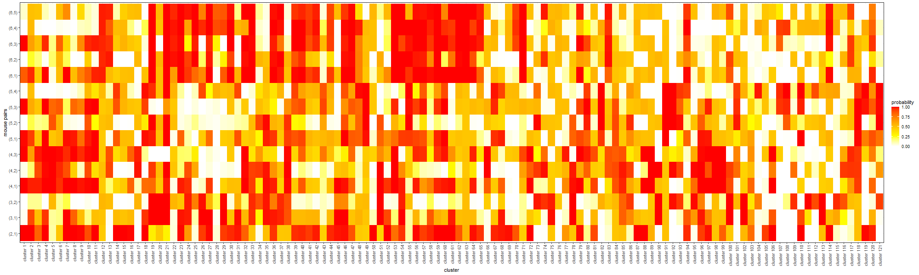
Comparison of allocation proportions across any two mice:

Slide 11
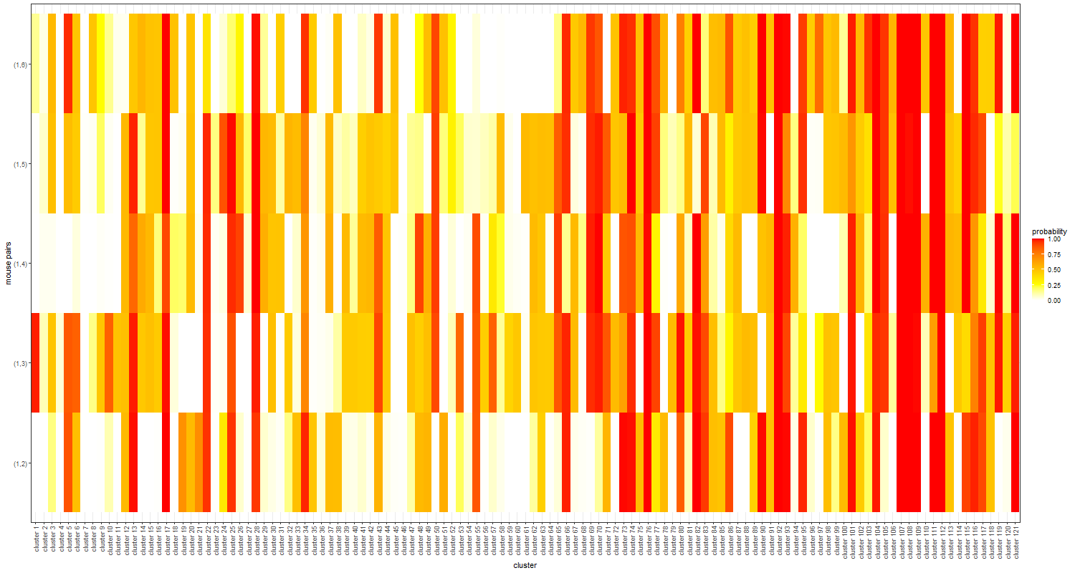

Slide 12
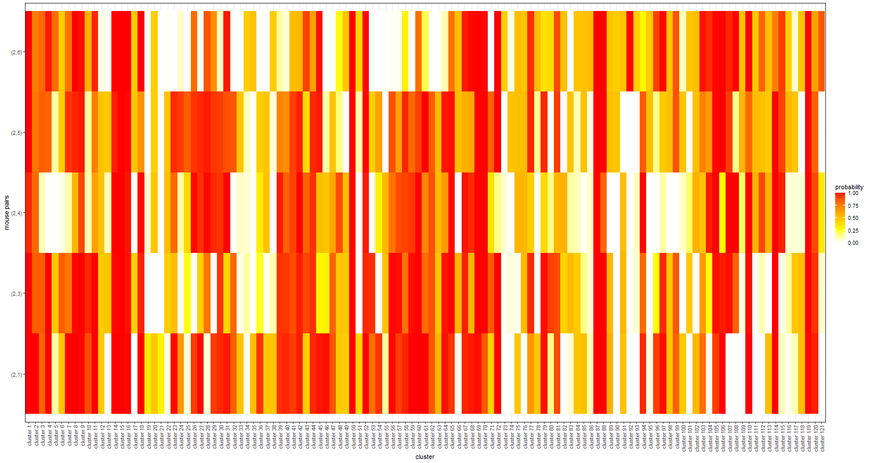

Slide 13
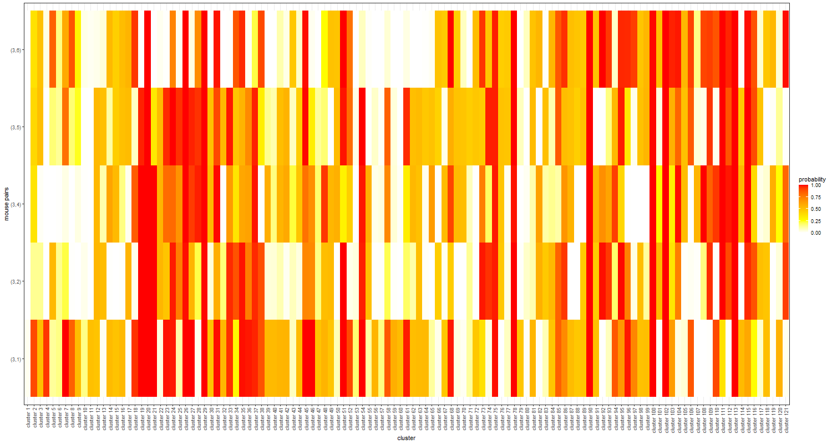

Slide 14
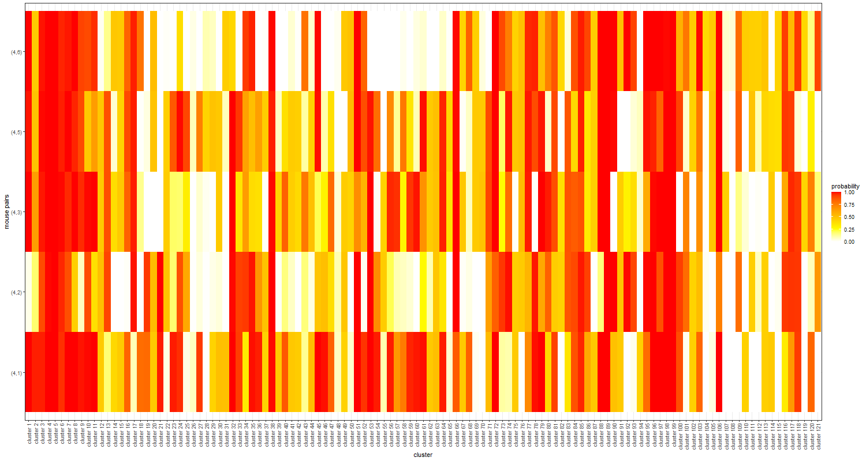

Slide 15
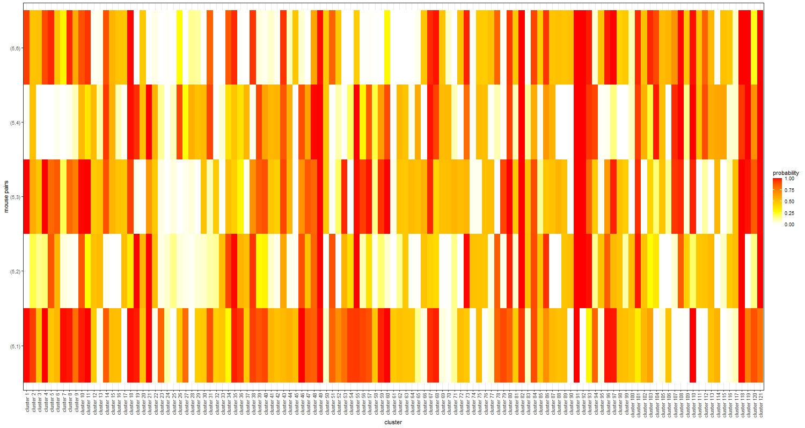

Slide 16
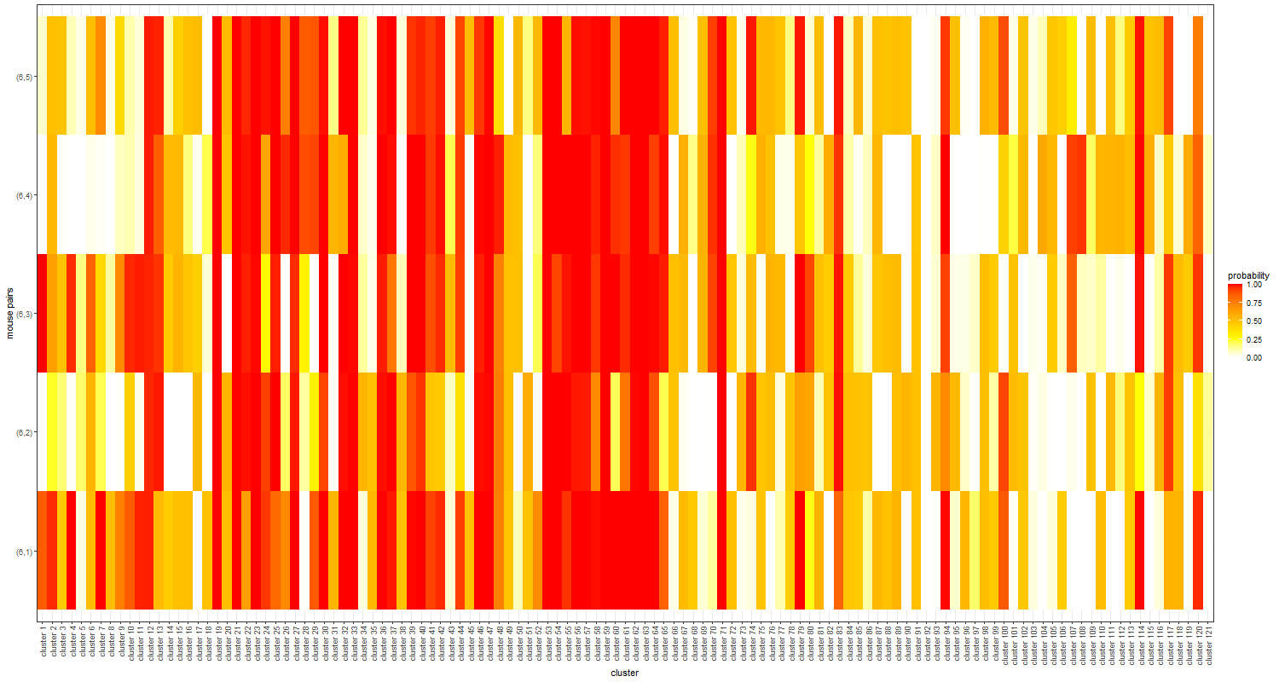

Slide 17
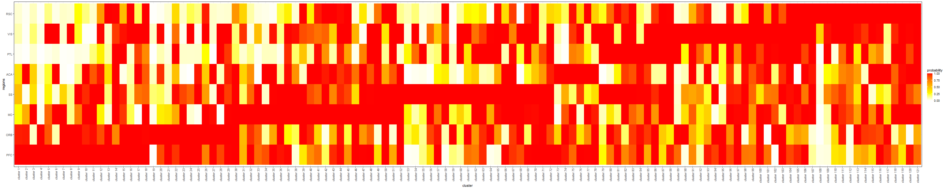
Probability of having the projection strength greater than 0.01 for each cluster and region:

Slide 18
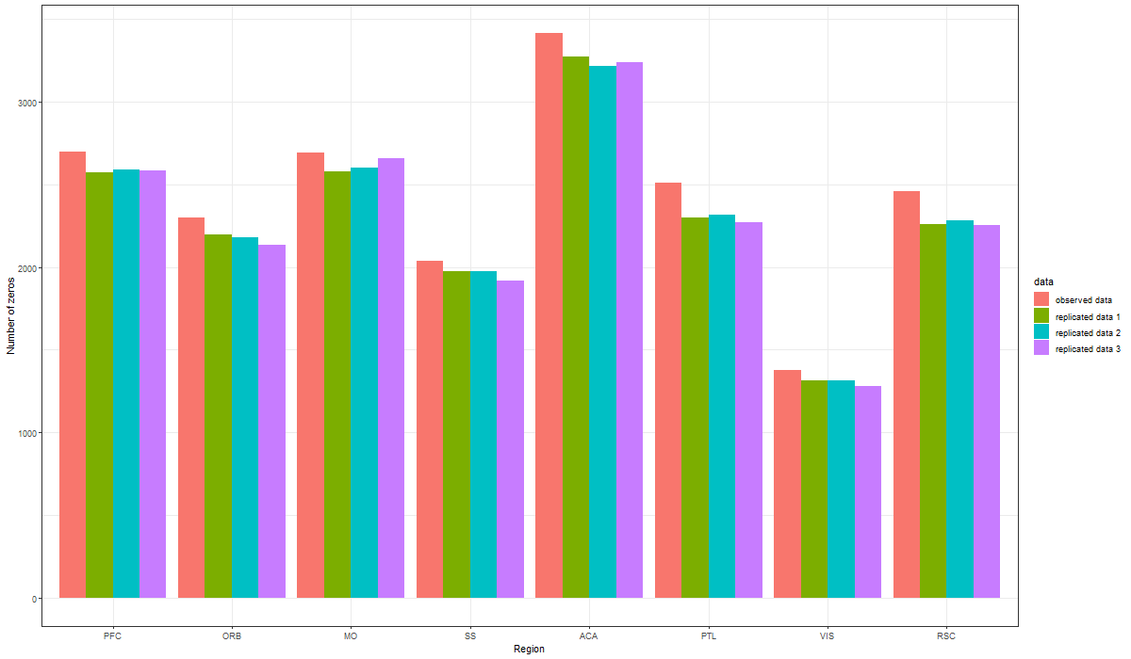
Posterior predictive check with three replicated datasets: (number of zeros of each region). This is used to assess the fit of the model to the data.

Slide 19
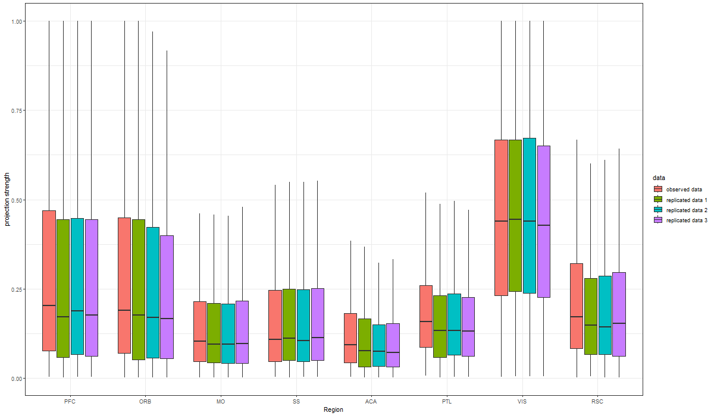
Distribution of non-zero projection strengths for the observed and replicated data.

Slide 20
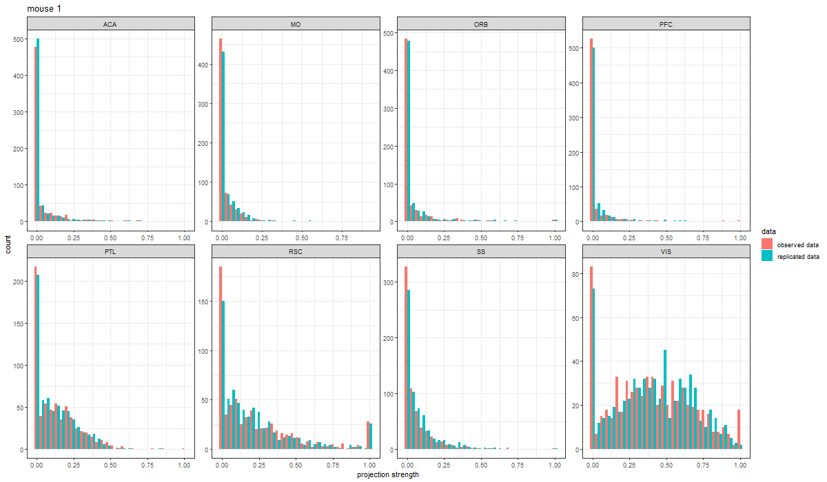
We can also carry out posterior predictive check with single replicated dataset. Figure below compares the distribution of projection strengths of neurons in mouse 1.

Slide 21
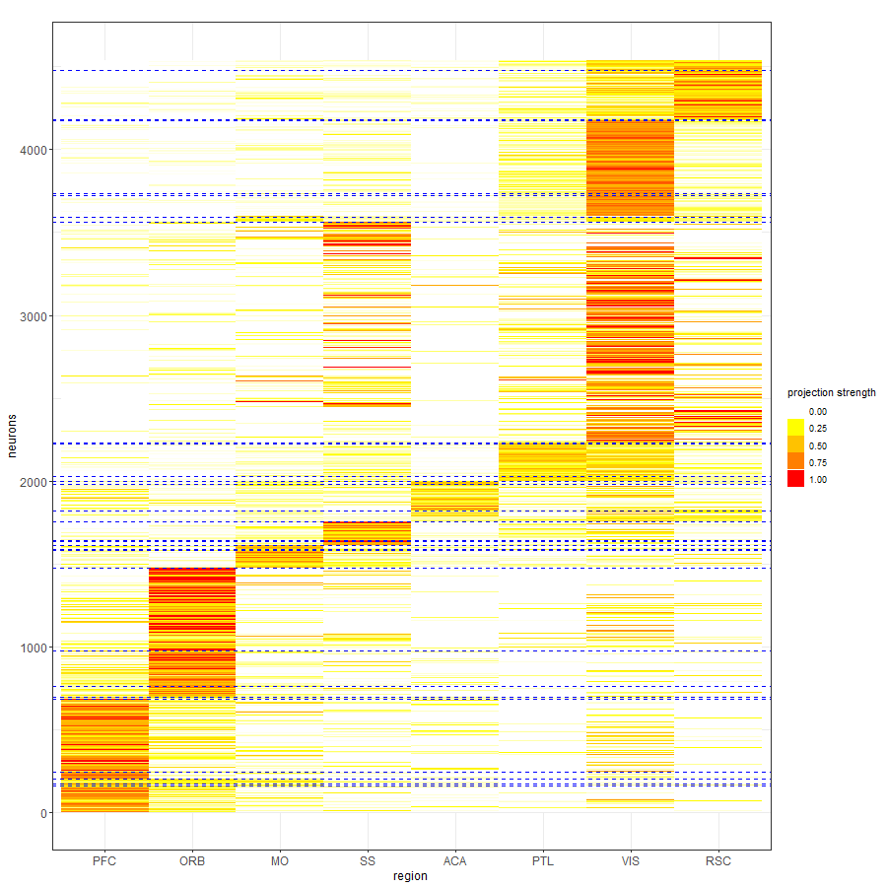
k-means with 30 clusters

Slide 22
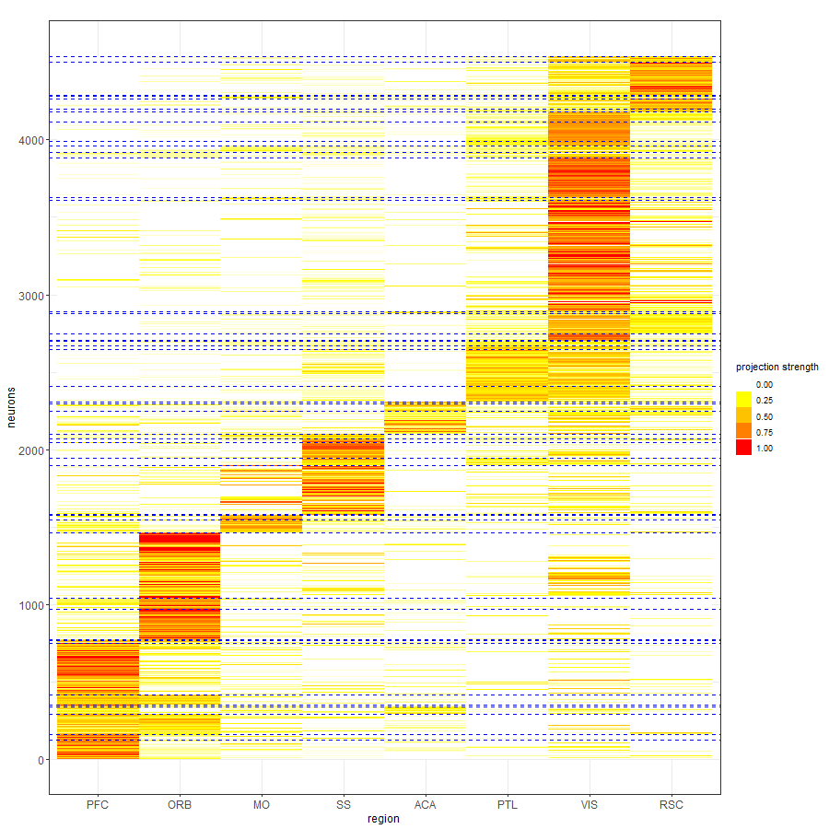
k-means with 50 clusters

Slide 23
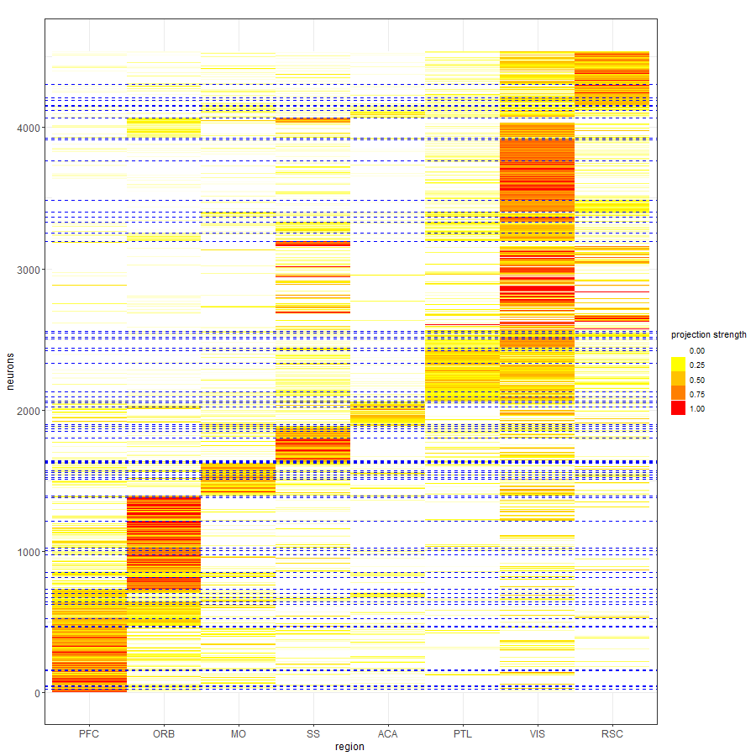
k-means with 70 clusters

Slide 24
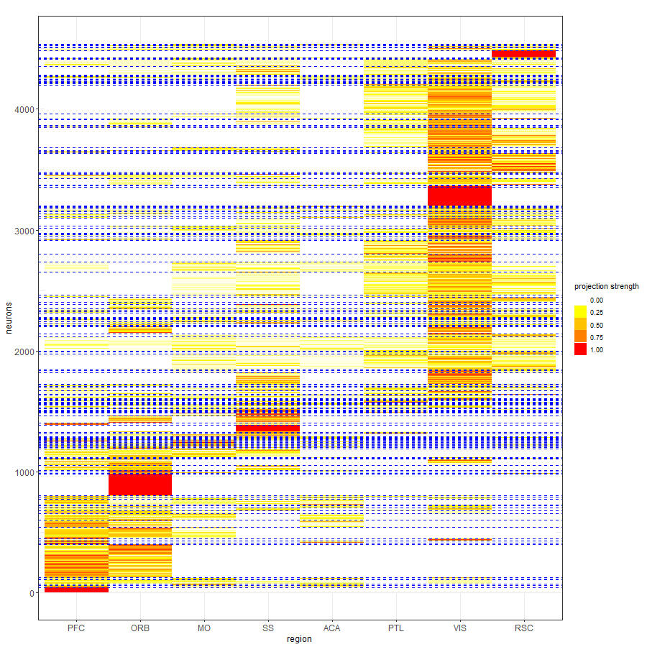
Heatmap of the Binomial model which detects 208 motifs:

Slide 25
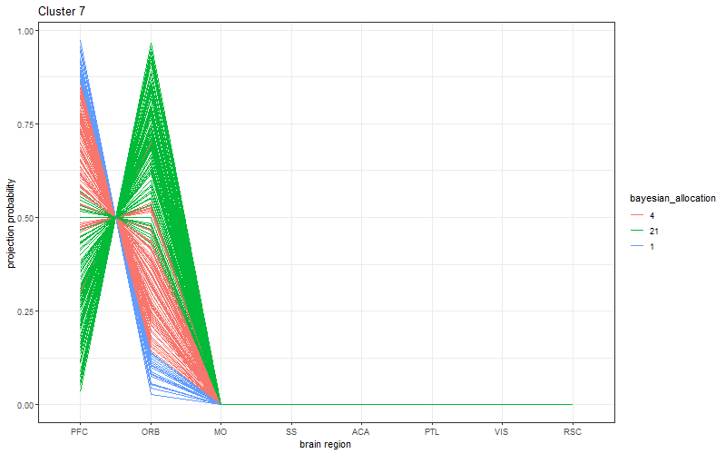
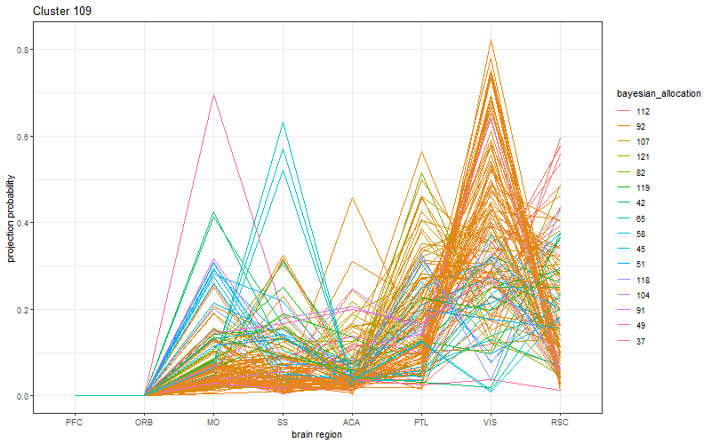
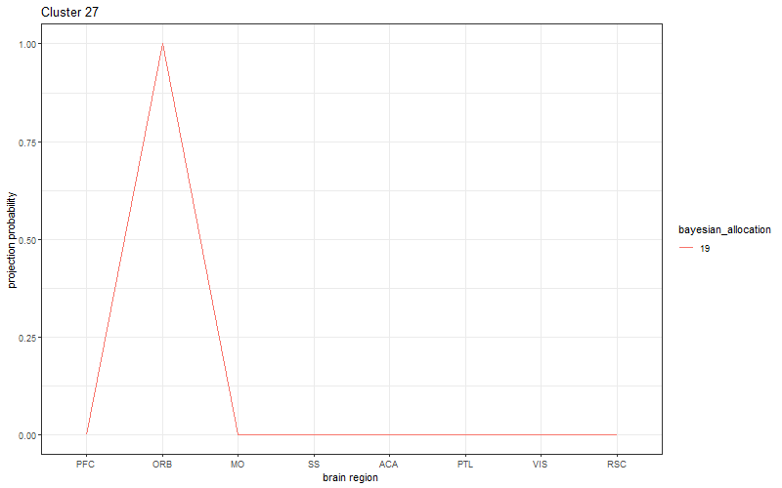
For some of the large Binomial motifs, we present the projection strengths of each neuron to each region, color-coded by the corresponding Bayesian allocations. There are ten motifs identified by the Binomial model with more than 100 allocated neurons.

Slide 26

Comparison of cluster estimates using VI (values shown are standardized to range [0,1])

