Slide 1
Instance of a Class Meaning

Slide 2
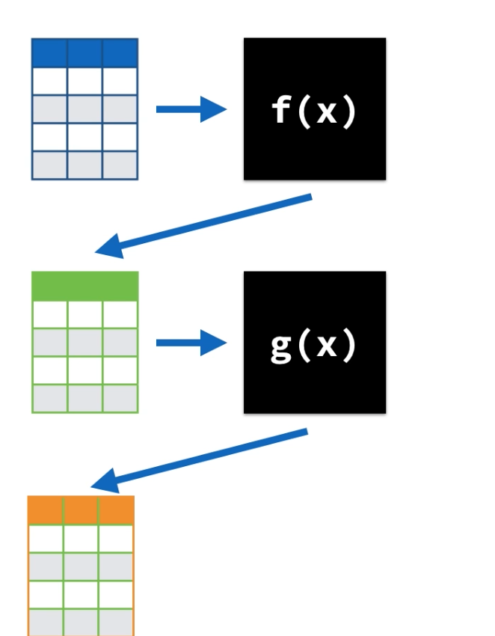
Procedural programming
Focus is to break down a programming task into a collection of variables, data structures, and subroutines
It focuses on process rather than data
It takes a problem as a sequence of things to be done such as reading, calculating, and printing.
A program is divided into a number of functions and each function has clearly defined purpose.
A program is divided into a number of functions and each function has clearly defined purpose.
Most of the functions share global data.
Data moves openly around the system from function to function.
Lots of Data Science is like this, so what are the weakness of this?
Notes:
https://arxiv.org/abs/1602.04938
https://hackernoon.com/dogs-wolves-data-science-and-why-machines-must-learn-like-humans-do-41c43bc7f982
Understanding the reasons behind predictions is important in assessing trust, which is fundamental if one plans to take action based on a prediction, or when choosing to whether to deploy a new model.
Despite widespread adoption, machine learning models remain mostly black boxes. Understanding the reasons behind predictions is, however, quite important in assessing trust, which is fundamental if one plans to take action based on a prediction, or when choosing whether to deploy a new model.
Despite widespread adoption, machine learning models remain mostly black boxes. Understanding the reasons behind predictions is, however, quite important in assessing trust, which is fundamental if one plans to take action based on a prediction, or when choosing whether to deploy a new model.

Slide 3
Procedural programming
It emphasis on doing things.
Since every function has complete access to global variables, the new programmer can corrupt the data accidently by creating a function.
Difficult to design because the components function and data structure do not model the real world
Lots of Data Science is like this, so what are the weakness of this?
Notes:
https://arxiv.org/abs/1602.04938
https://hackernoon.com/dogs-wolves-data-science-and-why-machines-must-learn-like-humans-do-41c43bc7f982
Understanding the reasons behind predictions is important in assessing trust, which is fundamental if one plans to take action based on a prediction, or when choosing to whether to deploy a new model.
Despite widespread adoption, machine learning models remain mostly black boxes. Understanding the reasons behind predictions is, however, quite important in assessing trust, which is fundamental if one plans to take action based on a prediction, or when choosing whether to deploy a new model.
Despite widespread adoption, machine learning models remain mostly black boxes. Understanding the reasons behind predictions is, however, quite important in assessing trust, which is fundamental if one plans to take action based on a prediction, or when choosing whether to deploy a new model.

Slide 4
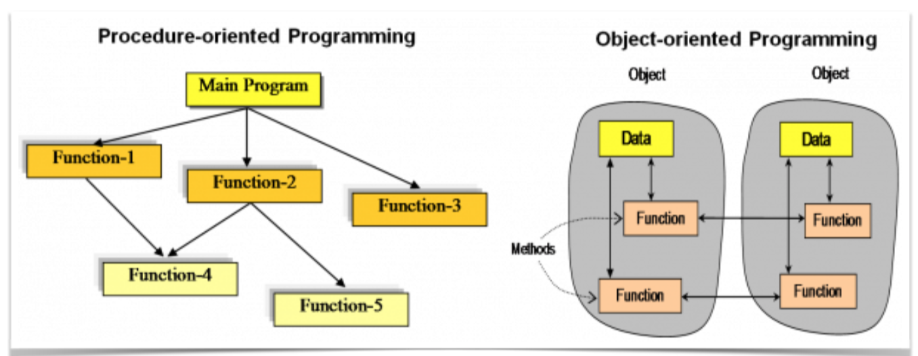
Procedure vs Object Oriented
Notes:
Python 2.2 introduced “new-style” classes, prior to that were “old-style” classes. Python 3 is a cleaned up implementation of new-style classes.

Slide 5
Why OOP
Python 3 is fully object-oriented
Everything is a class
When programs get large, we need to partition the code into short, modular pieces which can be tested and maintained in isolation.
Code reuse: the “write once” rule. Avoiding duplication of code makes it easier to understand and fix.
Functions provide a way to partition the code, however, they Object oriented programing helps with that.
Notes:
https://arxiv.org/abs/1602.04938
https://hackernoon.com/dogs-wolves-data-science-and-why-machines-must-learn-like-humans-do-41c43bc7f982
Understanding the reasons behind predictions is important in assessing trust, which is fundamental if one plans to take action based on a prediction, or when choosing to whether to deploy a new model.
Despite widespread adoption, machine learning models remain mostly black boxes. Understanding the reasons behind predictions is, however, quite important in assessing trust, which is fundamental if one plans to take action based on a prediction, or when choosing whether to deploy a new model.
Despite widespread adoption, machine learning models remain mostly black boxes. Understanding the reasons behind predictions is, however, quite important in assessing trust, which is fundamental if one plans to take action based on a prediction, or when choosing whether to deploy a new model.

Slide 6
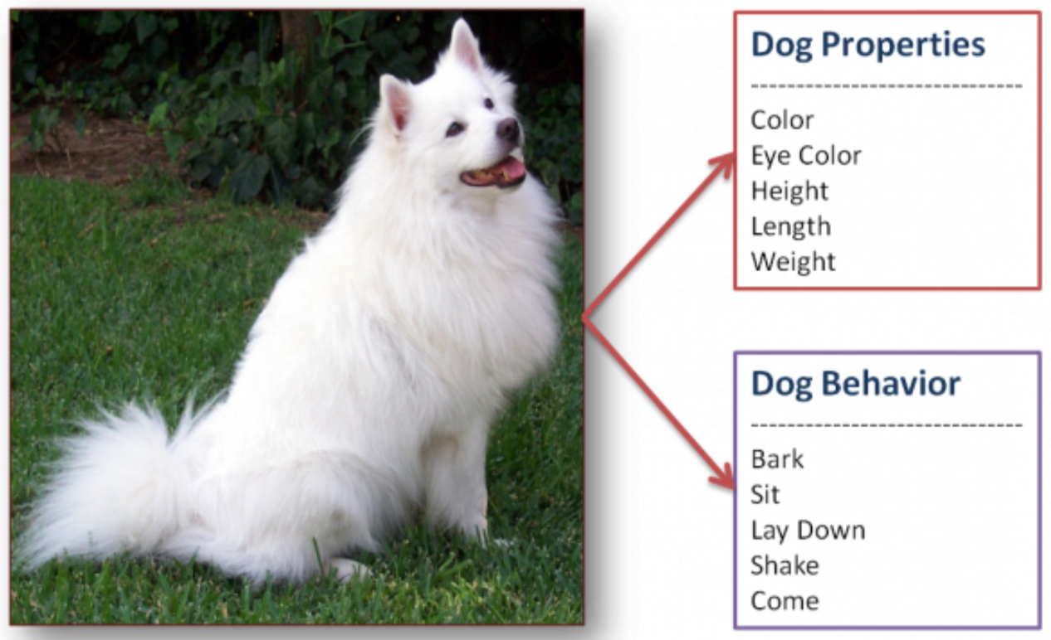
Real World Object

Slide 7
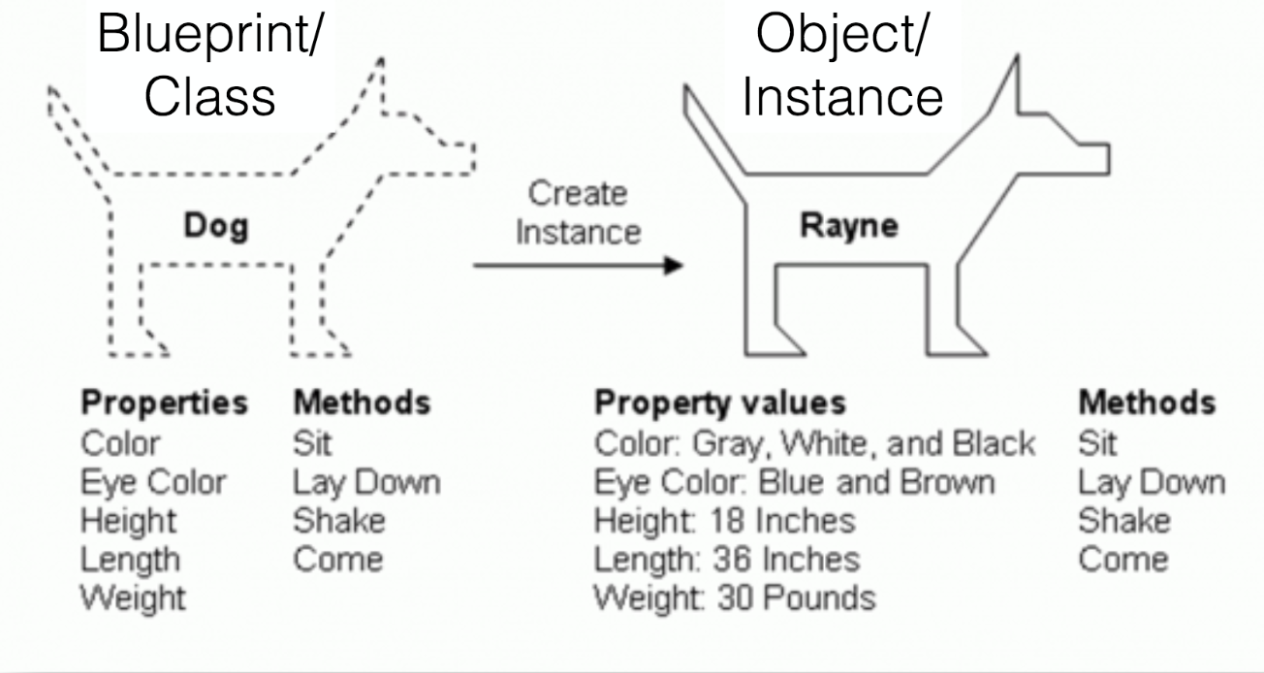
The Difference between class and instance of a class
A Class is basically a blueprint for creating instances.
Each unique dog we create using our dog class will be an instance of that class
Need a blueprint to create a new dog so we don’t have to do it manually from scratch everytime
Notes:
Class is basically a blueprint for creating instances. Each unique employee we create using our employee class will be an instance of that class (with a unique location in memory, you can print out class if needed)

Slide 8
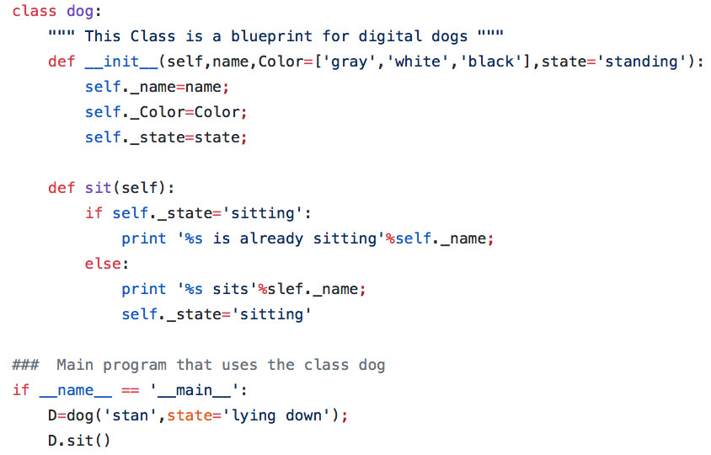
The Difference between class and instance of a class

