Slide 1
AI · BigData Academy AI Lab. 1
Seongbin Baek / sungbin0515@posetch.ac.kr

Slide 2
Contents
Today’s goal
Search Problems
Successor function
8-Queens Problem
Brute Force
DFS / BFS
A* algorithm: 8 puzzle

Slide 3
Today’s goal
Understand the basic concept of Search Problem
Understand and Implement basic algorithms that can be used for Search Problem (with Python 3.7 or higher)
BFS / DFS
Understand the basic concept of A* Search algorithm

Slide 4

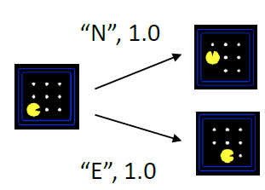
Search Problems
A search problem consists of:
A state-space: Set of every possible state of the problem.
(e.g. every placement of chess pieces)
A successor function with actions and costs
A start state and a goal test
(e.g. checkmate)

Slide 5
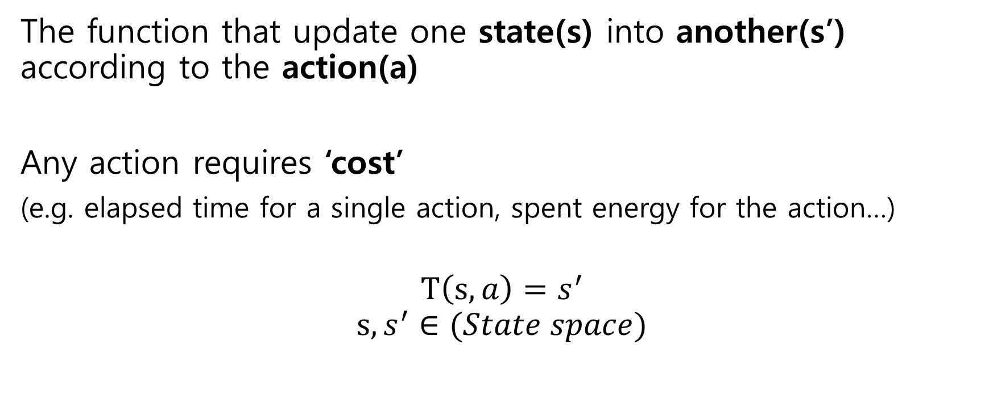

Successor Function $T(s,a)$
The function that update one state(s) into another(s’) according to the action(a)
Any action requires ‘cost’
(e.g. elapsed time for a single action, spent energy for the action…)
$$T\left(s,a\right)=s^{′}$$
$$s,s^{′}∈(State space)$$

Slide 6
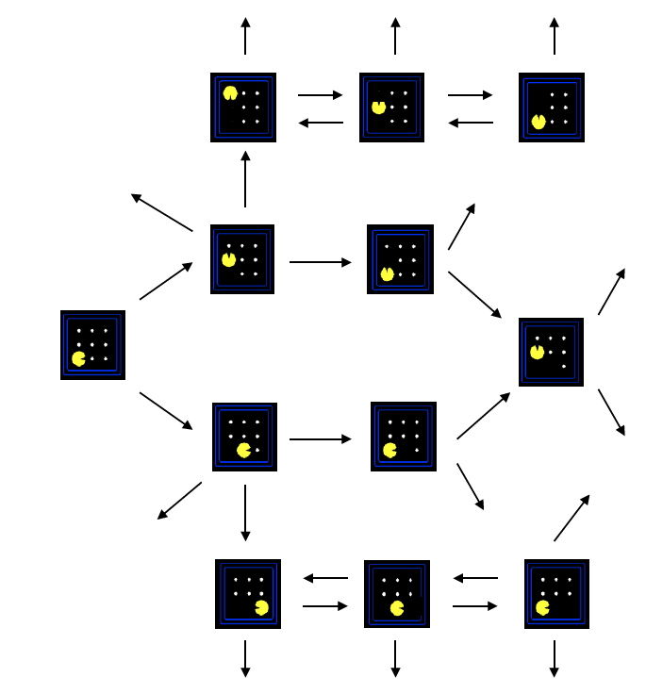
State Space Graph
Nodes represent single state
Edges represent Successor function
No duplicated state is allowed while nodes with two or more parents are allowed.

Slide 7
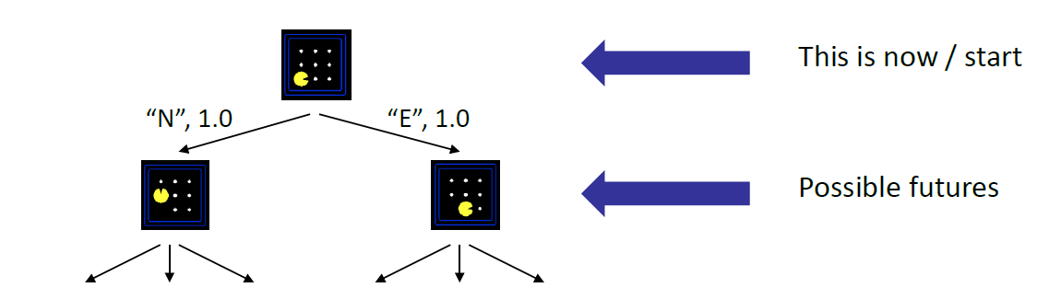
Search Trees
Nodes show states, but correspond to PLANS that achieve those states
Edges represent the Successor function
The duplicated state is allowed while nodes with two or more parents are forbidden.

Slide 8
Problem: 8-Queens problem
We will learn the N-Queens problem in the third lecture.
We will solve the 8-Queens problem, a simplified version of the N-Queens problem (n=8), in this lab.

Slide 9
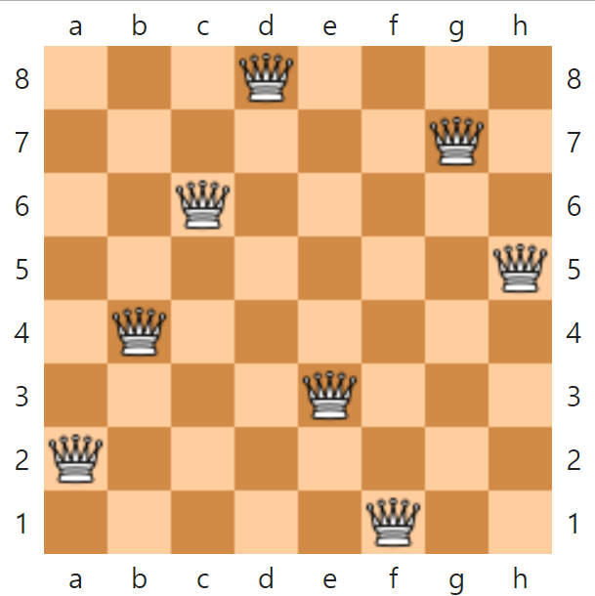
8-Queens problem
Place 8 queens in 8x8 chess board
While no queens threaten each other
There exists 12 solutions
There exists 64C8 = 4.43E+9 possible states
Art Ref: https://ko.wikipedia.org/wiki/%EC%97%AC%EB%8D%9F_%ED%80%B8_%EB%AC%B8%EC%A0%9C

Slide 10
8-Queens problem: Brute Force
Then, how long does it take to solve the problem by brute-force algorithm?
With python 3.9, it takes about 1.84 Hours.
Because the system literally check ‘every’ states.

Slide 11
DFS / BFS
Depth First Search(DFS)
expand a deepest node first
Used for Tree
A->B->D->E->C->F
Breadth First Search(BFS)
expand a shallowest node first
A->B->C->D->E->F
A
B
C
D
E
F

Slide 12
8-Queens problem: DFS / BFS
Then, how can we adapt DFS / BFS into 8-Queens Problem?
Re-define 8-Queens problem into familiar form:
State and successor function!

Slide 13
8-Queens problem: DFS / BFS
State: (list of position of queen, up to 8)
Action: Position of a new queen
Condition of Goal State:
There must exist, 8 queens,
There must exist no queens which threaten each other
If # of queens exceeds 8 or there exists at least 2 queens which threaten each other, stop searching further.

Slide 14
Implement DFS / BFS
We will implement naïve implementation of DFS / BFS
by using Python list.
If we implement correctly, the elapsed time of DFS / BFS is similar to this:

Slide 15
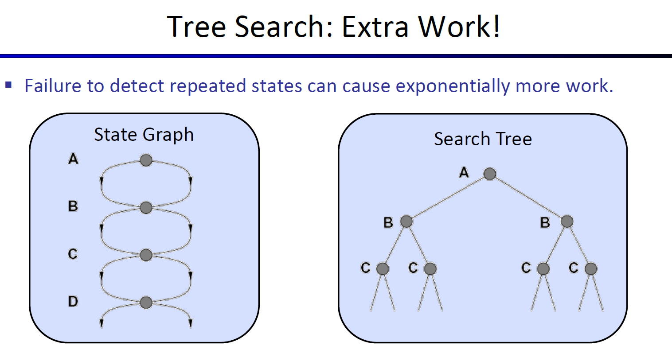
Optimize DFS / BFS implementation
In the second lecture, we will learn how to optimize for those case.
(Optional) Optimize your implement of DFS / BFS by the method.

Slide 16
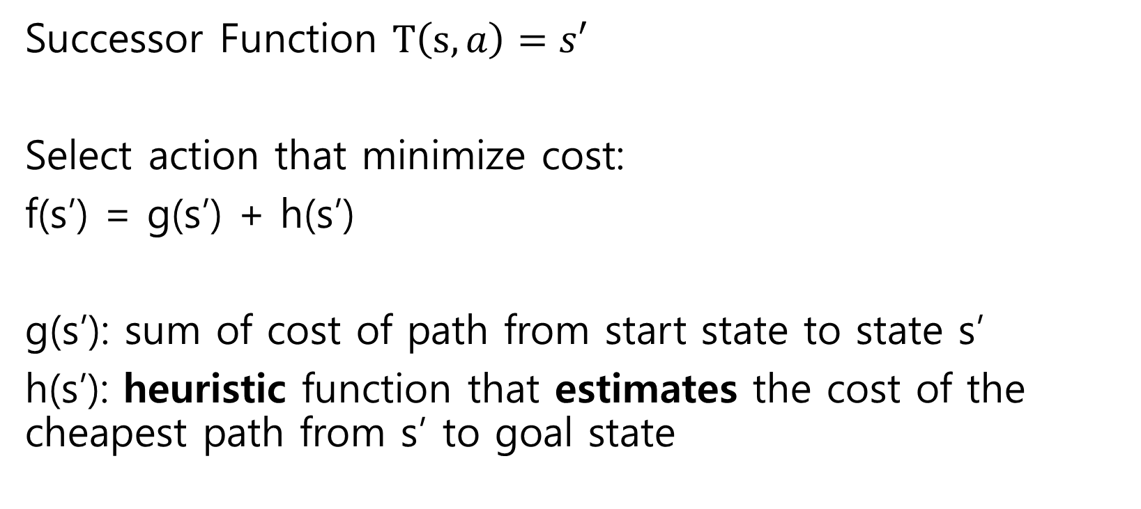
A* search algorithm
Successor Function $T\left(s,a\right)=s′$
Select action that minimize cost:
f(s’) = g(s’) + h(s’)
g(s’): sum of cost of path from start state to state s’
h(s’): heuristic function that estimates the cost of the cheapest path from s’ to goal state

Slide 17
Heuristic?
If the system can observe every edge and node of the state space, h(s’) becomes max function.
However, in most of the case, the system cannot observe every edge and node of the state space. (e.g. Find path of maze with no map)
In this case, we need to rely on a practical method that is not guaranteed to be optimal, perfect, or rational, which is called the heuristic method.*
*Ref: https://en.wikipedia.org/wiki/Heuristic

Slide 18
Next Lab’s topic
Q&A about the second lecture
- If you send question about the lecture via DM before lab session, it will be easier to get a detailed and proper answer.
Demonstrate the Optimized implement of DFS / BFS
Constraint Satisfaction Problems and Backtracking
Markov Decision Problems

