Slide 1
AI · BigData Academy AI Lab. 2
Seongbin Baek / sungbin0515@posetch.ac.kr

Slide 2
Contents
Q&A about the second lecture
Today’s goal
Constraint Satisfaction Problems and Backtracking
Implement Adversarial Search
Min-max
Alpha-beta Pruning

Slide 3
Q&A about the second lecture
Q&A

Slide 4
Today’s goal
Understand basic concept of Constraint Satisfaction Problems
Understand and perform Backtracking
Understand and implement basic concept of Adversarial search

Slide 5
Constraint satisfaction problem (CSP)
A special subset of search problems
State is defined by variables X with values from a domain D (e.g. 4 color map problem: State = (color of all area), Domain = (option of color))
Goal test is a set of constraints specifying allowable combinations of values for subsets of variables
(e.g. 4 color map problem: neighboring area must not share same color)

Slide 6
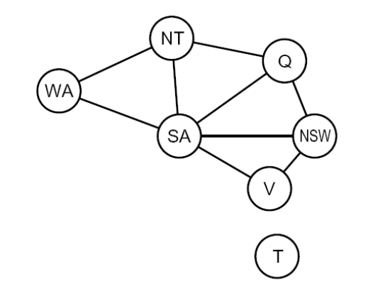
Constraint Graphs
Binary CSP: each constraint relates (at most) two variables
(e.g. 4 color map problem: paired variables must not share same value (color))
Binary constraint graph: nodes are variables, arcs show constraints
Example Binary Constraint graph of 4-color problem

Slide 7
Backtracking Search
Based on DFS, with these modification:
Assign one variable at a time, which means fix order of variable assignments.
Check constraints per each cycle.
If newly assigned variable cause constraint violation, cancel the last assignment and return last state, continue to search the answer.

Slide 8
Implement: Backtrack
In the last lab, we’d implement DFS to solve 8-Queen problem, while check constraints per each cycle.
Now, let’s implement 4-color map problem solver by using backtracking algorithm.
(By using scaffold named Day2_backtrack.ipynb)

Slide 9
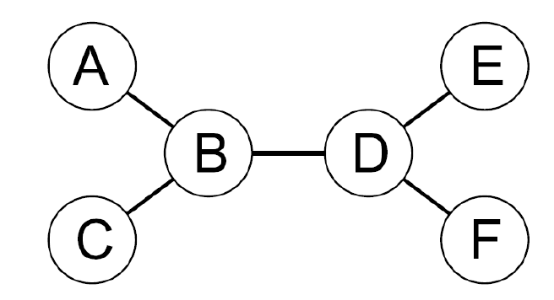
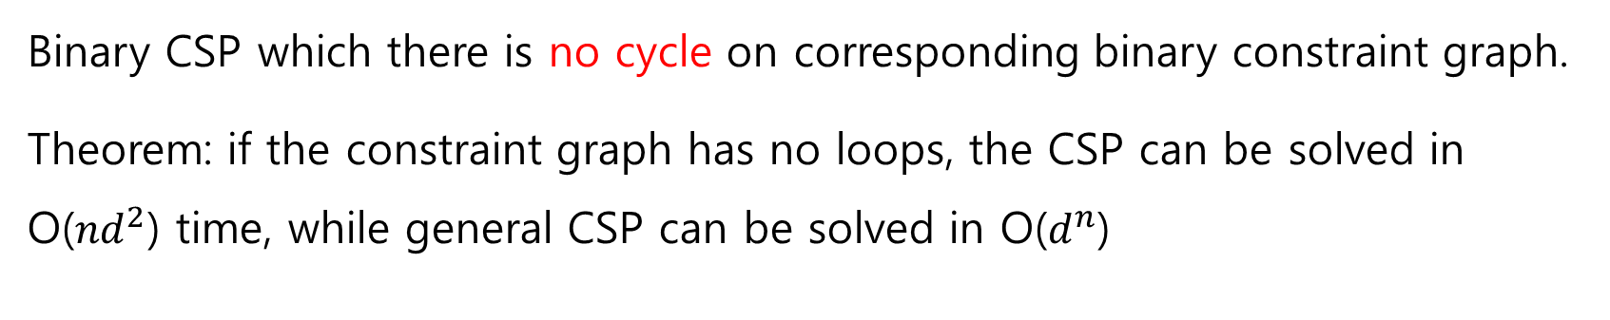
Tree-structured CSP
Binary CSP which there is no cycle on corresponding binary constraint graph.
Theorem: if the constraint graph has no loops, the CSP can be solved in O(${nd}^{2}$) time, while general CSP can be solved in O($d^{n}$)

Slide 10
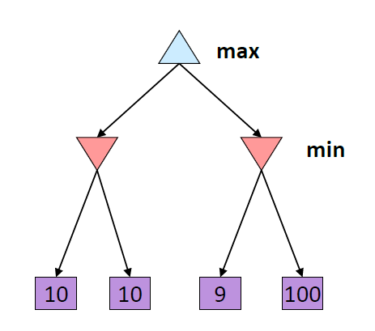
Adversarial Search
Perform search, one agent(player) try to maximize the result while the other agent(player) try to minimize the result.
Two agents acts in tern,
while terminal values reached.
e.g. Tic-tac-toe game: Player 1 try to make player 1 win, while player 2 try to make player 1 lose

Slide 11
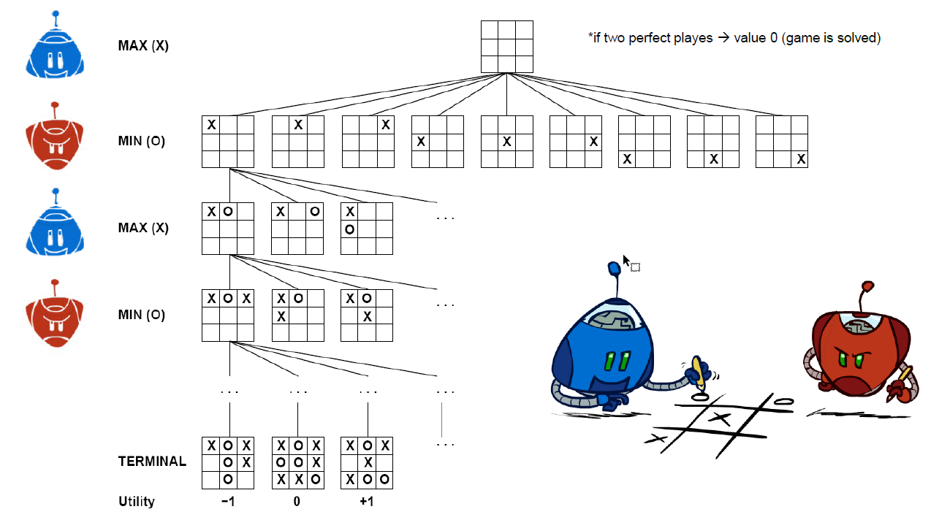
Implement: Adversarial Search (Min-max)
Now, let’s implement tic-tac-toe player by using adversarial search (min-max, no pruning)
(By using scaffold named Day2_minmax.ipynb)

Slide 12
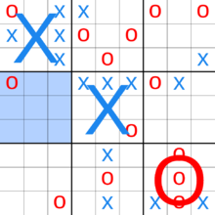
(tic-tac-toe)²
In original Tic tac toe, the player wins if the player makes a row.
In (tic-tac-toe)², the player need to win small tic-tac-toe game and make a row in big tic-tac-toe board

Slide 13
Implement: Alpha-beta pruning
Now, let’s implement (tic-tac-toe)² player by using adversarial search (Alpha-beta pruning)
(By using scaffold named Day2_alphabeta.ipynb)

Slide 14
Next Lab’s topic
Q&A about the third lecture
Probability
Bayes’ Net
Markov Decision Process
Policy
Time-limited Policy

