Slide 1
Structure Level Low Power Sequence Verification
Using LGE Automatic CPF to SVA Generator
2013-06-07
SIC 연구소 Mobile AP 개발실 MSD 팀
김 시 현

Slide 2
Index
1. Motivation
2. Verification Flow and Environment
3. LGE CPF to SVA Program
- User Configuration File Format
- SVA (SystemVerilog Assertion) Instantiation File
- SVA Module
4. Results and Debug
5. R & R
Appendix: ICS/PERI SVA module

Slide 3
Motivation
현재 Simulation-based CPF LP Sequence Assertion 검증환경의 개선점
  Cadence simulator 의 assertion coverage hole
    Power up/down sequence
    Power req/ack sequence
    Clock enable, Reset sequence
  Source code level debug 제약
    Simulator 에서 생성된 assertion 은 protected code 로 code debug 가 불 가능.
  Reusability
    Simulator 에서 생성된 assertion 은 protected code 로 ZeBu 합성 불 가능.

Slide 4
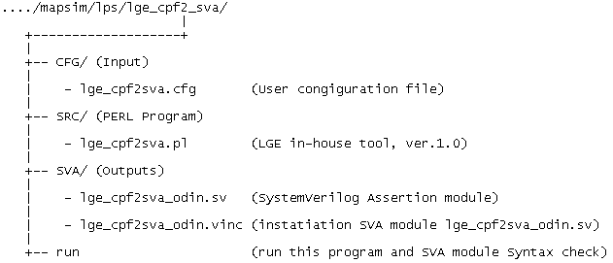
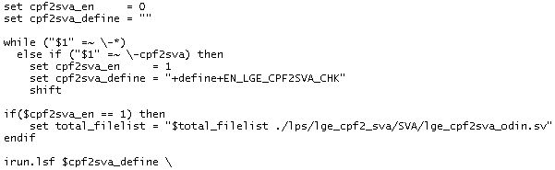
Verification Flow and Environment
Flow Environment
run script
run option
User Cfg
CPF Files
Automatic CPF to SystemVerilog Assertion Generator
(LGE SIC In-house Tool)
(1) SystemVerilog Asssertion File,
(2) Top Instantiation File
Cadence Simulator
Report:
- Pass, Fail
- Assertion coverage

Slide 5
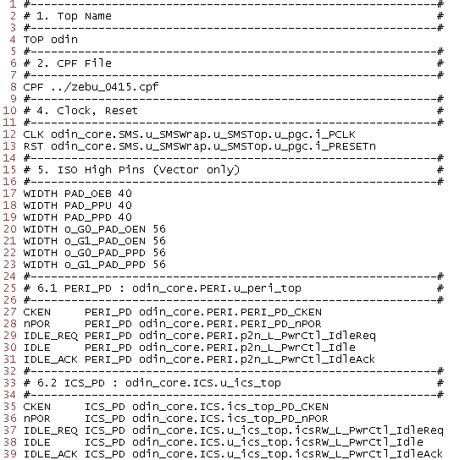
User Configuration File Format : lge_cpf2sva.cfg

Slide 6
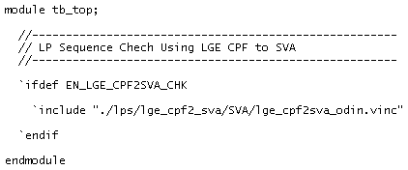
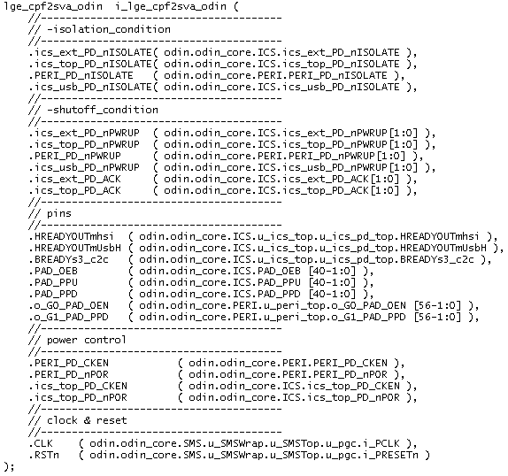
Instantiation SVA Module: lge_cpf2sva.vinc
tb_top.v lge_cpf2sva_odin.vinc

Slide 7
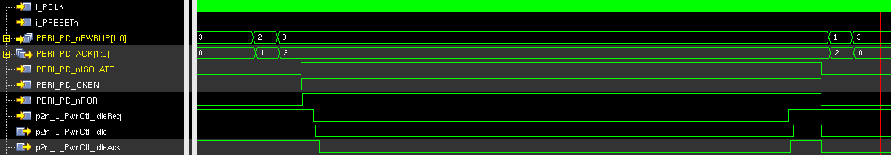
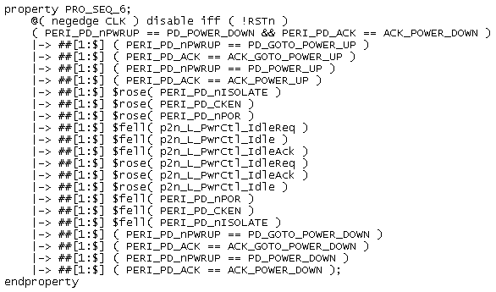
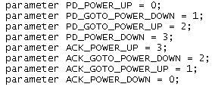
SVA Module: lge_cpf2sva.sv ( 1. Ordered Liveness Assertion )
Example: PERI Power Domain
L1
L2
L3
L1
L2
L3

Slide 8
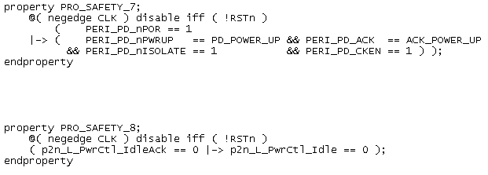
SVA Module ( 2. Safety Assertion )
Example: PERI Power Domain
L2
S1
S2
S1
S2

Slide 9
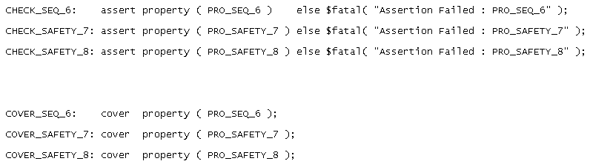
SVA Module ( 3. Assertion Coverage )
Example: PERI Power Domain
L1
S1
S2
L1
S1
S2
C1
C2
C3

Slide 10
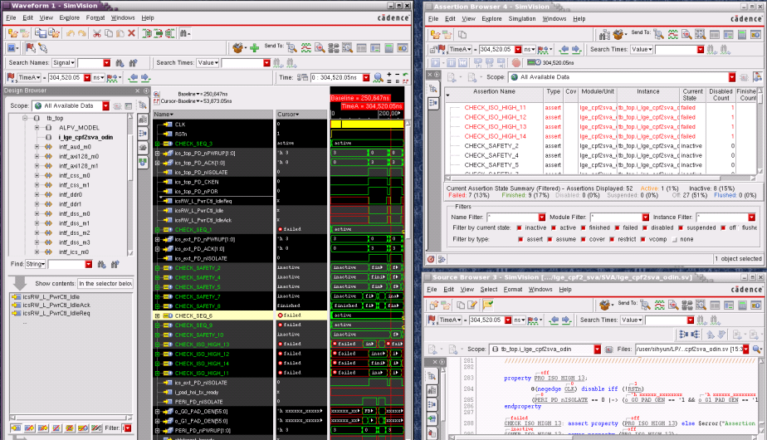
Simulation Result Check and Debug
Terminal log
SimVision™ Assertion Browser and Debugger

Slide 11
R & R
 | 검증 Part | 설계 Part
P & R | 1. 본 방법론 및 tool 개발 및 유지보수 2. 설계파트에 환경 전달 및 기술 지원 3. 검증결과 coverage log 최종 확인 ( VR 시 report ) | 1. 본 방법론을 적용하여 LP sim. 실행 - Sub-system level - Top level 2. Assertion Coverage = 100% 되기 위한 Testbench 개선 3. 최종 coverage 결과 log 를 검증파트에 전달.

Slide 12

Appendix: ICS/PERI SVA module

