Slide 1
Random Forest Tutorial
Student : Yu Wei Huang

Slide 2
Outline
About Random Forest
Python environment
Anaconda on Windows
Linux
Colab
Python Code
Pokémon legendary classification
Kinase inhibitors classification

Slide 3
About Random Forest

Slide 4
What is Random Forest?
Using a lot of decision trees to predict result (play or don’t play)
…
Play
Don’t play
Play
Majority-voting
Play

Slide 5
Python environment Anaconda on windows

Slide 6
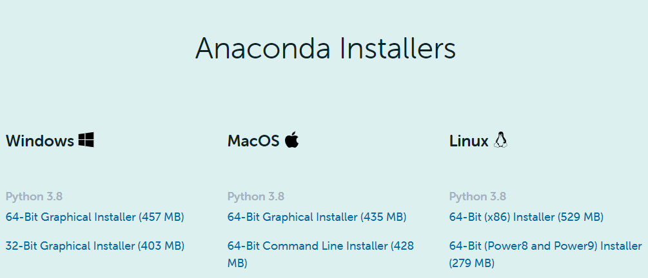
Download Anaconda
Python environment Anaconda on windows
Download from here
https://www.anaconda.com/products/individual
Choose version fit for your computer

Slide 7
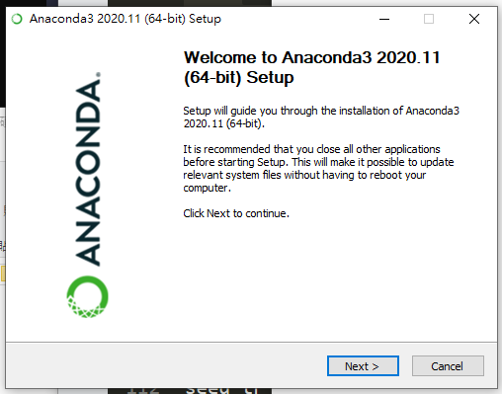
Install Anaconda
Python environment Anaconda on windows
Click all Next, decide anaconda's path and finish installation

Slide 8
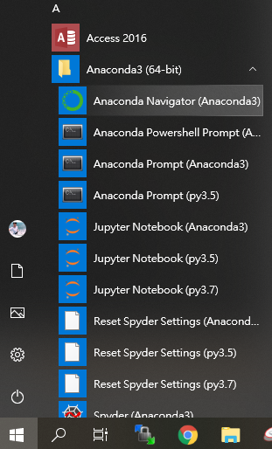
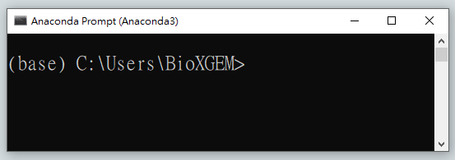
Run Anaconda Prompt
Python environment Anaconda on windows
After installation, click start from windows will see that
Click Anaconda Prompt will see this

Slide 9
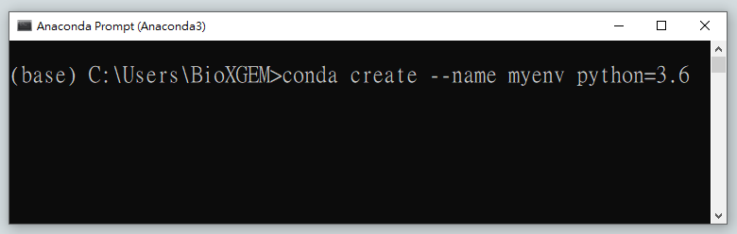
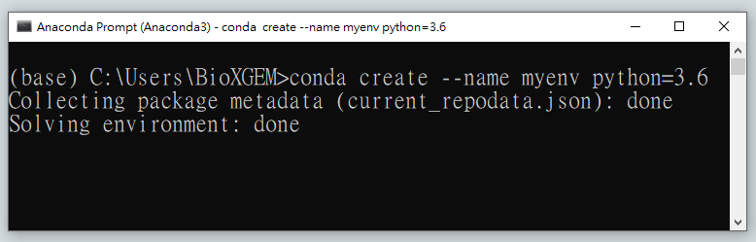
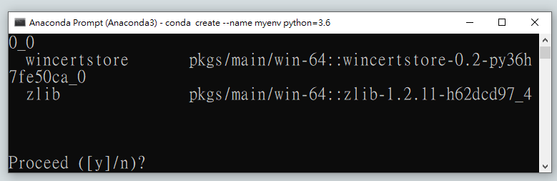
Create environment
Python environment Anaconda on windows
Install environment : conda create --name myenv python=3.6
myenv means your python environment name
3.6 means which python version you install
Input y and enter

Slide 10
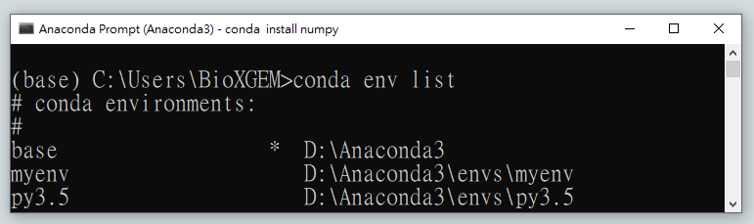
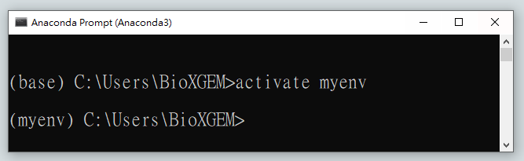
About environment
Python environment Anaconda on windows
Show all environment : conda env list
myenv create successful!
Enter to environment : activate myenv
Change environment base to myenv

Slide 11
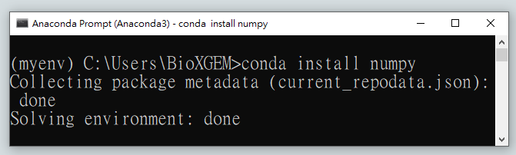
Install package
Python environment Anaconda on windows
Install package : conda install numpy
In process, please input y and enter to install successful
Common instruction on install package
conda install matplotlib
conda install pandas
conda install scikit-learn
conda install tensorflow
conda install keras

Slide 12
Python environment Linux

Slide 13
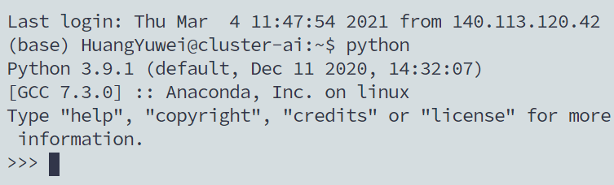
Linux
Python environment Anaconda on windows
Connect to 140.113.120.248
If here not show (base), please input “source activate”
Input “python” and coding

Slide 14
Python environment Colab

Slide 15

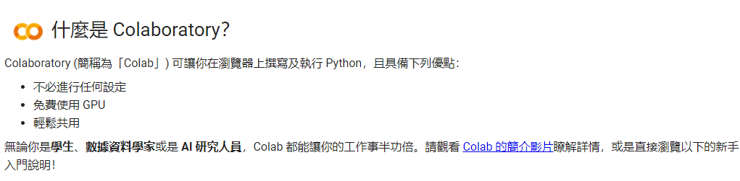
About Colab
Python environment Anaconda on windows
Python environment provided from Google
Introduction
Create new python file and start!

Slide 16

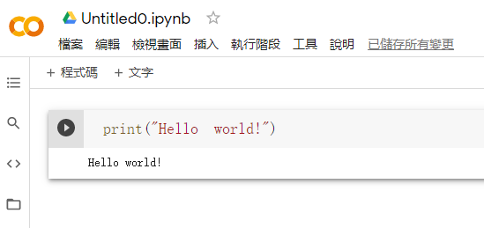
Coding on Colab
Python environment Anaconda on windows
Colab
Modify file name
Input your code
Result
Run

Slide 17
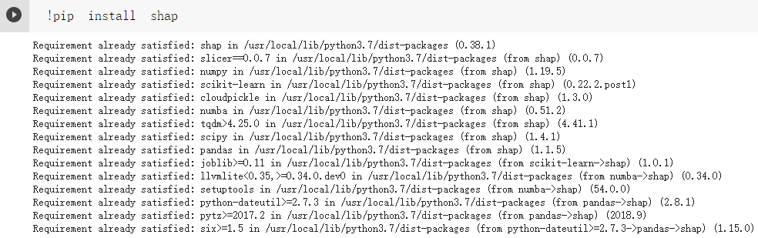
Install package
Python environment Anaconda on windows
Some package not install on Colab
Input “!pip install package name”
Input your code
Run
Result

Slide 18
Python code Pokémon type classification

Slide 19
Pokémon Classification
Pokémon dataset from Kaggle
Using 34 features (Pokemon.xlsx – feature description)
Identify 18 main type of Pokémon (#802)
一般 Normal (#105)
水 water (#114)
火 fire (#52)
草 grass (#78)
電 electric (#39)
冰 ice (#23)
格鬥 fighting (#28)
毒 poison (#32)
地面 ground (#32)
Python code on colab (only view)
飛行 flying (#3)
超能力 psychic (#53)
蟲 bug (#72)
岩石 rock (#45)
幽靈 ghost (#27)
龍 dragon (#27)
惡 dark (#29)
鋼 steel (#24)
妖精 fairy (#18)

Slide 20


















百變怪
一般 normal
傑尼龜
水 water
小火龍
火 fire
妙蛙種子
草 grass
皮卡丘
電 electric
信使鳥
冰 ice
腕力
格鬥 fighting
臭泥
毒 poison
三地鼠
地面 ground
嗡蝠
飛行 flying
夢幻
超能力 psychic
獨角蟲
蟲 bug
小拳石
岩石 rock
耿鬼
幽靈 ghost
迷你龍
龍 dragon
月亮伊布
惡 dark
可可多拉
鋼 steel
波克比
妖精 fairy

Slide 21
Code － import package
!pip install shap #install package colab not install
import shap
import pandas as pd # for read files
import seaborn as sns
import matplotlib.pyplot as plt # for draw figure
from sklearn import metrics
# calculate some performance index ex. accuracy/mcc
from sklearn.ensemble import RandomForestClassifier
# random forest model
from sklearn.model_selection import train_test_split
# splitting test/train set
from IPython.display import display, HTML
# better for export format

Slide 22
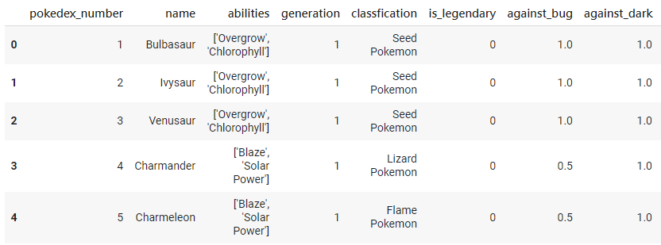
Code － read data
url = 'https://raw.githubusercontent.com/su-zu-me/RF_Model_Tutorial/main/Pokemon-classification/pokemon.csv'
ori_data = pd.read_csv(url)
# save ori data and save as "pandas dataframe" format
data = pd.read_csv(url) # change some data type
pokemon_info = data[['pokedex_number', 'name', 'type1']]
data.head() # output top5 samples of data
…

Slide 23
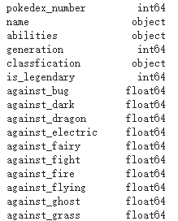
Code － read data
data.dtypes # output each feature format type
Each feature’s data type ( integer, float or char … )
…

Slide 24
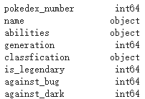
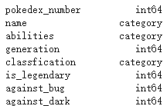
Code － data preprocessing
Aim: Change all data type be model can calculate (digit)
and for convenience change all be integer
Function tutorial
on next page
# convert not numeric type to category
for label,content in data.items():
if not pd.api.types.is_numeric_dtype(content):
data[label] = data[label].astype('category')
data.dtypes
After change data type

Slide 25
Code － data preprocessing
Function on Python dictionary items https://pandas.pydata.org/pandas-docs/stable/reference/api/pandas.DataFrame.items.html
example code
output
dict = {'one': 'apple', 'two': 'orange'}
for key, value in dict.items():
print(key, value)
one apple
Two orange

Slide 26
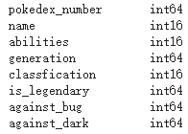
Code － data preprocessing
Aim: Change all data type be model can calculate (digit)
and for convenience change all be integer
# convert categorical to numeric
for label,content in data.items():
if pd.api.types.is_categorical_dtype(content):
data[label] = pd.Categorical(content).codes
data.dtypes
After change data type

Slide 27
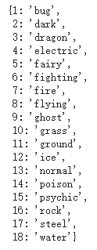
Code － data preprocessing
Aim: Change all data type be model can calculate (digit)
and for convenience change all be integer
# output category code and ori data mapping
### zip: merge multiple array
# Reference: https://www.w3schools.com/python/ref_func_zip.asp
### dict: create array but key cannot duplicate
# Reference: https://www.w3schools.com/python/python_dictionaries.asp
type1_index_info = dict(zip(data['type1'], ori_data['type1']))
type1_index_info
Code: category name
…

Slide 28
Code － split train and test data
X = data.drop(['pokedex_number', 'name', 'type1', 'classfication'], axis=1)
# remove, axis=0 for delete sample, and 1 for column (key)
y = data['type1'] # only remain type1 data
fea_name_list = list(X.columns) # save feature name list
X_train, X_test, y_train, y_test, pokemon_info_train, pokemon_info_test = train_test_split(X, y, pokemon_info, test_size=0.2)
# split train and test dataset (0.8, 0.2)

Slide 29
Code － build RF model
rf_model = RandomForestClassifier(n_estimators=500, bootstrap=True, max_features='sqrt', random_state=12)
# create random forest model parameters
rf_model.fit(X_train, y_train) # train model by X_train data
RandomForestClassifier(parameters)
n_estimators: how many trees you want to build
bootstrap: use random samples to build each tree or not
max_features: use how many feature candidates split each node
random_state: control random seed

Slide 30
Code － predict model
y_pred = rf_model.predict(X_test) # predict X_test
print('Accuracy: ', round(metrics.accuracy_score(y_test, y_pred), 3)) # calculate accuracy
print('MCC: ', round(metrics.matthews_corrcoef(y_test, y_pred), 3)) # calculate mcc

Slide 31
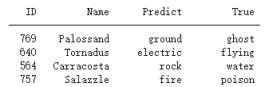
Code － output error sample
# output error samples print('{:>5s} {:>12s} {:>12s} {:>12s}'.format('ID', 'Name', 'Predict', 'True'))
print('-'*45)
count = 0
for id, label in y_test.items():
if(label != y_pred[count]): # if predict label not same
print('{:>5d} {:>12s} {:>12s} {:>12s}'.format(id, ori_data.iloc[id]['name'], type1_index_info[y_pred[count]], type1_index_info[label]))
error_id_observe_on_shap = id # observe this samples on shap value part
count += 1
…

Slide 32
Code － feature importance
Reference: https://scikit-learn.org/stable/modules/generated/sklearn.ensemble.RandomForestClassifier.html#sklearn.ensemble.RandomForestClassifier.feature_importances_
The impurity-based feature importances and the higher, the more important the feature.
feature_imp = pd.Series(rf_model.feature_importances_, index=fea_name_list).sort_values(ascending=False)
# get feature importance score and sorting
sns_plot = sns.barplot(x=feature_imp[:20], y=feature_imp.index[:20]) # draw top20 important features
fig = sns_plot.get_figure()
plt.xlabel('Feature Importance Score')
plt.ylabel('Features')
plt.title("Visualizing Important Features")
plt.legend()
plt.show()

Slide 33
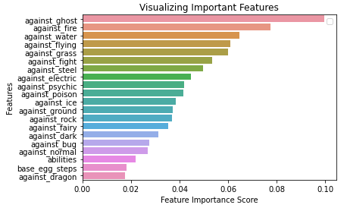
Code － feature importance
Reference: https://scikit-learn.org/stable/modules/generated/sklearn.ensemble.RandomForestClassifier.html#sklearn.ensemble.RandomForestClassifier.feature_importances_
The impurity-based feature importances and the higher, the more important the feature.

Slide 34
Code － SHAP value
Refernce: https://github.com/slundberg/shap
SHAP (SHapley Additive exPlanations) is a game theoretic approach to explain the output of any machine learning model. It connects optimal credit allocation with local explanations using the classic Shapley values from game theory and their related extensions
explainer = shap.TreeExplainer(rf_model)
# input rf_model to shap
shap_values = explainer.shap_values(X_train)
# calculate shap value of X_train
shap.summary_plot(shap_values, X_train, plot_type="bar")
# draw figure

Slide 35
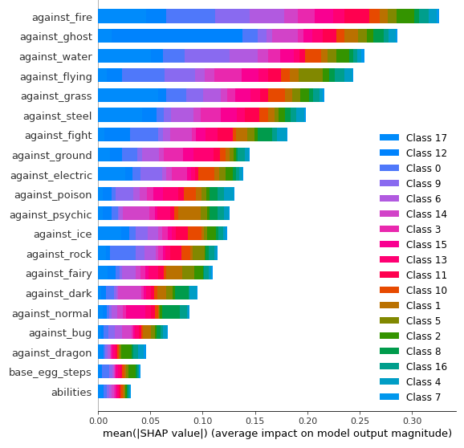
Code － SHAP value
Each feature importance on each type

