Slide 1
Artificial Intelligence and Machine Learning
Project
Project Name: Heart Disease Prediction Analysis
Team Details: Group - 8
Jinny Kapur (2210990462)
Jiya Gaba (2210990464)
Joyash Sood (2210990466)
Kartavya Tomar (2210990484)
Supervised By: Ms. Shagun Sharma
Chitkara University Institute of Engineering and Technology,
Chitkara University, Punjab

Slide 2
TABLE OF CONTENTS
Introduction
Problem Statement
Technical Details
Key Features
Project Highlights
Conclusion
References/Links used

Slide 3
INTRODUCTION
Our project targets developing a sophisticated machine learning model for heart disease prediction, utilizing data from 1025 patients with variables like age, gender, chest pain type, blood pressure, and cholesterol levels. We're evaluating Logistic Regression, Decision Tree, and Support Vector Machine models for accuracy, aiming to improve patient outcomes and reduce heart disease burden.

Slide 4
PROBLEM STATEMENT
Heart disease is a global health concern, demanding early detection and accurate prediction for better outcomes. This project aims to develop a machine learning model for predicting heart disease based on medical and demographic features. It involves data preprocessing, exploratory analysis, model training, and impact assessment using relevant patient data.

Slide 5





TECHNICAL DETAILS
The Heart Disease Prediction project leveraged essential libraries for its development:
1. NumPy: Utilized for handling large multi-dimensional arrays and matrices, and providing advanced mathematical functions.
2. Pandas: Used for high-performance data structures, enabling efficient data cleaning, preprocessing, and manipulation.
3. Matplotlib: Employed for creating high-quality static and interactive visualizations.
4. Seaborn: Enhances Matplotlib by providing a simplified interface for creating attractive statistical graphics.
5. Scikit-learn: Offers a range of machine learning tools including classification, regression, and clustering algorithms, along with model evaluation and selection capabilities.

Slide 6
KEY FEATURES
1. Supervised Learning Approach: The project employs supervised learning techniques to predict heart disease, where models are trained on labeled data with 14 attributes including age, sex, cholesterol levels, and other health metrics.
2. Three Classification Models: Three different classification models are utilized - Logistic Regression, Decision Tree, and Support Vector Machine - to classify patients into those with heart disease and those without.
3. Data Preprocessing: Includes handling missing values, duplicates, and outliers, along with feature selection to improve model performance.

Slide 7
KEY FEATURES
4. Visualization: Utilizes histograms to visualize feature distributions, correlation matrices to understand feature relationships, and confusion matrices to analyze model predictions.
5. Practical Application: Provides a user interface for custom input prediction, showcasing the practicality of the Decision Tree model for healthcare professionals.
6. Significance: The project aims to improve early detection and management of heart disease, potentially enhancing patient outcomes, reducing healthcare costs, and informing public health policies.

Slide 8

PROJECT HIGHLIGHTS
Here are the key highlights of the heart disease prediction project in bullet points:
Effective Decision Tree Model: Emerged as the top-performing model in predicting heart disease, outshining Logistic Regression and SVM in terms of accuracy and predictive power.
Comprehensive Data Analysis: Explored key features such as age, gender, blood pressure, cholesterol, and chest pain types through Exploratory Data Analysis (EDA), uncovering critical patterns crucial for accurate predictions.
Rigorous Model Evaluation: Utilized metrics like accuracy, sensitivity, specificity, and precision to assess the performance of Logistic Regression, Decision Tree, and SVM models.

Slide 9

PROJECT HIGHLIGHTS
Practical Application Enabled: Developed a user interface allowing healthcare professionals to input custom data for heart disease predictions, demonstrating the practical utility of the Decision Tree model.
Confusion Matrix Insight: Provided detailed analysis of true positives, false positives, true negatives, and false negatives, helping to understand the models' effectiveness in distinguishing between heart disease and non-heart disease cases.

Slide 10
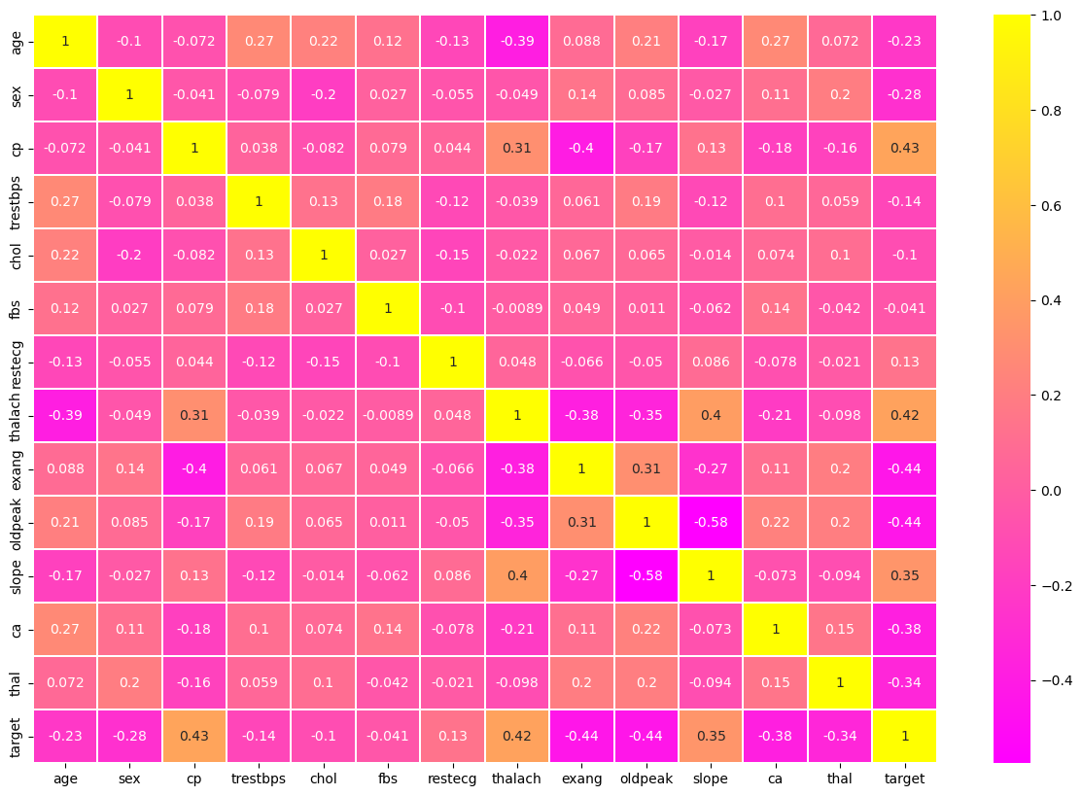
HIGHLIGHTS OF THE PROJECT
Correlation Matrix: Visualising the data features to find the correlation between them which will infer the important features.

Slide 11
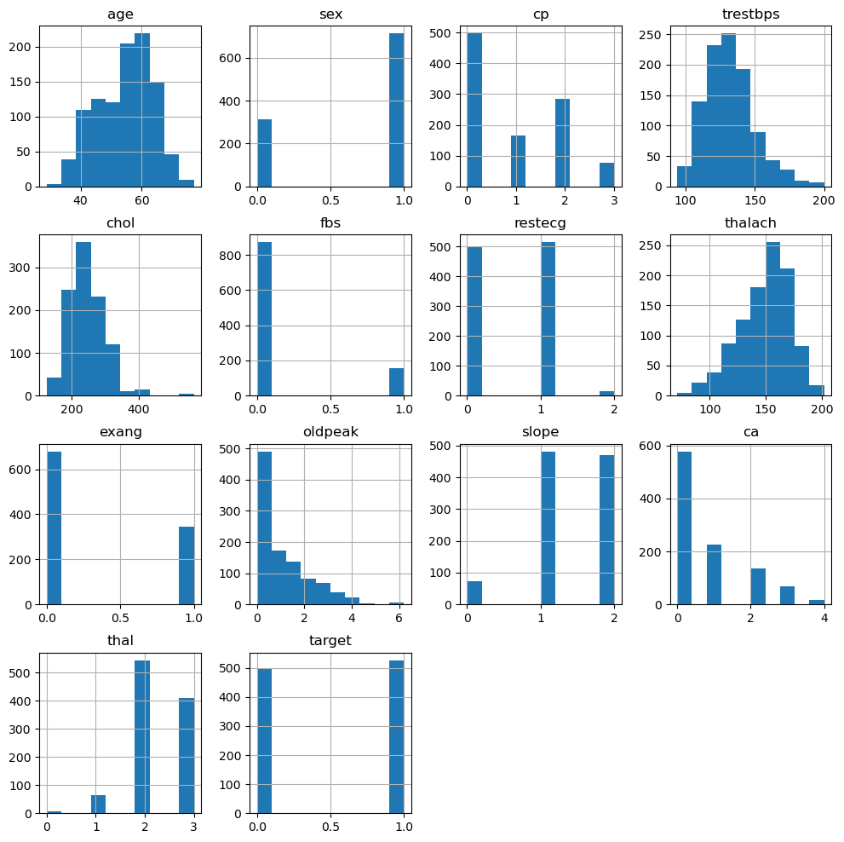
HIGHLIGHTS OF THE PROJECT
Relationship Between Each Features Distribution With The Help Of Histogram

Slide 12
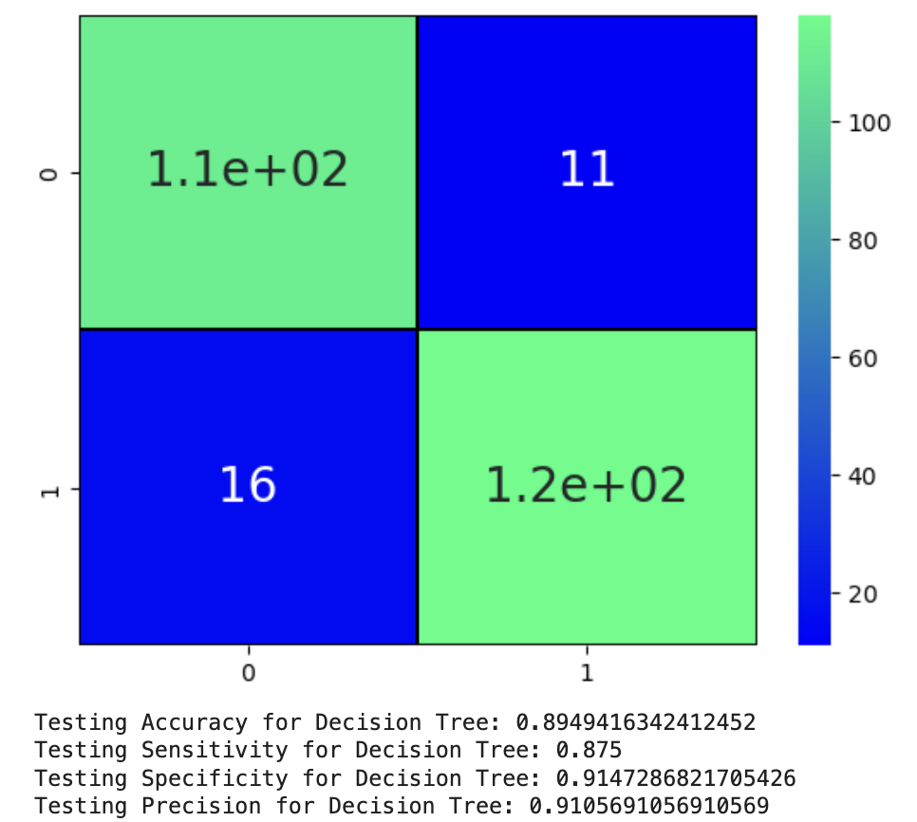
HIGHLIGHTS OF THE PROJECT
Confusion Matrix
Of
Decision Tree Model

Slide 13
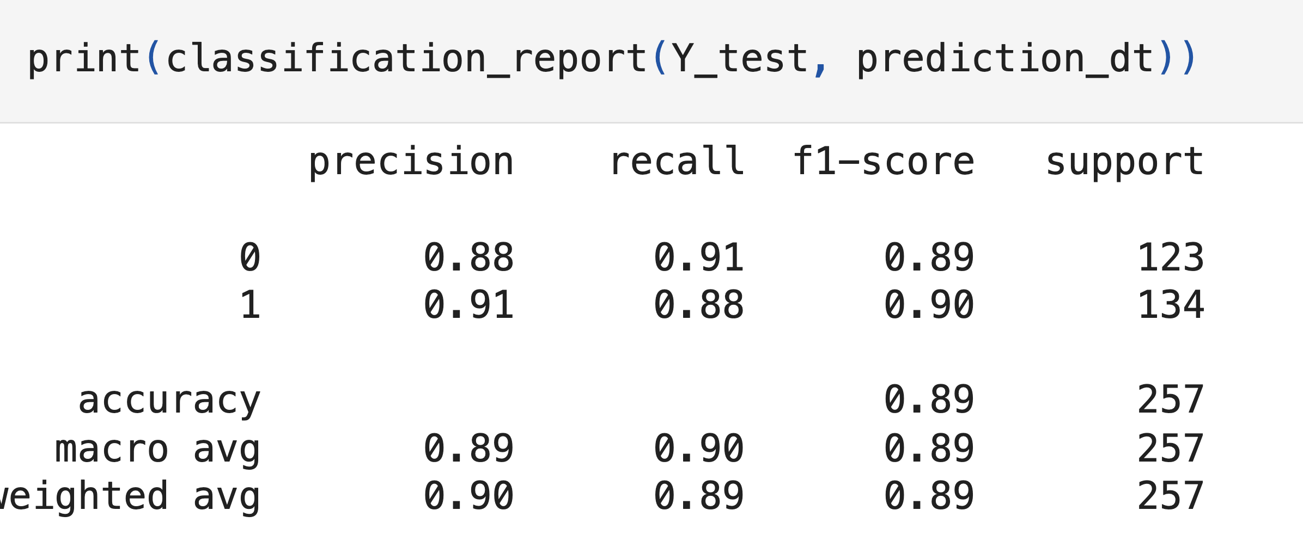
HIGHLIGHTS OF THE PROJECT
Classification Report Of Decision Tree Model

Slide 14
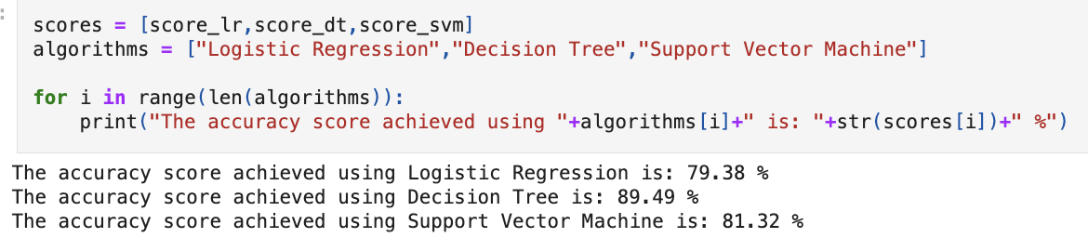
HIGHLIGHTS OF THE PROJECT
Accuracy Scores Of Logistic Regression, Decision Tree and Support Vector Machine Models

Slide 15
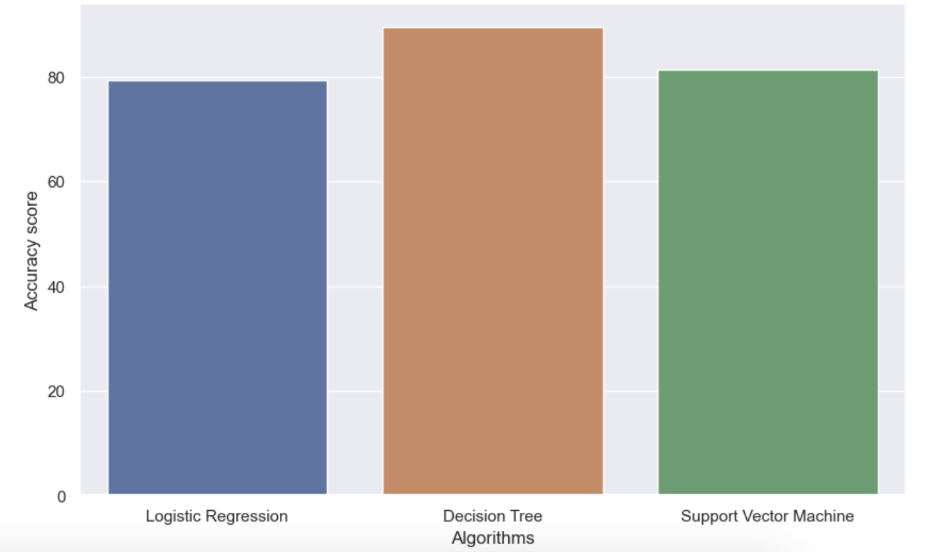
HIGHLIGHTS OF THE PROJECT
Comparison of Accuracy Scores of All 3 Models

Slide 16

CONCLUSION
Our Heart Disease Prediction project utilized Exploratory Data Analysis (EDA) to uncover crucial patterns for accurate prediction. We trained and evaluated Logistic Regression, Decision Tree, and Support Vector Machine models, with Decision Tree proving superior. Confusion matrix analysis highlighted model performance, and our custom input interface demonstrated practicality, empowering healthcare professionals.

Slide 17
REFERENCES/LINKS USED
Kaggle:
https://www.kaggle.com/datasets/johnsmith88/heart-disease-dataset
Geeks For Geeks:
https://www.geeksforgeeks.org/supervised-machine-learning/
https://www.geeksforgeeks.org/understanding-logistic-regression/
https://www.geeksforgeeks.org/support-vector-machine-algorithm/
https://www.geeksforgeeks.org/decision-tree/
Analytics Vidhya
https://www.analyticsvidhya.com/blog/2022/02/heart-disease-prediction-using-machine-learning-2/

Slide 18


