Slide 1

PASSWORD GENERATOR
(Python Solo Project)
Submitted by:
Jinny Kapur
2210990462
G10
Submitted to:
Tushar Khitoliya

Slide 2

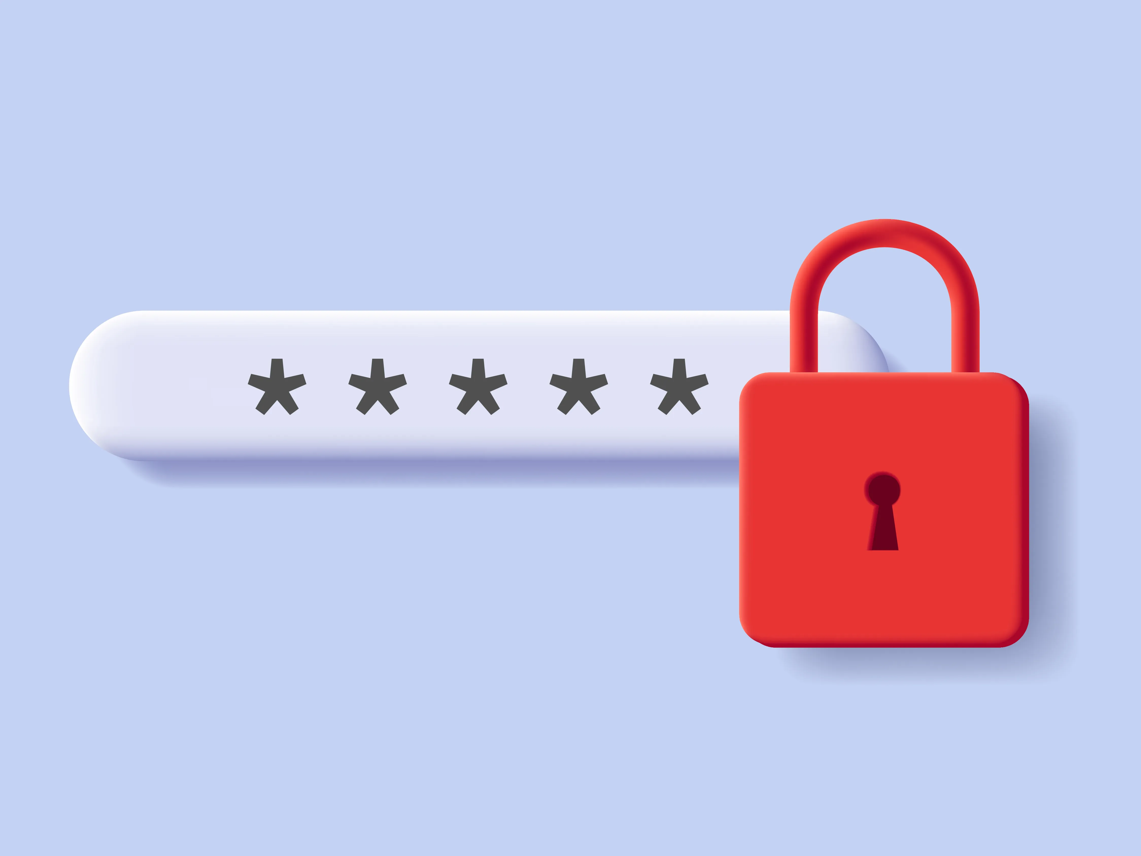
Introduction
The Password Generator Application is a Python project designed with Tkinter, offering users a streamlined method to create strong passwords. Its graphical interface simplifies the process for users of all levels, allowing them to generate randomized strings of varying lengths comprising letters (uppercase and lowercase), numbers, and symbols.
One of its notable features is the ability to copy passwords to the clipboard, enhancing convenience when using passwords across different platforms. This application addresses the growing need for robust password practices, catering to users who prioritize security in their digital interactions.

Slide 3
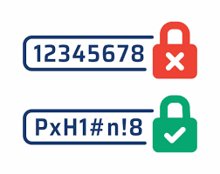
Motivation
The Password Generator Application is driven by the pressing need for enhanced cybersecurity practices in today's digital landscape. With the prevalence of cyber threats and the risks associated with weak passwords, this project aims to provide users with a straightforward tool to create strong and unique passwords. By promoting better password management habits, the application seeks to bolster online security and protect users' sensitive information effectively.

Slide 4
Justification of the Project
Offers user convenience with a user-friendly interface and clipboard copying functionality.
Versatile application suitable for various digital security needs.
Enhances cybersecurity by providing a tool for generating strong passwords.
Promotes the creation of unique passwords to mitigate data breaches.
Educates users about password security best practices.
Potential for open-source collaboration and continuous improvement.

Slide 5

PROBLEM STATEMENT
Weak and easily guessable passwords are a common security risk, leading to unauthorized access and data breaches. There's a need for a user-friendly solution to help individuals create strong passwords and improve cybersecurity across online platforms.

Slide 6
OBJECTIVE
The objective of the Password Generator Application is to provide users with a simple and efficient tool to generate strong, unique passwords, thereby enhancing cybersecurity and reducing the risk of unauthorized access and data breaches across online platforms and applications.

Slide 7
METHADOLOGY
User Input: Prompt users for the desired password length.
Random Generation: Generate a random password based on the user's input.
Display: Show the generated password on the interface.
Clipboard Functionality: Include an option to copy the password to the clipboard.
Error Handling: Handle invalid inputs or errors gracefully.
User-Friendly Interface: Design an intuitive and easy-to-use interface.
Testing: Conduct thorough testing for functionality and compatibility.
Documentation: Provide comprehensive user and technical documentation.

Slide 8
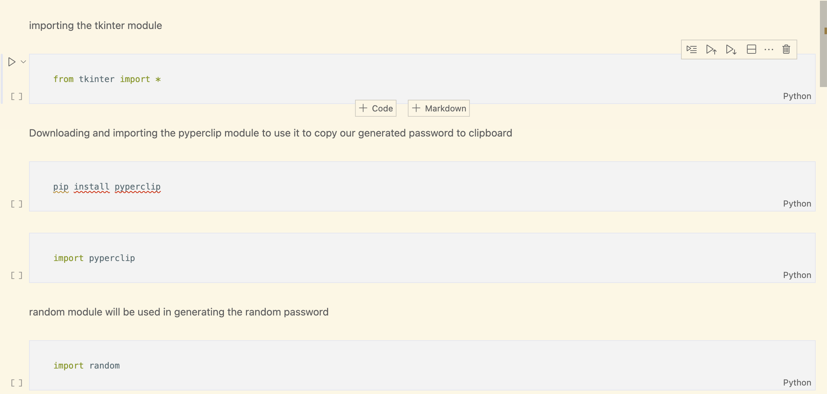
CODE SNIPPETS

Slide 9
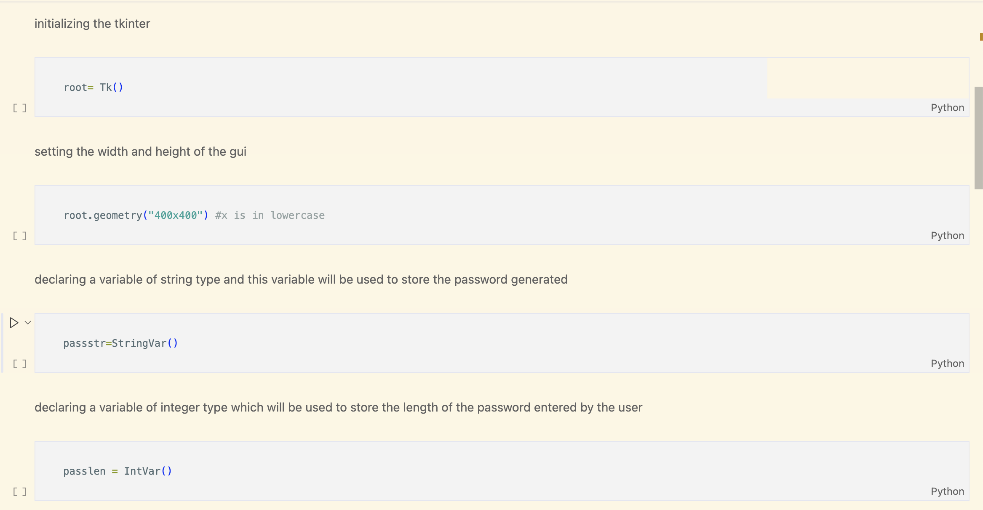
CODE SNIPPETS

Slide 10
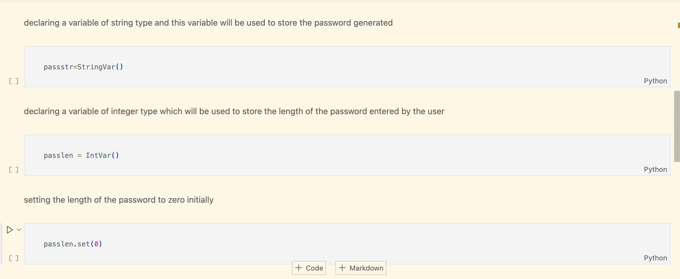
CODE SNIPPETS

Slide 11
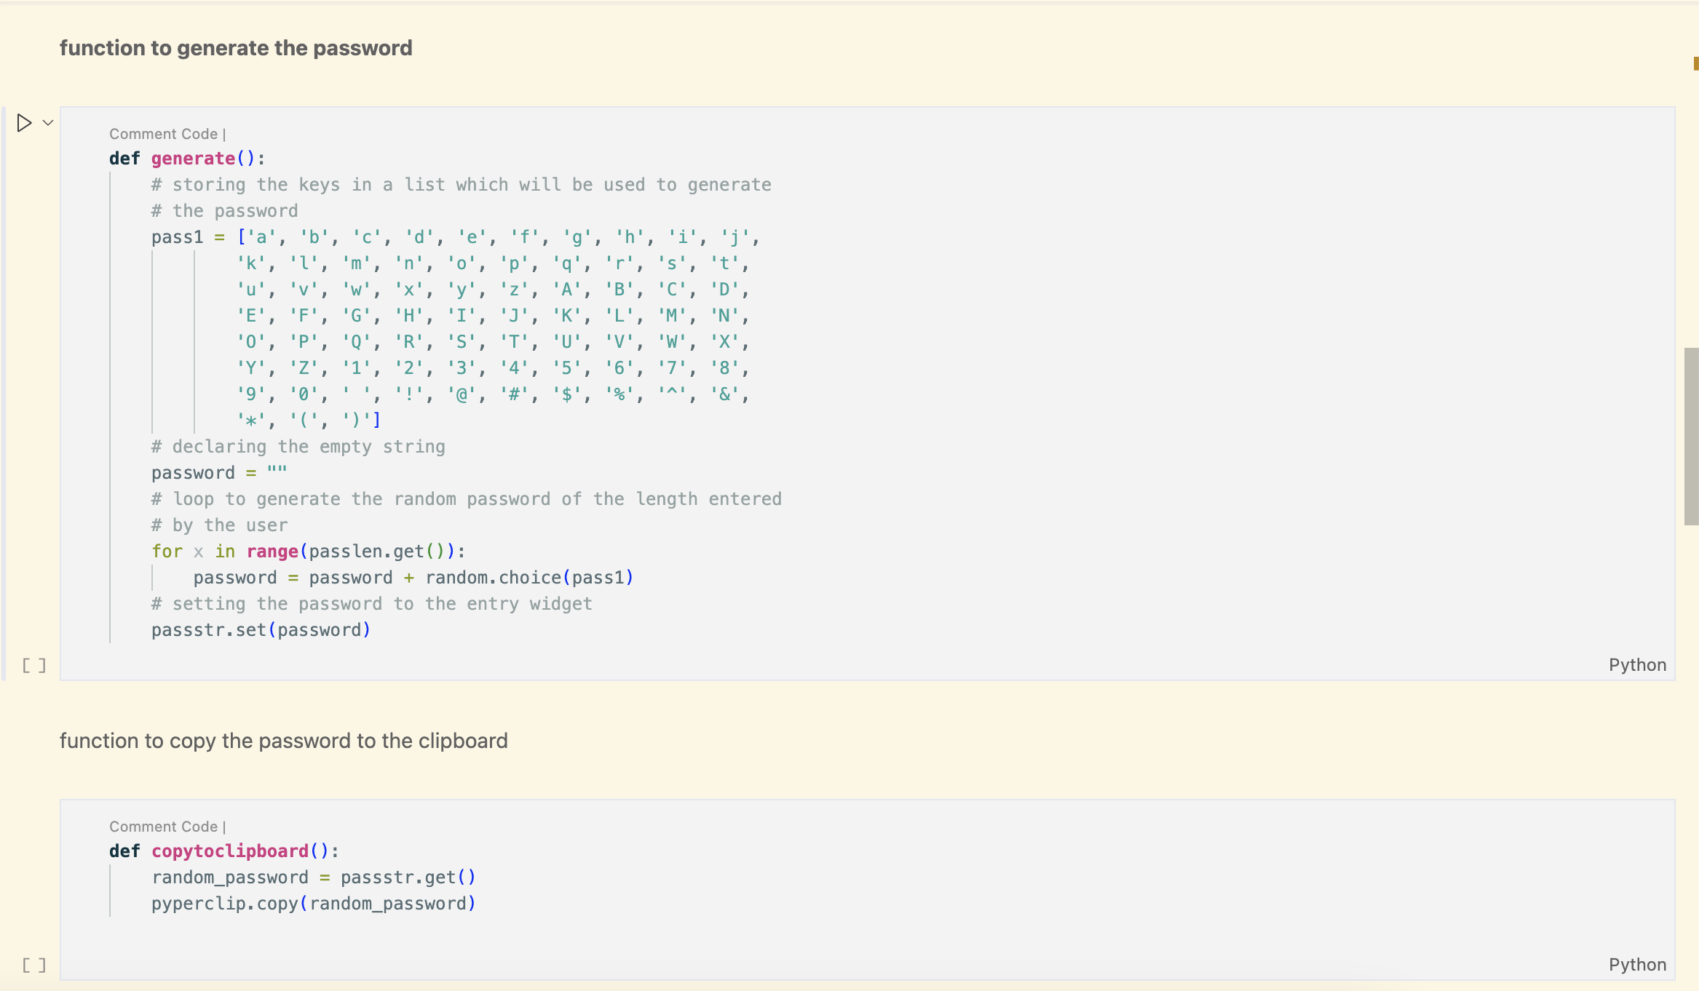
CODE SNIPPETS

Slide 12
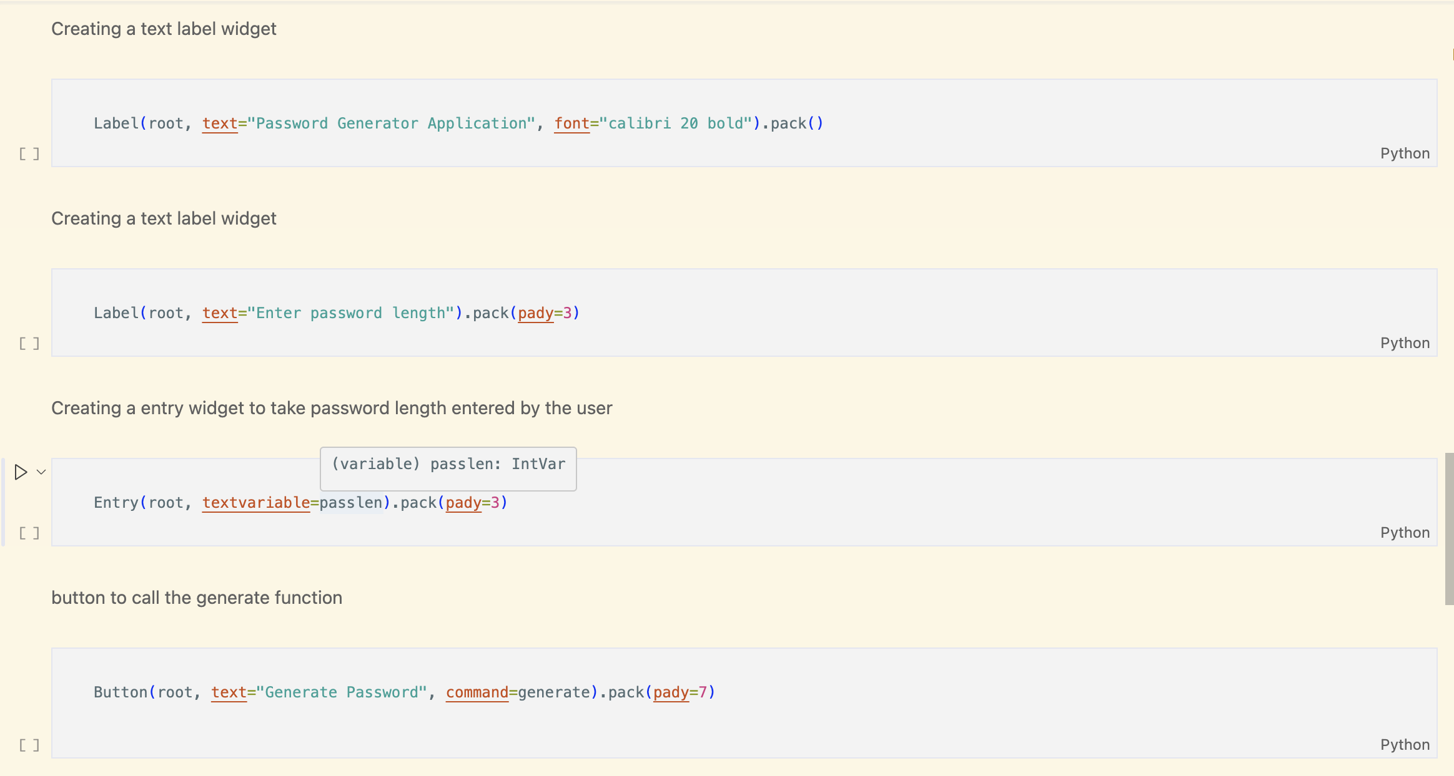
CODE SNIPPETS

Slide 13
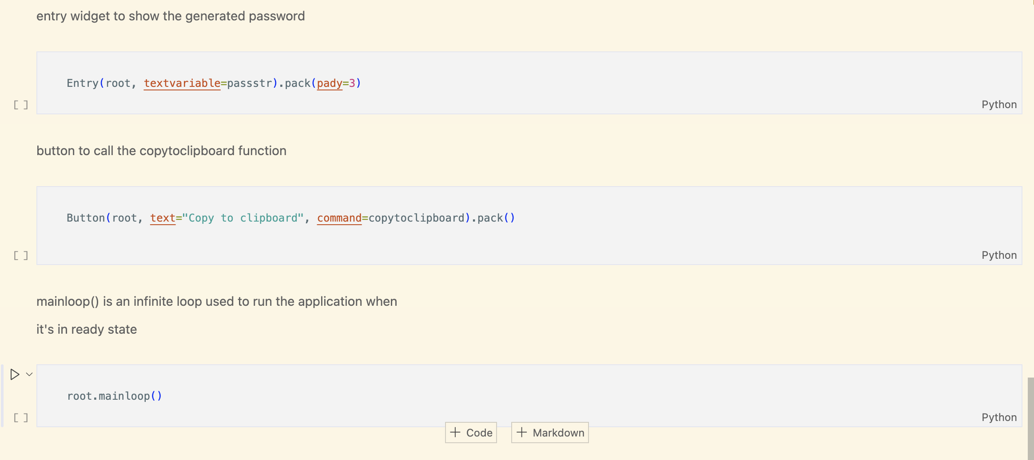
CODE SNIPPETS

Slide 14
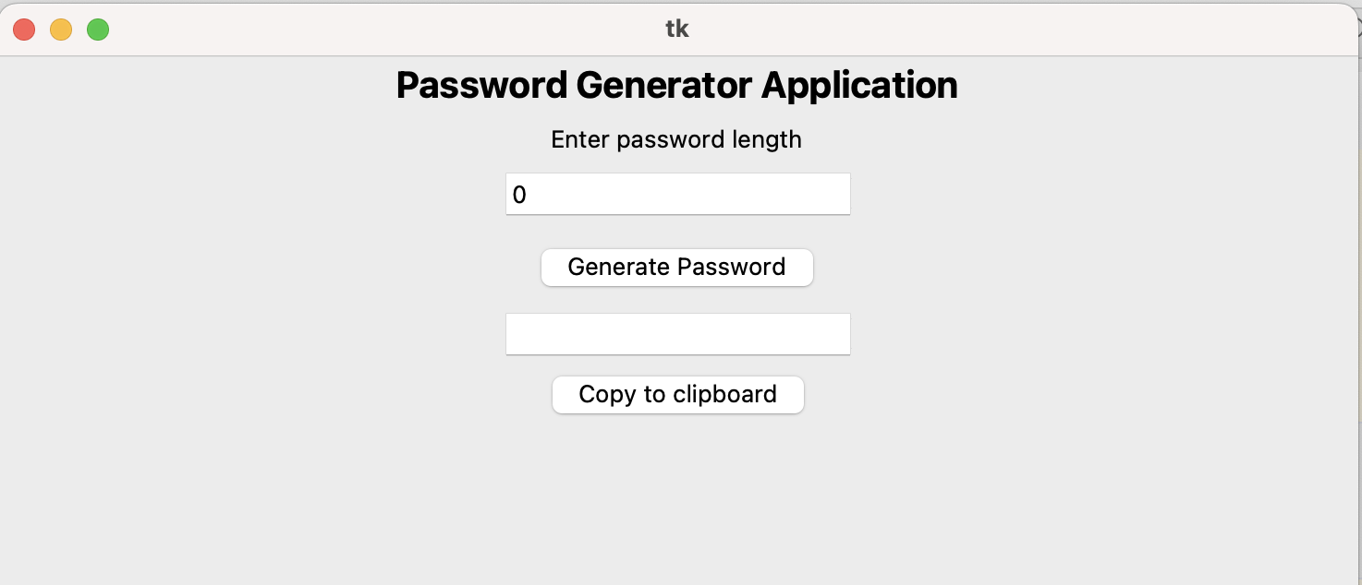
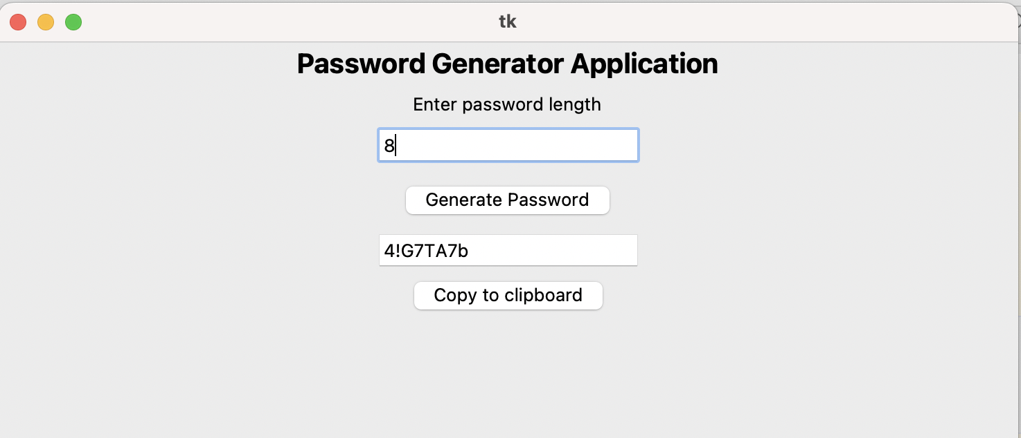
EXPECTED OUTCOMES

Slide 15
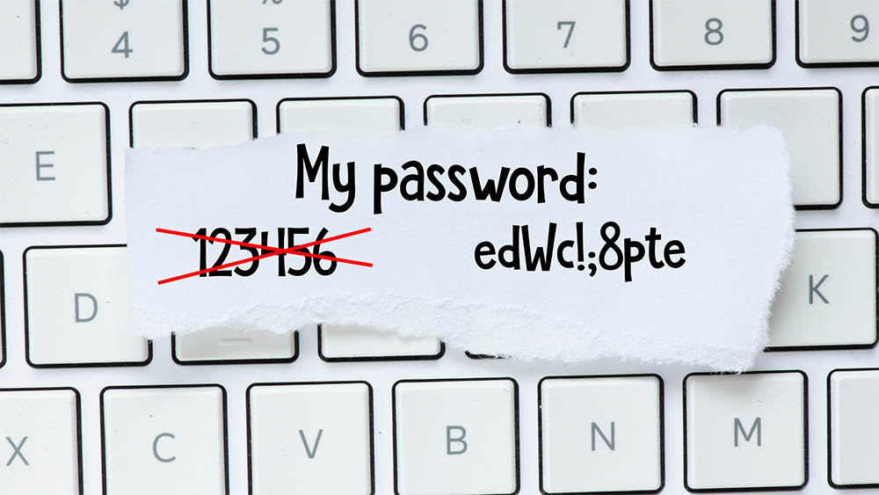
References
https://tutorialslink.com/Articles/Password-Generator-APP-using-Python/1832

Slide 16

Thank You

