Slide 1
Project Presentation of Exploratory Project (EP)
On
Traffic Light Control System
Department of Computer Science and Engineering,
Chitkara University, Punjab
Submitted by:
Jinny Kapur (2210990462)
Khushi (2210991796)
Serena Balyan (2210992281)
Supervised by:
Dr. Gifty Gupta
Assistant Professor,
Chitkara University, Punjab

Slide 2
INTRODUCTION
Rapid urbanization has led to increased traffic congestion.
Traditional traffic signals operate on fixed timing mechanisms.
Fixed timers do not adapt to changing traffic conditions.
Inefficient traffic control results in delays, fuel wastage, and pollution.
This project simulates a smart traffic signal system using Java.
2

Slide 3

PROBLEM STATEMENT
Existing traffic signal systems lack adaptability.
Fixed-time signals fail during peak traffic hours.
Emergency vehicle movement is not prioritized.
Many educational models lack real-time visualization.
Problem Statement:
To design a traffic signal control system simulation that dynamically adjusts signal timing based on traffic density and supports an emergency mode.

Slide 4

OBJECTIVE
This project aims to:
To design a graphical traffic signal simulation using Java Swing.
To implement red, yellow, and green signal transitions.
To introduce traffic density–based signal timing.
To include an emergency mode for special situations.
To apply object-oriented programming concepts.
To ensure smooth animation using multithreading.

Slide 5
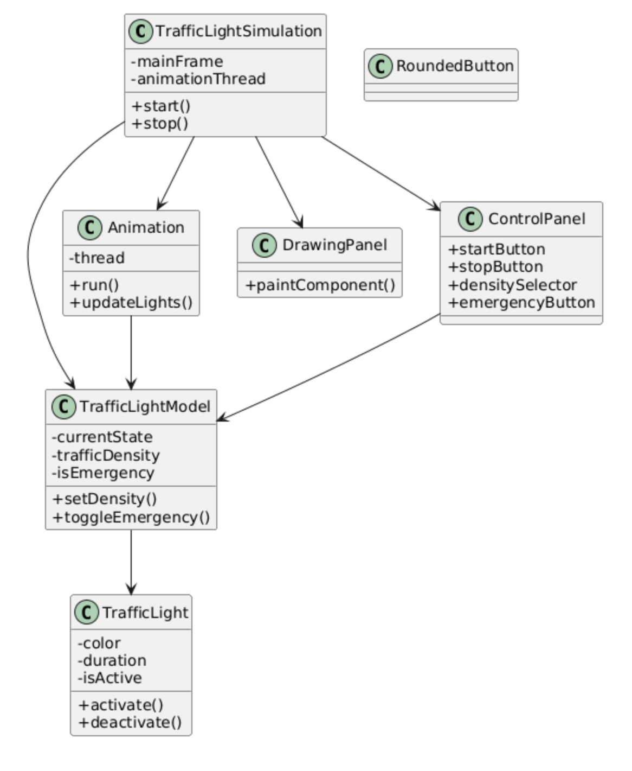
UML Diagram

Slide 6

TOOLS & TECHNOLOGIES
Programming Language: Java
Framework: Java Swing
Libraries: Java AWT, Multithreading
IDE: Visual Studio Code
Platform: Cross-platform (Windows / Linux / macOS)

Slide 7

RESULTS
Successfully simulates three traffic signals (Red, Yellow, Green).
Countdown timer works accurately.
Green signal duration changes with traffic density.
Emergency mode activates blinking yellow signal.
User interface remains responsive.
System runs smoothly without errors.

Slide 8
CONCLUSION
The project demonstrates a realistic traffic signal simulation.
Density-based control improves efficiency over fixed-time systems.
Emergency mode enhances real-world applicability.
Object-oriented design ensures clean and maintainable code.
The system is suitable for learning and demonstration purposes.

Slide 9

Thank You
9

