Slide 1
Reinforcement Learning Agents in Colonel Blotto
Joseph Christian G. Noel
(Code, paper, and presentation available at https://github.com/jinonoel/BlottoRL)

Slide 2
Colonel Blotto
Constant-sum game proposed by Emile Borel in 1921.
No one best strategy, any strategy can be beaten.
Strategy: Tailor based on opponent’s strategy
Agent-based model
Player A | *** | ***** | **
Player B | ** | ** | ******

Slide 3

Reinforcement Learning (RL) Agent
Agent learns by performing actions which changes the state of an environment.
Agent learns through “rewards” returned by the environment after an action. Goal for agent is to maximize the cumulative rewards it receives over time.
State-action value function Q: Estimate of the expected rewards an agent will be receive by performing action a in state s and following policy π afterwards.

Slide 4
Markov Process
To simplify things, reinforcement learning problems are usually constructed as Markov models.
Markov Property: All pertinent information from the state history is encapsulated in the previous state.
Decision optimization tasks like this are called Markov Decision Processes.

Slide 5
Q-Learning
One of the basic RL algorithms.
Calculate the state-action value function Q in a recursive manner
Use a weighted average of the old value and the new information retrieved from the action and subsequent reward.

Slide 6
Experiment
Colonel Blotto with 3 fronts, 2 players, and 10 coins each.
RL Agent (using Q-Learning) vs Random Agent.
Exploration rate of 0.2
Reward of 1 for won games, -1 for lost games.
Up to 1M games played using OpenSpiel simulator environment (https://github.com/deepmind/open_spiel)
Player A | *** | ***** | **
Player B | ** | ** | ******

Slide 7
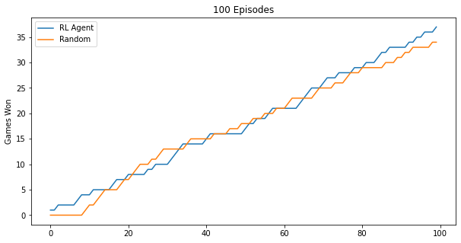
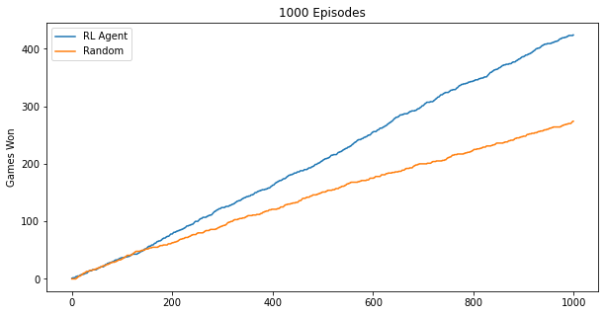
Results
Performance is the same within the first 100 games
RL Agent starts to win more regularly at close to 200 games
At 1000 games and more, the better performance can be clearly seen.

Slide 8
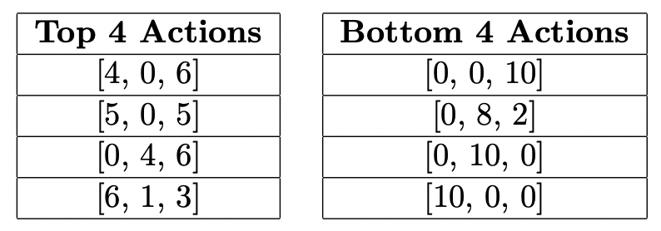
Strategy
Look into the individual action Q-values to find out what strategy the RL agent arrived at:
Best actions sacrifice one front to focus on the other 2 fronts
Worst actions sacrifice 2 fronts, guaranteeing a loss.

Slide 9
Conclusion
Reinforcement learning is a good way to learn tailored strategies against an opponent in games like Colonel Blotto.
RL agents take awhile to search for and learn optimal strategies.
A good strategy in Colonel Blotto is to sacrifice one front and increase the probability of winning the other fronts.

Slide 10
End

