Slide 1

Airbnb Revenue Influenced by Citibikes?
CIS 9440 - UWA
Data Warehousing & Analytics
Group 5
Mehdi Lahlou Charki
Ahmmed Hossain
Hojin Lee
Notes:
Good evening professor and everyone, We are group 5 Mehdi, Ahmmed, and me, Hojin.
Today, We are going to talk about airbnb and citibike

Slide 2
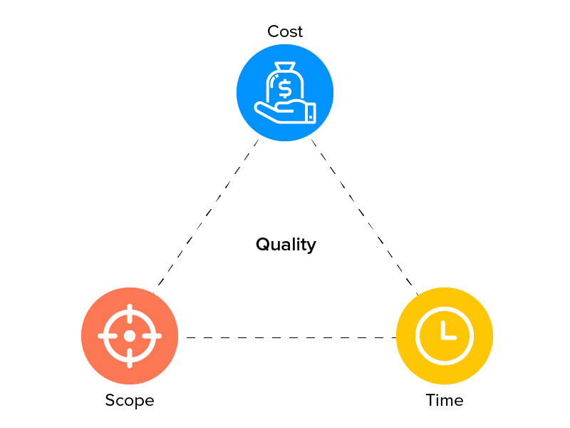


Project Goal
To identify Airbnb revenue factors generated by CitiBike traffic
Project Limitation
Incomplete Airbnb data
Only Jan and Feb 2021 data used for Citibike traffic
Possibly incorrect zip codes
Limited time and cost
X
Notes:
Our project goal is to identify Airbnb revenue factors based on the Citibike traffic
We tried to understand the correlation between revenue of Airbnb listings and CitiBike traffic
However,
There were limitations on our project.
We found the Airbnb data on Kaggle and there are not enough information that we want such as date and zipcodes
For the citibike data, We only used january and february 2021. We tried to merge datasets for other months but they have different formats so for better quality and accuracy, we decided to use only january and february data
We need zipcodes to connect airbnb data with citibike data but In the original data, we don’t have zipcodes so we needed to research a way to get the zip code from the provided longitude and latitude. The best way that we found was using an API. we also found an website, BigDataCloud.com and it provided an API that interprets the geocode and responds with the respective Zip Code.
We created zip codes using the API found online and we don’t know the longitude and latitude provided in the original data are 100% correct
so we can’t be sure all the zipcodes are correct
Lastly, we thought that if we have more time and budget, we may be able to gain better insights and results.

Slide 3
Final 5 KPI’s
X
Number of citi bike trips per location
Total Revenue per location
Average price a night per location
Number of rentals generated based on citi bike trips
Average ratings per location
Notes:
This is our final KPI’s
Number of citi bike trips per location
Total Revenue per location
Average price a night per location
Number of rentals based on citi bike trips
Average ratings per location
Now my teammate Mehdi will talk about the dashboard that we created in Tableau based on the final KPI’s

Slide 4
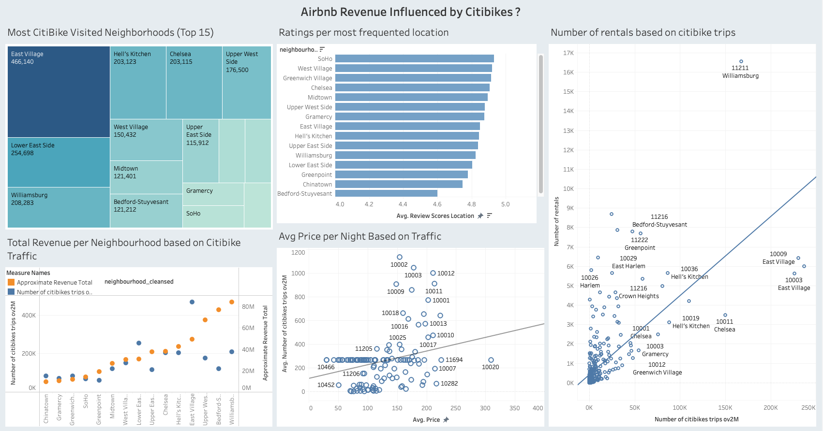
Tableau Dashboard based on our KPIs
X
https://public.tableau.com/app/profile/mehdi.lahlou.charki/viz/Tableaufinalproject_16383659899150/Dashboard1
Notes:
The greater the number of CitiBike trips, the higher Airbnb price per night.
The greater the traffic in CitiBike, the higher the number of listings will be rented

Slide 5
Conclusion
Based on our analysis, higher citi bike traffic contributes to higher neighborhood attractiveness
Other external factors should be considered as well, when judging a potential listing generated revenue
Correlation doesn’t mean causation
X

Slide 6
Thank you

