Slide 1

DAF-MIT AI ACCELERATOR
陈生阳

Slide 2
CONTENT
Part 01
Home
Part 02
About
Life isn't about waiting for the storm to pass. it's about learning to dance
News
Part 03
Part 04
Research
Part 05
Challenges
Part 06
FAQ
Part 07
Contact Us

Slide 3
A.
Part 01
Home
Life isn't about waiting for the storm to pass. it's about learning to dance Life isn't it's about learning to dance in the rain.

Slide 4

Home
主页是对网站全称的介绍，点击learn more可以进入“About”界面
标题文字容
ENTER THE TITLE HERE
ENTER THE TITLE HERE

Slide 5
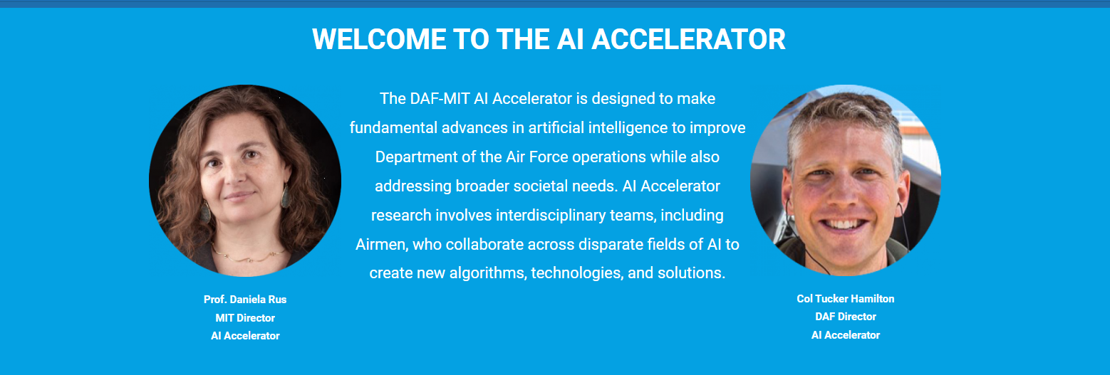
Home
DAF-MIT AI ACCELERATOR领导人的一些欢迎语
标题文字容
ENTER THE TITLE HERE
ENTER THE TITLE HERE

Slide 6

Home
新闻和团队照片
标题文字容
ENTER THE TITLE HERE
ENTER THE TITLE HERE

Slide 7
B.
Part 02
About
Life isn't about waiting for the storm to pass. it's about learning to dance Life isn't it's about learning to dance in the rain.

Slide 8
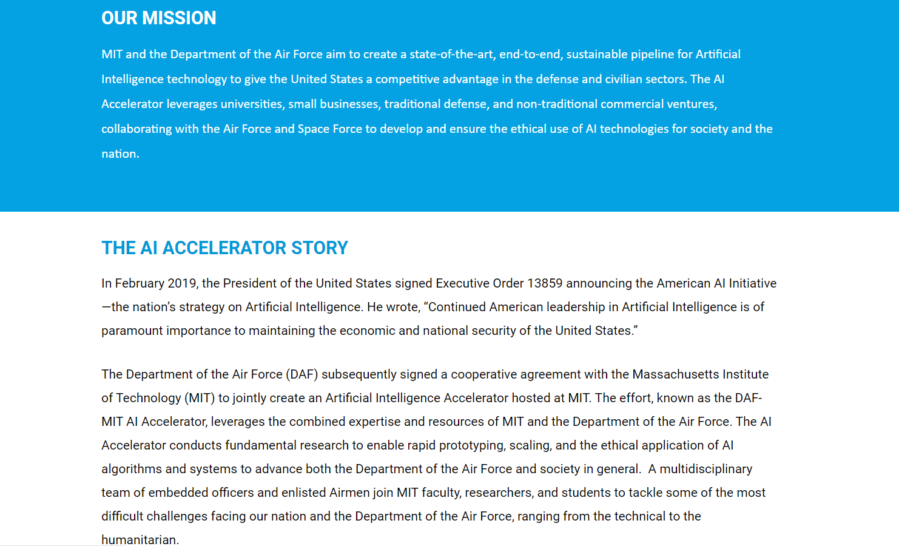
About
目标和AI加速器故事
标题文字容
ENTER THE TITLE HERE
ENTER THE TITLE HERE

Slide 9
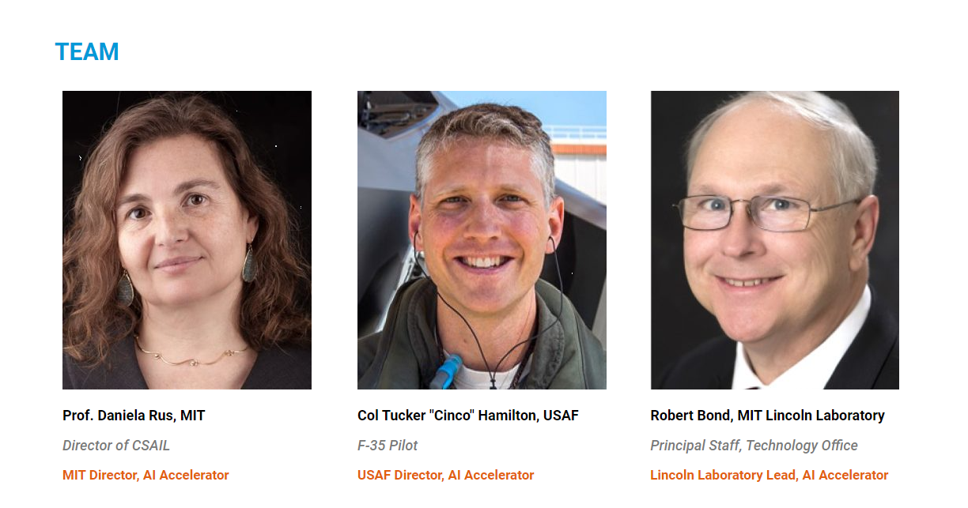
About
团队介绍
标题文字容
ENTER THE TITLE HERE

Slide 10
C.
Part 03
News
Life isn't about waiting for the storm to pass. it's about learning to dance Life isn't it's about learning to dance in the rain.

Slide 11
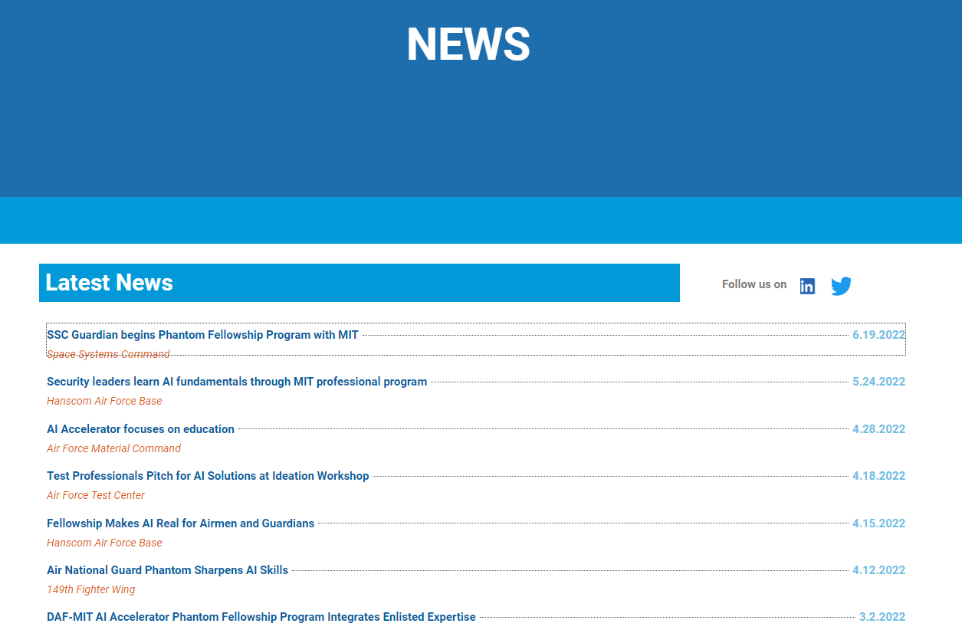
News
AI加速器各种新闻
标题文字容
ENTER THE TITLE HERE

Slide 12
C.
Part 04
Reasearch
Life isn't about waiting for the storm to pass. it's about learning to dance Life isn't it's about learning to dance in the rain.

Slide 13
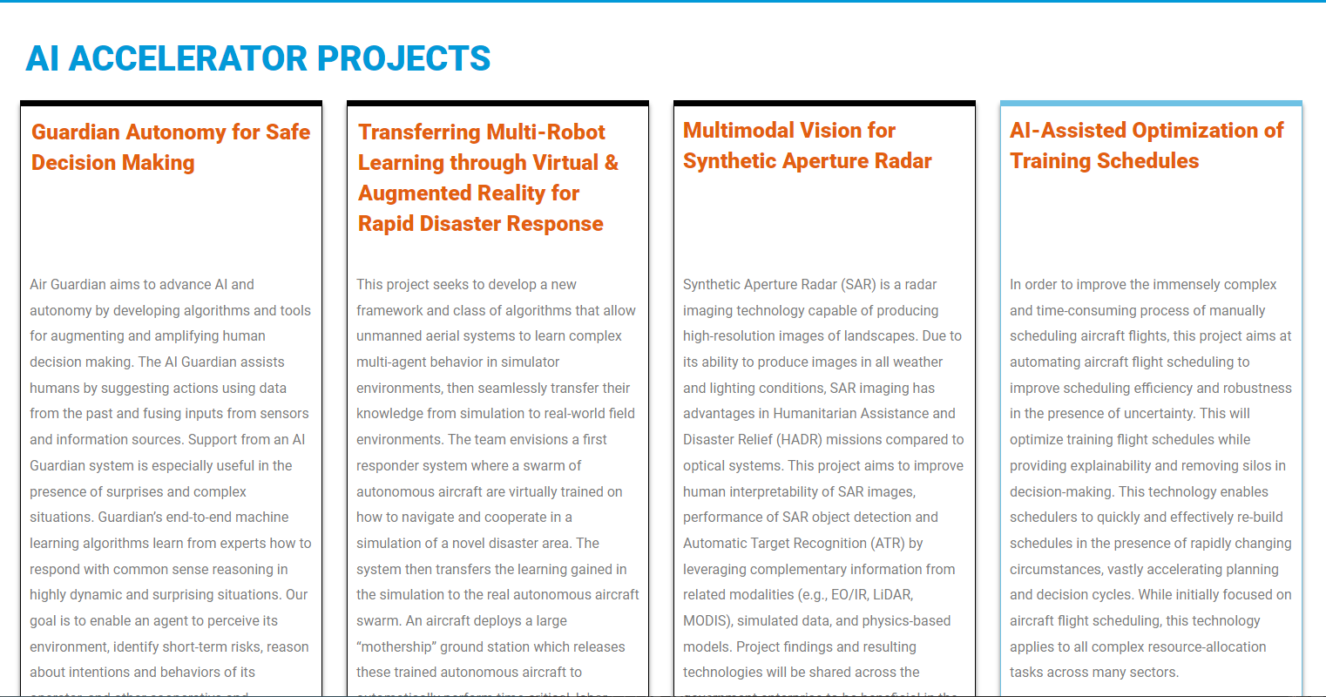
Research
AI加速器各种项目介绍和团队介绍
标题文字容
ENTER THE TITLE HERE

Slide 14
C.
Part 05
Challenges
Life isn't about waiting for the storm to pass. it's about learning to dance Life isn't it's about learning to dance in the rain.

Slide 15

Challenges
网站发布的各种挑战项目，包括发布的团队和挑战的详细信息
标题文字容
ENTER THE TITLE HERE

Slide 16
C.
Part 06
FAQ
Life isn't about waiting for the storm to pass. it's about learning to dance Life isn't it's about learning to dance in the rain.

Slide 17
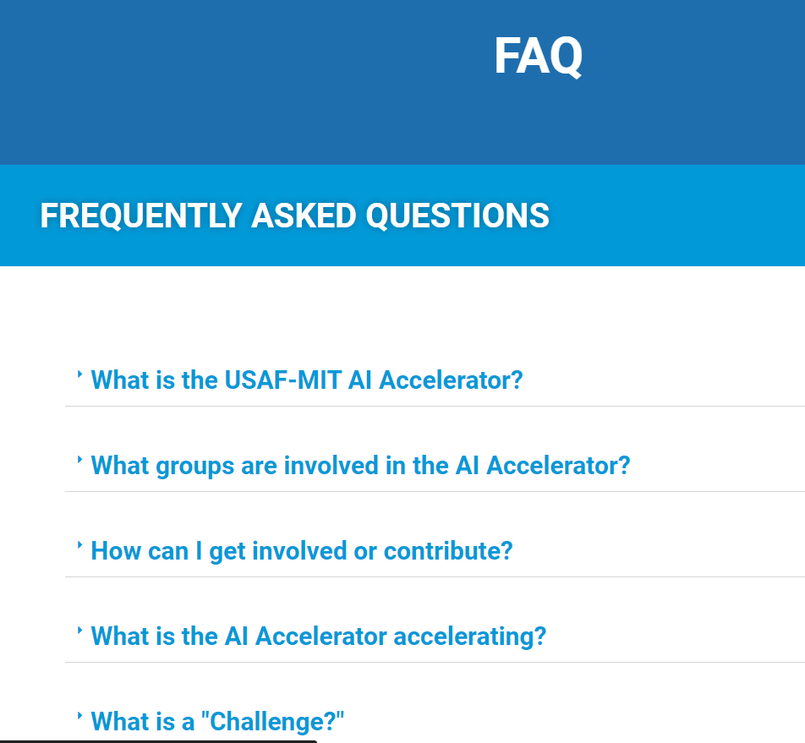
FAQ
关于AI加速器的一些问题和回答
标题文字容
ENTER THE TITLE HERE

Slide 18
C.
Part 07
Contact Us
Life isn't about waiting for the storm to pass. it's about learning to dance Life isn't it's about learning to dance in the rain.

Slide 19
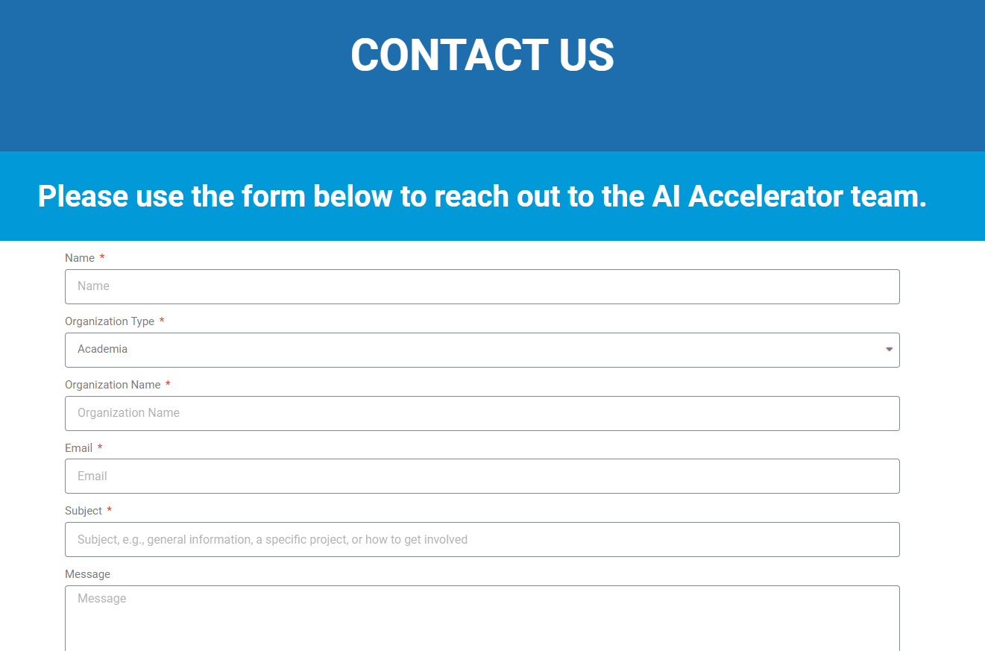
Contact Us
填写相关资料联系团队
标题文字容
ENTER THE TITLE HERE

