Slide 1
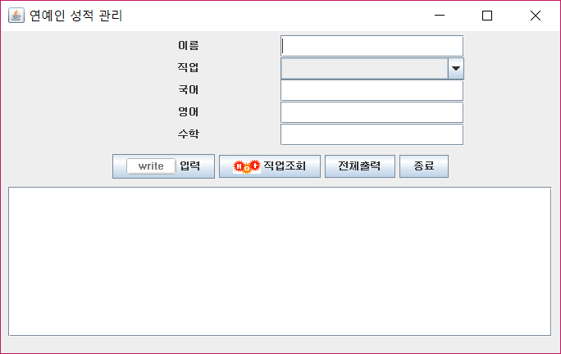
contenPane
20
txtName
jpup
comJob
txtKor
txtEng
450
txtMat
jpbtn
btnInput
btnSearch
btnOutput
btnExit
10
60
scrollPane
txtPool
700

