Slide 1
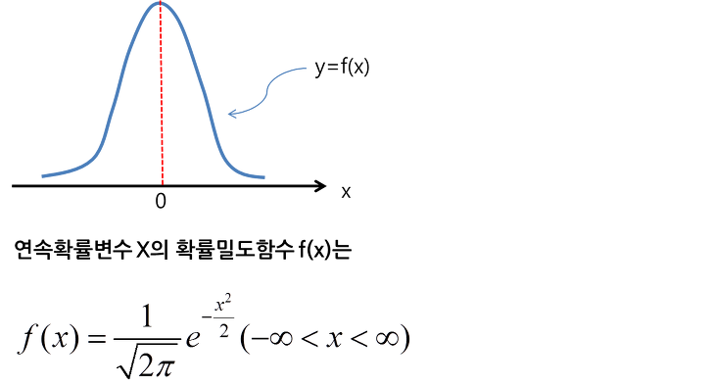
STDDEV
STDDEV
평균
68.12%
95.44%

Slide 2
