Slide 1
CS235101 Data Structure Homework 3
Due date: 2017/11/23 23:59

Slide 2
Max Heap
A max tree is a tree in which the key value in each node is no smaller than the key values in its children. A max heap is a complete binary tree that is also a max tree.
14
12
7
10
8
6

Slide 3
Target
The target of this homework is to implement a max heap
You are asked to implement 6 functions below
Insert (int value)
DeleteMax()
MaxPathWeight (int index)
InorderTraversal (int index)
PreorderTraversal (int index)
PostorderTraversal (int index)

Slide 4
Target
Insert (int value)
Insert a data into the heap
DeleteMax()
Delete the root node.
4
2
3
1

Slide 5
Target
14
12
7
MaxPathWeight (int index)
Return the max path weight from root to leaf.
Ex: 14+12+10 is the maximum path weight, so output 36
InorderTraversal (int index)
Return the inorder traversal path from root.
Ex: 10 12 8 14 6 7
10
8
6

Slide 6
Target
14
12
7
PreorderTraversal (int index)
Return the preorder traversal path from root.
Ex: 14 12 10 8 7 6
PostorderTraversal (int index)
Return the postorder traversal path from root.
Ex: 10 8 12 6 7 14
Each traversal path output format:
Int Int Int Int …… Int
10
8
6

Slide 7
File Structure
#include “function.h”
class “Heap” represents a Heap
size : Use this variable to record your heap size.
heap: Use this array to construct the heap.
In the end, we use above variable to print the whole heap.
class “Implement” contains your implementation
Sample input and output

Slide 8
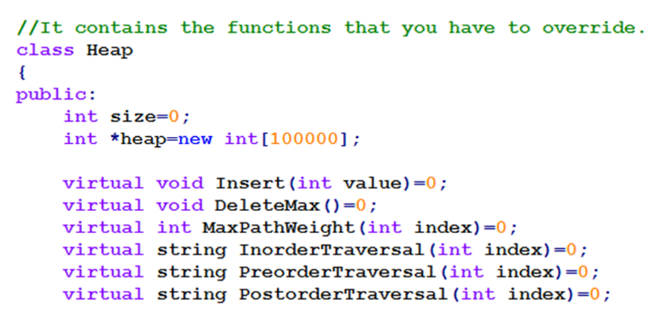
Heap

Slide 9
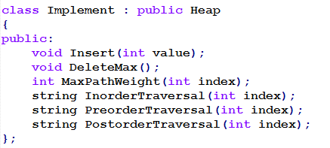
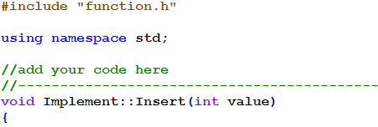
Implement
In function.h
code.cpp

Slide 10
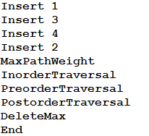

Sample IO
End will output the whole heap.
But you don’t need to handle it.

Slide 11
Note
1.Each data is an integer ranges from 1 to 99999
2.Each node is unique, two duplicate integers won’t exist at the same time
3.There will exists at least 1 and at most 99999 nodes in the final heap.
4.Root index is 1.

Slide 12
STL is not allowed
<list> <vector> <forward_list> … are not allowed
If you try to include the above headers, your source files WILL NOT be compiled properly during TA’s evaluation

Slide 13
Submission
Online Judge: #11653
Archive your source codes (whole hw3 folder) into a zip file named [studentID]_hw3.zip
E.g. 102062999_hw3.zip
Submit the zip file to ilms system BEFORE the deadline

