Slide 1

Agriculture Management System

Slide 2
TEAM MEMBERS
Radhanpura Stuti Nishitbhai (20162121024)
Shah Jinay Pratikkumar (20162121025)
Shah Purav Sanjay (20162121026)
Shah Sakshi Kalpeshbhai (20162121027)

Slide 3
PROPOSED SYSTEM
We have used Packages like java.io.* for FileHandling and java.util.* for Scanning
We have made 3 classes named Project , variable , Menu.
We have Inheritance.(Single level Inheritance).
We have used ArrayList.
We have used File Handling which uses FileWriter and BufferedWriter class , by using their objects we have stored output in different text files.
Exception Handling is used to catch the exception caused due to file handling if any.

Slide 4
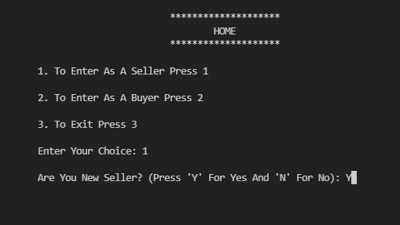
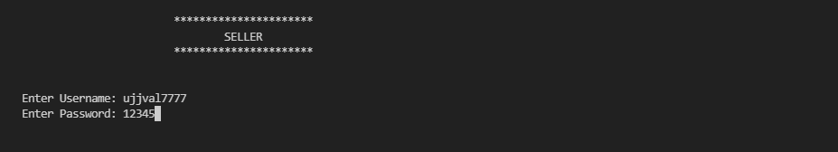
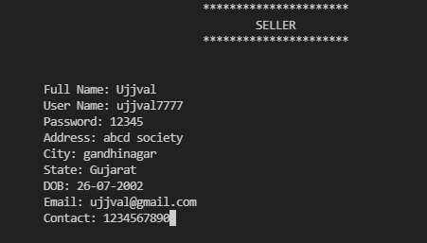
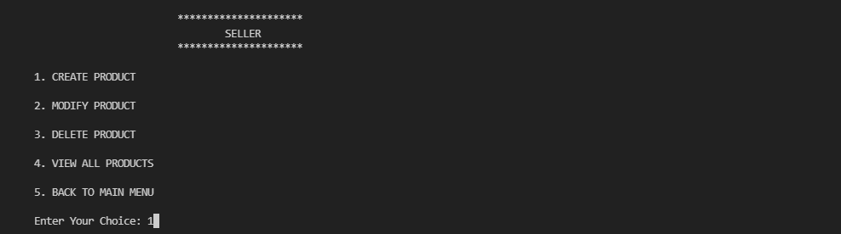
SCREENSHOT
1
3
2
4

Slide 5
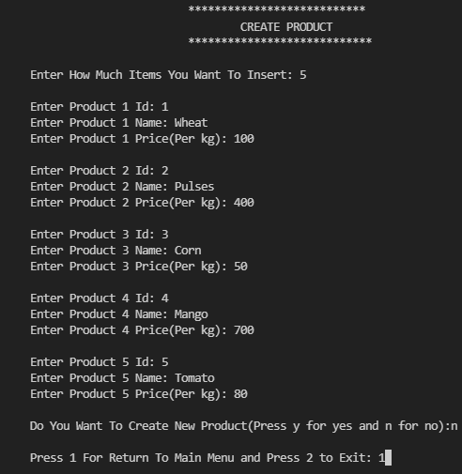
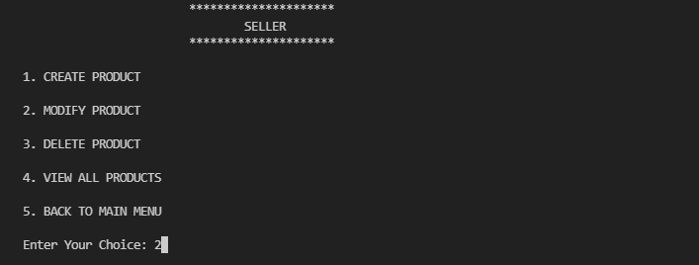
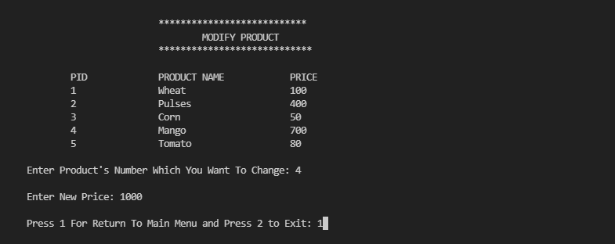
6
7
8

Slide 6
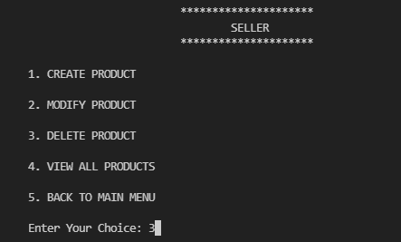
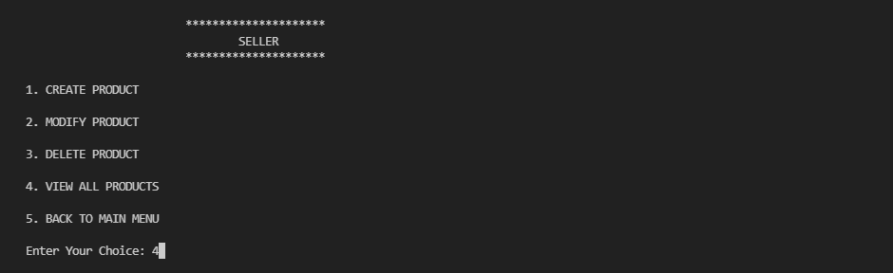
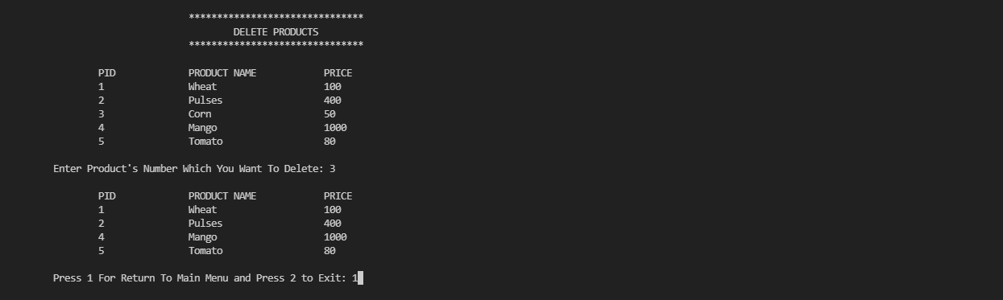
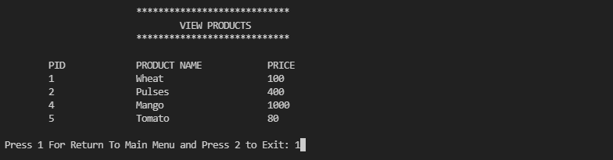
9
11
10
12

Slide 7
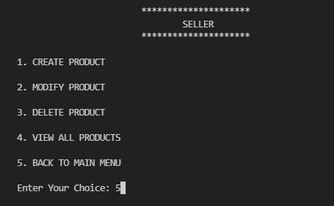


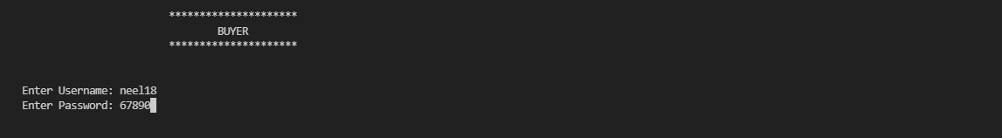
13
15
14
16

Slide 8

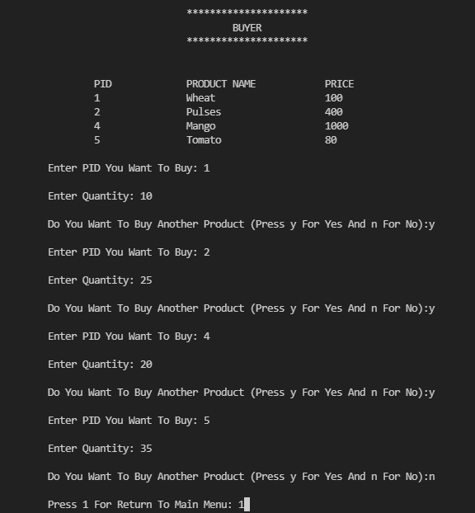
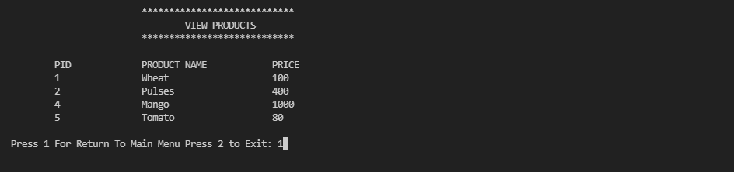
17
19
.
18

Slide 9
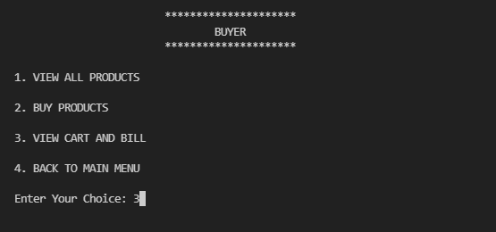
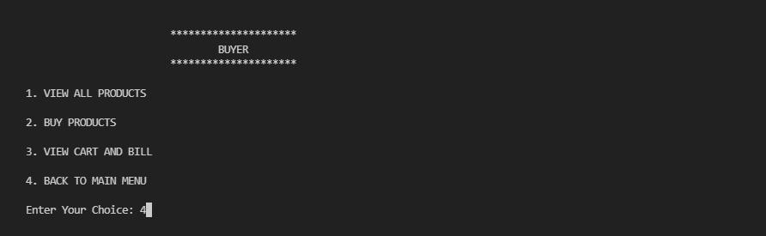
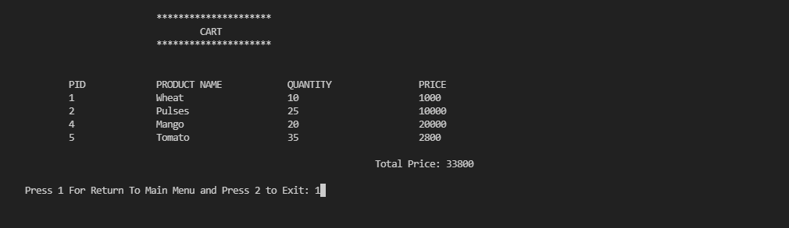
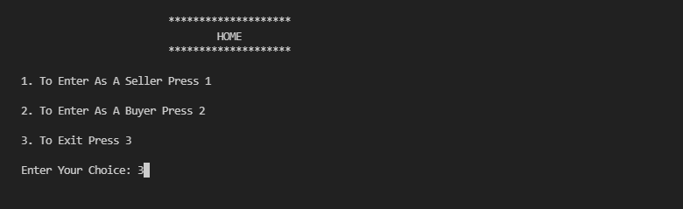
20
22
21
23

Slide 10
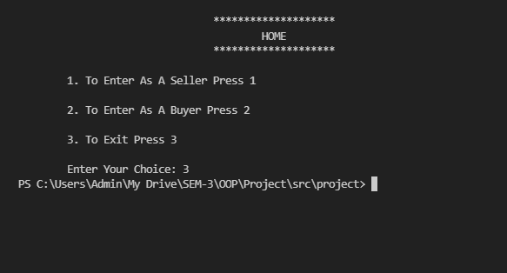
24

Slide 11
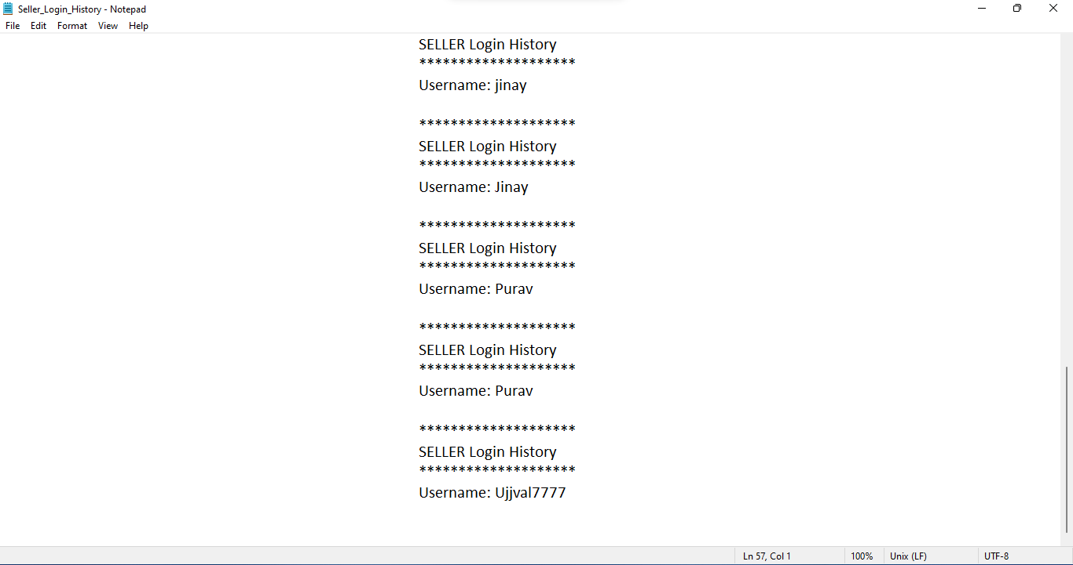
Seller_Login_History.txt

Slide 12
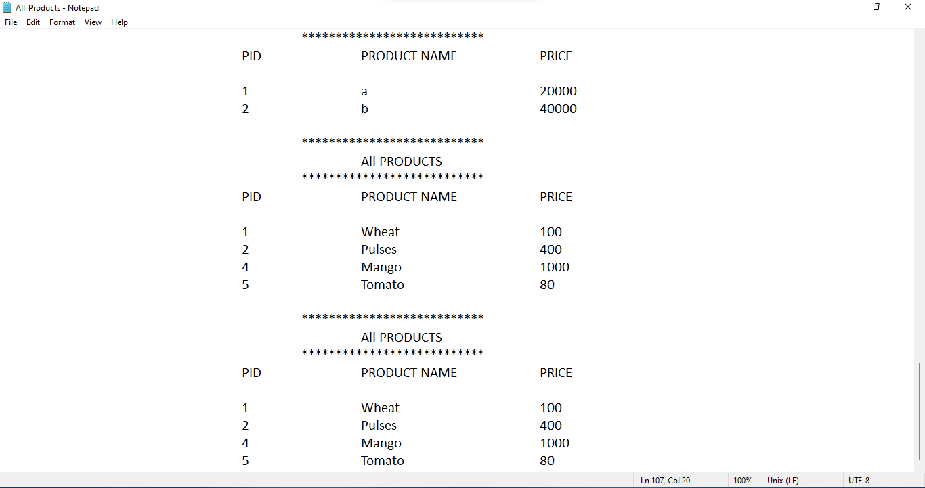
All_Products.txt

Slide 13
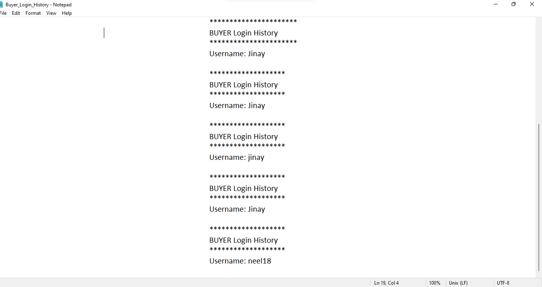
Buyer_Login_History.txt

Slide 14
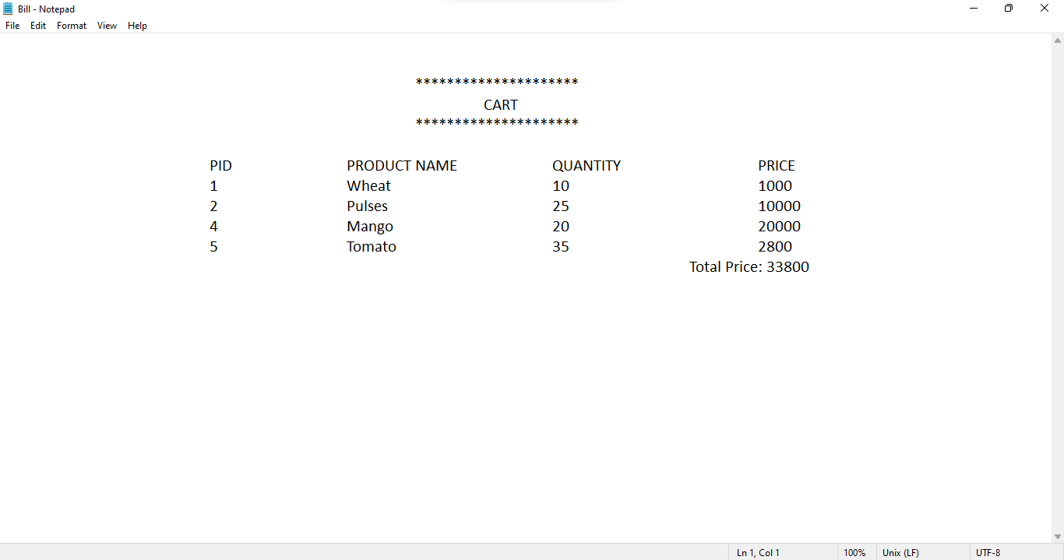
Bill.txt

Slide 15
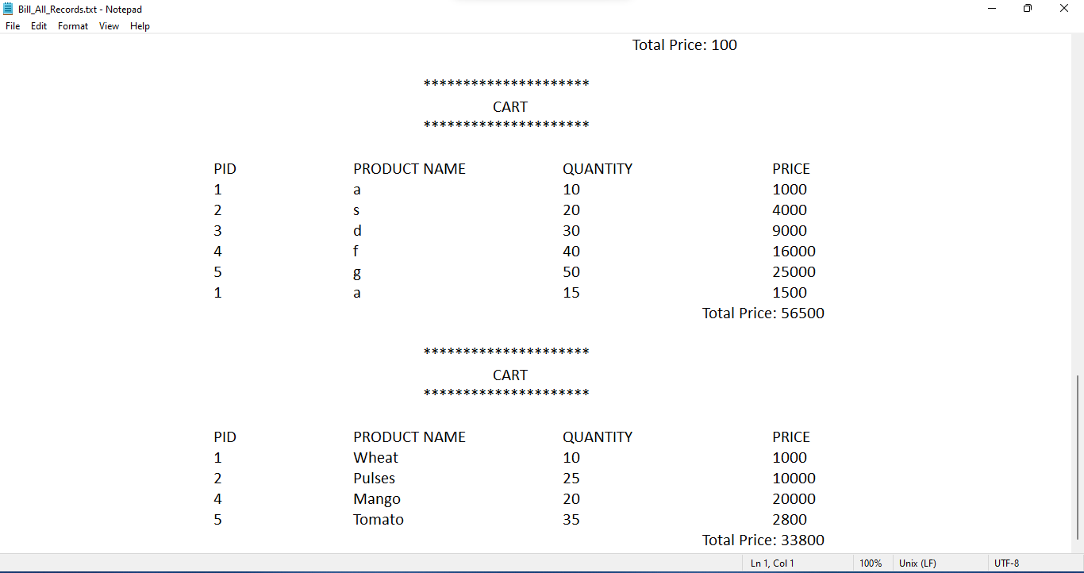
Bill_All_Records.txt

Slide 16
FLOWCHART
Link :
https://drive.google.com/drive/folders/1SdbuOUIhdW7Jh2kbM3-SjqpCfVArbAbc?usp=sharing

Slide 17
FUTURE ENHANCEMENT
We can create admin who can manage users , can manage products.
We can create a system that collect coupon codes and gives discounts accordingly.
We can apply java and database connectivity (JDBC).
We may also deploy a web application by connecting it with different servers.
We may also try for Android / iOS applications.

Slide 18


