Slide 1
SpringBoot Deploy
Weblogic Websphere
Tomcat
etc.
SpringBoot App1 SpringBoot App2
SpringBoot App3
etc.
JVM
JVM
VM
VM
Notes:
History
Last reviewed or updated on 22-NOV-2022.
References
Microservices on AWS, https://docs.aws.amazon.com/whitepapers/latest/microservices-on-aws/microservices.html
https://aws.amazon.com/lambda/pricing/
https://azure.microsoft.com/en-us/pricing/details/functions/
Microservices with .NET, https://dotnet.microsoft.com/en-us/apps/aspnet/microservices
Microservice architecture design, https://docs.microsoft.com/en-us/azure/architecture/microservices/
https://cloud.google.com/functions/pricing

Slide 2
Docker Deploy
Weblogic Websphere
Tomcat
etc.
Container1
Container2 Container3
etc.
JVM
Docker
VM
VM
Notes:
History
Last reviewed or updated on 22-NOV-2022.
References
Microservices on AWS, https://docs.aws.amazon.com/whitepapers/latest/microservices-on-aws/microservices.html
https://aws.amazon.com/lambda/pricing/
https://azure.microsoft.com/en-us/pricing/details/functions/
Microservices with .NET, https://dotnet.microsoft.com/en-us/apps/aspnet/microservices
Microservice architecture design, https://docs.microsoft.com/en-us/azure/architecture/microservices/
https://cloud.google.com/functions/pricing

Slide 3
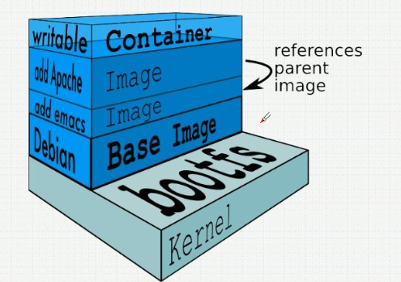
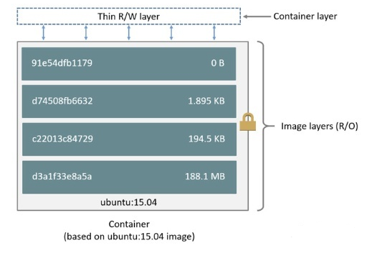
Docker
VS Vmware
个人
公司
dotCloud
PaaS
内部工具
Notes:
History
Last reviewed or updated on 22-NOV-2022.
References
Microservices on AWS, https://docs.aws.amazon.com/whitepapers/latest/microservices-on-aws/microservices.html
https://aws.amazon.com/lambda/pricing/
https://azure.microsoft.com/en-us/pricing/details/functions/
Microservices with .NET, https://dotnet.microsoft.com/en-us/apps/aspnet/microservices
Microservice architecture design, https://docs.microsoft.com/en-us/azure/architecture/microservices/
https://cloud.google.com/functions/pricing

Slide 4
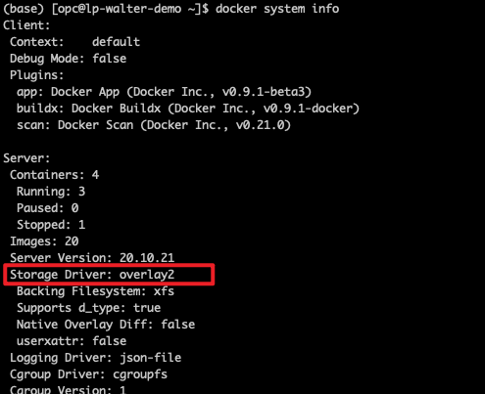
Docker Storage
本地
镜像
挂载的目录
具体实现
AUFS
Overlay2
Device Mapper
Btrfs
ZFS
Notes:
History
Last reviewed or updated on 22-NOV-2022.
References
Microservices on AWS, https://docs.aws.amazon.com/whitepapers/latest/microservices-on-aws/microservices.html
https://aws.amazon.com/lambda/pricing/
https://azure.microsoft.com/en-us/pricing/details/functions/
Microservices with .NET, https://dotnet.microsoft.com/en-us/apps/aspnet/microservices
Microservice architecture design, https://docs.microsoft.com/en-us/azure/architecture/microservices/
https://cloud.google.com/functions/pricing

Slide 5
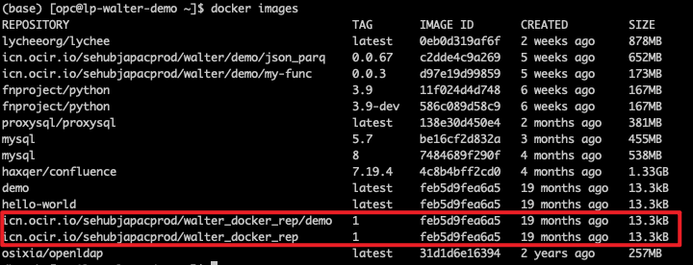
OCI Registry
Docker tag
Notes:
History
Last reviewed or updated on 22-NOV-2022.
References
Microservices on AWS, https://docs.aws.amazon.com/whitepapers/latest/microservices-on-aws/microservices.html
https://aws.amazon.com/lambda/pricing/
https://azure.microsoft.com/en-us/pricing/details/functions/
Microservices with .NET, https://dotnet.microsoft.com/en-us/apps/aspnet/microservices
Microservice architecture design, https://docs.microsoft.com/en-us/azure/architecture/microservices/
https://cloud.google.com/functions/pricing

Slide 6
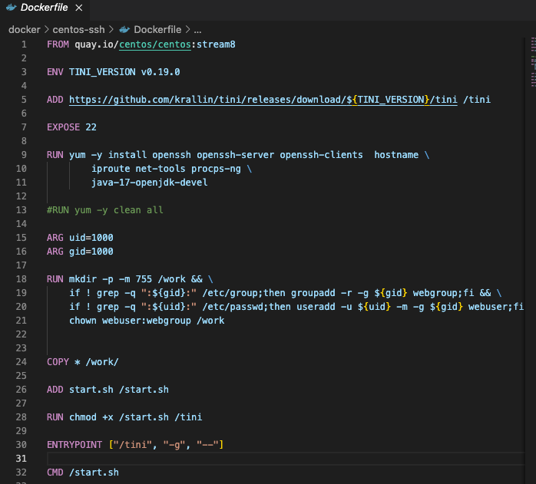
Dockerfile
Notes:
History
Last reviewed or updated on 22-NOV-2022.
References
Microservices on AWS, https://docs.aws.amazon.com/whitepapers/latest/microservices-on-aws/microservices.html
https://aws.amazon.com/lambda/pricing/
https://azure.microsoft.com/en-us/pricing/details/functions/
Microservices with .NET, https://dotnet.microsoft.com/en-us/apps/aspnet/microservices
Microservice architecture design, https://docs.microsoft.com/en-us/azure/architecture/microservices/
https://cloud.google.com/functions/pricing

Slide 7
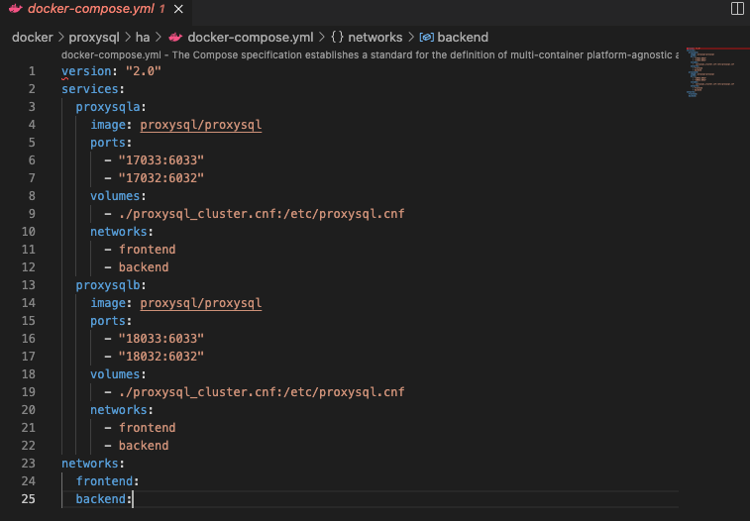
Docker-compose.yml
Notes:
History
Last reviewed or updated on 22-NOV-2022.
References
Microservices on AWS, https://docs.aws.amazon.com/whitepapers/latest/microservices-on-aws/microservices.html
https://aws.amazon.com/lambda/pricing/
https://azure.microsoft.com/en-us/pricing/details/functions/
Microservices with .NET, https://dotnet.microsoft.com/en-us/apps/aspnet/microservices
Microservice architecture design, https://docs.microsoft.com/en-us/azure/architecture/microservices/
https://cloud.google.com/functions/pricing

