Slide 1
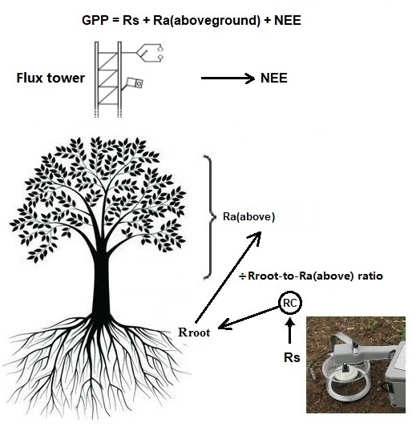
Top down
Bottom up

