Slide 1
Function
SW교육 지원자
김진수

Slide 2
Function
Definition
A set of commands needed to perform a specific tasks
built-in function
print(), input(), printf(), scanf(), MsgBox(), ...
user defined function
Procedure, method, subroutine, …
Advantage
Easy to write, read, understand, debug, modify, and maintain

Slide 3
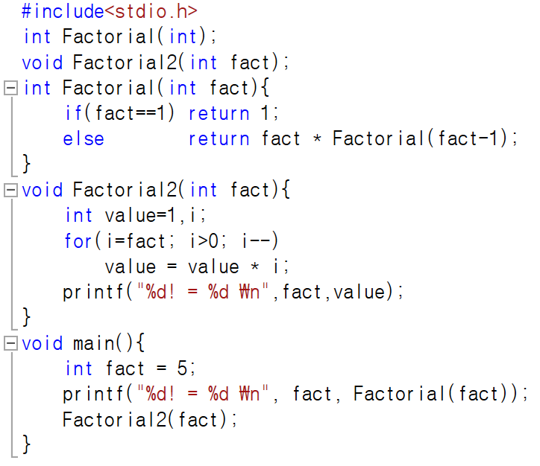
Elements of Function
Function declaration
Function definition
Function name
Parameter
Return value
Function call

Slide 4
Function Call and Return
Program
FunctionA
...
Statement1
Statement2
FunctionA
Statement3
Statement4
...
StatementA
StatementB
StatementC
call
return

Slide 5
Function Usage
User Defined Function
Recursive Function

Slide 6
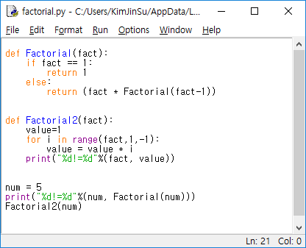
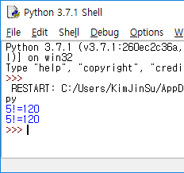
Python

Slide 7
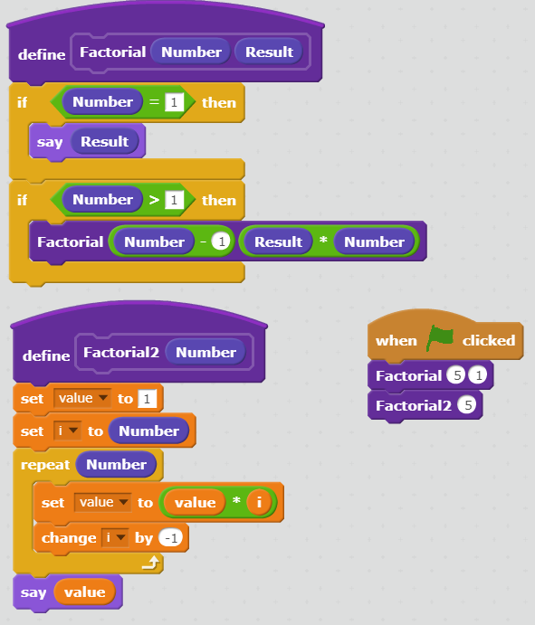
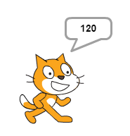
Scratch

Slide 8
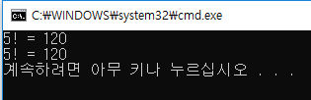
C

Slide 9
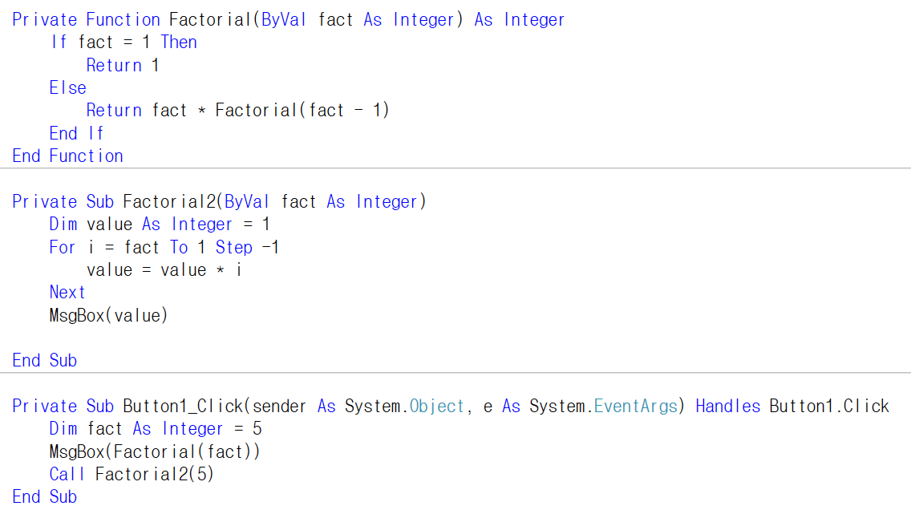
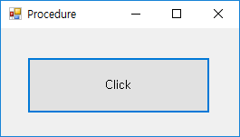
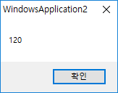
Visual Basic

