Slide 1
OutfitOra -Our daily style forecast
Presented by: Ardra Suresh, Jinsy Panamkkattu, Neethu Jose Chully, Reshma Mani
Notes:
Hello, we are presenting OutfitOra. It tells you what to wear today by looking at your calendar and the hourly weather. The video has four parts: why we built it, a demo, how it works in code, and a discussion of success and ethics.

Slide 2
A weather app is not an outfit app
Normal weather app
12 °C, rain 40%, wind 6 m/s
You decide what it means.
OutfitOra
Bring an umbrella, wear a wool coat, avoid white shoes
Made for your day.
→
Three things normal apps ignore: when you are outside • what event you dress for • how warm you like it
Notes:
Normal weather apps give a number for the whole day, for example 12 degrees and some chance of rain. You still have to decide what to wear. And you are not outside all day: only while you travel and at outdoor events. A date and a morning run need different clothes. Also some people are always cold, others always warm. OutfitOra turns the forecast for the hours you are really outside into a clear answer.

Slide 3
Application area and users
Who
Students, commuters, cyclists, anyone with a calendar
When
Every morning, before leaving home
Where
Changeable weather, for example Sweden
Example day: cycle to a lecture in wind, then walk to a dinner in nice clothes.
One forecast cannot answer that. OutfitOra can.
Notes:
The application area is a daily personal decision: what to wear and bring. The users are students, commuters, and cyclists, especially in changeable Nordic weather, and anyone who has dressed wrong for a date or a run. The system is low stakes, which matters for the ethics part later.

Slide 4
Demonstration
What the system does
Notes:
Now the demo. Steps: 1) choose city and day. 2) Add an event, for example Dinner at 19:00, or upload an .ics calendar file. 3) Read the verdict: Wear, Bring, Avoid, and the hourly chart with the event highlighted. 4) Change transport to bike and show the advice change. 5) Press Too cold and show the Tuned to you line.

Slide 5
System architecture
React frontend
(Vite)
FastAPI backend
/api/*
Open-Meteo
forecast + geocode
→
→
Frontend
Inputs: city, date, transport, events.
Shows verdict, chart, stats, feedback buttons.
Backend
Rules engine, event classifier, ICS parser, ML update, 30-minute forecast cache.
State
Stateless server. Settings and ML weights live in the browser's localStorage.
Notes:
Implementation, part one. Three parts: a React frontend that keeps your settings, a FastAPI backend that validates requests and computes the verdict, and Open-Meteo for weather and city search. The backend is stateless with no database, so everything arrives in the request and what it learns goes back in the response.

Slide 6
End-to-end workflow
1 Input
2 Fetch forecast
3 Classify events
4 Exposure windows
5 Rules + ML offset
6 Verdict
Input: city, day, transport and events (typed, or parsed from .ics by /api/ics).
Backend fetches 3 days of hourly weather (temp, feels-like, rain, wind, UV, cloud), cached by location.
Each event is tagged outdoor/indoor and sport/casual/smart/formal from its title and location.
Only the hours when you are outside are summarised: commute there, the event if outdoors, commute back.
Clothing bands and rules run on the 'effective temperature' (feels-like + activity − personal offset).
Frontend shows headline, Wear/Bring/Avoid chips, hourly chart; a vote trains the ML model.
Notes:
One request end to end: an input changes, the backend gets three days of hourly weather cached for thirty minutes, classifies each event, builds exposure windows, applies rules plus the ML offset, and the frontend shows the verdict. A vote then trains the model.

Slide 7
Rule-based 1: events and exposure windows
Keyword classification
Lists of Swedish/English words (park, löp, bröllop, dinner, möte ...).
Output per event:
outdoor: true/false
dress: sport / casual / smart / formal
kind: sport / outdoor / work / social / other
The dressiest event of the day sets the day's dress code.
Exposure windows
Time spent outside depends on transport:
walk 20 min, bike 20, transit 15, car 5.
Windows = (start − exposure → start) and (end → end + exposure), plus the event itself if outdoors.
No events? Judge a typical commute (07:30-09:00 and 16:30-18:00).
Notes:
Rules, block one. A Swedish and English keyword classifier decides if an event is outdoors and its dress code. Time outside depends on transport: walk 20 minutes, bike 20, transit 15, car 5. We only judge the weather in those windows; with no events, a typical commute.

Slide 8
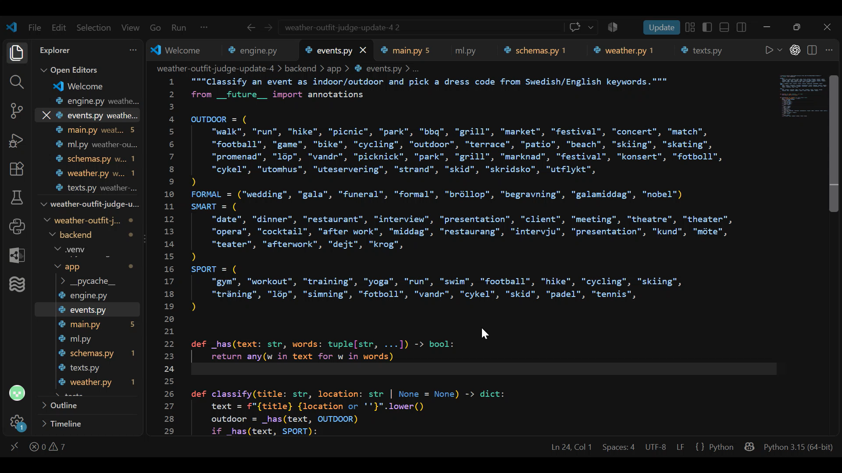

Slide 9
Rule-based 2: clothing bands
effective = feels-like (coldest hour) + activity adjustment − personal offset
Effective temp | Garments (first match wins)
Up to −15 °C | Thermal layer, down jacket, winter boots
−15 to −5 | Sweater, winter coat, winter boots
−5 to 2 | Sweater, warm coat, boots
2 to 8 | Sweater, jacket, boots
8 to 13 | Long sleeve, light jacket, sneakers
13 to 18 | Long sleeve, sneakers
18 to 24 | T-shirt, sneakers
Above 24 | T-shirt, shorts, sneakers
Adjustments
Activity: bike −1°, car +4°.
Sport: +6° for clothing.
Hat ≤ 5°, gloves ≤ 2°, scarf ≤ −5°.
Dress codes swap garments: jacket → wool coat, sneakers → dress shoes.
Notes:
The clothing rule: effective temperature is the coldest feels-like, plus an activity adjustment, minus your personal offset. The first band that fits picks the base outfit, thermal layers below minus fifteen up to T-shirt and shorts above twenty-four. Dressy events swap items, for example jacket to wool coat.

Slide 10
Rule-based 3: weather rules and text
Facts (engine)
→
Situation label
→
Template (texts.py)
→
Friendly sentence
Rain | precip ≥ 0.2 mm, or chance ≥ 60% and ≥ 0.05 mm → rain jacket; umbrella for smart/formal
Wind | ≥ 10 m/s → windproof advice; too windy for an umbrella
Ice | min temp ≤ 1° with precipitation → ice grips, avoid smooth soles
Sun / swing | UV ≥ 6 → sunglasses, sunscreen; feels-like swing > 8° → layers
Trade-offs are stated openly, e.g. 'Umbrella keeps the look sharp, but your back may get wet.'
Situations: ice, rain_dressy, rain, wind, cold, heat, nice.
Notes:
Weather rules then add items: rain jacket, or an umbrella for dressy events; wind replaces the umbrella; ice triggers grips; high UV adds sunglasses; big swings suggest layers. Trade-offs are stated openly, for instance that the umbrella keeps the look sharp but your back may get wet.

Slide 11
Machine learning: personal comfort model
offset(x) = w · x x = [1, wind, bike, car, walk, sport, rain, dressy]
Type of model
Linear regression trained online (normalised LMS, a form of SGD) with ridge (L2) shrinkage.
Why context?
Can learn 'I run cold when cycling in wind' without being cold everywhere.
Output
Offset in °C (+ = you run cold). It shifts the effective temperature and so the clothing band.
Notes:
The ML part. The old version had one global offset, which cannot say I freeze only when cycling in wind. Our model is online linear regression: normalised least mean squares with ridge shrinkage, eight context features, output an offset in degrees that shifts the clothing band.

Slide 12
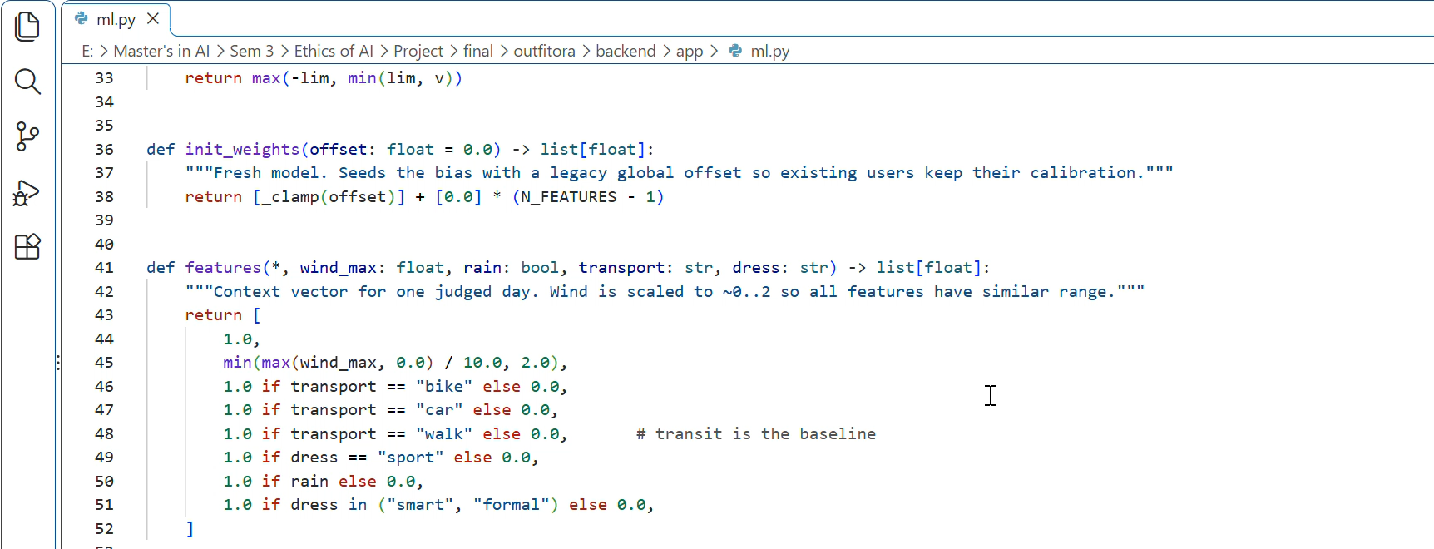

Slide 13
ML example: it separates situations
Windy + cycling
+0.8 °C
after one "Too cold" vote
Calm day on the bus
+0.26 °C
barely affected
Tested: 18 pytest tests. In a simulation the error halved after 600 votes.
Notes:
Worked example. It is windy, 12 metres per second, and you cycle. You press Too cold. The model raises the offset for that situation to about 0.8 degrees. A calm day on the bus now only gets 0.26 degrees. So after one vote the model has already started to tell the two situations apart. Tests: in a simulation with a hidden true user, after 600 votes the error was less than half. Honest limit: only 8 parameters and coarse votes, so it improves slowly.

Slide 14
Did it succeed?
What works
Only the hours you are outside
Clear Wear / Bring / Avoid
Learns your comfort
18 tests pass
Limits
3-day forecast, Sweden, English
Keyword event detection
No user study yet
Only 8 learned weights
Notes:
Compared with the goal, a clear outfit decision for the hours you are outside, the system works. It uses the calendar, the dress code and the transport, gives advice with trade-offs, and personalises. Limits: three-day forecast, Sweden only, English text, keyword event detection, fixed thresholds, only 8 model parameters, weights per browser. We did not run a user study, so we can show that it works with tests and the demo, but not yet measured user satisfaction. Next step: a small user study and calendar sync.

Slide 15
Ethical implications
Privacy
Calendars are used in memory and not stored. Weights stay in your browser.
Transparency
"Tuned to you" shows when your votes changed the advice.
Reliability
Forecasts can be wrong. It is advice, not a safety system.
Fairness
Only English and Swedish keywords. No group profiling.
Notes:
Ethically this is a low-stakes app, but there are issues. Privacy: calendars reveal habits, so we parse them in memory, never store them, and keep learned weights in the browser. The weather source is EU-hosted, and the backend should be too for GDPR. Transparency: the Tuned to you note shows when advice is personalised. Reliability: forecasts can be wrong, so advice is a suggestion, not safety critical. Fairness: keyword rules support only English and Swedish. The model learns one person, not groups, so little bias risk.

Slide 16
Conclusion
It looks only at the hours you are really outside, so the advice fits your day
Clear rules you can trust, plus a ML model that learns your comfort
Private by design: no database, no accounts, your data stays with you
Thank you.
Notes:
To summarise: OutfitOra judges only the hours you are outside, uses transparent rules for safety and a small model for personal comfort, and keeps your data private. Thank you.

