Slide 1
AI hackathon - Submission
Blood Cell Classifier – Using Deep Learning approach
Frameworks – Pytorch, Dash, Zappa (serverless deployment)

Slide 2
Approach Followed
Instead of building a neural network from the scratch we have tried to evaluate and use many pretrained models which have been trained, tuned and tested on multiple categories of image.
We exploit the capacity of these massive networks which have the weights tuned to identify fundamental components of the image at a more generic level.
Models evaluated
(VGG net, VGG Net on BatchNormalization, DenseNet, ResNet)
We have removed the classification layers of these networks and plugged in our custom hidden layers, required to generate the 4 output class probabilities in our scenario.
Training was on AWS deep learning AMI p2XLarge with GPU/CUDA.
Time taken – 30minutes for 15 epochs
Model selected – DenseNet201
Accuracy on Test Image – 74% ( can improve with more hyperparameter tuning and more training data)
Model checkpoint was saved and later on used for Inference on CPU.
Visualization – Realtime bar chart graphing showing the 4 classes and their predicted probability value
Deployment – to be deployed as lambda function on AWS, to be accessed via AWS gateway URL. We have used Zappa to execute this serverless webservice.

Slide 3
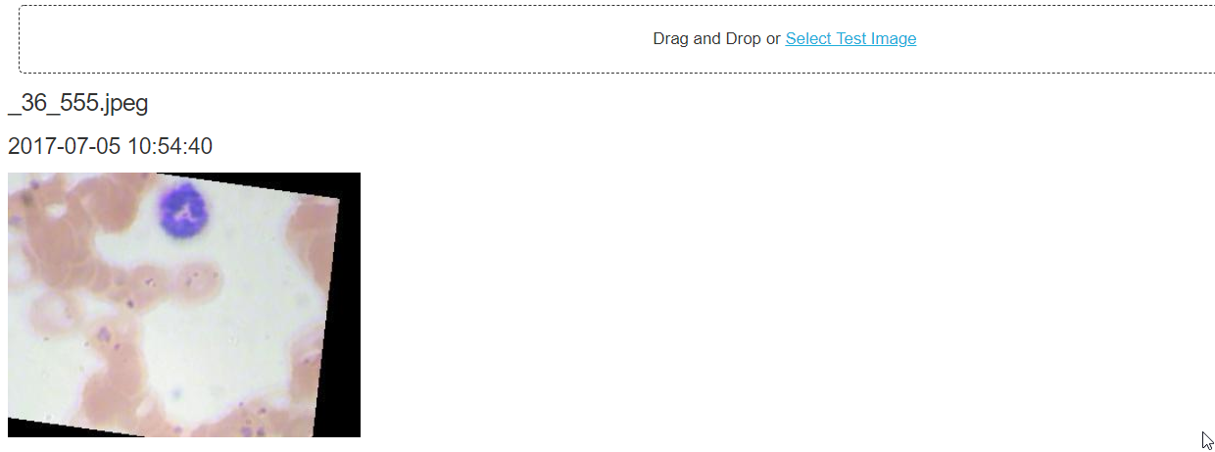
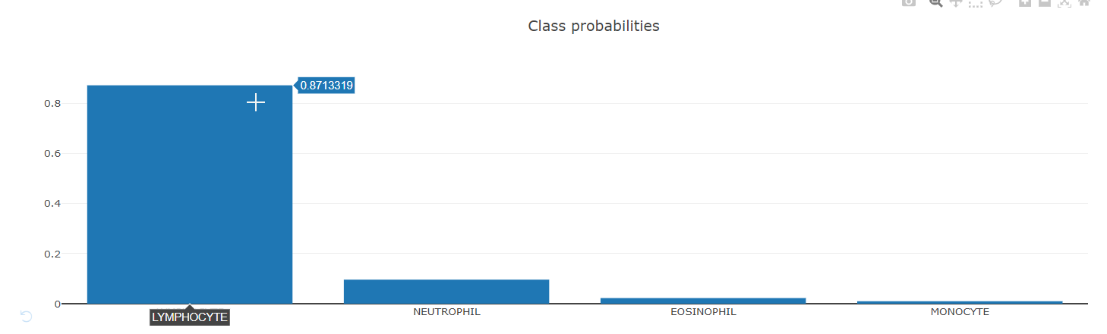
User Input/Model predictions

Slide 4
Future Works:
Can be evaluated with more hyper parameter tuning , like learning rate, dropouts, early stopping and epochs.
Also if possible to explore the availability of more labelled data to train the model for higher accuracy.
The model should be saved on S3 bucket and all dependencies can be moved to cloud.

