Slide 1
Corona Virus Analysis With SQL
Mentorness Internship Project
By Jinu J Kester
Batch – MIP-DA-11

Slide 2
Contents
Project Overview
Dataset description
Data Exploration and analysis
Key Findings
Conclusion

Slide 3
Project Overview
The Corona Virus pandemic has had a significant impact on public health and has created an urgent need for data-driven insights to understand the spread of the virus.
As a data analyst, I have been tasked with analyzing a Corona Virus dataset to derive meaningful insights and present the findings using SQL.

Slide 4
Dataset description
Dataset:
Description of each column in dataset:
Province : Geographic subdivision within a country/region.
Country : Geographic entity where data is recorded.
Latitude : North-south position on Earth's surface.
Longitude : East-west position on Earth's surface.
Date : Recorded date of CORONA VIRUS data.
Confirmed : Number of diagnosed CORONA VIRUS cases.
Deaths : Number of CORONA VIRUS related deaths.
Recovered : Number of recovered CORONA VIRUS cases.

Slide 5
Data Exploration and analysis
Import Dataset
Find any missing values
Find the beginning and end date of the dataset
Use aggregate functions that include avg, count, sum, min, max, etc
Use Statistical functions that include STDDEV, VARIANCE
Use conditional statements such as WHERE clause.
Group and sort dataset using GROUP BY and ORDER BY statement
What I did

Slide 6
Let Us Now Discuss The solutions to the questions With SQL queries

Slide 7
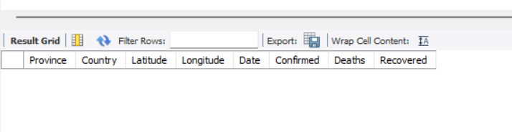
Q1. Write a code to check NULL values
SQL QUERY
SELECT * FROM corona
where Province is null
or country is null
or latitude is null
or longitude is null
or date is null
or confirmed is null
or deaths is null
or recovered is null;
Result

Slide 8
Q2. If NULL values are present, update them with zeros for all columns.
In the Data set No null Values found

Slide 9
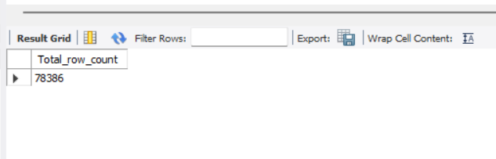
Q3. check total number of rows
Result
SQL QUERY
select count(*) as Total_row_count
from corona;

Slide 10
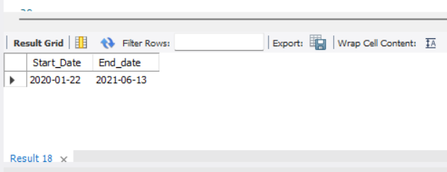
Q4. Check what is start_date and end_date
Result
SQL QUERY
select MIN(Date) as Start_Date,
MAX(Date) as End_date
from corona;

Slide 11
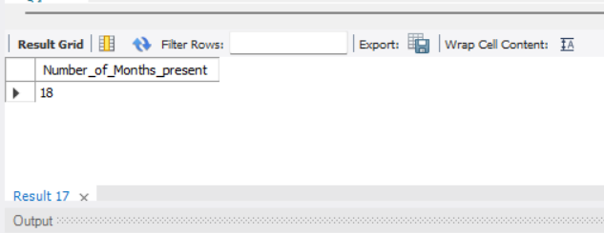
Q5. Number of month present in dataset
The DATE_FORMAT function is used to format the date column into a specific year-month format ('%y-%m'), and then COUNT(DISTINCT ...) is used to count the unique occurrences of these formatted dates.
SQL QUERY
SELECT
COUNT(DISTINCT DATE_FORMAT(date, '%y-%m’))
AS Number_of_Months_present
FROM corona;
Result

Slide 12
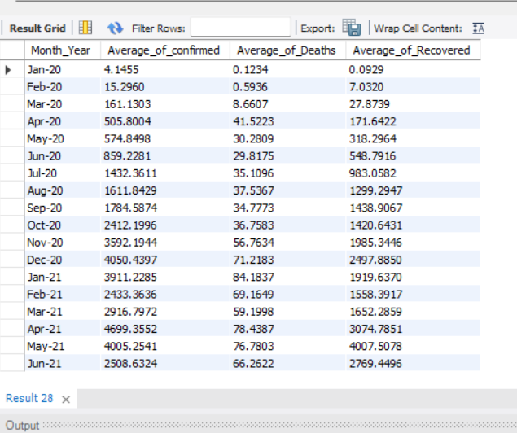
Q6. Find monthly average for confirmed, deaths, recovered
Result
SQL QUERY
SELECT
DATE_FORMAT(date, '%b-%y') as
Month_Year,
AVG(confirmed) as
Average_of_confirmed,
AVG(deaths) as
Average_of_Deaths,
AVG(Recovered) as
Average_of_Recovered
from corona;

Slide 13
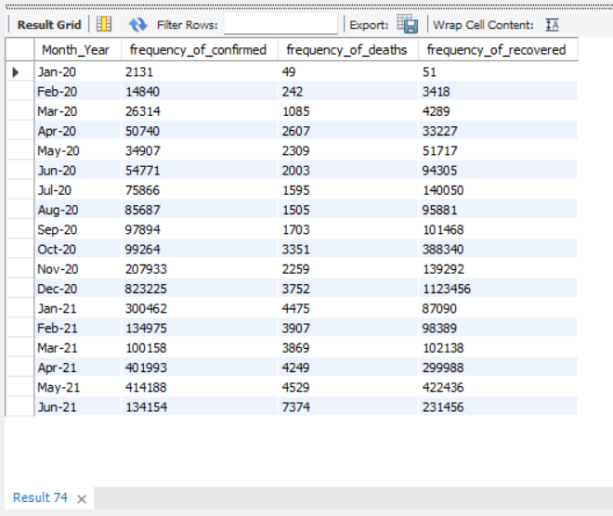
Q7. Find most frequent value for confirmed, deaths, recovered each month
Result
SQL QUERY
SELECT
DATE_FORMAT(date, '%b-%y') as
Month_Year,
max(Confirmed) as
frequency_of_confirmed,
max(Deaths) as
frequency_of_deaths,
max(recovered) as
frequency_of_recovered
from corona
group by DATE_FORMAT(date, '%b-%y');

Slide 14
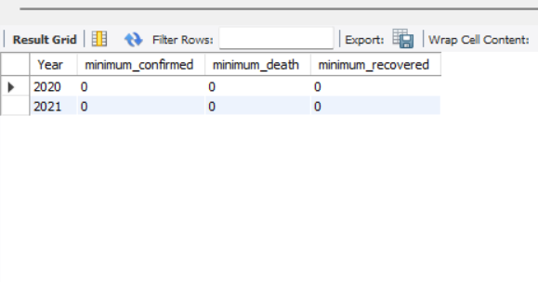
Q8. Find minimum values for confirmed, deaths, recovered per year
Result
SQL QUERY
SELECT
year(date)as Year,
min(Confirmed) as minimum_confirmed,
min(Deaths) as minimum_death,
min(recovered) as minimum_recovered
from corona
group by year(date);

Slide 15
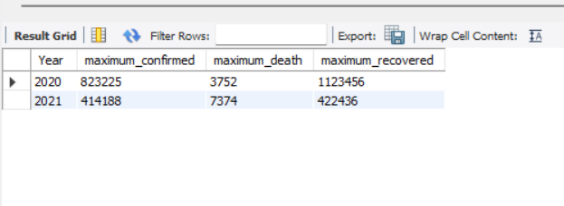
Q9. Find maximum values of confirmed, deaths, recovered per year
Result
SQL QUERY
SELECT
year(date)as Year,
max(Confirmed) as maximum_confirmed,
max(Deaths) as maximum_death,
max(recovered) as maximum_recovered
from corona
group by year(date);

Slide 16
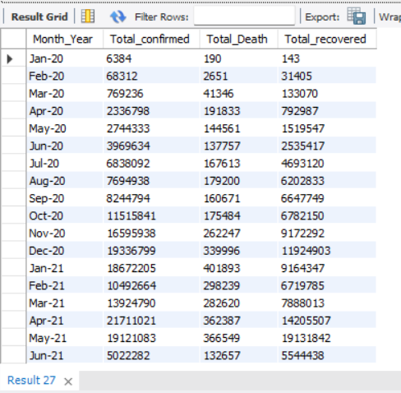
Q10. The total number of case of confirmed, deaths, recovered each month
Result
SQL QUERY
SELECT
DATE_FORMAT(date, '%b-%y') as Month_Year,
sum(Confirmed) as Total_confirmed,
sum(Deaths) as Total_Death,
sum(recovered as as Total_recovered)
from corona
group by DATE_FORMAT(date, '%b-%y');

Slide 17
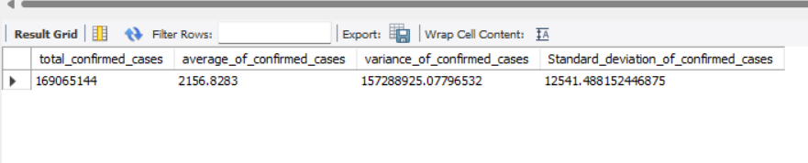
Q11. Check how corona virus spread out with respect to confirmed case (Eg.: total confirmed cases, their average, variance & STDEV )
SQL QUERY
SELECT
sum(Confirmed) as total_confirmed_cases,
Avg(Confirmed) as
average_of_confirmed_cases,
variance(Confirmed) as
variance_of_confirmed_cases,
stddev(Confirmed) as
Standard_deviation_of_confirmed_cases
from corona;
Result

Slide 18
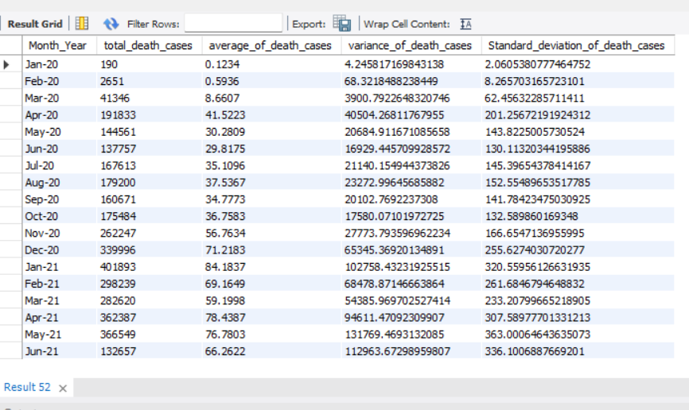
Q12. Check how corona virus spread out with respect to death case per month (Eg.: total confirmed cases, their average, variance & STDEV )
SQL QUERY
SELECT DATE_FORMAT(date, '%b-%y') as Month_Year,
sum(deaths) as total_death_cases,
Avg(deaths) as average_of_death_cases,
variance(deaths) as variance_of_death_cases,
stddev(deaths) as
Standard_deviation_of_death_cases
from corona
group by DATE_FORMAT(date, '%b-%y');
Result

Slide 19
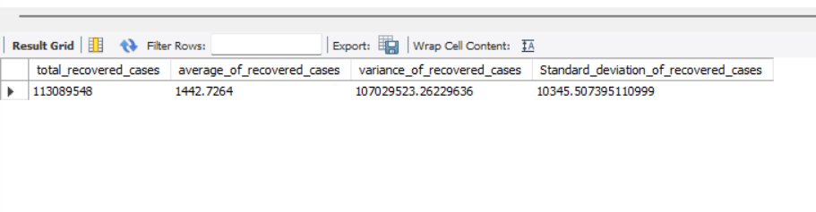
Q13. Check how corona virus spread out with respect to recovered case (Eg.: total confirmed cases, their average, variance & STDEV )
SQL QUERY
SELECT
sum(recovered) as total_recovered_cases,
Avg(recovered) as average_of_recovered_cases,
variance(recovered) as variance_of_recovered_cases,
stddev(recovered) as
Standard_deviation_of_recovered_cases
from corona;
Result

Slide 20
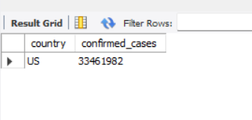
Q14. Find Country having highest number of the Confirmed case
SQL QUERY
select
country,
sum(Confirmed) as confirmed_cases from corona
group by country
order by confirmed_cases desc
limit 1;
Result

Slide 21
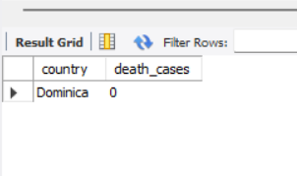
Q15. Find Country having lowest number of the death case
Result
SQL QUERY
select
country,
sum(deaths) as death_cases from corona
group by country
order by Death_cases
limit 1;

Slide 22
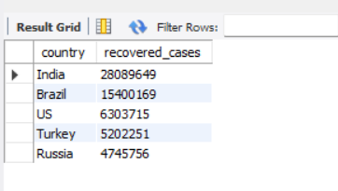
Q16. Find top 5 countries having highest recovered case
Result
SQL QUERY
select
country,
sum(Recovered) as recovered_cases from corona
group by country
order by recovered_cases desc
limit 5;

Slide 23
Key Findings
The Data set contains data for confirmed, Deaths and recovered cases affected by covid-19 pandemic.
The duration of the data starts from 22nd January 2020 and ends on 13th June 2021.
USA, India and Brazil are the top 3 countries with highest confirmed cases.
USA, Brazil and India are the top 3 countries with highest Death cases.
India, Brazil and USA are the top 3 countries with highest Recovered cases.
Kiribati, Samoa, Marshall Islands, Dominica are the top 4 countries with least confirmed cases and zero death.

Slide 24
Conclusion
In conclusion, these statistics and analytics provide fundamental insights into the Covid-19 dataset.

Slide 25
Thank You

