Slide 1
Cybersecurity

Slide 2
What is in Cybersecurity?
Cyber security is the practice of protecting computers, networks, applications, and data from digital attacks.
Real Example: – Gmail blocking spam emails – Bank preventing unauthorized login

Slide 3
Why Should You Learn Cyber Security?
✔ Massive job demand ✔ High salary & global opportunities ✔ Every company needs security ✔ Protect your own digital identity ✔ AI + Security = Future job trend
Scenario: A student gets hacked on Instagram → learns cyber security → helps 10 friends secure accounts → gets an internship.

Slide 4
What is Cyber?
Anything related to computers, networks, data, internet, digital devices.
Examples: – Cyber cafe – Cyber crime – Cyber law – Cyber attack

Slide 5
What is Security?
Protecting something from damage, loss, or unauthorized access.
Types: ✔ Physical (guards, locks) ✔ Digital (passwords, firewalls) ✔ Human (training employees)

Slide 6
Types of Security
Network Security – firewalls, routers, IDS/IPS
Application Security – secure coding, patching
Cloud Security – AWS, Azure protection
Endpoint Security – antivirus, device security
Information Security – data encryption
Operational Security – organizational policies

Slide 7
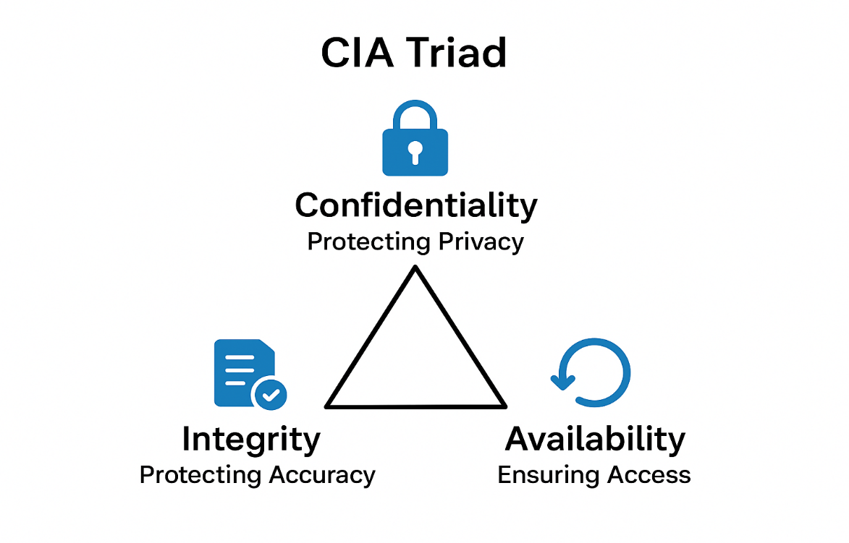

Slide 8
CIA Triad (Confidentiality, Integrity, Availability)
Every cybersecurity policy, tool, and defence mechanism is designed to support one or more of these three principles.
CIA Triad = Keep data safe, correct, and available.
Confidentiality – Keep Data Secret
Integrity – Keep Data Correct
Availability – Keep Systems Working

Slide 9
Confidentiality
Make sure only the right people can access the information.
Examples:
Passwords protect your email
Encryption protects WhatsApp chats
OTP prevents others from using your bank account
If confidentiality is broken → Data leak.

Slide 10
Confidentiality -Real-world example
A hacker tries to steal your UPI PIN.
Because of encryption, even if the data is captured, the hacker cannot read it.
Google Pay / PhonePe ensures only the bank and you can see the real PIN.

Slide 11
Integrity
Ensure data is not changed, damaged, or tampered with by anyone.
Examples:
A hacker modifying exam marks → Integrity attack
Digital signatures verify that a file is unchanged
Hash values ensure a downloaded file is original
If integrity is broken → Fake or altered data.

Slide 12
Integrity - Real-world example
Imagine a bank database:
Your balance: ₹20,000
If a hacker modifies it to ₹2,00,000, that is a loss of integrity.
Integrity mechanisms detect:
Unauthorized modification attempt
Mismatch in hashing
Abnormal transactions

Slide 13
Availability
Make sure systems and data are available whenever users need them.
Examples:
Websites running 24/7
Backups during server failure
DDoS protection to prevent websites from going down
If availability is broken → System downtime.

Slide 14
Availability - Real-world example
A hospital needs access to patient records 24/7.
If a ransomware attack locks the system
Doctors cannot access data , Emergency treatments stop and Operations get delayed
With proper cybersecurity:
Backups restore data
DDoS protection keeps servers online
Firewall blocks malicious traffic

Slide 15
What is an Attack?
An attack is any attempt to break, damage, or steal data from a system.
A hacker trying to enter your computer = someone trying to break into your locked house.
If they try to open the door → trying to access your system
If they break your furniture → damaging your data
If they steal your valuables → stealing your information
That is exactly what happens in the cyber world.

Slide 16
Types of Attacks
Phishing → Fake emails to steal passwords
Ransomware → Locking your files and asking for money
DDoS Attack → Making a website crash
Malware → Harmful software placed in your system

Slide 17
Real-Time Attack
WannaCry Ransomware – 2017 – Infected 200,000 computers globally – Locked files and demanded Bitcoin
Facebook Data Breach – 2018 – 50 million accounts affected
SBI Server Leak – India – 3 million customer data exposed

Slide 18
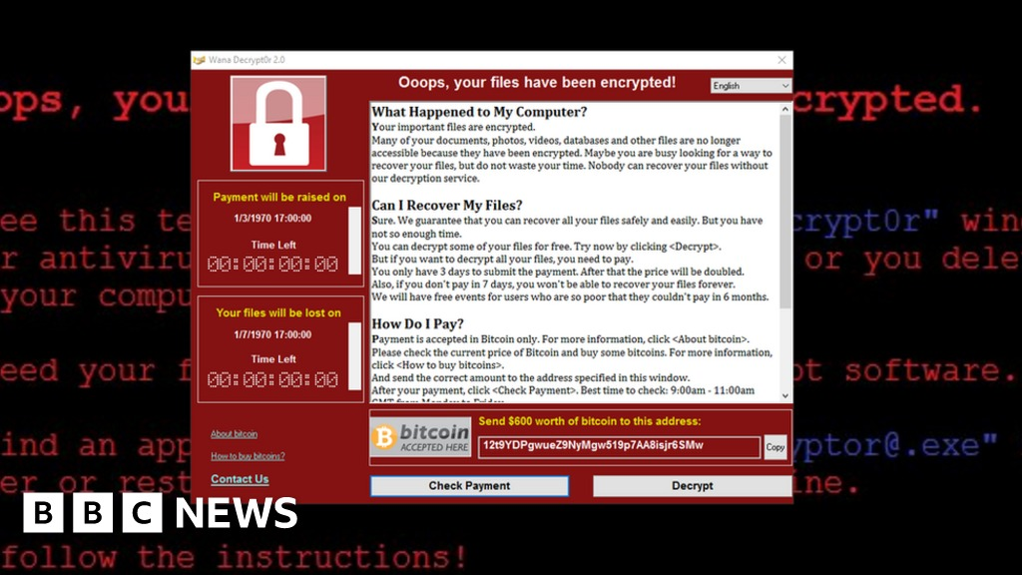

Slide 19
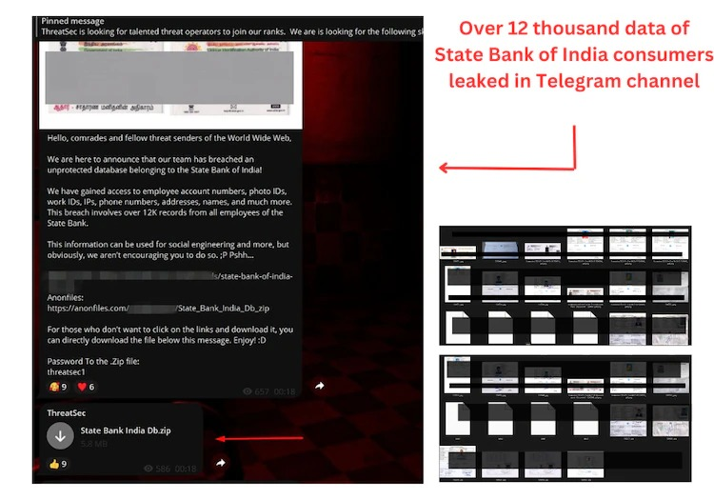

Slide 20
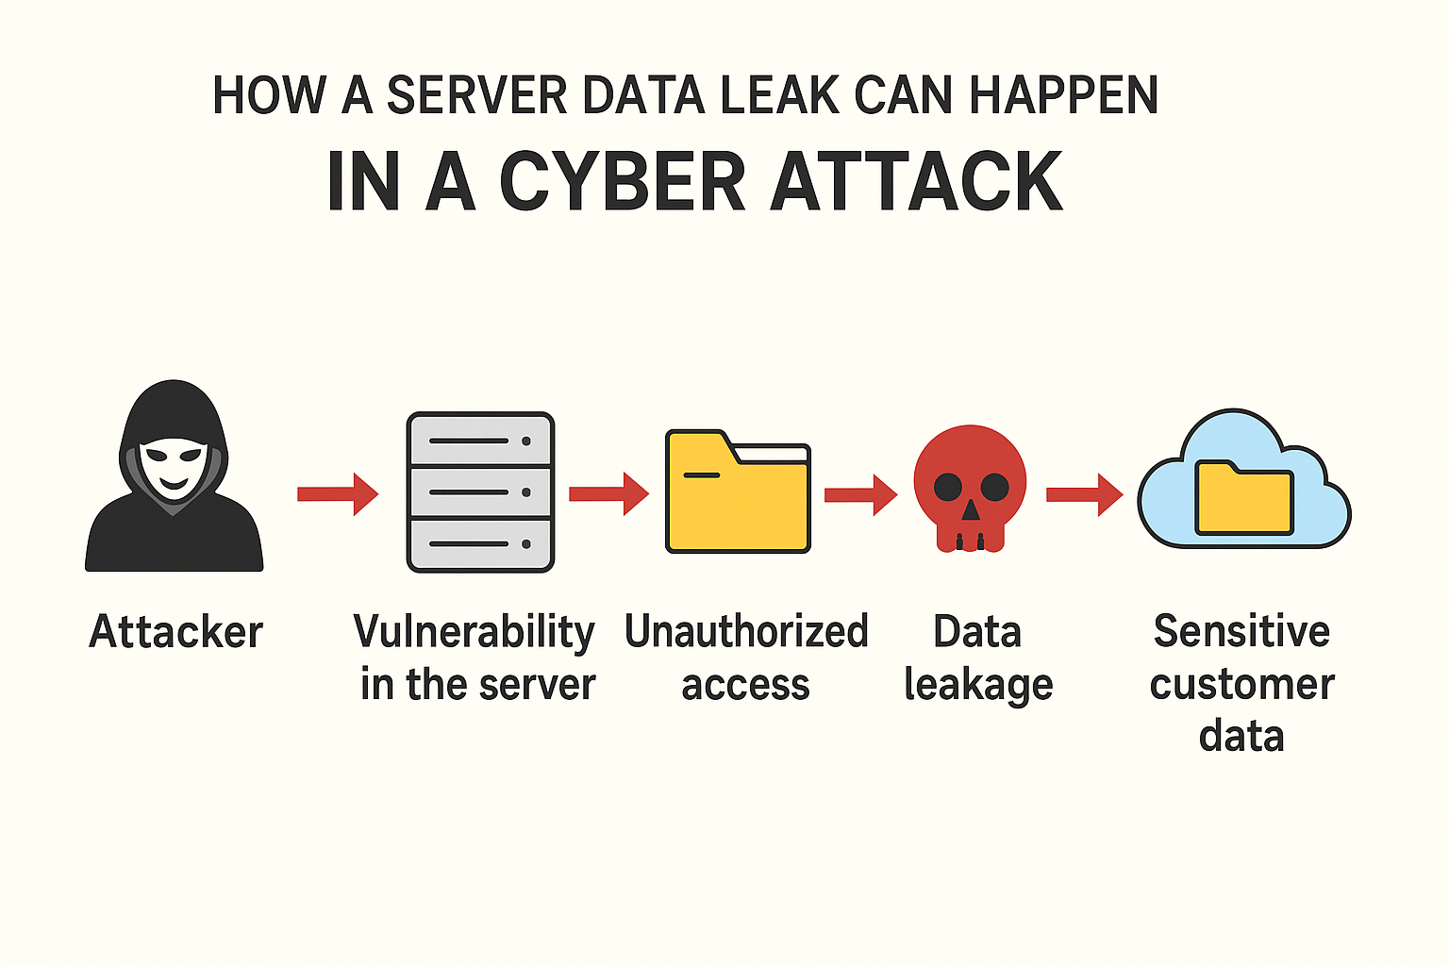

Slide 21
What is AI (Artificial Intelligence)?
AI is a technology that enables machines to think, learn, and make decisions like humans.
Examples: – Siri / Alexa – Google Maps traffic prediction – ChatGPT

Slide 22
Role of AI in Cyber Security
AI helps in: ✔ Detecting threats automatically ✔ Identifying anomalies ✔ Reducing human workload ✔ Real-time monitoring at scale
Example: AI detects unusual login from China → sends alert → temporarily blocks access.

Slide 23
What is Machine Learning (ML)?
ML is a subset of AI where systems learn from data without being explicitly programmed.
Simple Example: Email learns which messages are spam → automatically filters them.

Slide 24
Role of ML in Cyber Security
✔ Spam detection ✔ Fraud detection ✔ Malware classification ✔ Network anomaly detection ✔ Predicting risky users
Scenario: A bank ML model detects unusual ₹50,000 transfer at midnight and blocks the transaction.

Slide 25
What is Deep Learning?
Deep Learning is an advanced type of ML using neural networks with many layers.
Works Like: A simplified human brain model.
Used In: – Facial recognition – Speech detection – Self-driving cars

Slide 26
Role of Deep Learning in Cyber Security
✔ Detects sophisticated attacks ✔ Identifies unknown malware ✔ Analyses millions of logs in seconds ✔ Behavioral-based authentication
Real Example: A DL model detects an employee who never works late suddenly downloading 200GB data → insider threat alert.

Slide 27
What is Kali Linux?
A Debian-based operating system.
Designed for cybersecurity and penetration testing.
Used for ethical hacking and digital forensics.

Slide 28
Linux vs Windows
Linux
Free and open-source OS
Highly secure with strong permissions
Fast, lightweight, and customizable
Best for developers, servers, and cybersecurity
Uses a powerful terminal-based workflow
Very stable with fewer viruses
Windows
Paid, closed-source OS
More vulnerable to malware
Heavy, resource-intensive, less customizable
Best for general users and gaming
Limited command-line (requires extra tools)
Updates and system processes often slow performance

Slide 29
Why Kali Linux Matters
Includes 600+ pre-installed security tools.
Used in cybersecurity labs and industry.
Ideal for vulnerability testing and auditing.

Slide 30
Key Features
Lightweight, customizable, open-source.
Supports live boot and virtual machines.
Perfect for network and application testing.

Slide 31
Popular Tools
Nmap – Network scanning.
Metasploit – Exploitation framework.
Wireshark – Packet analysis.
Burp Suite – Web testing.

Slide 32
Who Uses Kali Linux?
Cybersecurity professionals.
Ethical hackers and penetration testers.
Security researchers and students.
Digital forensics teams.

Slide 33
What is a Command in Kali Linux?
Commands are typed in the Terminal and executed directly by the system.
listing files
creating folders
scanning networks
checking IP address
running hacking tools
installing software

Slide 34
whoami
Shows current logged-in user.
hostname
Displays system's hostname.

Slide 35
cd / ~
cd: change directory
~: home directory
/: root directory
ls / ls -l
ls: list files
ls -l: detailed list with permissions

Slide 36
pwd
Prints current working directory.
touch
Creates empty file or updates timestamp.
echo
Prints text to terminal.

Slide 37
rm / rm -r
rm: removes files
rm -r: removes folders recursively
cp
Copies files or folders.
mv
Move or rename file/folder.

Slide 38
mkdir / rmdir
mkdir: create directory
rmdir: remove empty directory
Sudo
Run command as superuser.
apt update/upgrade/install
update: refresh package list
upgrade: upgrade packages
install: install new package

Slide 39
chmod
Change file permissions.
permissions
r = read
w = write
x = execute
Example: rw-r--r--

Slide 40
network
ipconfig: Windows command
ip a: show IP details
eth0: ethernet interface
lo: loopback
ping: test connectivity

Slide 41
THANK YOU

