Slide 1

Project Week 4
Wave Forecasting
Exploring Timeseries
João Inverno
07th of Augst 2020

Slide 2
Intro
Zoom Video Communications VS Tech companies
During the covid period
Webscrapping
API·

Slide 3
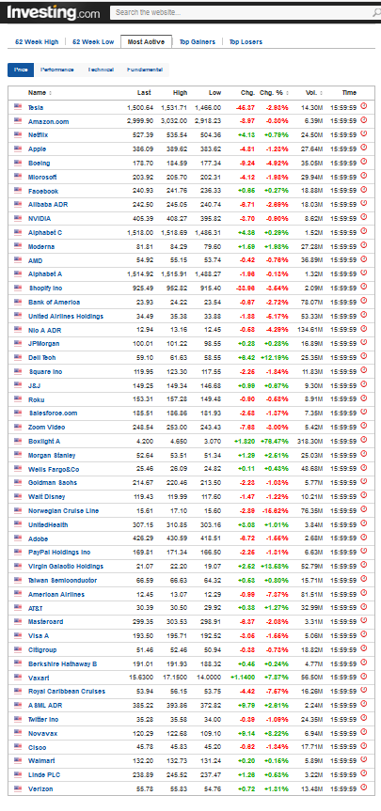
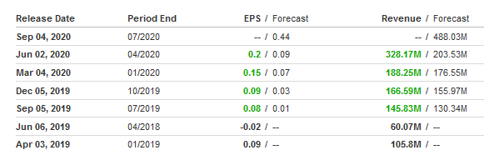
Web Scraping - investing.com
Top 52 most active companies USA
Automated process :
Get the Earnings / Analysts forecast
Zoom Video

Slide 4
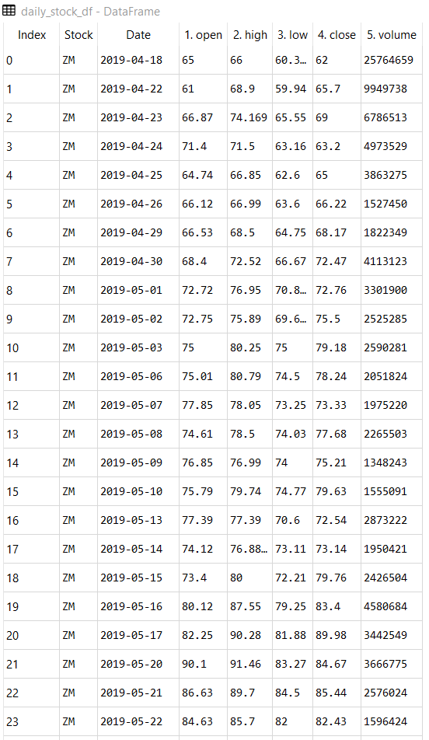
API - Alpha Vantage
Stocks
ZM
Tech Companies
AAPL
GOOGL
AMZN
MSFT
NVDA

Slide 5
Challenges – Webscrapping and API
Webscraping can be challenging
response = requests.get(url, headers= headers)
headers = {'User-Agent': 'Mozilla/5.0 (Macintosh; Intel Mac OS X 10_10_1) AppleWebKit/537.36 (KHTML, like Gecko) Chrome/39.0.2171.95 Safari/537.36'}
Using Timer
Save to csv
To reduce the need of multiple calls
API
Limitation of numbers of calls
Data type
Using Timer

Slide 6
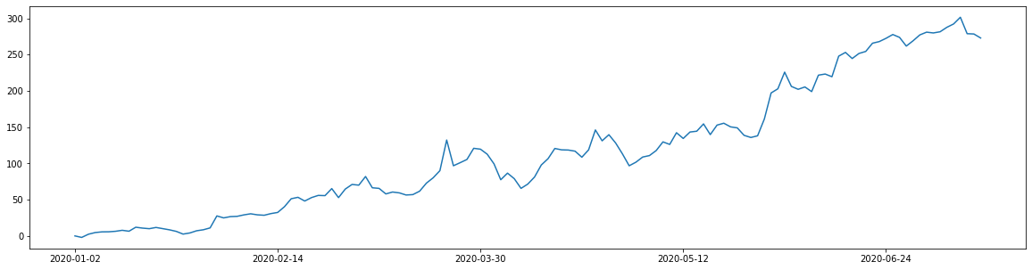
Zoom
Percentual performance from Jan 2020
%
Covid
Lockdown
Date

Slide 7
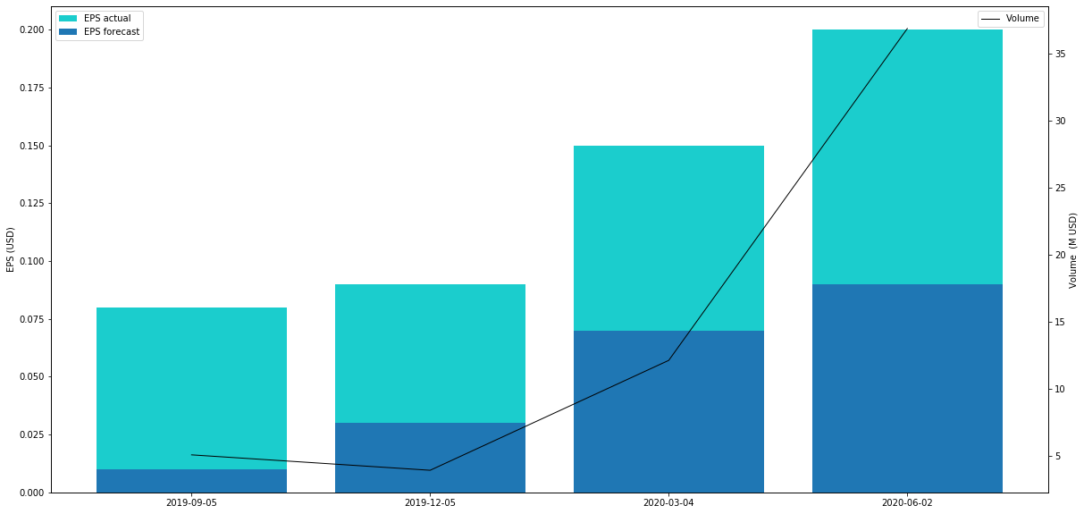
Zoom
Crossing information from webscraping VS API
Earnings per Share (EPS) and Volume
Date

Slide 8
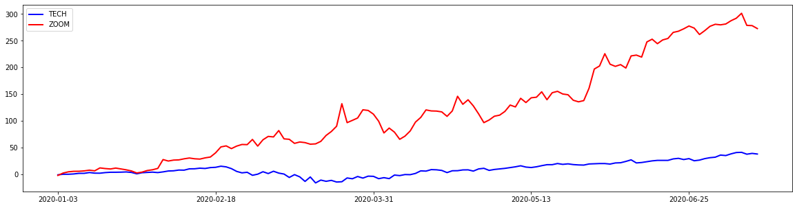
Zoom Vs Tech
Zoom
Top 5 Tech Stocks
Apple, Nvdia, Google, Microsoft and Amazon
%
Date

Slide 9
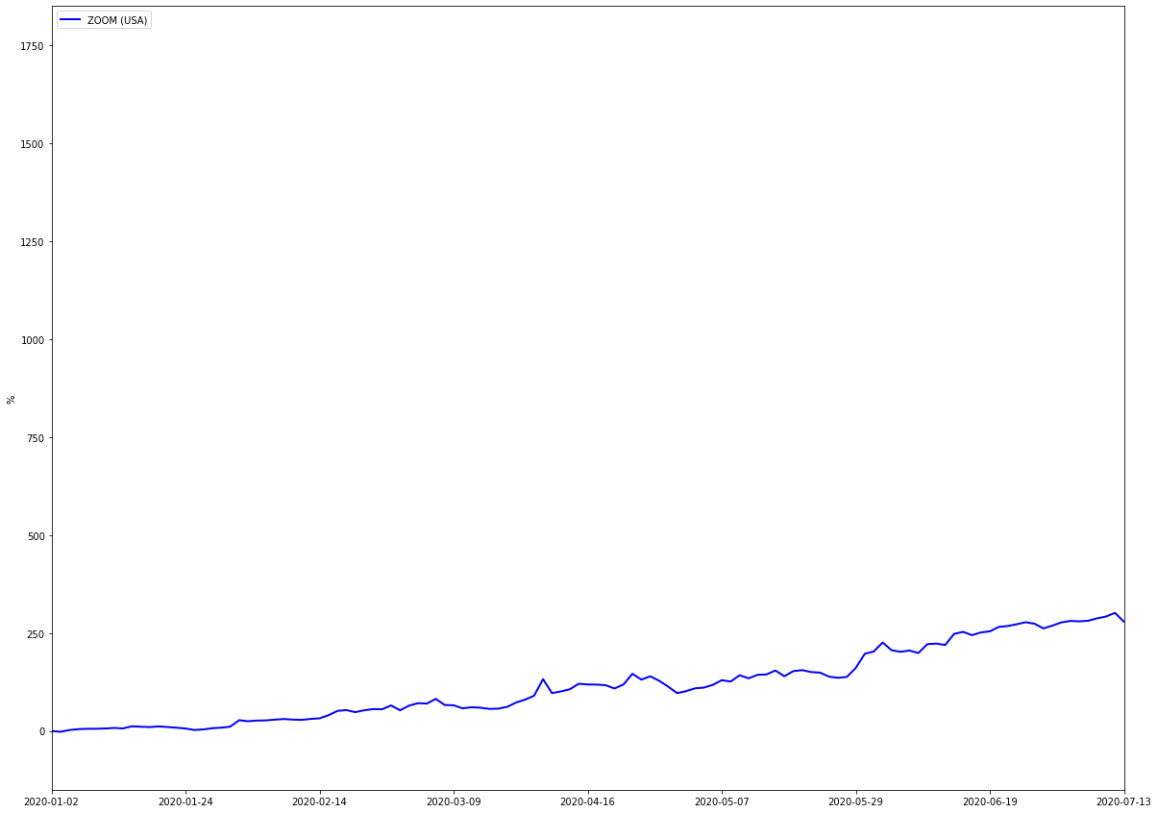
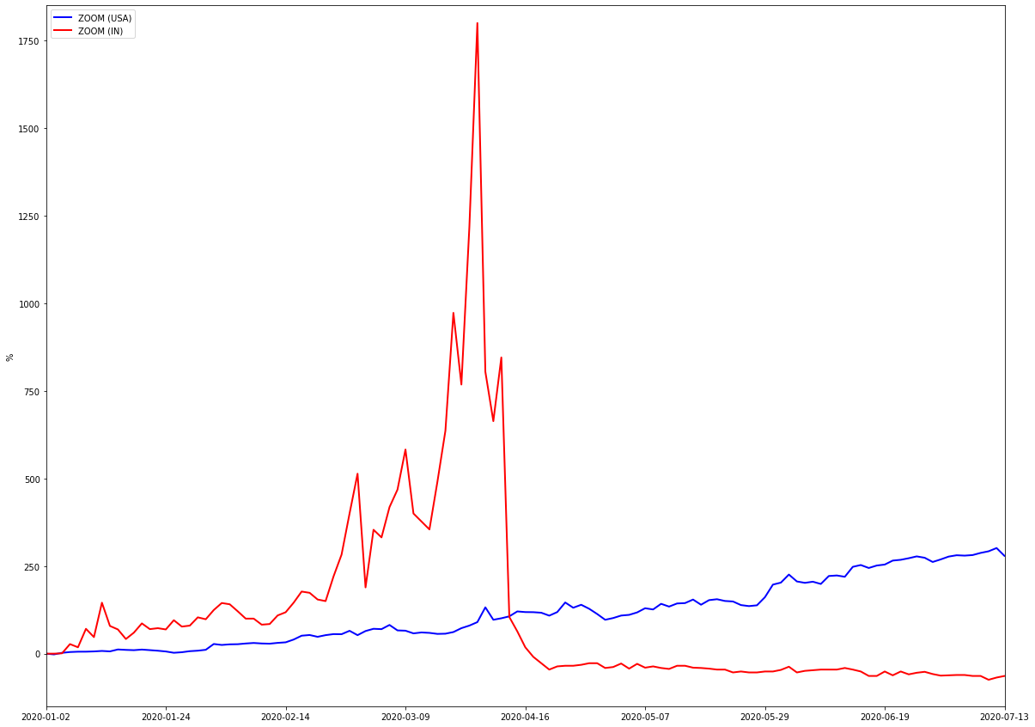
ZOOM (s)
Zoom Video Communications, Inc. (ZM)
ZOOM Technologies, Inc. (ZOOM)
%
Date

Slide 10
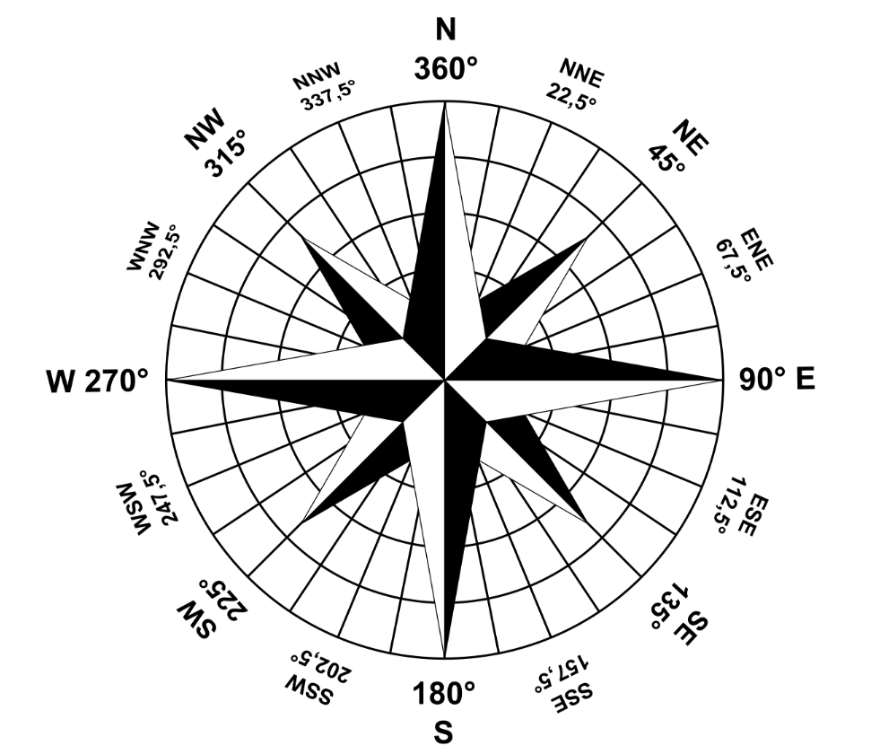
Considerations
The technology sector had a good performance, during the covid
Hightlight for Zoom that had a great performance
The Zoom stocks performed more than 6 times the average sector average
Transaction volume increase means interest in the company
Great increase when Analystics forecast started
The Indian Zoom did great... But, not really

Slide 11
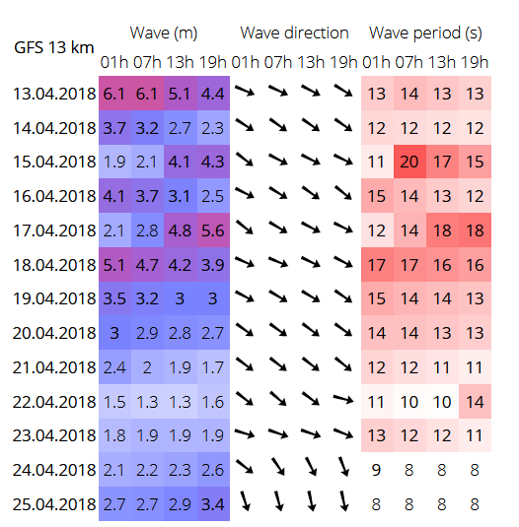
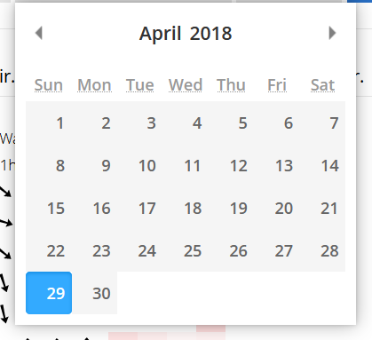

Slide 12
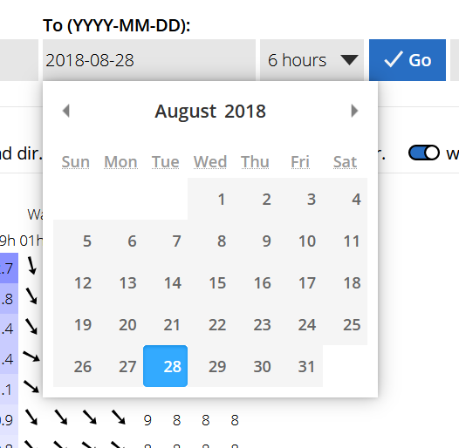

Slide 13
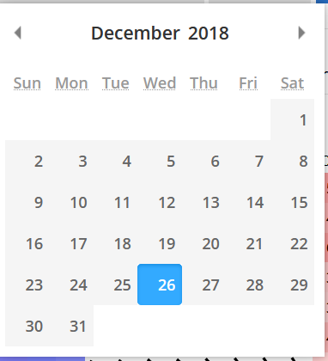

Slide 14
ARIMA(1, 0, 0) MSE=2.539
ARIMA(1, 0, 1) MSE=2.549
ARIMA(1, 0, 2) MSE=2.586
ARIMA(1, 1, 0) MSE=2.893
ARIMA(1, 1, 1) MSE=2.493
ARIMA(1, 1, 2) MSE=2.473
ARIMA(1, 2, 0) MSE=5.136
ARIMA(2, 0, 0) MSE=2.546
ARIMA(2, 0, 1) MSE=2.592
ARIMA(2, 0, 2) MSE=2.463
ARIMA(2, 1, 0) MSE=2.758
ARIMA(2, 1, 1) MSE=2.477
ARIMA(2, 1, 2) MSE=2.485
ARIMA(2, 2, 0) MSE=4.237
ARIMA(4, 0, 0) MSE=2.538
ARIMA(4, 0, 1) MSE=2.472
ARIMA(4, 0, 2) MSE=2.486
ARIMA(4, 1, 0) MSE=2.743
ARIMA(4, 1, 1) MSE=2.479
ARIMA(4, 2, 0) MSE=3.654
ARIMA(6, 0, 0) MSE=2.584
ARIMA(6, 0, 1) MSE=2.470
ARIMA(6, 0, 2) MSE=2.475
ARIMA(6, 1, 0) MSE=2.701
ARIMA(6, 1, 1) MSE=2.490
ARIMA(6, 2, 0) MSE=3.518
ARIMA(8, 0, 0) MSE=2.561
ARIMA(8, 1, 0) MSE=2.650
ARIMA(8, 2, 0) MSE=3.240
ARIMA(8, 2, 1) MSE=2.657
ARIMA(8, 2, 2) MSE=2.521
Best ARIMA(2, 0, 2) MSE=2.463
ARIMA(1, 0, 0) MSE=0.351
ARIMA(1, 0, 1) MSE=0.345
ARIMA(1, 0, 2) MSE=0.346
ARIMA(1, 1, 0) MSE=0.405
ARIMA(1, 1, 1) MSE=0.350
ARIMA(1, 1, 2) MSE=0.341
ARIMA(1, 2, 0) MSE=0.725
ARIMA(2, 0, 0) MSE=0.348
ARIMA(2, 0, 1) MSE=0.344
ARIMA(2, 0, 2) MSE=0.340
ARIMA(2, 1, 0) MSE=0.369
ARIMA(2, 1, 1) MSE=0.345
ARIMA(2, 1, 2) MSE=0.341
ARIMA(2, 2, 0) MSE=0.581
ARIMA(4, 0, 0) MSE=0.338
ARIMA(4, 0, 1) MSE=0.334
ARIMA(4, 0, 2) MSE=0.339
ARIMA(4, 1, 0) MSE=0.379
ARIMA(4, 1, 1) MSE=0.337
ARIMA(4, 1, 2) MSE=0.340
ARIMA(4, 2, 0) MSE=0.472
ARIMA(6, 0, 0) MSE=0.349
ARIMA(6, 0, 1) MSE=0.343
ARIMA(6, 0, 2) MSE=0.338
ARIMA(6, 1, 0) MSE=0.387
ARIMA(6, 1, 1) MSE=0.349
ARIMA(6, 1, 2) MSE=0.341
ARIMA(6, 2, 0) MSE=0.470
ARIMA(8, 0, 0) MSE=0.356
ARIMA(8, 0, 1) MSE=0.357
ARIMA(8, 0, 2) MSE=0.353
ARIMA(8, 1, 0) MSE=0.384
ARIMA(8, 2, 0) MSE=0.456
ARIMA(8, 2, 1) MSE=0.385
Best ARIMA(4, 0, 1) MSE=0.334
Total time: 308.13826328516006min30

Slide 15
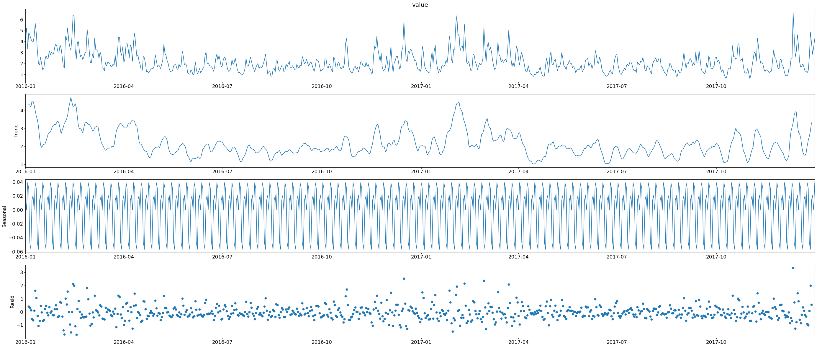

Slide 16
