Slide 1

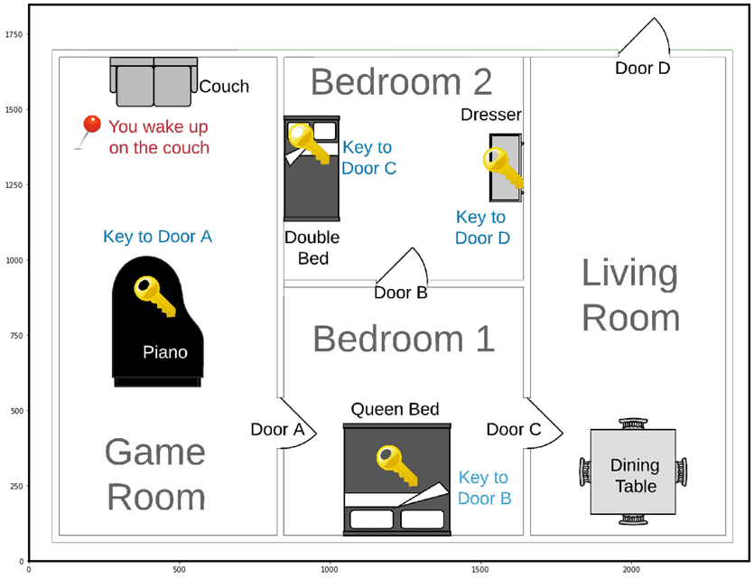

Group 1
GREENHACK
João Inverno
João Quintela
Project: Escape Room Python Game
featuring
Our dear Teacher
Pedro Carneiro

