Slide 1
CSCI 218 Group Assignment (Machine Learning- Adult dataset)

Slide 2
Workload distribution
Name | Task | Contribution
Nicolas Ng Tien Chuan (8865619) | Data Cleaning & Logistic Regression | 100%
Lin Xiaofeng (8219680) | Random forest & literature review | 100%
Tey Jin Wan (7435902) | Multi-Layer-Perceptron, Experiment Result, Result Analysis | 100%
Leow Jing Xue (8768833) |  | 100%
Vishnudhevan Merdam Muthu (8769242) | SVM Model Development, Feature Selection, Hyperparameter Tuning, Performance Analysis | 100%
Ng Kho Yuan (8221005) | Gradient Boosting | 100%

Slide 3
Introduction
About the Project: To Apply Machine Learning techniques to analyze the UCI Adult dataset.
Background: The Adult Income Dataset is widely used to train AI models to predict income levels based on attributes related to demographic and economic factors.
The target variable is:
>50K → High Income
<=50K → Low Income
Contains attributes like age, race, education, occupation, work hours, etc.
Commonly used for classification tasks in machine learning research.
Aim: To develop AI models to predict income levels (>50K/<50K) using the dataset and compare these different models to find the most accurate and efficient approach.

Slide 4
Literature review
Various studies have tried to apply different techniques and approaches to improve accuracy in predicting income levels.
Common Machine Learning Techniques & Approaches:
Logistic Regression
Decision Tree
Random Forest
Support Vector Machine (SVM)
Gradient Boosting (XGBoost, LightGBM, CatBoost)
Artificial Neural Networks (MLP - Multi-Layer Perceptron)

Slide 5
Literature review
Performance Insights: It is clear that upon research on existing projects & review papers, there are certain ML technique models that are more accurate than the others. Below are some examples: Chakrabarty and Biswas (2018) applied a Gradient Boosting Classifier to the UCI Adult dataset, achieving 88.16% accuracy, surpassing previous benchmarks.
Jo (2024) compared multiple models and found Random Forest performed best in accuracy (86.41%) and F1-score (82.06%).

Slide 6
Literature review
Models’ Advantages & Drawbacks
Model | Advantages | Draw backs
Logistic Regression | Simple, interpretable | Limited to linear decision boundaries
Decision Tree | Easy to interpret | Prone to overfitting
Random Forest | Reduces overfitting, high accuracy | Computationally expensive
SVM | Works well with non-linear data | Slow on large datasets
XGBoost/LightGBM | High accuracy, handles missing data well | Requires tuning, high computational cost
MLP (Neural Networks) | Captures complex patterns | Requires big data & tuning

Slide 7
Literature review
Conclusion
The choice of the best model depends on the trade-off between interpretability and performance.
Logistic Regression and Decision Trees are simple and explainable,
Random Forest, SVM, Gradient Boosting, and Neural Networks offer better accuracy but require more computational resources and tuning.
For this project, Random Forest and Gradient Boosting are strong candidates due to their ability to handle both categorical and numerical features efficiently. If the dataset were smaller, SVM could also be a competitive option, but it may struggle with efficiency on larger datasets.

Slide 8
Our Implementation
Logistic Regression
Decision Tree
Random Forest
Support Vector Machine (SVM)
Gradient Boosting (XGBoost, LightGBM, CatBoost)
Artificial Neural Networks (MLP - Multi-Layer Perceptron)

Slide 9
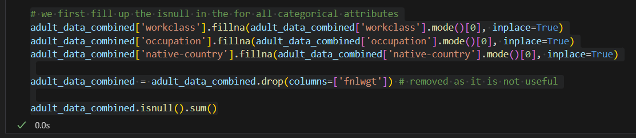
Data Cleaning
Imported “Adult.test” & “Adult.data” files into google colab and merged them into 1 data set
Filled in missing values with mode values and dropped “fnlwgt” column

Slide 10
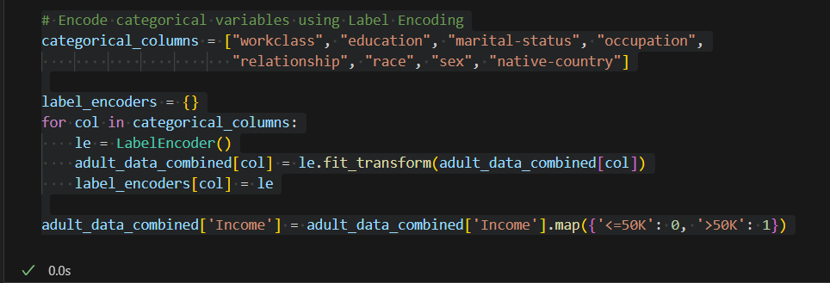
Data Cleaning
Encoded Categorical variable using label encoding
Used stratified sampling to do splitting of data

Slide 11
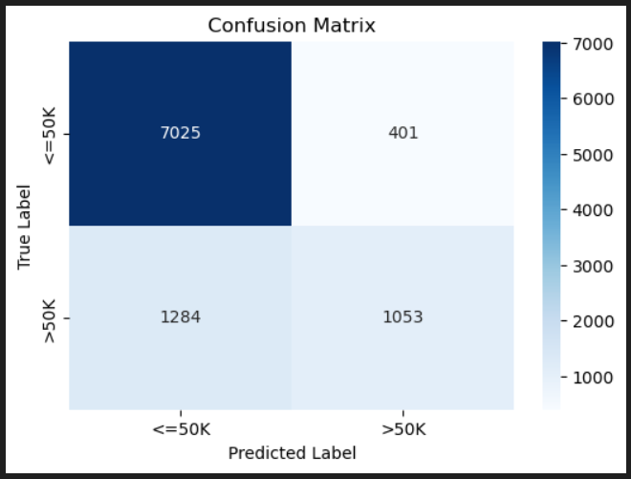
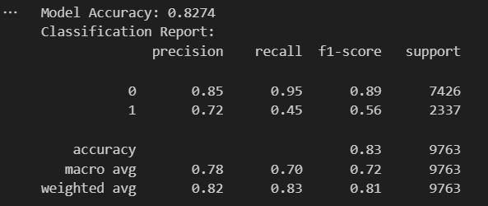
Results (Logistic Regression)

Slide 12
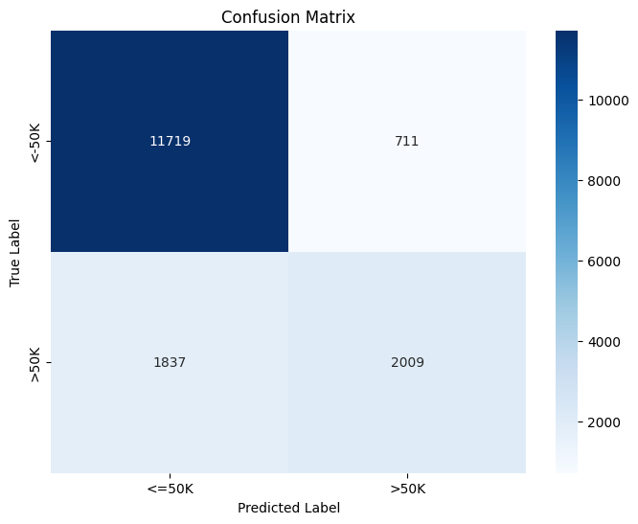
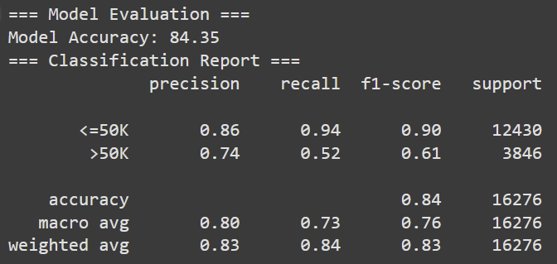
Results (Decision Tree)

Slide 13
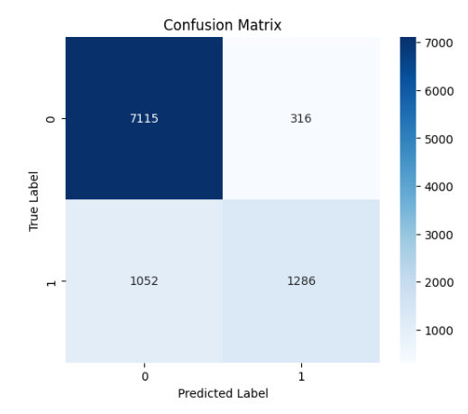
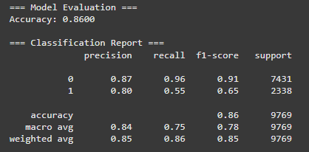
Results (Random Forest)

Slide 14
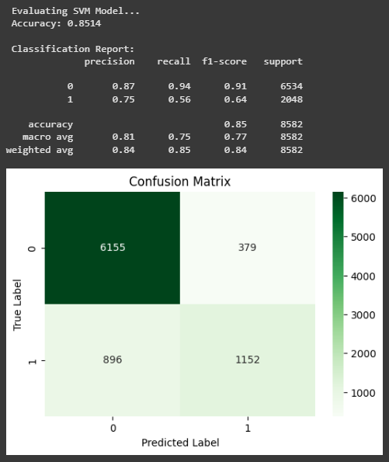
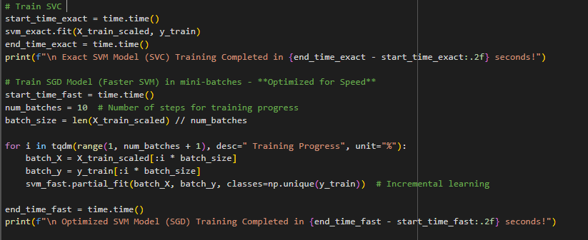
Results (Support vector Machine)

Slide 15
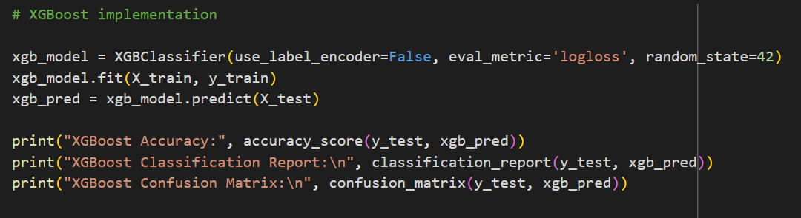
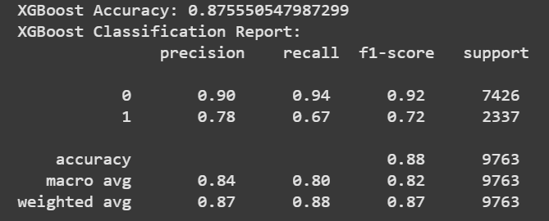
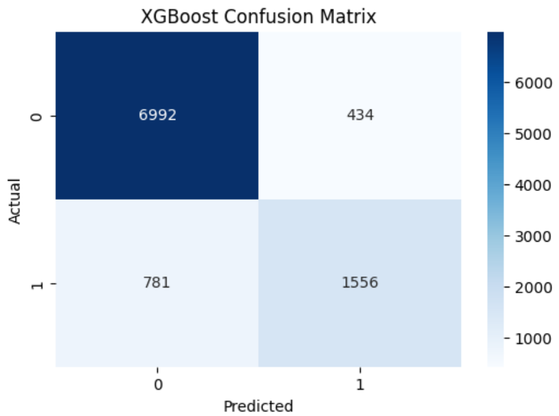
Results (Gradient Boosting) (XGBoost)

Slide 16
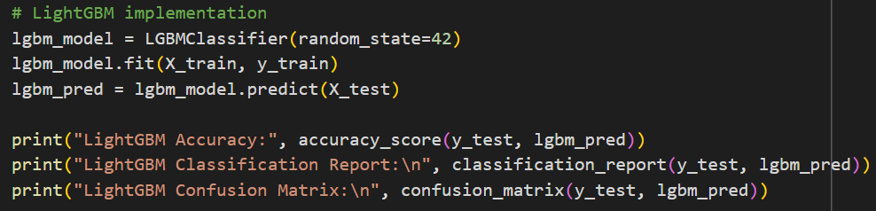

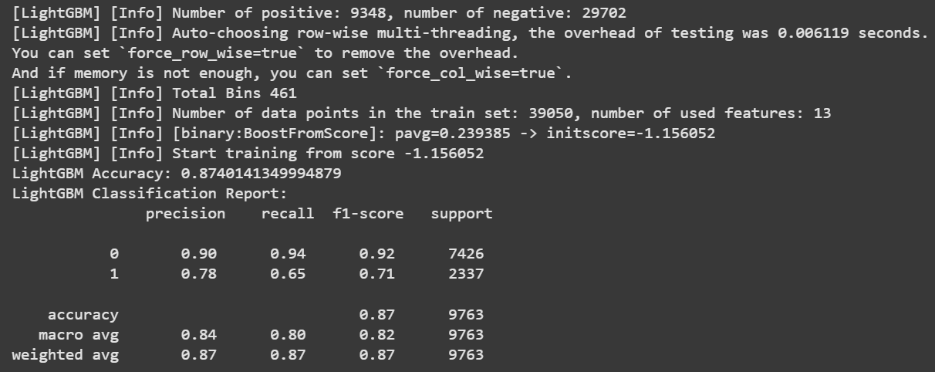
Results (Gradient Boosting) (LightGBM)

Slide 17
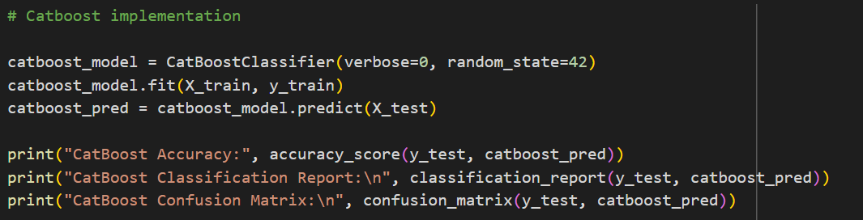

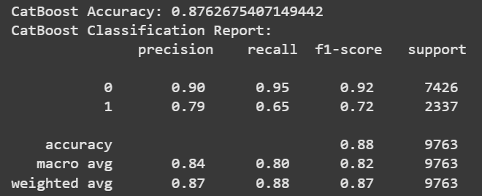
Results (Gradient Boosting) (CatBoost)

Slide 18
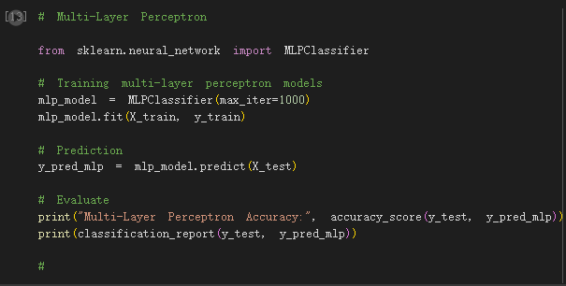
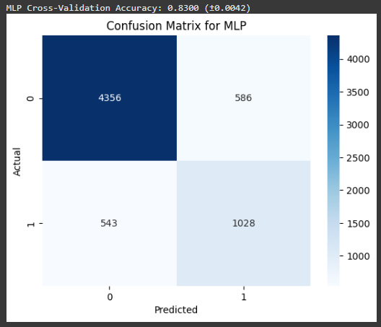
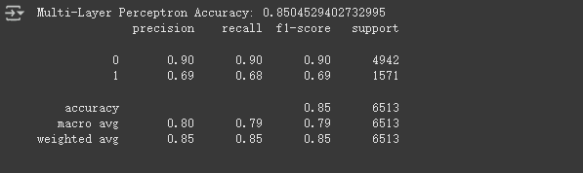
Results (Multi-Layer-Perceptron)
Advantages: Able to capture complex nonlinear relationships, suitable for processing high-dimensional data.
Reason: As a foundation model for neural networks, to help us explore the potential of deep learning methods.

Slide 19
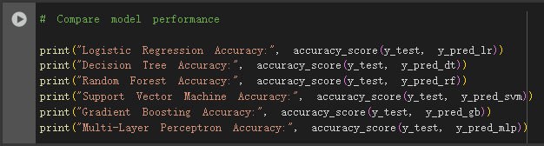
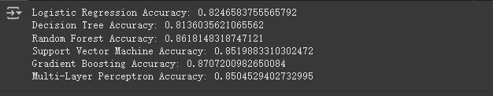
Experiment result
The best performing model: Gradient Boosting, which has the highest accuracy (0.87).

Slide 20
Result analysis
Advantages and disadvantages of the model
Logistic Regression:
Advantages: Simple, easy to explain.
Disadvantages: The ability to capture nonlinear relations is weak.
Decision Tree:
Advantages: Easy to interpret, able to handle nonlinear relationships.
Disadvantages: Easy to overfit.
Random Forest:
Advantages: Reduced overfitting, suitable for high-dimensional data.
Disadvantages: The model is more complex and the training time is longer.

Slide 21
Result analysis
Support Vector Machine:
Advantages: Performs well in high dimensional Spaces.
Disadvantages: Long training time on large data sets.
Gradient Boosting:
Advantages: Powerful ensemble learning method, suitable for dealing with complex nonlinear relationships.
Disadvantages: Long training time, poor model interpretation.
Multi-Layer Perceptron:
Advantage: Ability to capture complex non-linear relationships.
Disadvantages: requires a lot of data and computing resources, and the model is poor in interpretation.
Decision Tree and Random Forest perform better when the data has obvious feature importance, but they are easy to overfit when the data is noisy.

Slide 22
Result analysis
In which cases the model performs best or worst
Gradient Boosting works best in most cases, especially when the data has complex nonlinear relationships.
Logistic Regression and Support Vector machines perform well on linearly separable data, but poorly on complex nonlinear data.

Slide 23
Conclusion: Results
The best performing model: Gradient Boosting (CatBoost), which has the highest accuracy (87.6%).
Does the model performance meet the expectations? Yes, Gradient Boosting performs better than other models and achieves the expected goals.
What it means: The project shows how machine learning models can be used to predict individual income levels and help governments or businesses formulate relevant policies.

Slide 24
Conclusion: Project limitation
Data Imbalance: The dataset contains more low-income individuals (~76%) which may bias the model.
Feature Limitations: Certain socio-economic factors (e.g., cost of living, job market conditions are not included in dataset.
Model interpretability: For example, Gradient Boosting and Multi-Layer Perceptron have poor model interpretability.
Computational resources: Complex models such as Gradient Boosting and Multi-Layer Perceptron require significant computational resources.
Generalization Issues: The dataset is based on 1994 census data, losing its relevance towards modern economic trends.

Slide 25
Conclusion: Improvements
Improvement suggestion
Try more complex models like XGBoost, LightGBM, or deep learning models.
Carry out more in-depth feature engineering: such as feature selection, feature combination and so on.
Use larger data sets: to further improve the generalization of the model.

Slide 26
Appendix
References & Sources Cited:
Chakrabarty, N. and Biswas, S. (2018). A Statistical Approach to Adult Census Income Level Prediction. Proceedings of the 2018 International Conference on Advances in Computing, Communication Control and Networking (ICACCCN), pp. 1015-1019. Available at: https://ieeexplore.ieee.org/document/8748528.
Jo, H. (2024). Income Prediction Using Machine Learning Techniques. Master's Thesis, University of California. Available at: https://escholarship.org/uc/item/6d01c9v7.

Slide 27
End of Presentation

