Slide 1
Small RNA-seq Analysis of
Drosophila melanogaster loqs Mutants
A work-in-progress by:
Lee Jin Wee & Teo Ren Yi

Slide 2
Contents
Recap of progress thus far
Future work
Conclusions and reflections

Slide 3
Recap

Slide 4
Work-In-Progress
Index name | Description
dm3excludeUextrRNA | background RNAs
dm3excludeUextFBdmelr5.52.bed.PT.exon.rRNA.merge | background RNAs
Chr1dmerdna | background RNAs
dm3excludeUextRNA | background RNAs
dm3excludeUextFBdmelr5.52.bed.PT.exon.tRNA.merge | background RNAs
dm3excludeUextFBdmelr5.52.bed.PT.exon.snRNA.merge | background RNAs
dm3excludeUextFBdmelr5.52.bed.PT.exon.snoRNA.merge | background RNAs
dmestemloopmirbasev20 | Mirprecursor
knownhprna | hpRNA
dm3excludeUextLTR | retrotransposon
dm3excludeUextLINE | retrotransposon
dm3excludeUextDNA | DNA transposon
dm3excludeUextSatellite | other repeats
dm3excludeUextLow_complexity | other repeats
dm3excludeUextRC | other repeats
dm3excludeUextSimple_repeat | other repeats
dm3excludeUextOther | other repeats
dm3excludeUextUnknown | other repeats
dm3excludeUextFBdmelr5.52.bed.PT.transposableelement.transposableelement.merge | other repeats
dm3excludeUextARTEFACT | other repeats
dm3excludeUextokamura2008nsmb | other known siRNA loci
dm3excludeUextczech2008nature | other known siRNA loci
dm3excludeUextkawamura2008nature | other known siRNA loci
dm3excludeUextghildiyal2008science | other known siRNA loci
dm3excludeUextCR14033 | other known siRNA loci
dm3excludeUextoverlapFBdmelr5.52.txt.exon.mRNA.merge.FBdmelr5.52.txt.exon.mRNA.merge | new cisNAT loci
dm3excludeUextoverlapFBdmelr5.52.txt.exon.mRNA.merge.FBdmelr5.52.txt.exon.ncRNA.merge | new cisNAT loci
dm3excludeUextoverlapFBdmelr5.52.txt.exon.mRNA.merge.FBdmelr5.52.txt.exon.tRNA.merge | new cisNAT loci
dm3excludeUextoverlapFBdmelr5.52.txt.exon.mRNA.merge.FBdmelr5.52.txt.exon.snoRNA.merge | new cisNAT loci
dm3excludeUextoverlapFBdmelr5.52.txt.exon.mRNA.merge.FBdmelr5.52.txt.exon.pseudogene.merge | new cisNAT loci
Thought:
siRNAs play a crucial role in targeting transposable elements for RNA-silencing.
If we moved the siRNA indexes before the transposable element indexes, would we see a higher count for siRNA loci?

Slide 5
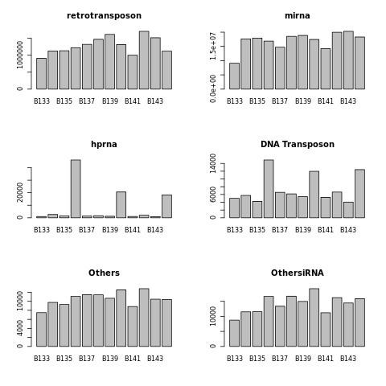
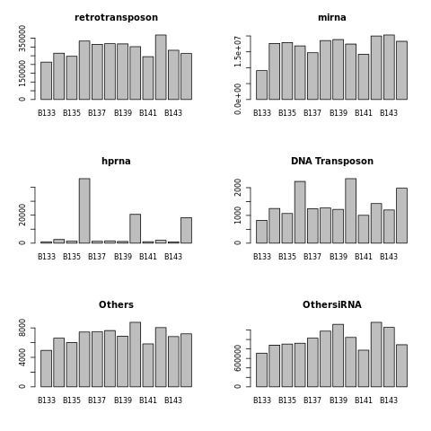
Recap
33 34 35 36 37 38 39 40 41 42 43 44
33 34 35 36 37 38 39 40 41 42 43 44
33 34 35 36 37 38 39 40 41 42 43 44
33 34 35 36 37 38 39 40 41 42 43 44
33 34 35 36 37 38 39 40 41 42 43 44
33 34 35 36 37 38 39 40 41 42 43 44
33 34 35 36 37 38 39 40 41 42 43 44
33 34 35 36 37 38 39 40 41 42 43 44
33 34 35 36 37 38 39 40 41 42 43 44
33 34 35 36 37 38 39 40 41 42 43 44
33 34 35 36 37 38 39 40 41 42 43 44
33 34 35 36 37 38 39 40 41 42 43 44
Notes:
No observable trend, means rougly equal amounts for each library mapped to both OthersiRNA and transposon?
Notably, trend of DNA transposon still shows high levels of Loqs-PD bias. Thoughts? Our OthersiRNA indexes do not cover DNA transposons?
Or is it that Loqs-PD could also be involved in processing DNA-transposon based siRNAs?

Slide 6
Future Work
Fix bugs in Snakemake workflow, while incorporating normalization/ multiple mappers.
Set-up a meeting with Liling to discuss way ahead/ variation problems.
Potentially incorporate EdgeR/ other tools?
Prepare to take “back-end” role to set Montella up for success.

Slide 7
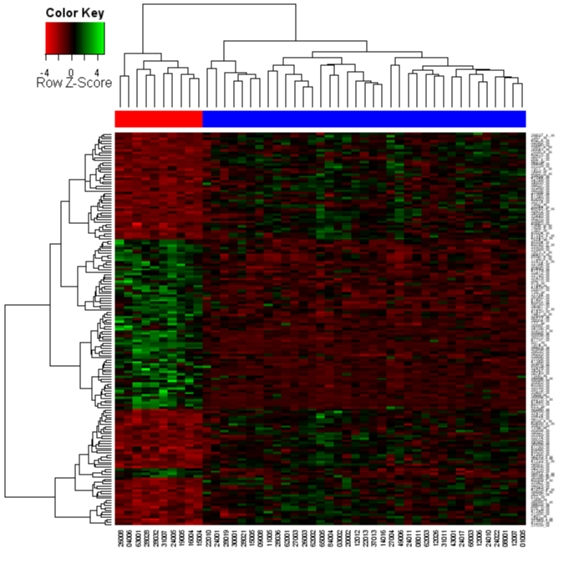


Conclusion and Reflections
Choose one?
Self-discovery
Scientific-discovery

