Slide 1

Small RNA-seq Analysis of
Drosophila melanogaster loqs Mutants
A work-in-progress by:
Lee Jin Wee & Teo Ren Yi

Slide 2
Contents
Background information
Project objectives
Current Progress
Work-In-Progress

Slide 3

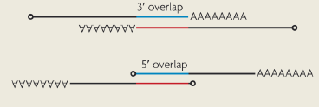


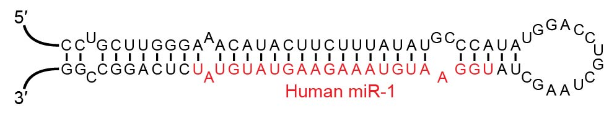
Background Information
Hairpin
Transposable Element
Cis/Trans-nat
siRNAs (21 nts)
miRNAs (22~ nts)
piRNAs (24-32nts)
Small-RNAs (18-32nts)
Notes:
RNA interference (RNAi), the process by which double-stranded RNA (dsRNA) is processed
into small interfering RNAs (siRNAs) that silence homologous transcripts, is both a fascinating
cellular machinery and a powerful experimental technique. What about its endogenous functions?
Hp-RNAs > 400-bp duplex separated by a large loop

Slide 4
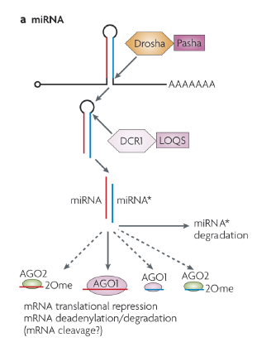
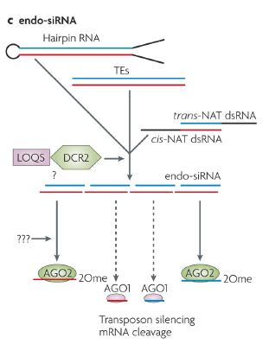
Background Information
Same LOQs?
Notes:
Primary miRNA -> pre-miRNA

Slide 5
Background Information
LOQS-PA
LOQS-PB
LOQS-PD
Pre-miRNA Processing
Pre-siRNA Processing
Evidence:
Studies involving loqs triple-KO mutants showed that upon rescue with LOQS-PA/PB or LOQS-PD, either mature-miRNA levels or mature-siRNA levels were restored.

Slide 6
Background Information
Limitations of current studies:
The extent of miRNA/siRNA rescue was previously measured by singly overexpressing known miRNA/siRNA precursors in rescued cells. I.e only over-expressing miR-307a.
Current studies do not provide a complete picture of specific LOQs targets in small-RNA processing. But rather they focus on identifying the class of small-RNAs that LOQs targets.
Transcriptomic analysis of loqs-rescue mutants have yet to be performed.

Slide 7
Background Information
Where do we begin?
A Drosophila cell line lacking loqs gene locus and demonstrated established by Prof Okamura’s lab.
Rescue cells with LOQS-PA/PB/PD, with EGFP negative controls.
Perform RNA-sequencing
Library | Description
B133 | FLAG-EGFP #1
B134 | FLAG-Loqs-PA #1
B135 | FLAG-Loqs-PB #1
B136 | FLAG-Loqs-PD #1
B137 | FLAG-EGFP #2
B138 | FLAG-Loqs-PA #2
B139 | FLAG-Loqs-PB #2
B140 | FLAG-Loqs-PD #2
B141 | FLAG-EGFP #3
B142 | FLAG-Loqs-PA #3
B143 | FLAG-Loqs-PB #3
B144 | FLAG-Loqs-PD #3

Slide 8
Background Information
Preliminary work by Dr Liling
Pre-process libraries to obtain high quality
reads of 18-32nts.
Sequentially map libraries to
Bowtie Indexes.
Analyze differential expression of small-RNAs
based on adjusted, normalized counts.
Index name | Description
dm3excludeUextrRNA | background RNAs
dm3excludeUextFBdmelr5.52.bed.PT.exon.rRNA.merge | background RNAs
Chr1dmerdna | background RNAs
dm3excludeUextRNA | background RNAs
dm3excludeUextFBdmelr5.52.bed.PT.exon.tRNA.merge | background RNAs
dm3excludeUextFBdmelr5.52.bed.PT.exon.snRNA.merge | background RNAs
dm3excludeUextFBdmelr5.52.bed.PT.exon.snoRNA.merge | background RNAs
dmestemloopmirbasev20 | Mirprecursor
knownhprna | hpRNA
dm3excludeUextLTR | retrotransposon
dm3excludeUextLINE | retrotransposon
dm3excludeUextDNA | DNA transposon
dm3excludeUextSatellite | other repeats
dm3excludeUextLow_complexity | other repeats
dm3excludeUextRC | other repeats
dm3excludeUextSimple_repeat | other repeats
dm3excludeUextOther | other repeats
dm3excludeUextUnknown | other repeats
dm3excludeUextFBdmelr5.52.bed.PT.transposableelement.transposableelement.merge | other repeats
dm3excludeUextARTEFACT | other repeats
dm3excludeUextokamura2008nsmb | other known siRNA loci
dm3excludeUextczech2008nature | other known siRNA loci
dm3excludeUextkawamura2008nature | other known siRNA loci
dm3excludeUextghildiyal2008science | other known siRNA loci
dm3excludeUextCR14033 | other known siRNA loci
dm3excludeUextoverlapFBdmelr5.52.txt.exon.mRNA.merge.FBdmelr5.52.txt.exon.mRNA.merge | new cisNAT loci
dm3excludeUextoverlapFBdmelr5.52.txt.exon.mRNA.merge.FBdmelr5.52.txt.exon.ncRNA.merge | new cisNAT loci
dm3excludeUextoverlapFBdmelr5.52.txt.exon.mRNA.merge.FBdmelr5.52.txt.exon.tRNA.merge | new cisNAT loci
dm3excludeUextoverlapFBdmelr5.52.txt.exon.mRNA.merge.FBdmelr5.52.txt.exon.snoRNA.merge | new cisNAT loci
dm3excludeUextoverlapFBdmelr5.52.txt.exon.mRNA.merge.FBdmelr5.52.txt.exon.pseudogene.merge | new cisNAT loci

Slide 9
Background Information

Slide 10
Background Information
Limitations of Dr Liling’s preliminary work:
Initial analysis was performed in 2008, using DM-Release 5 genome assembly. DM-Release 6 was published in 2014, with much higher coverage in heterochromatin/ non-coding regions.
Takes around 20+ bash scripts and a few thousand lines of code to generate the previous bar-chart.
A lot of aspects of the scripts were hardcoded/repetitive. Resulting in a relatively convoluted and rigid pipeline that would not allow us to easily test other datasets.
Because of how sequential mapping was conducted, her final bar-chart only reflects 1 possible permutation of sequential mapping.
**!!!CAVEAT, Dr Liling was just starting out, like us!

Slide 11



Project Objectives
Can barely string together a for-loop
Taking LSM2241 and LSM3241 is enough… right?
Vim vs EMACS? More like what's a text editor.
ioinformatics
BIOINFORMATICS

Slide 12
Project Objectives
Walkthrough Dr Liling’s scripts and understand each individual component
Rewrite the analysis pipeline into a modularized Snakemake workflow that is based on DM-Release 6 genome assembly.
Generate something similar to Dr Liling’s bar-chart.
Make necessary updates to the theoretical underpinnings of Dr Liling’s analysis. See if results change.
Test other datasets using modified pipeline to ascertain if results are reproducible.

Slide 13
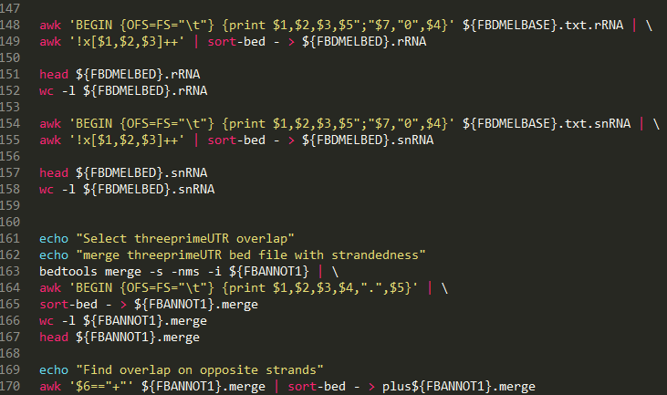
Current Progress
Pre-processed libraries
31 x Bowtie Indexes
Sequential mapping
reality
Normalize by reads per million, spike-in control , account for multiple mappers
expectations
(X 1000)
Counts

Slide 14

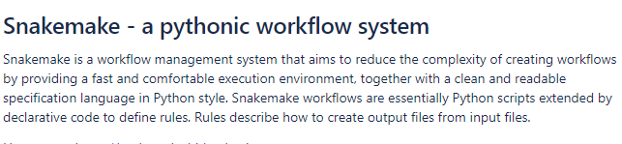



Current Progress
us
Notes:
easy-to-use data structures and data analysis tools for the Python programming language.
The workflow is determined automatically from top (the files you want) to bottom (the files you have/ generate as intermediates).
We tell Snakemake what files we want and based on the rules, it figures out what intermediate files we need to reach final output.

Slide 15
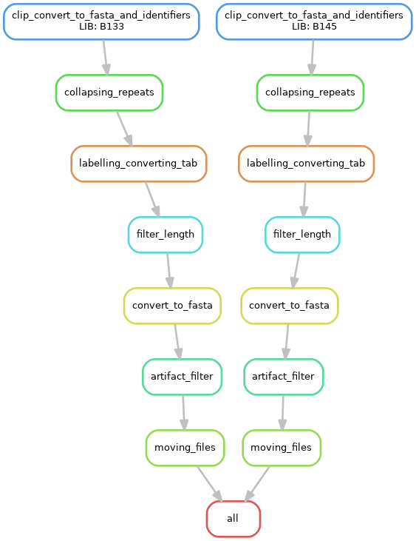
Current Progress
Input
Directed Acyclic Graph (DAG) for RNA-seq library pre-processing
Output
Notes:
directed acyclic graph (DAG) of jobs where the edges represent dependencies.

Slide 16
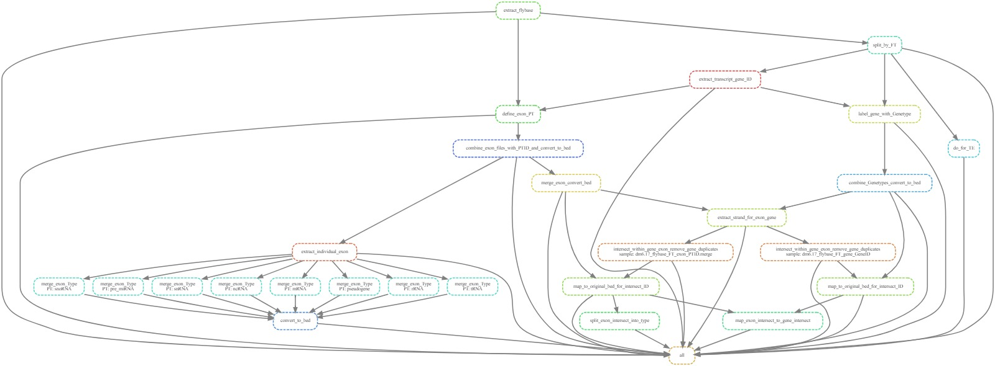

Slide 17
Current Progress
Index name | Description
dm3excludeUextrRNA | background RNAs
dm3excludeUextFBdmelr5.52.bed.PT.exon.rRNA.merge | background RNAs
Chr1dmerdna | background RNAs
dm3excludeUextRNA | background RNAs
dm3excludeUextFBdmelr5.52.bed.PT.exon.tRNA.merge | background RNAs
dm3excludeUextFBdmelr5.52.bed.PT.exon.snRNA.merge | background RNAs
dm3excludeUextFBdmelr5.52.bed.PT.exon.snoRNA.merge | background RNAs
dmestemloopmirbasev20 | Mirprecursor
knownhprna | hpRNA
dm3excludeUextLTR | retrotransposon
dm3excludeUextLINE | retrotransposon
dm3excludeUextDNA | DNA transposon
dm3excludeUextSatellite | other repeats
dm3excludeUextLow_complexity | other repeats
dm3excludeUextRC | other repeats
dm3excludeUextSimple_repeat | other repeats
dm3excludeUextOther | other repeats
dm3excludeUextUnknown | other repeats
dm3excludeUextFBdmelr5.52.bed.PT.transposableelement.transposableelement.merge | other repeats
dm3excludeUextARTEFACT | other repeats
dm3excludeUextokamura2008nsmb | other known siRNA loci
dm3excludeUextczech2008nature | other known siRNA loci
dm3excludeUextkawamura2008nature | other known siRNA loci
dm3excludeUextghildiyal2008science | other known siRNA loci
dm3excludeUextCR14033 | other known siRNA loci
dm3excludeUextoverlapFBdmelr5.52.txt.exon.mRNA.merge.FBdmelr5.52.txt.exon.mRNA.merge | new cisNAT loci
dm3excludeUextoverlapFBdmelr5.52.txt.exon.mRNA.merge.FBdmelr5.52.txt.exon.ncRNA.merge | new cisNAT loci
dm3excludeUextoverlapFBdmelr5.52.txt.exon.mRNA.merge.FBdmelr5.52.txt.exon.tRNA.merge | new cisNAT loci
dm3excludeUextoverlapFBdmelr5.52.txt.exon.mRNA.merge.FBdmelr5.52.txt.exon.snoRNA.merge | new cisNAT loci
dm3excludeUextoverlapFBdmelr5.52.txt.exon.mRNA.merge.FBdmelr5.52.txt.exon.pseudogene.merge | new cisNAT loci
GFF/FASTA
miRbase + UCSC LiftOver
✓
GFF
Repeatmasker
GFF
Repeatmasker
Supplementary Info + UCSC LiftOver
Data at hand, yet to convert to correct formats.
GFF

Slide 18
Current Progress
*Note, generated using raw counts. Other siRNA indexes not mapped yet.

Slide 19
Work-In-Progress
Index name | Description
dm3excludeUextrRNA | background RNAs
dm3excludeUextFBdmelr5.52.bed.PT.exon.rRNA.merge | background RNAs
Chr1dmerdna | background RNAs
dm3excludeUextRNA | background RNAs
dm3excludeUextFBdmelr5.52.bed.PT.exon.tRNA.merge | background RNAs
dm3excludeUextFBdmelr5.52.bed.PT.exon.snRNA.merge | background RNAs
dm3excludeUextFBdmelr5.52.bed.PT.exon.snoRNA.merge | background RNAs
dmestemloopmirbasev20 | Mirprecursor
knownhprna | hpRNA
dm3excludeUextLTR | retrotransposon
dm3excludeUextLINE | retrotransposon
dm3excludeUextDNA | DNA transposon
dm3excludeUextSatellite | other repeats
dm3excludeUextLow_complexity | other repeats
dm3excludeUextRC | other repeats
dm3excludeUextSimple_repeat | other repeats
dm3excludeUextOther | other repeats
dm3excludeUextUnknown | other repeats
dm3excludeUextFBdmelr5.52.bed.PT.transposableelement.transposableelement.merge | other repeats
dm3excludeUextARTEFACT | other repeats
dm3excludeUextokamura2008nsmb | other known siRNA loci
dm3excludeUextczech2008nature | other known siRNA loci
dm3excludeUextkawamura2008nature | other known siRNA loci
dm3excludeUextghildiyal2008science | other known siRNA loci
dm3excludeUextCR14033 | other known siRNA loci
dm3excludeUextoverlapFBdmelr5.52.txt.exon.mRNA.merge.FBdmelr5.52.txt.exon.mRNA.merge | new cisNAT loci
dm3excludeUextoverlapFBdmelr5.52.txt.exon.mRNA.merge.FBdmelr5.52.txt.exon.ncRNA.merge | new cisNAT loci
dm3excludeUextoverlapFBdmelr5.52.txt.exon.mRNA.merge.FBdmelr5.52.txt.exon.tRNA.merge | new cisNAT loci
dm3excludeUextoverlapFBdmelr5.52.txt.exon.mRNA.merge.FBdmelr5.52.txt.exon.snoRNA.merge | new cisNAT loci
dm3excludeUextoverlapFBdmelr5.52.txt.exon.mRNA.merge.FBdmelr5.52.txt.exon.pseudogene.merge | new cisNAT loci
Problem 1 :
Once a read is mapped to an index,
It is removed from the sequential mapping chain.
How do we deal with multiple mappers?
Mapped reads
Mapped reads
Problem 2 :
Given the high propensity for multiple mappers in small-RNA seq, changing the order of indexes could drastically affect final counts.

Slide 20
Work-In-Progress
Index name | Description
dm3excludeUextrRNA | background RNAs
dm3excludeUextFBdmelr5.52.bed.PT.exon.rRNA.merge | background RNAs
Chr1dmerdna | background RNAs
dm3excludeUextRNA | background RNAs
dm3excludeUextFBdmelr5.52.bed.PT.exon.tRNA.merge | background RNAs
dm3excludeUextFBdmelr5.52.bed.PT.exon.snRNA.merge | background RNAs
dm3excludeUextFBdmelr5.52.bed.PT.exon.snoRNA.merge | background RNAs
dmestemloopmirbasev20 | Mirprecursor
knownhprna | hpRNA
dm3excludeUextLTR | retrotransposon
dm3excludeUextLINE | retrotransposon
dm3excludeUextDNA | DNA transposon
dm3excludeUextSatellite | other repeats
dm3excludeUextLow_complexity | other repeats
dm3excludeUextRC | other repeats
dm3excludeUextSimple_repeat | other repeats
dm3excludeUextOther | other repeats
dm3excludeUextUnknown | other repeats
dm3excludeUextFBdmelr5.52.bed.PT.transposableelement.transposableelement.merge | other repeats
dm3excludeUextARTEFACT | other repeats
dm3excludeUextokamura2008nsmb | other known siRNA loci
dm3excludeUextczech2008nature | other known siRNA loci
dm3excludeUextkawamura2008nature | other known siRNA loci
dm3excludeUextghildiyal2008science | other known siRNA loci
dm3excludeUextCR14033 | other known siRNA loci
dm3excludeUextoverlapFBdmelr5.52.txt.exon.mRNA.merge.FBdmelr5.52.txt.exon.mRNA.merge | new cisNAT loci
dm3excludeUextoverlapFBdmelr5.52.txt.exon.mRNA.merge.FBdmelr5.52.txt.exon.ncRNA.merge | new cisNAT loci
dm3excludeUextoverlapFBdmelr5.52.txt.exon.mRNA.merge.FBdmelr5.52.txt.exon.tRNA.merge | new cisNAT loci
dm3excludeUextoverlapFBdmelr5.52.txt.exon.mRNA.merge.FBdmelr5.52.txt.exon.snoRNA.merge | new cisNAT loci
dm3excludeUextoverlapFBdmelr5.52.txt.exon.mRNA.merge.FBdmelr5.52.txt.exon.pseudogene.merge | new cisNAT loci
Thought:
siRNAs play a crucial role in targeting transposable elements for RNA-silencing.
If we moved the siRNA indexes before the transposable element indexes, would we see a higher count for siRNA loci?

Slide 21
Work-In-Progress
Future Plans:
Rearrangement of indexes in sequential mapping. Notably, shifting the position of siRNA indexes upwards to determine if hpRNA still shows the most significant upregulation in LOQS-PD rescue.
Work on integrating normalization and multiple mapping occurrences into Snakemake workflow. Possible integration of other analysis programs like ShortStack.
Lastly, improve the quality of our in-house cis-nat siRNA indexes.

Slide 22
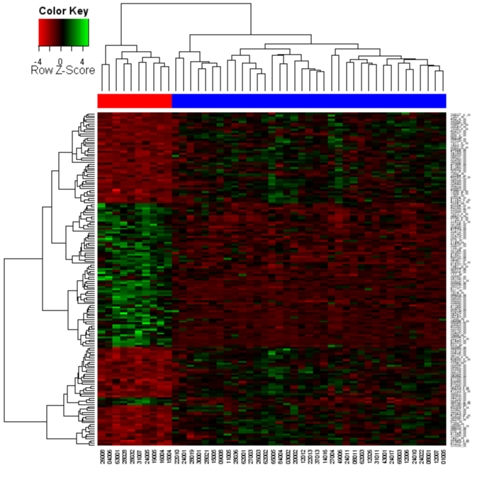
Work-In-Progress
In conclusion …
>
Self-discovery
Scientific-discovery

Slide 23

Conclusion
Thank you for your kind attention!
Shout out to Greg, Kenneth and Liling
for their patience and guidance thus far.
Stay tuned for …
ioinformatics
BIOINFORMATICS

