Slide 1
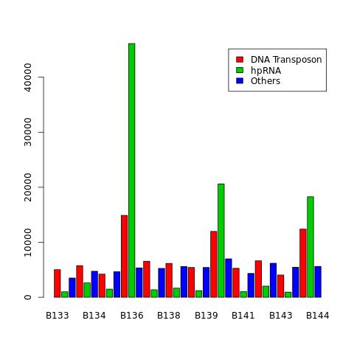
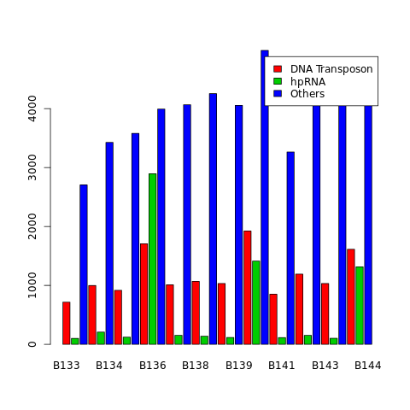
Old
single mapper
Multiple mapper

Slide 2
Contents
miRNA mapping, library variation, sequential mapping update
Potential issues with existing multiple mapping/ normalization
Potential solutions to multiple mapping/normalization issues

Slide 3
Liling’s parameters
Noticeable variation between technical replicates?
3 x LOQS-PD libraries
3 x EGFP libraries
Notes:
Corrected for sequencing depth/ TC normalization. Strange. First of all there appears to be abnormally

Slide 4
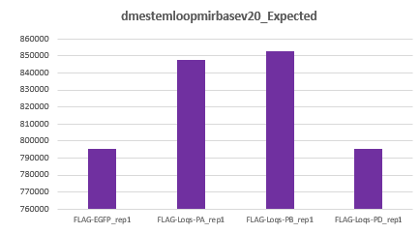
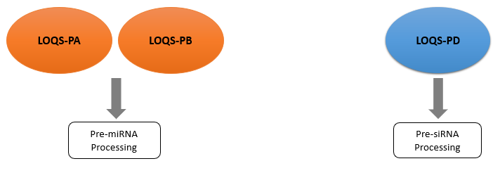
Liling’s parameters
Expectation:
Reality:
Notes:
Corrected for sequencing depth/ TC normalization. Strange. First of all there appears to be abnormally

Slide 5
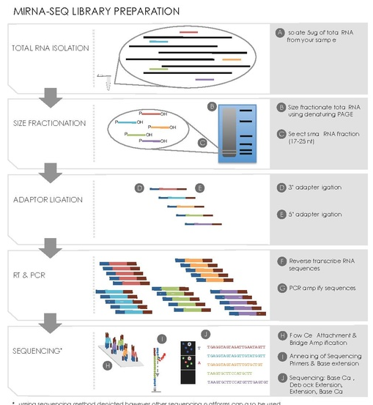
Liling’s parameters

Slide 6
Mature-miRNA
Liling’s parameters
Our explanation:
Theoretically, while we would expect a LOQS-PA/PB rescue to have higher mature-miRNA expression level, we should conversely also expect it to have a lower pre-miRNA level than LOQS-PD, due to more effective processing and less accumulation.
dmestemloopmirbasev20 is an index constructed using full-length pre-miRNA features (i.e miRNA precursors), with each feature ranging from 70-100 nts in length. It is NOT a mature-miRNA index.
Could it perhaps be that during library preparation, the separation of small-RNA fragments was not thorough, and pre-miRNA fragments were sequenced, confounding the results? (This is highly unlikely).
So instead we tried using mature-miRNA features drawn from flybase GFF file, which averaged 22-25 nts.
Pre-miRNA
LOQS-PA
LOQS-PB
>
LOQS-PD
LOQS-PA
LOQS-PB
LOQS-PD
<

Slide 7
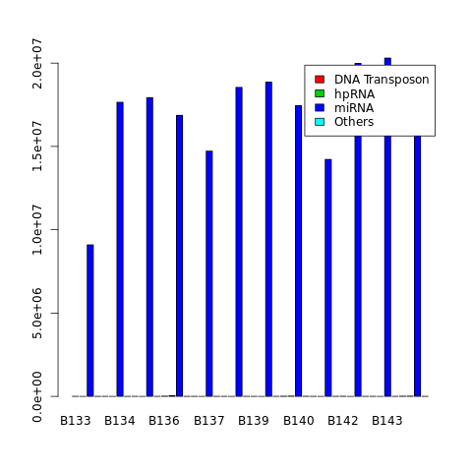
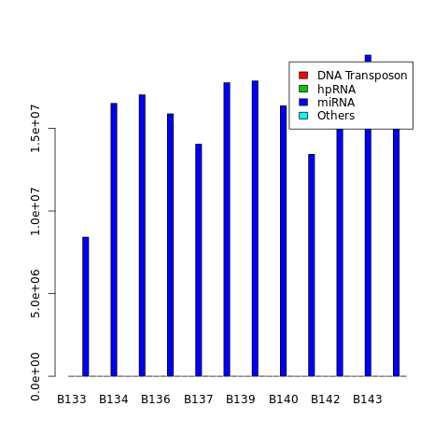
Pre-mirna
single mapper
Multiple mapper

Slide 8
Mature-miRNA
Our parameters
*Note, not corrected for sequencing depth.
Single-mapping
Multiple-mapping

Slide 9
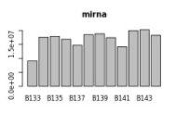
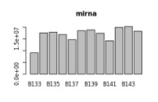
dmestemloop (pre-miRNA)
Our parameters
Mature-miRNA
*Note, not corrected for sequencing depth.

Slide 10
Our parameters
Expectation:
Reality:
Notes:
K so turns out they are about the same. Initial theoretical knowledge is that with a PA/PB rescue, we should see a spike in miRNA counts yes?
But lets think about how the sequencing was even carried out. Bascially, was there a prior filtering step during library construction to filter for size?
yes, so technically the precursors/pre-miRNAs would have been filtered out because the max length of read based on read distribution is 50nts. So its either that the sequencing run was kept at 50nts OR the input transcript lengths were kept at 50nts.
Assuming all of the above, we would expect to get a higher spike in both B134/5, B138/39,

Slide 11
Our parameters
Conclusion:
Does this challenge the validity of our raw data? Or is this variation to be expected?
Variation?

Slide 12
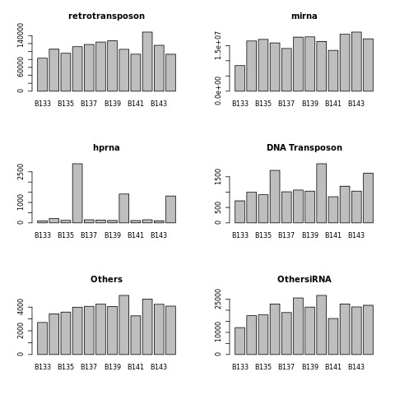


Sequential Mapping Update

Slide 13
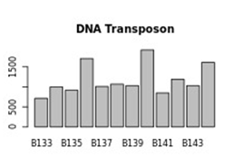
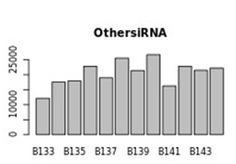
Sequential Mapping Update

Slide 14
Work-In-Progress
Index name | Description
dm3excludeUextrRNA | background RNAs
dm3excludeUextFBdmelr5.52.bed.PT.exon.rRNA.merge | background RNAs
Chr1dmerdna | background RNAs
dm3excludeUextRNA | background RNAs
dm3excludeUextFBdmelr5.52.bed.PT.exon.tRNA.merge | background RNAs
dm3excludeUextFBdmelr5.52.bed.PT.exon.snRNA.merge | background RNAs
dm3excludeUextFBdmelr5.52.bed.PT.exon.snoRNA.merge | background RNAs
dmestemloopmirbasev20 | Mirprecursor
knownhprna | hpRNA
dm3excludeUextLTR | retrotransposon
dm3excludeUextLINE | retrotransposon
dm3excludeUextDNA | DNA transposon
dm3excludeUextSatellite | other repeats
dm3excludeUextLow_complexity | other repeats
dm3excludeUextRC | other repeats
dm3excludeUextSimple_repeat | other repeats
dm3excludeUextOther | other repeats
dm3excludeUextUnknown | other repeats
dm3excludeUextFBdmelr5.52.bed.PT.transposableelement.transposableelement.merge | other repeats
dm3excludeUextARTEFACT | other repeats
dm3excludeUextokamura2008nsmb | other known siRNA loci
dm3excludeUextczech2008nature | other known siRNA loci
dm3excludeUextkawamura2008nature | other known siRNA loci
dm3excludeUextghildiyal2008science | other known siRNA loci
dm3excludeUextCR14033 | other known siRNA loci
dm3excludeUextoverlapFBdmelr5.52.txt.exon.mRNA.merge.FBdmelr5.52.txt.exon.mRNA.merge | new cisNAT loci
dm3excludeUextoverlapFBdmelr5.52.txt.exon.mRNA.merge.FBdmelr5.52.txt.exon.ncRNA.merge | new cisNAT loci
dm3excludeUextoverlapFBdmelr5.52.txt.exon.mRNA.merge.FBdmelr5.52.txt.exon.tRNA.merge | new cisNAT loci
dm3excludeUextoverlapFBdmelr5.52.txt.exon.mRNA.merge.FBdmelr5.52.txt.exon.snoRNA.merge | new cisNAT loci
dm3excludeUextoverlapFBdmelr5.52.txt.exon.mRNA.merge.FBdmelr5.52.txt.exon.pseudogene.merge | new cisNAT loci
Thought:
siRNAs play a crucial role in targeting transposable elements for RNA-silencing.
If we moved the siRNA indexes before the transposable element indexes, would we see a higher count for siRNA loci?

Slide 15
Current Multi-Mapping/ Normalization
Multi-mappers:
Approximately 80% of reads in processed library are multi-mappers.
Counts for multi-mapping reads are divided by number of genomic hits.
I.e. Read1: 600 counts, maps 6 locations -> Read1: 100 counts.
Assumption: For a multi-mapping read, it is assumed that each of its mapped loci express the read equally.
Normalization:
The counts for each read are then normalized based on library sequencing depth = for each library, the total read counts that are mapped to DM6 genome.
Very simplistic form of normalization? Does not account for the fact that assuming constant sequencing depth between libraries, the counts of a read is also dependant on the expression profile of the entire library. I.e The sequencing 'real estate' available given expression profile of other genes.

Slide 16
Proposed Multi-Mapping/ Normalization
Resolve multi-mappers
Improve Normalization
Generate normalized counts plot (i.e Updated version of Liling’s bar chat)
Read normalized counts into DE-package to perform Differential Expression Analysis.

Slide 17
Proposed Multi-Mapping/ Normalization
Solutions to Multi-mappers:
Leverage on packages/ pipelines that handle multi-mapping reads:
MuMRescueLite (2009) (90cites)
Rescue Strategy for multi-mapping reads (2009) (90cites)
RNA-Seq by Expectation Maximization (RSEM) (2011)
eXpress (2012)
ShortStack (2016)
Kallisto (2016)
Solutions to Normalization:
Improve normalization by using a more thorough method:
RPKM?
DESeq? Normalize by Library specific scaling factor.
EdgeR? Normalize by Trimmed Mean of M-values (TMM) calculated scaling factor.

