Slide 1
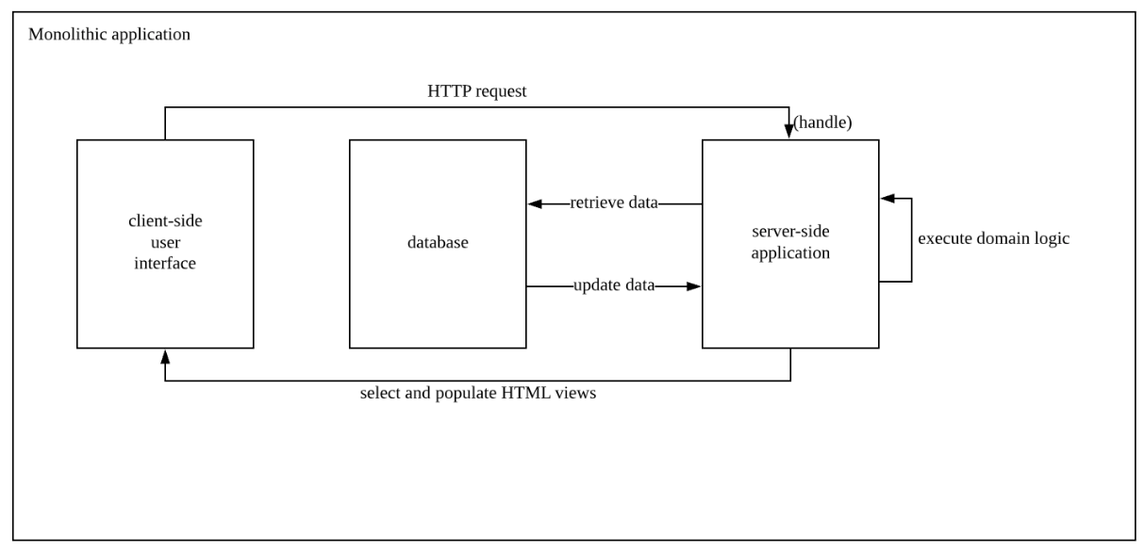
Monolithic
Shortcomings
All logic for handling a request runs in a single process
A small change requires the entire monolith to be rebuilt and deployed

Slide 2
Microservice
Smaller granularity of services can make it easier to create relationships between developers and users
1. Microservice componentizes software by breaking down into service
2. Microservice is choreographed using simple RESTish protocols (HTTP request-response with API, lightweight messaging)
3. Decoupled and cohesive: applications own their own domain logic and can be independently deployable
Martin Fowler
4. Decentralized governance
5. Services can be implemented in various languages, and data management is decentralized
Ethos
Products not projects
Microservice teams would expect to see sophisticated monitoring and logging setups for each individual service such as dashboards showing up/down status and a variety of operational and business relevant metrics.
You build, you run it
Risks
Continuous integration & Continuous delivery pipeline
Not enough time has passed to judge microservices are the future direction for software architectures
It's hard to figure out exactly where the component boundaries should lie
If the components do not compose cleanly, then all you are doing is shifting complexity from inside a component to the connections between components.

