Slide 1

STOCK MARKET SIMULATOR SYSTEM
COMP 208
Group GWMF
Project Monitor: Sebastian Coope
Requirement Reviewer: Sebastian Coope
Group Member: Jinwei Zhang, Jingzhi Gong, Jin Zhang, Linhui Lu, Qihao Feng

Slide 2

Content
Server setting
Encryption
Log In
Data visualization
Sign In
Top up
Quotation
News
Trade
Database
Predict

Slide 3
Server Setting
LocateRegistry.createRegistry(1099);
ServerImpl remote = new ServerImpl();
Naming.rebind("rmi://localhost/queryProcessor", remote);

Slide 4
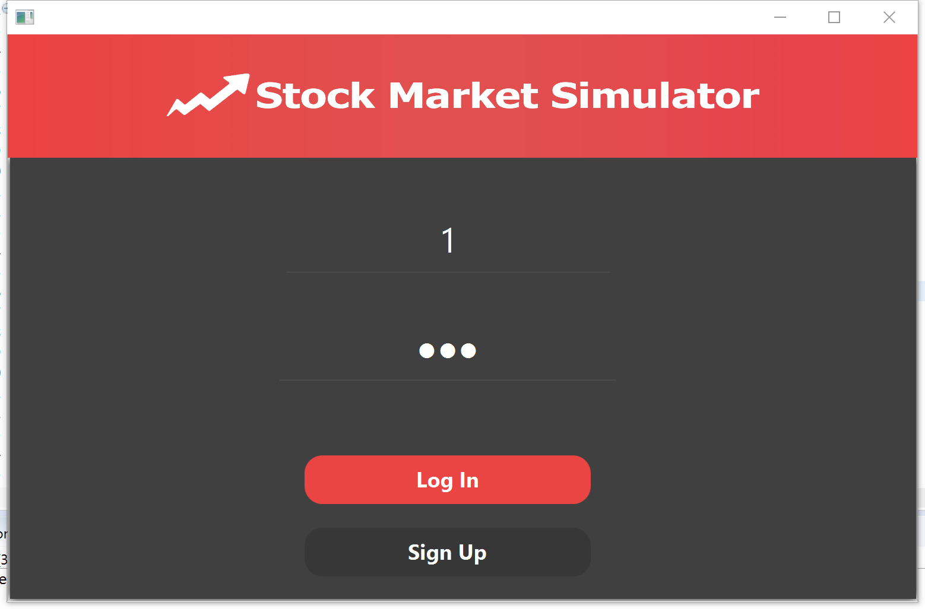
Log in Menu
JFXTextField which promt user to input the information whenever cursor click on it, it will give a nice effect to notify the user to input
JFXButton which will give user a nice effect of “clicking” radius of the button is also customized

Slide 5

JAVA FXML mainframe
Each window is a fxml file, combine with XML there is a controller java file to hand the event generator by user.
Each FXML file can bound with CSS file which can do a lot a optimisation such as changing font, background colour etc.

Slide 6
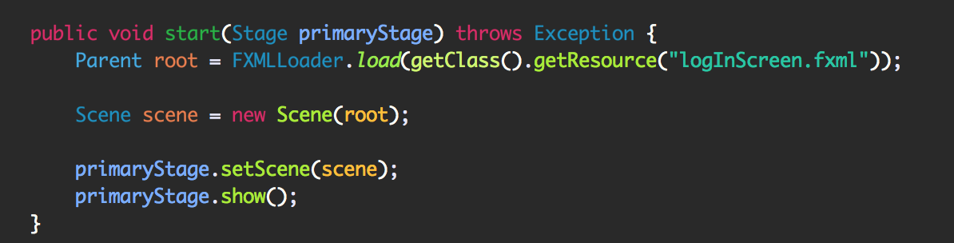

Slide 7
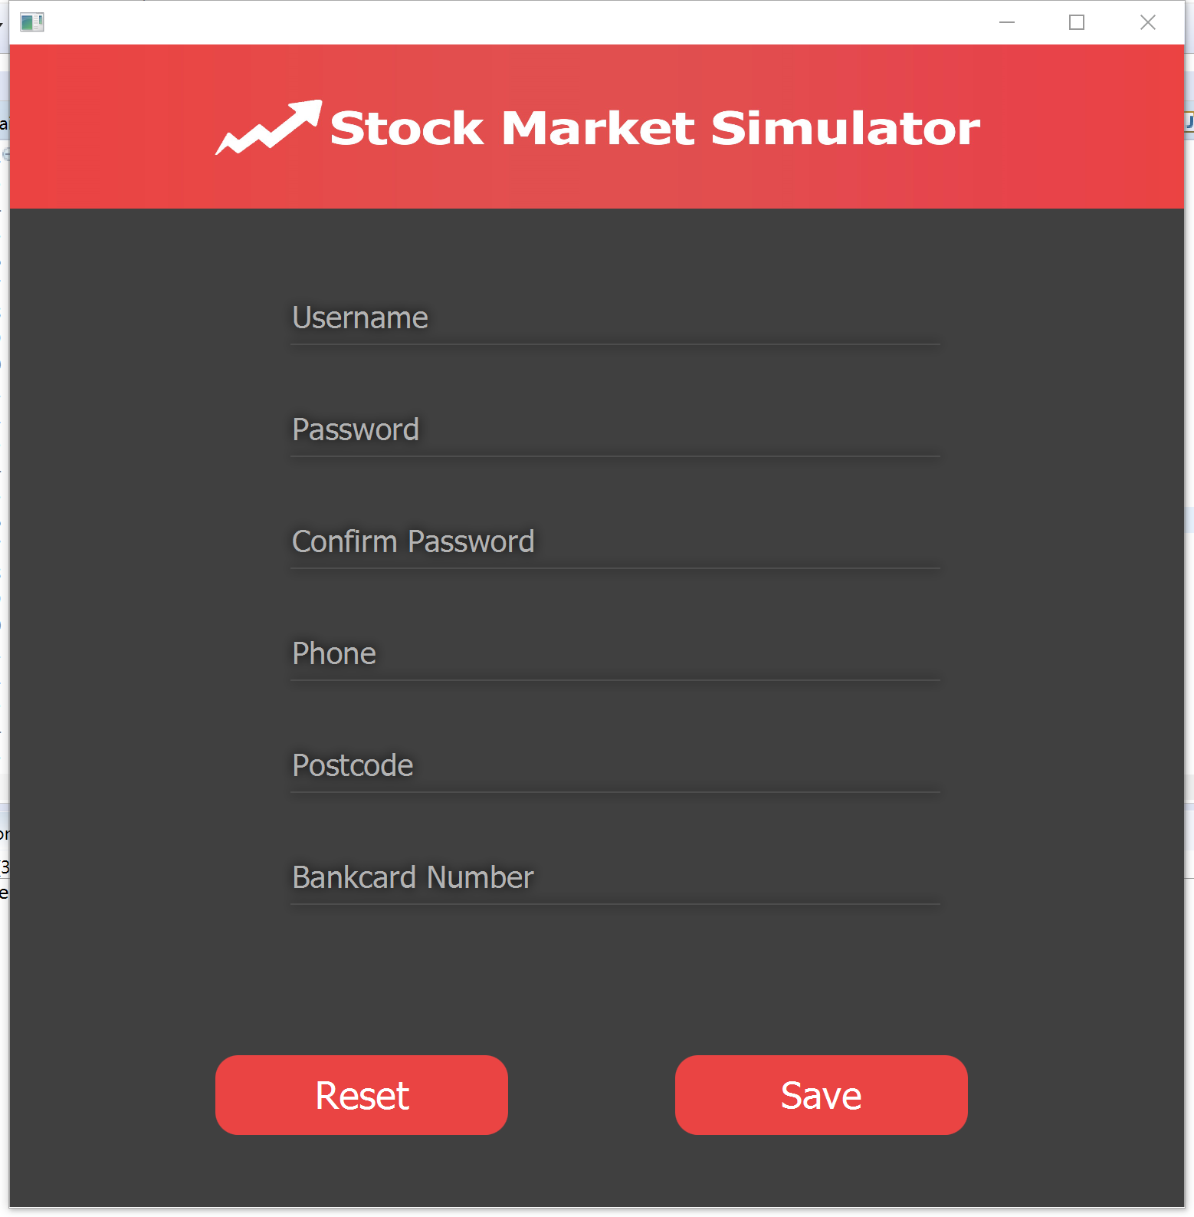
Overview of Sign In
VBox Contained by anchorPane
ImageView set as title

Slide 8
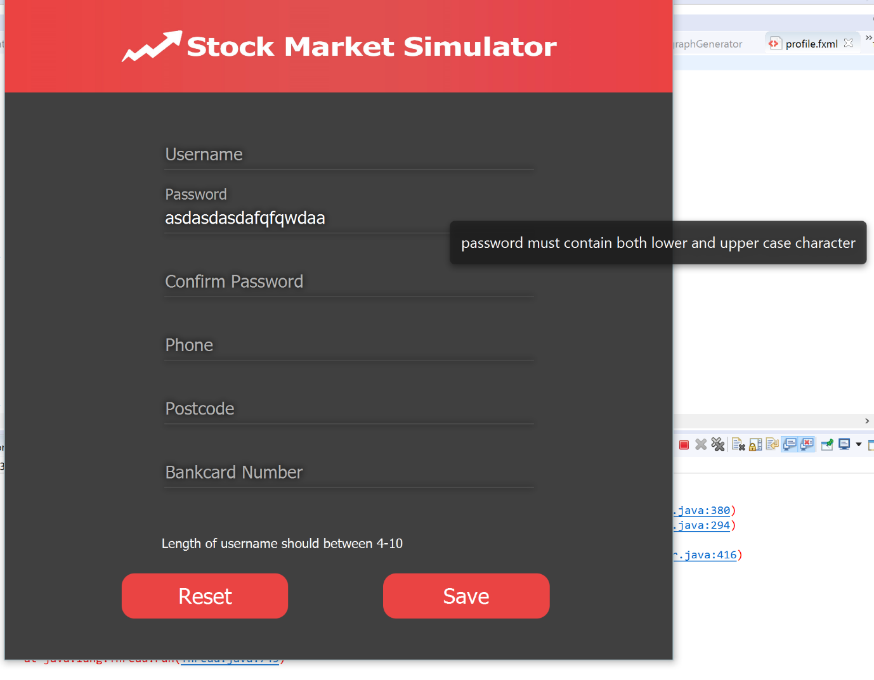
Sign In Detail
Fx Tooltip can show the hint of the form when cursor move on to this textField
jfxTextField with focus effect
pop up Label to show error message

Slide 9
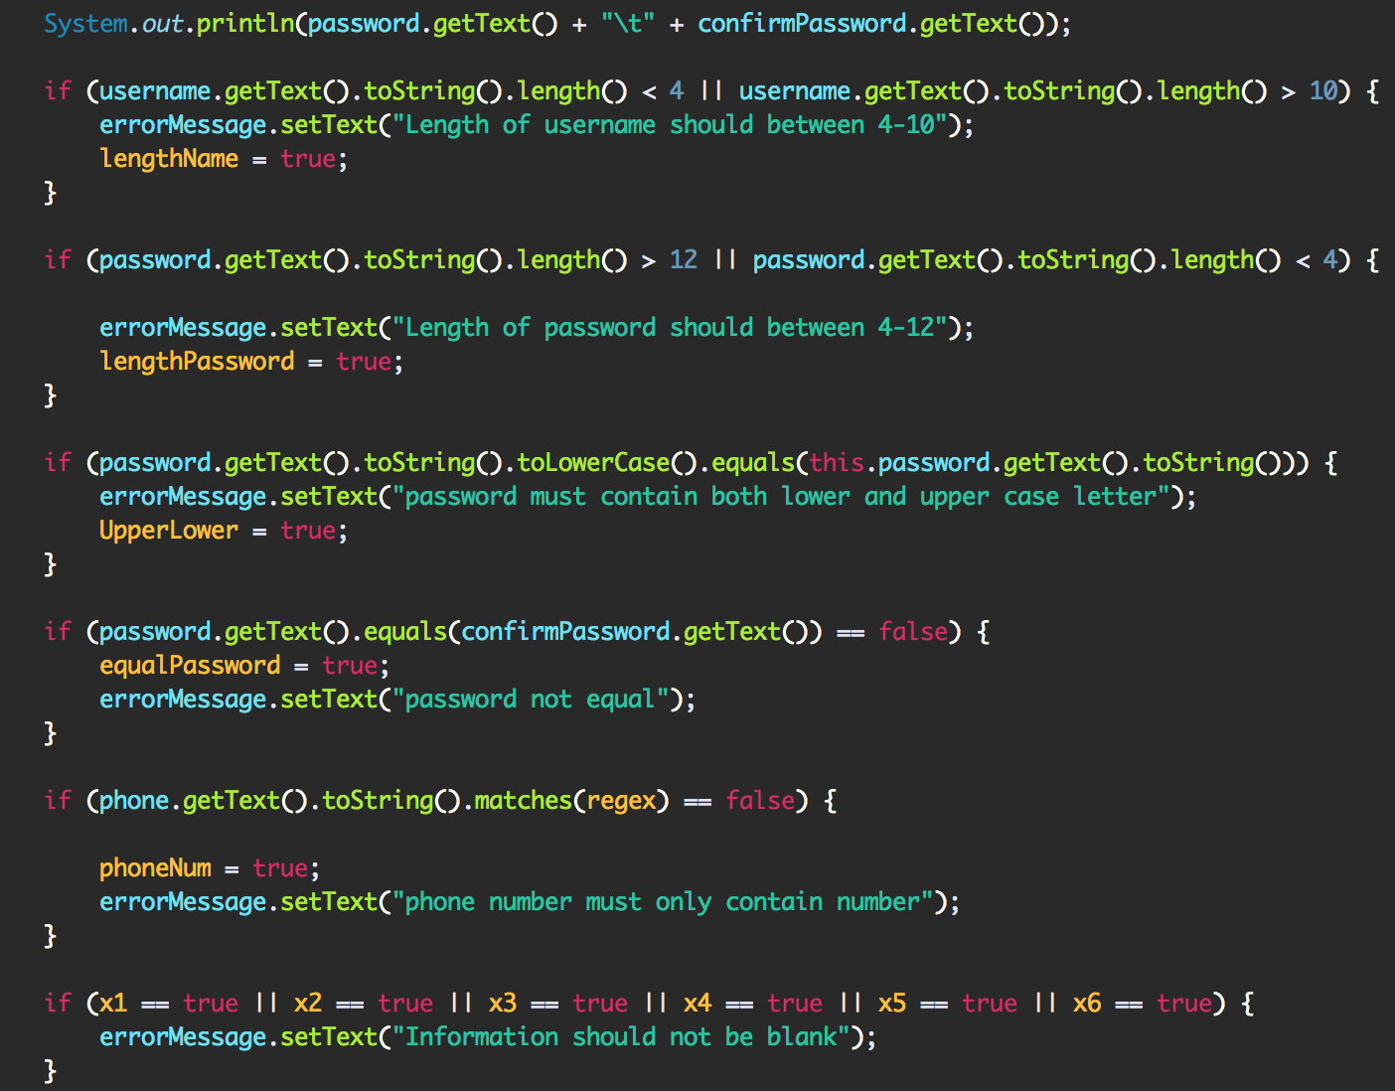

Slide 10
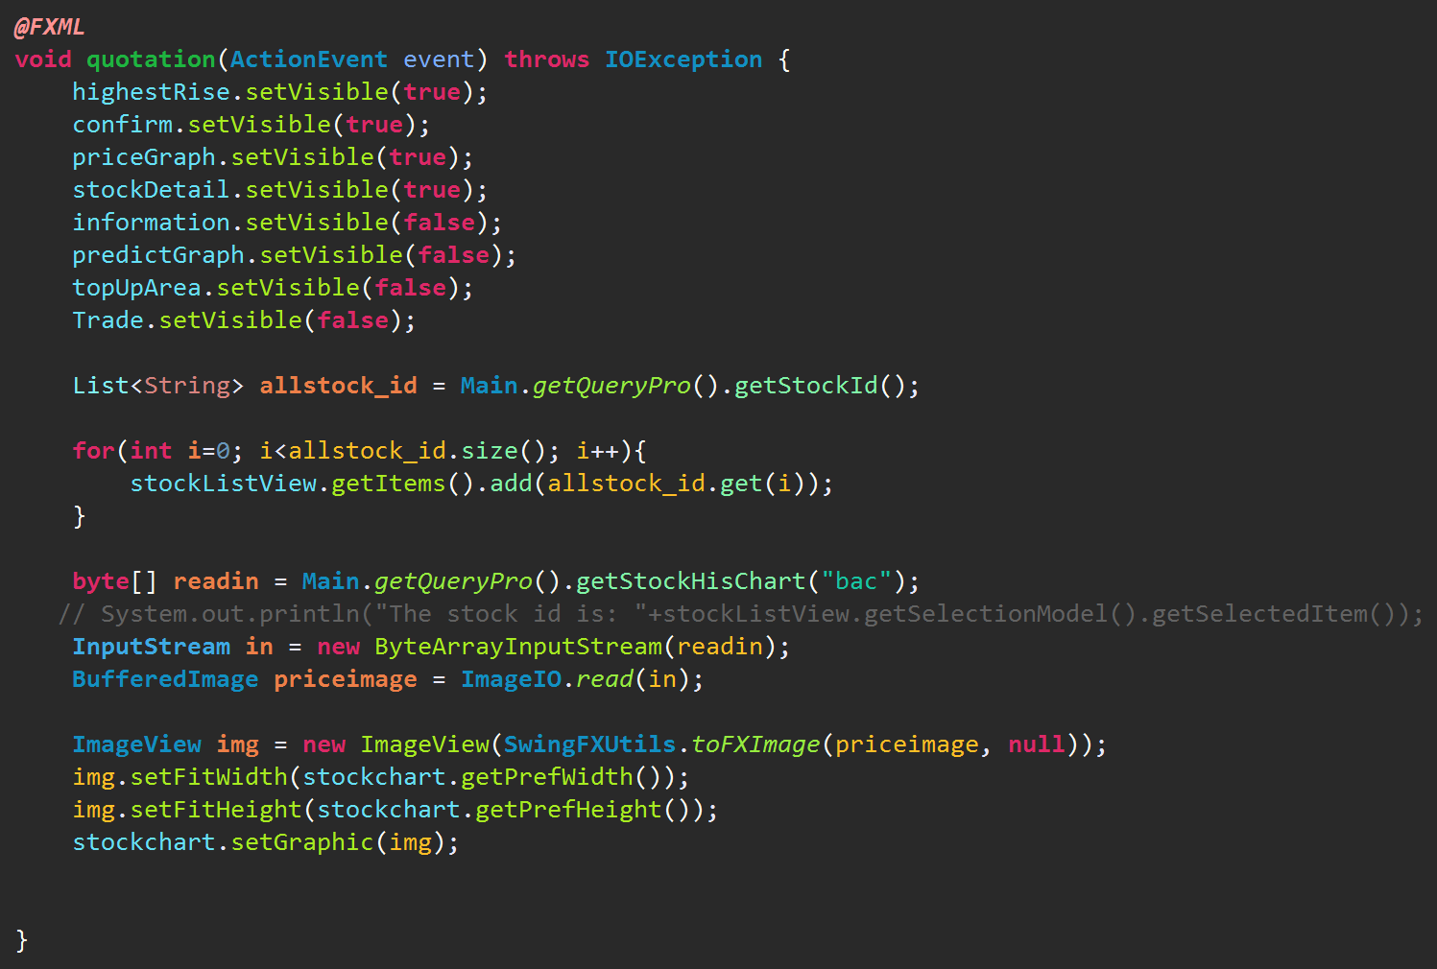
Main Interface (Quotation)
Traverse the stock list and display it.
Set default graph (stock code BAC) when user click on the quotation

Slide 11
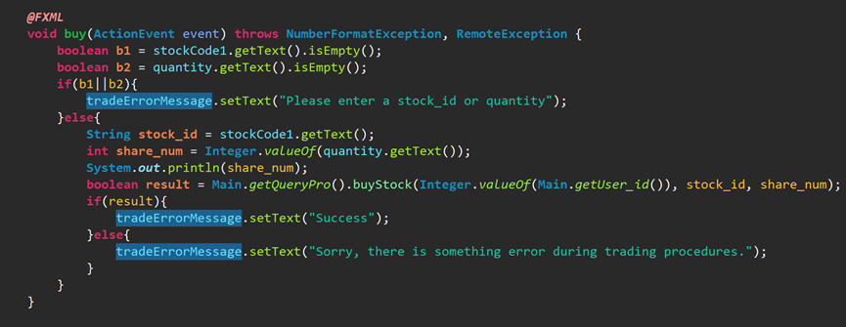
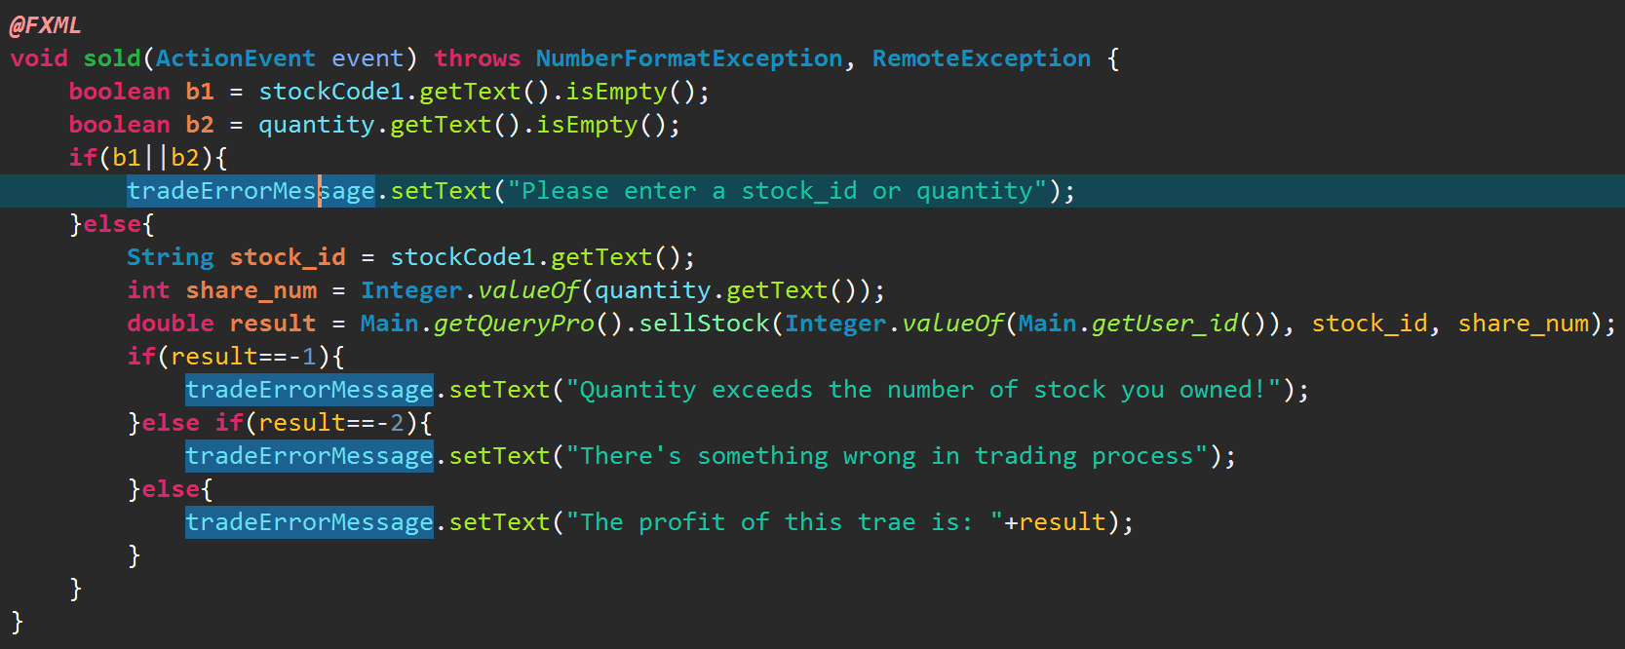
Main Interface (Trade)

Slide 12
Main Interface (Predict)
Linear regression - Overview
X_{t+1} = M(D^{t}) + d
X_{t+1} is prediction measurement;
M() is predictive model;
D^{t} is a collection of q historical data;
d is model deviation.

Slide 13
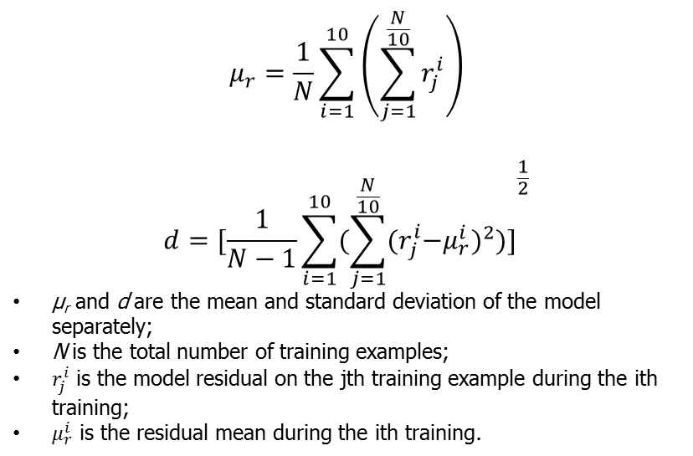
Linear regression – Model deviation

Slide 14
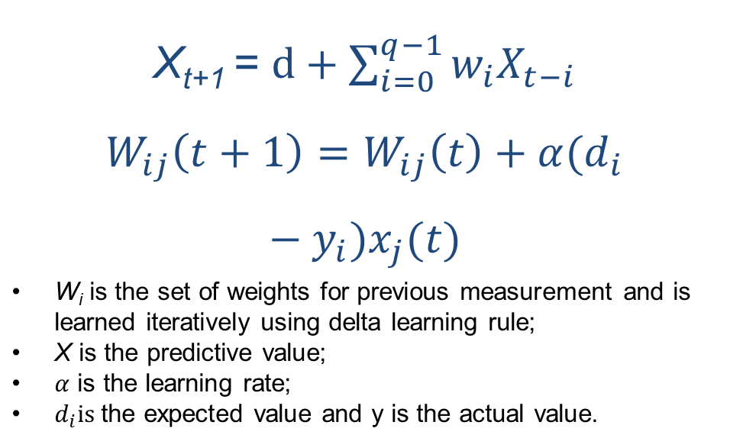
Linear regression – Prediction model

Slide 15
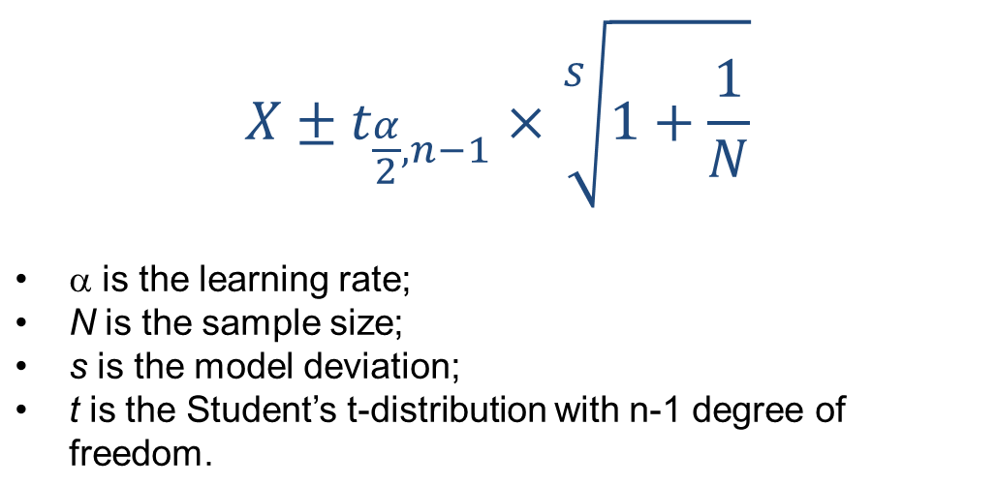
Linear regression
– Anomaly classification

Slide 16
Linear regression – Pseudo code
Classify the training set into 10 equal size sub set
Calculate the model variance of the subset
Get the model deviation by the formula
Use the training set to calculate the weight matrix
Get the prediction value X by the model
Calculate the PI
If Price > upper bound
Prediction failure
If Price < lower bound
Prediction failure

Slide 17
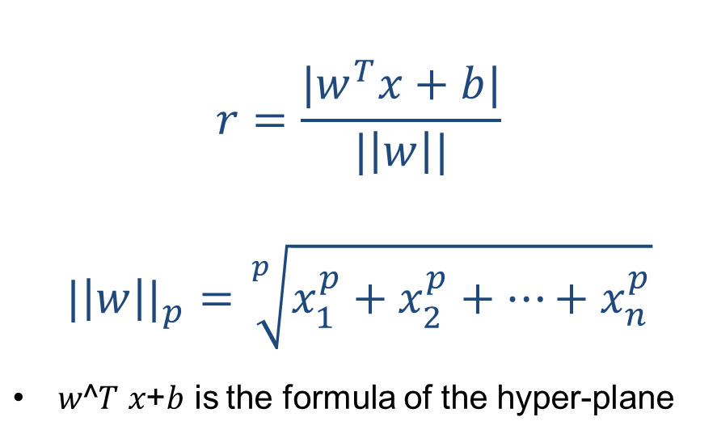
Support Vector Machine

Slide 18
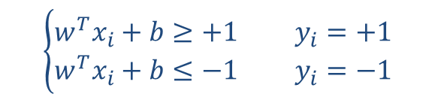
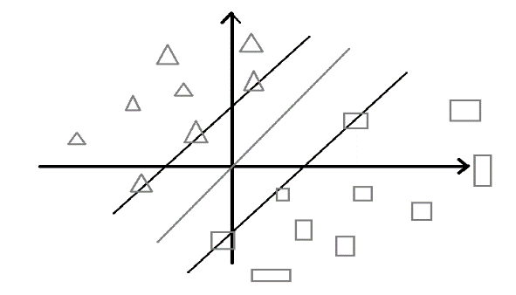
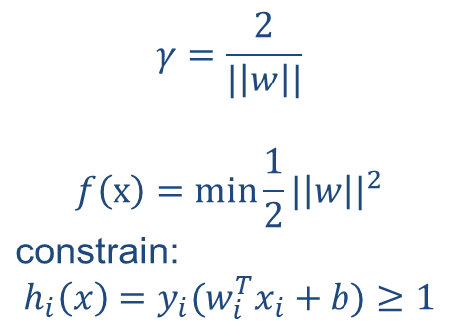
Support Vector Machine

Slide 19

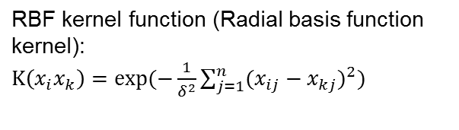
Support Vector Machine
Substituting equation2 into equation1
Use kernel function to map the
inputs to higher-dimensional space
Solve the result a, then find
b and w in order to get the model

Slide 20
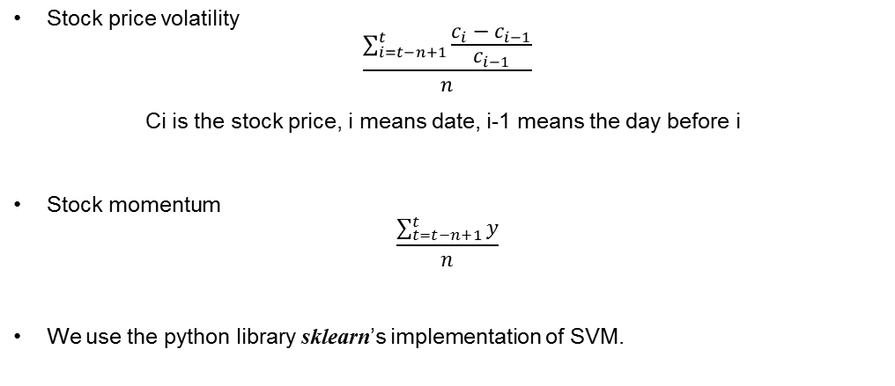
Support Vector Machine
Choose attribute

Slide 21
Encryption
private String encode(String item){
byte[] tmp = item.getBytes();
Base64 encode = new Base64();
tmp = encode.encode(tmp);
return new String(tmp);
}
private String decode(String item){
byte[] tmp = item.getBytes();
Base64 decode = new Base64();
tmp = decode.decode(tmp);
return new String(tmp);
}

Slide 22
Data visualization

Slide 23
Plotting libraries
Matplotlib
    Python 2D plotting library
Numpy
    Array processing for numbers, strings,
    records, and objects.

Slide 24
Graphs
Candlestick graph
Volume graph
Moving Average graph

Slide 25
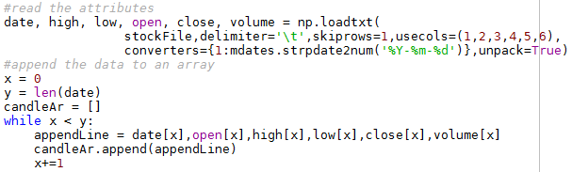
Candlestick graph
Matplotlib.finance

Slide 26



Moving Average

Slide 27
Volume graph

Slide 28
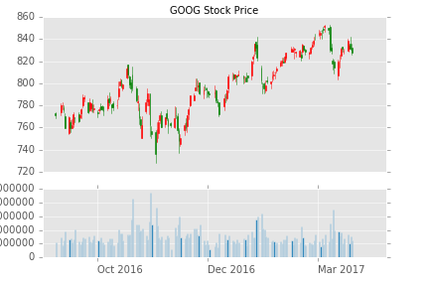
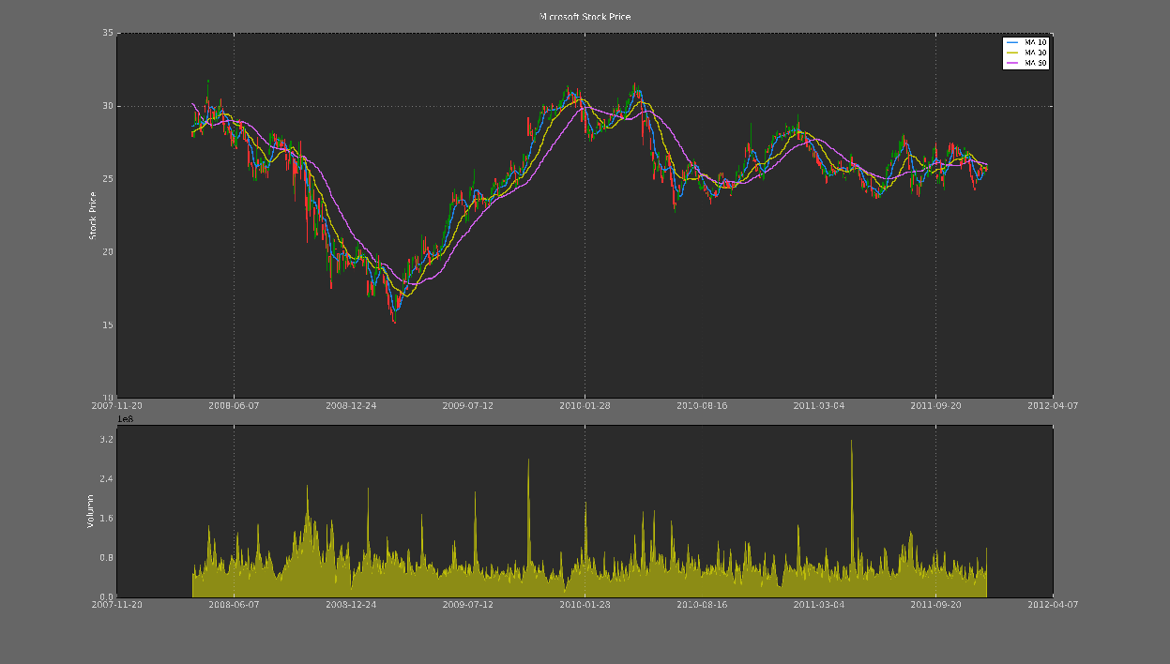
Customizing

Slide 29
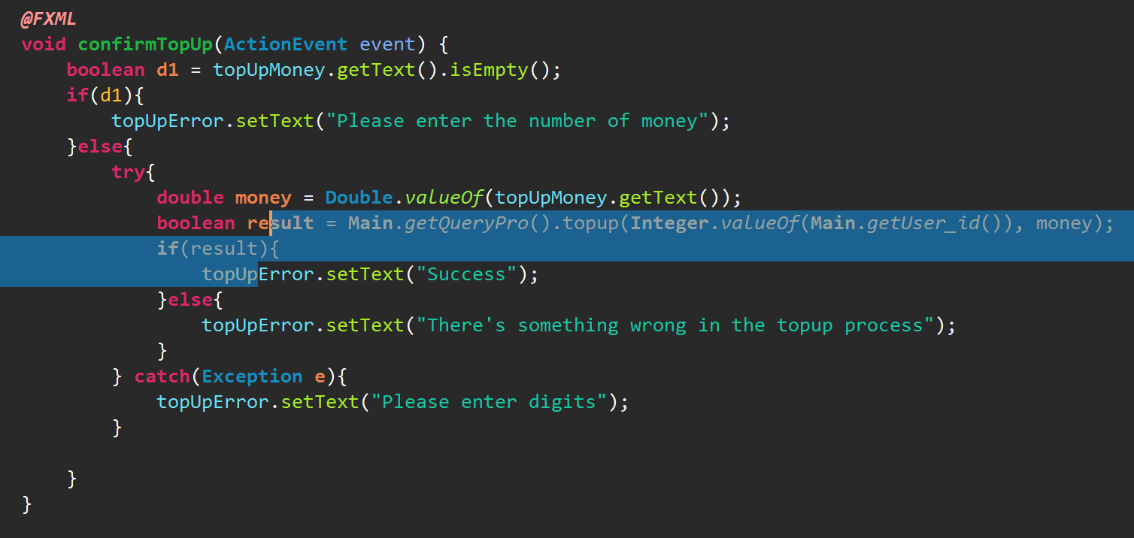
Main Interface (Top up)
Set result as Boolean value. Success If result is true. Fail if result is false.

Slide 30
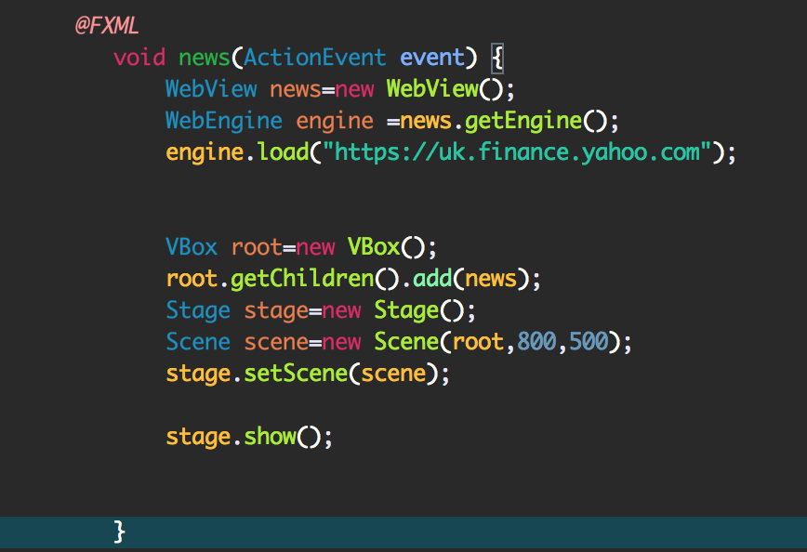
News
JavaFX FXML, XML-based language
WebEngine is a non-visual object
It is a node
For network access and protocol handing
Has a border and padding set
Top-level window
Contains a scene graph

Slide 31
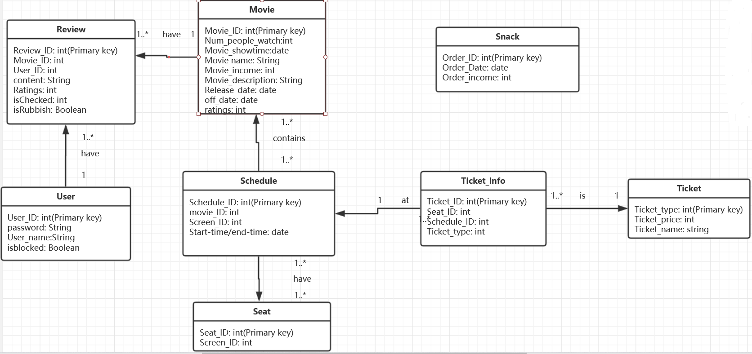
Database

Slide 32
Thanks !

