Slide 1

BeamGage Software automation
Jinwei Zhang

Slide 2

Aim and Objectives
Aim
Develop a system that automates the measurement of optical profiles using the Spiricon Beam Gage and the standard software
Objectives
Develop a system to control the experiment
Develop a series of calculations to analyse raw beam profiles calculating the required data
Develop a method to automatically move the z axis to
To combine these to produce a semi- automated procedure

Slide 3
Introduction
BeamGage Software automation
Slow doesn't run smoothly.
Taking picture (License issue, API)
Store, rename, checking and move image file (.bmp .png …)
Analyse image
HDF5 and Matlab
Read .bgData file (H5 format)
Plot figure in C++ using matlab Dynamic-link library
Pack matlab function and script then invoke them in C++

Slide 4
Code Stage
Actuator moves to home position
Laser fire for 30 seconds
Bitmap image taken and store in certain directory
Image Processing (Image existence checking, making new directory. Image renaming. Image shifting)
Move actuator 50mm by clicking “ENTER” key.
Laser fire for 30 seconds
Bitmap image taken and store in certain directory
Image Processing
……
Actuator move to home position.
Increase Power of laser
……

Slide 5
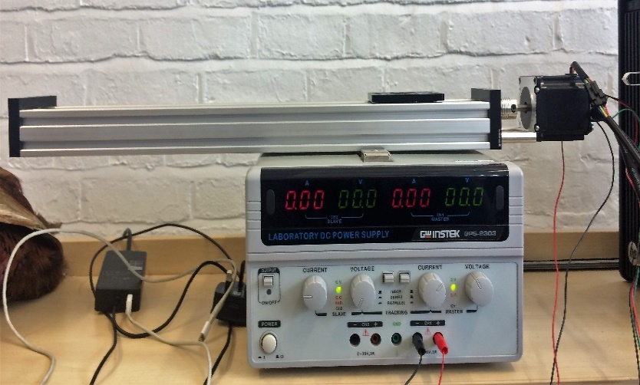
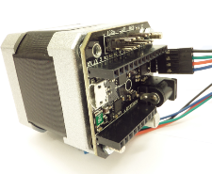

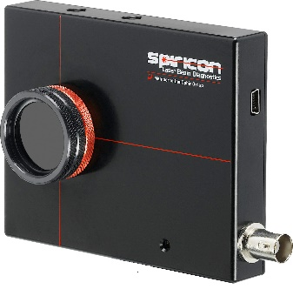

UStepper API (Encoder)
C++
AutomationInterfaceAPI

Slide 6
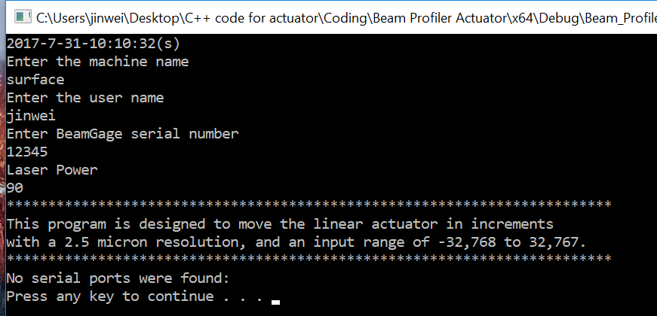
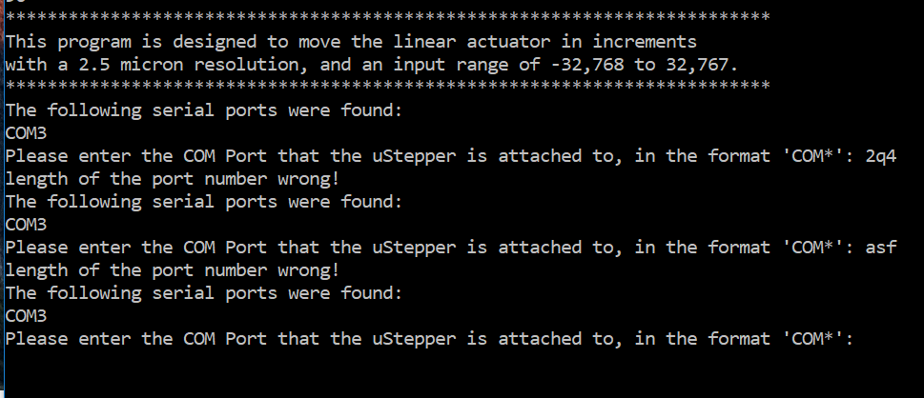
User Input and Validation

Slide 7
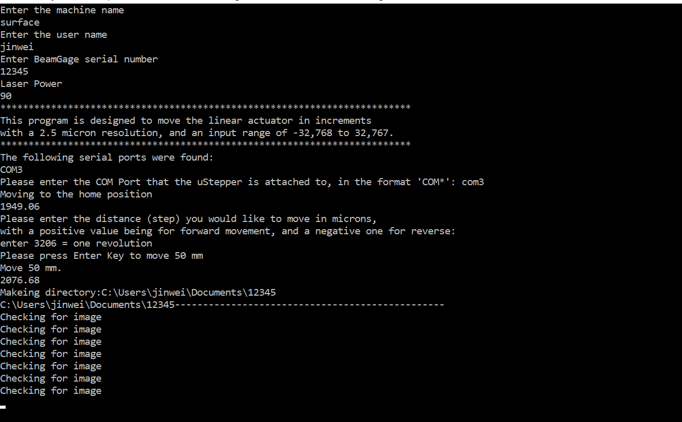
After that

Slide 8
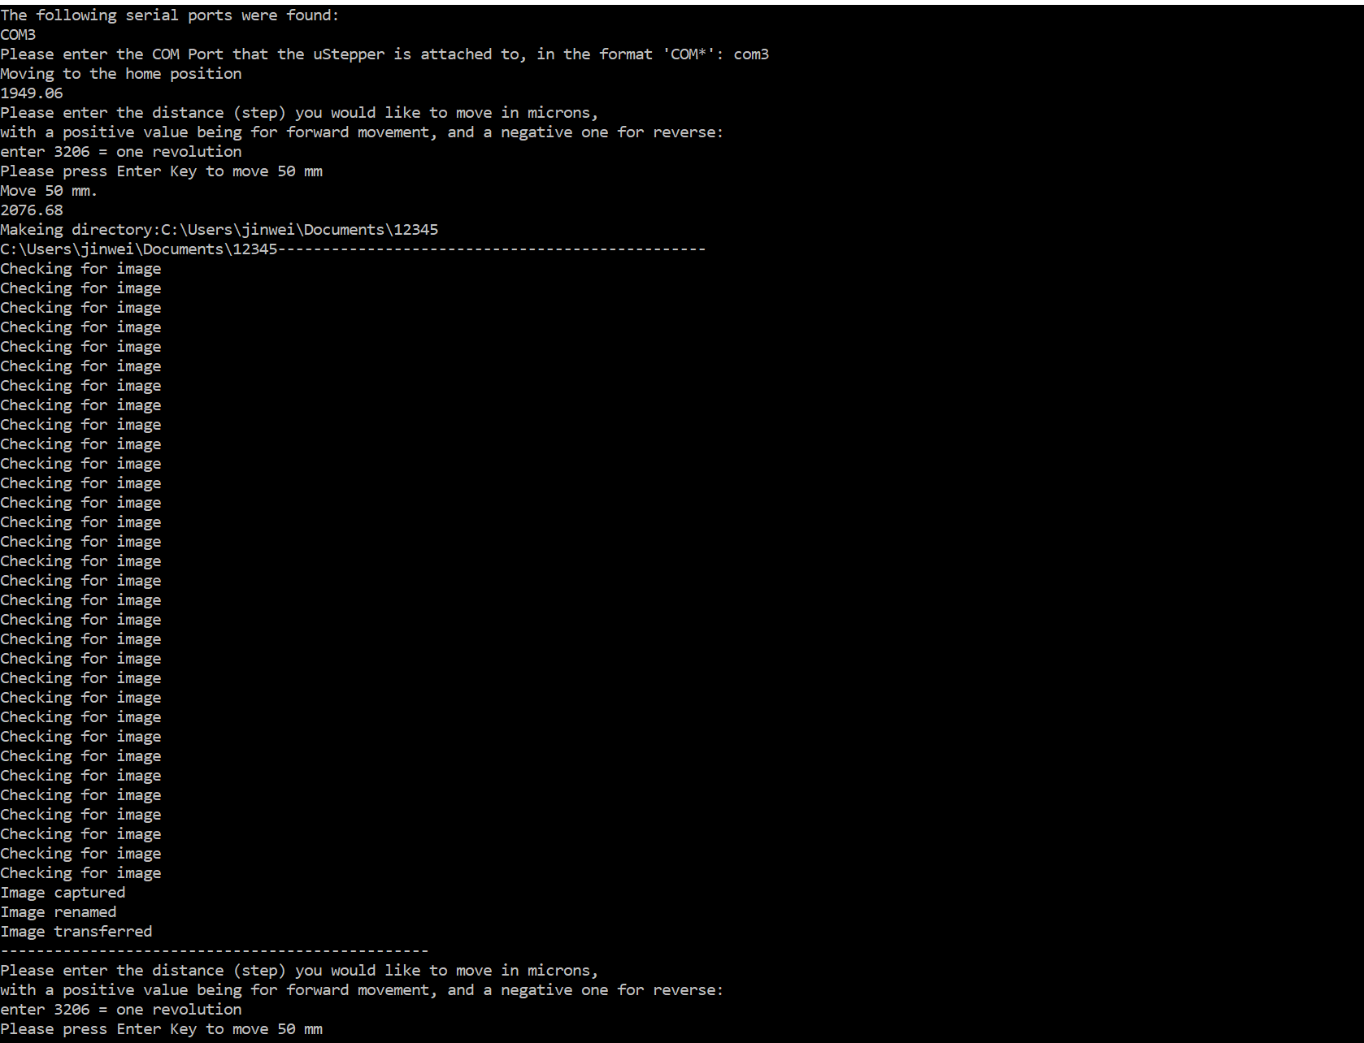
Main Process

Slide 9
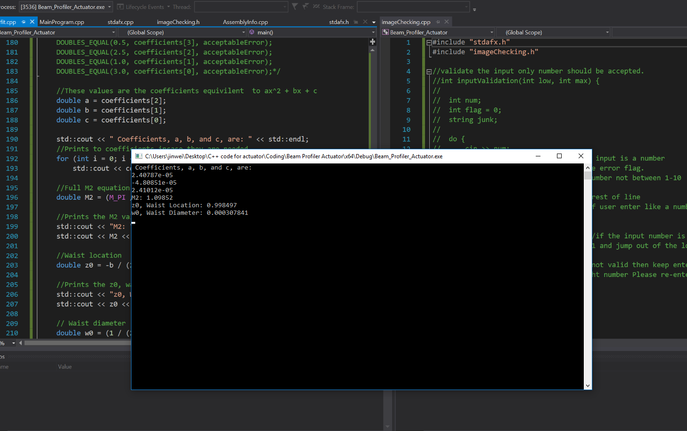
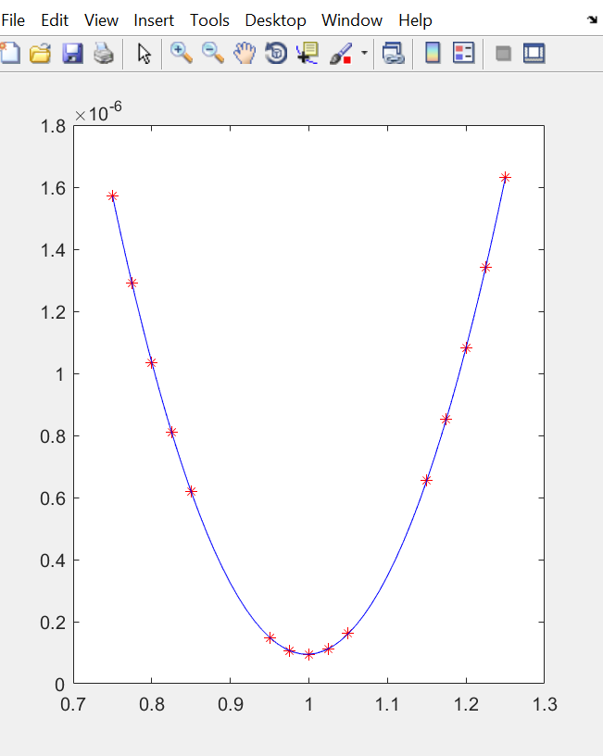
Ployfit matlab function translation

Slide 10
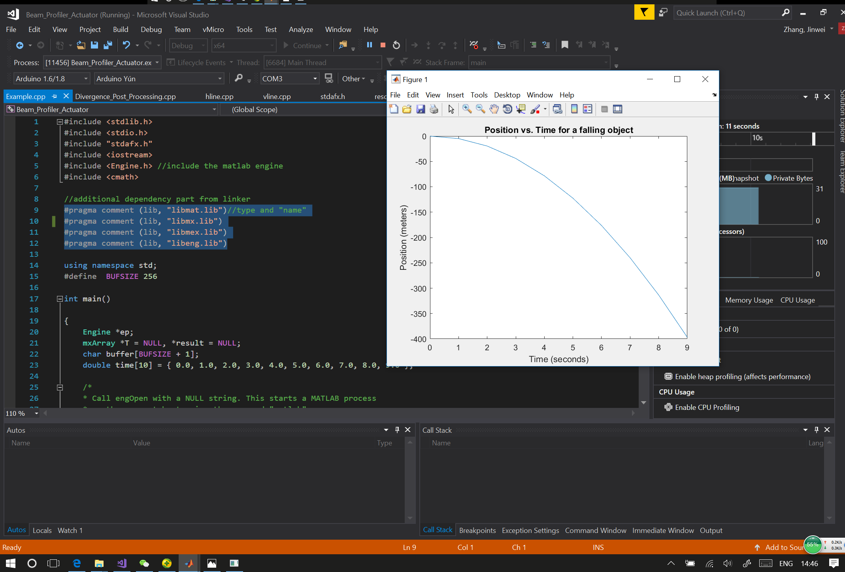
Plot function in C++ (trial version)

Slide 11
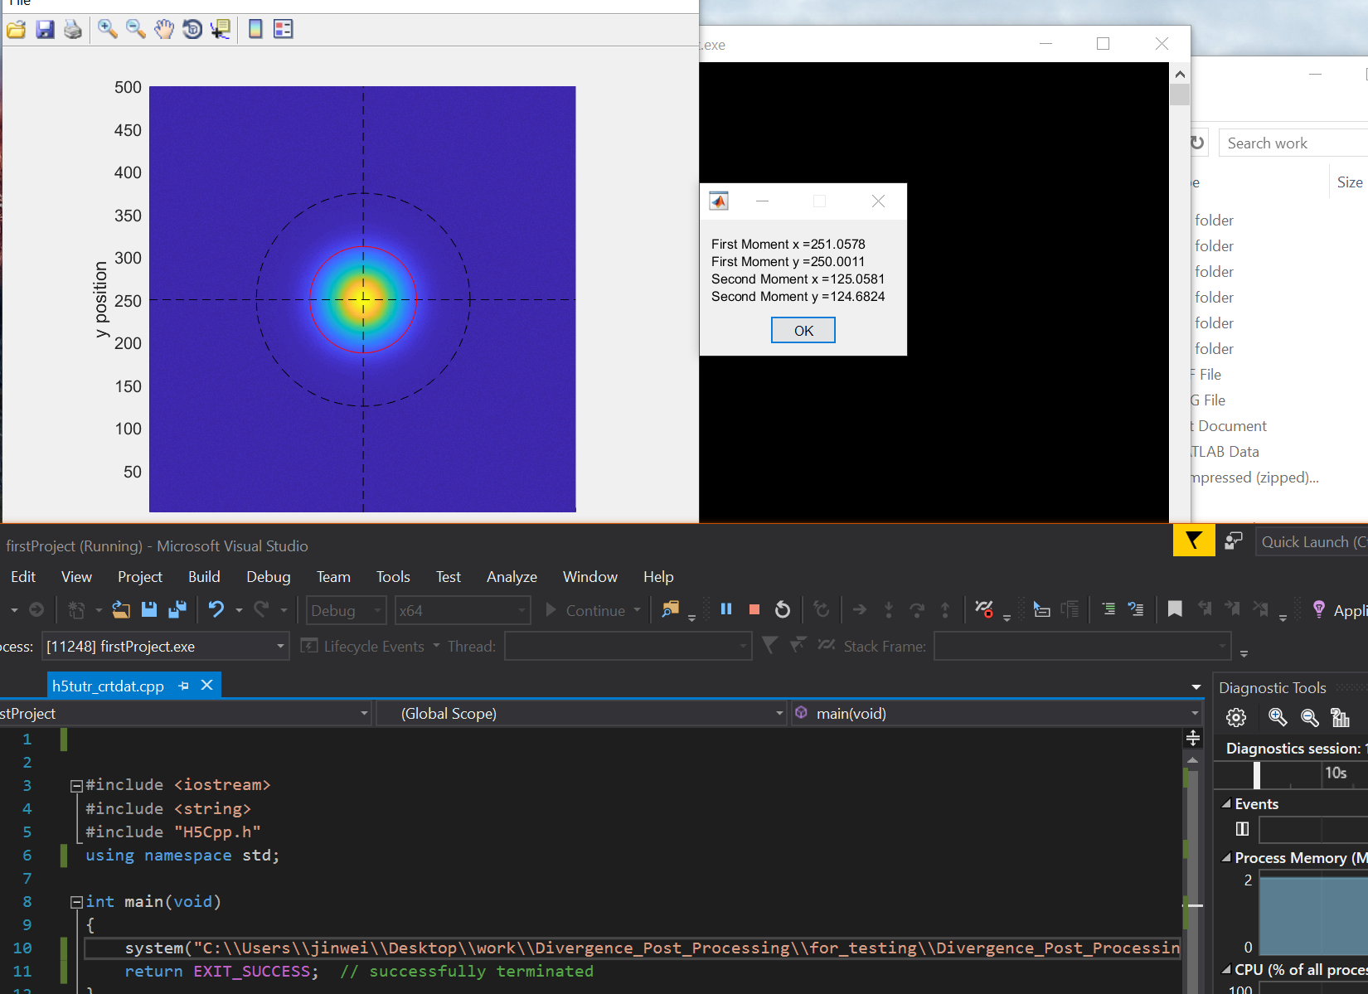
Matlab code read and plot hdf5 file

Slide 12







Softwares and Tools
Visual Micro

Slide 13
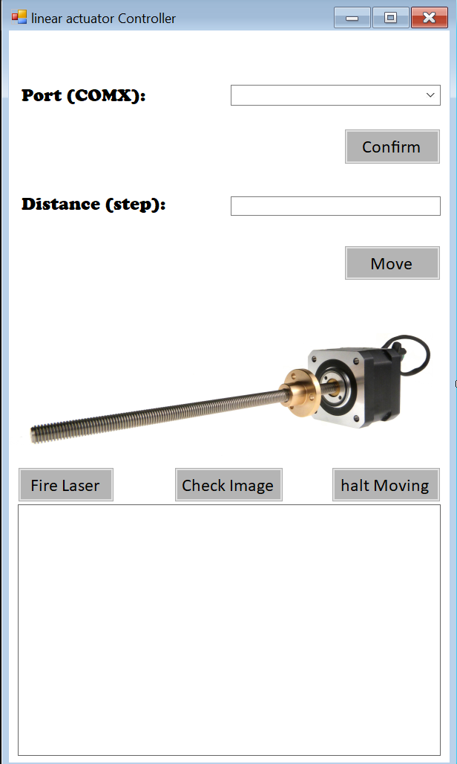
Further Task : GUI and Code structure
Alert box
User Friendly
Encapsulation
Inheritance
Code robustness

Slide 14
Thank you

